Slide 1
De-Risking Demand:
How Structured Waitlists and Guarantee Frameworks Unlock Cooperative Housing Finance

Slide 2
1
Opening Remarks
2
The Housing Challenge
3
The Guarantee Model
4
Cooperative Sector Reality
5
Technology System and Pilot
6
Results and Lessons Learned
7
Plan for National Scale

Slide 3

The Housing Challenge
2M+
80%
<2%
Unit housing
deficit in Kenya
Cannot afford
current supply
Mortgage
penetration
The bottleneck is not demand. It is the absence of credible, verified off-take that would give developers and financiers confidence to build.
Developers cannot raise debt or equity without a credible off-take arrangement

Slide 4
Why Current Approaches Fail
1
No verified demand
Interest lists are not binding commitments; developers cannot underwrite against them
2
Affordability mismatch
Units priced above what target households can pay, leading to low uptake
3
No deposit readiness
Households lack savings discipline; deposits come late or not at all
4
Off-taker risk is unpriced
Vacancy and default risk falls entirely on the developer, blocking finance
Result: a coordination failure where each party waits for the other to move first

Slide 5
The Solution: THWG
Tenant Housing Waiting-list Guarantee
Structured
Waiting List
Bounded
Guarantee
Stronger
Off-take
Verified, deposit-ready
households in 8 tiers
→
Covers limited non-payment
after deposit exhausted
→
Developers & financiers gain
confidence to build
Outcome: developers can raise debt and equity to build affordable housing

Slide 6
The Demand Funnel: 8-Tier Pipeline
1
Interested
Expressed interest
Key Insight
2
Registered
KYC completed
By Tier 5, a household has a verified deposit in escrow. This is the trigger point for guarantee eligibility and unit matching.
3
Screened
Affordability confirmed
4
Deposit started
Saving towards deposit
5
Deposit ready
Full deposit in escrow
Conversion Logic
6
Matched
Allocated to a unit
50,000 onboarded
→ 2,000 guarantees issued
7
Committed
Lease signed
8
Occupied
Moved in, paying rent

Slide 7
How the Guarantee Works
1
2
3
Deposit-First Loss
Bounded Cover
Fast Replacement
Household deposit (1–3 months) is exhausted before guarantee pays. This aligns incentives and limits exposure.
Guarantee covers only the gap between deposit exhaustion and tenant replacement — typically 2–4 months.
Waiting list enables rapid re-letting. Each empty month that is avoided is a month the guarantee does not pay.
The guarantee is not a subsidy — it is a time-limited bridge that the waiting list makes short

Slide 8
Expected Claim Costs
Per active guarantee, per year | Monthly payment = KES 10,000 | After deposit
Base
Downturn
Shock
Claim frequency
4%
Claim frequency
7%
Claim frequency
12%
Payable months
2
Payable months
3
Payable months
4
Annual expected cost
Annual expected cost
Annual expected cost
KES 800
KES 2,100
KES 4,800
KES 67
KES 175
KES 400
/month
/month
/month
Note: expected costs, not maximum payout. Caps and replacement discipline limit actual exposure.

Slide 9

Year 1 Pilot Plan
50,000
2,000
Households onboarded
to the waiting list
Active guarantees
issued in Year 1
KES 123.8M
3 Pilots
Total Year-1 programme
cost (base scenario)
Nairobi, Mombasa, Kisumu
metropolitan areas
Cost breakdown: Opex KES 95.4M + Expected claims KES 28.4M = Total KES 123.8M

Slide 10
Impact at Scale
5-Year (Mid)
10-Year (Mid)
18,000
80,000
Housing units delivered
Housing units delivered
36,000
160,000
Construction jobs created
Construction jobs created
KES 54B
KES 240B
Private finance mobilised
Private finance mobilised
Every KES 1 of guarantee exposure can unlock KES 15–20 of private construction finance

Slide 11
What Makes This Different
Demand-led, not supply-pushed
Verified waiting list proves off-take before construction starts
Bounded, not open-ended
Deposit-first loss + replacement discipline keep expected costs low
Market-building, not subsidy
Designed to crowd in private capital, not replace it
Data-rich governance
Real-time dashboard tracks pipeline, claims, and financial exposure
Scalable infrastructure
Cooperative network provides low-cost member onboarding at scale

Slide 12
Next Steps
1
Stakeholder alignment
Q2 2026
Convene cooperatives, off-takers, and county governments around the THWG design
2
Pilot structuring
Q3 2026
Finalise guarantee terms, pricing, and operating model with anchor partners
3
Waiting list build
Q3–Q4 2026
Begin onboarding 50,000 households through cooperative networks
4
First guarantees issued
Q1 2027
Issue initial guarantees to matched, deposit-ready households

Slide 13
The Kenya Cooperative Sector Reality
1
2,500
33%
(4.6M)
72%
(3.3M)
Housing and Investment Cooperatives
Are in Urban Areas
Do not own a home
14M
25%
USD 1 Billion
Total Cooperative Members
Loans Distributed by Saccos is for housing and land

Slide 14
The Nature of Housing Cooperatives
Advantages:
Highly trusted, tightly nit, community-based entities – built in trust and social accountability
Member ownership and incentive alignment
Many cooperatives jointly own development ready land
Efficient network for program delivery
Opportunities:
Standardization of onboarding criteria across many unique forms, and processes
Digital enablement for operational efficiency
Providing members a more structured pathway to housing readiness
Extended access to properties and projects beyond their localized communities
This is a national network of ready and waiting citizens. The challenge isn't creating demand—its verification and efficiency.

Slide 15

Pilot: Household Evaluation and Affordability Scoring Methodology to Stregnthen Tenant Waitlist Powered by Pngme Pilot Period: Nov 2025 – Feb 2026

Slide 16
Pilot Structure
Affordable housing allocation remains difficult because:
Income verification is unreliable in informal economies
Waiting lists are manual and fragmented
Self-reported income often lacks verification
Housing projects struggle to identify financially ready households
Result:
Misallocation of housing units
Higher risk of tenant default
Exclusion of informal workers
The project aimed to:
Digitize cooperative housing waitlists
Verify household financial capacity
Develop an affordability scoring methodology
Create a transparent system for housing allocation
Outcome:
A data-driven tenant waitlist system combining traditional cooperative onboarding with digital financial intelligence.
Notes:
The Problem (Speaker Script)
Affordable housing programs face a structural challenge when it comes to identifying the right households to allocate units to.
In most cases, housing eligibility is assessed using self-reported income, payslips, or manual verification processes. However, these approaches do not work well in economies where a large share of households earn income through informal work, small businesses, or multiple income streams.
As a result, housing providers often lack a reliable way to determine who can actually afford a housing unit and sustain payments over time.
This creates several risks for the ecosystem. Housing units may be allocated to households that struggle to maintain payments, while many financially capable households are excluded simply because their income cannot be easily verified.
At the same time, waiting lists are often manual, fragmented, and difficult to audit, which reduces transparency and makes it harder for lenders, developers, and cooperatives to trust the allocation process.
So the central challenge becomes: How do we accurately measure affordability and readiness for housing among households whose financial lives are largely informal?
Project Objective / Pilot (Speaker Script)
This pilot project was designed to test whether a data-driven approach to household affordability assessment could strengthen the housing allocation process within the cooperative ecosystem.
Working with FSD Kenya, NACHU, and Placemakers, the goal was to develop and test a system that could combine traditional cooperative onboarding with digital financial intelligence.
The pilot had four key objectives.
First, to digitize the cooperative housing waitlist, moving away from static spreadsheets and manual records.
Second, to collect both household profile data and financial behaviour data, allowing us to build a more accurate picture of each applicant’s financial capacity.
Third, to develop an affordability scoring model that combines income signals, risk indicators, and financial behaviour into a transparent household ranking system.
And finally, to produce a pre-qualified waitlist of housing cooperative members, enabling housing providers to identify the households that are most prepared for housing allocation.
Over a 12–16 week pilot period, this system was deployed across multiple housing cooperatives, allowing us to test both the technology infrastructure and the onboarding process in real-world conditions.
The results provide important insights into how digital financial data can help make affordable housing allocation more transparent, more inclusive, and significantly less risky for the ecosystem.

Slide 17
The System We Built
Live Household Dashboard and Waitlist Index
Affordability Scorecard and Ranking System
Household Matching Interface
200+ Data Points for Validation and Assessment
Unified Data Infrastructure for Household Profile
NACHU Digital Onboarding Form
Household Profile Data Collection
Identity, contact details, pilot consent
Cooperative Affiliation
ScoreMe Digital Scoring App
Mobile Transaction Data (MPESA, Bank accounts)
Digital Income Estimation
Risk Assessment
NACHU Internal DataBase
Cooperative Profile
Deposits held with Cooperative
Land / Home purchase history
Household and Personal Data Sources
Notes:
“At the core of this pilot was a simple idea: combine cooperative data, household data, and digital financial signals into a single system that can objectively measure housing readiness.”
The system begins with the NACHU Digital Onboarding Form, which captures the foundational household information required for housing eligibility. This includes identity details, cooperative affiliation, and household profile data, as well as consent for participation in the pilot.
The second component is the ScoreMe Digital Scoring Application, which allows applicants to securely connect their financial activity. With consent, the system analyzes mobile money and bank transaction data to estimate income, observe financial behavior, and generate a risk assessment. This allows us to move beyond self-reported income and observe real financial patterns.
The third data source comes from NACHU’s internal cooperative records, which provide important context around member deposits, cooperative savings history, and any prior land or housing purchase activity.
All three of these sources feed into a unified data infrastructure, where the information is consolidated into a single household profile. From there, the system produces a live dashboard and waitlist index, generates an affordability scorecard for each household, and ultimately enables the ranking and matching of households to appropriate housing opportunities.
What this creates is a single, transparent system of record for housing readiness, replacing fragmented manual processes with a structured, data-driven approach.

Slide 18
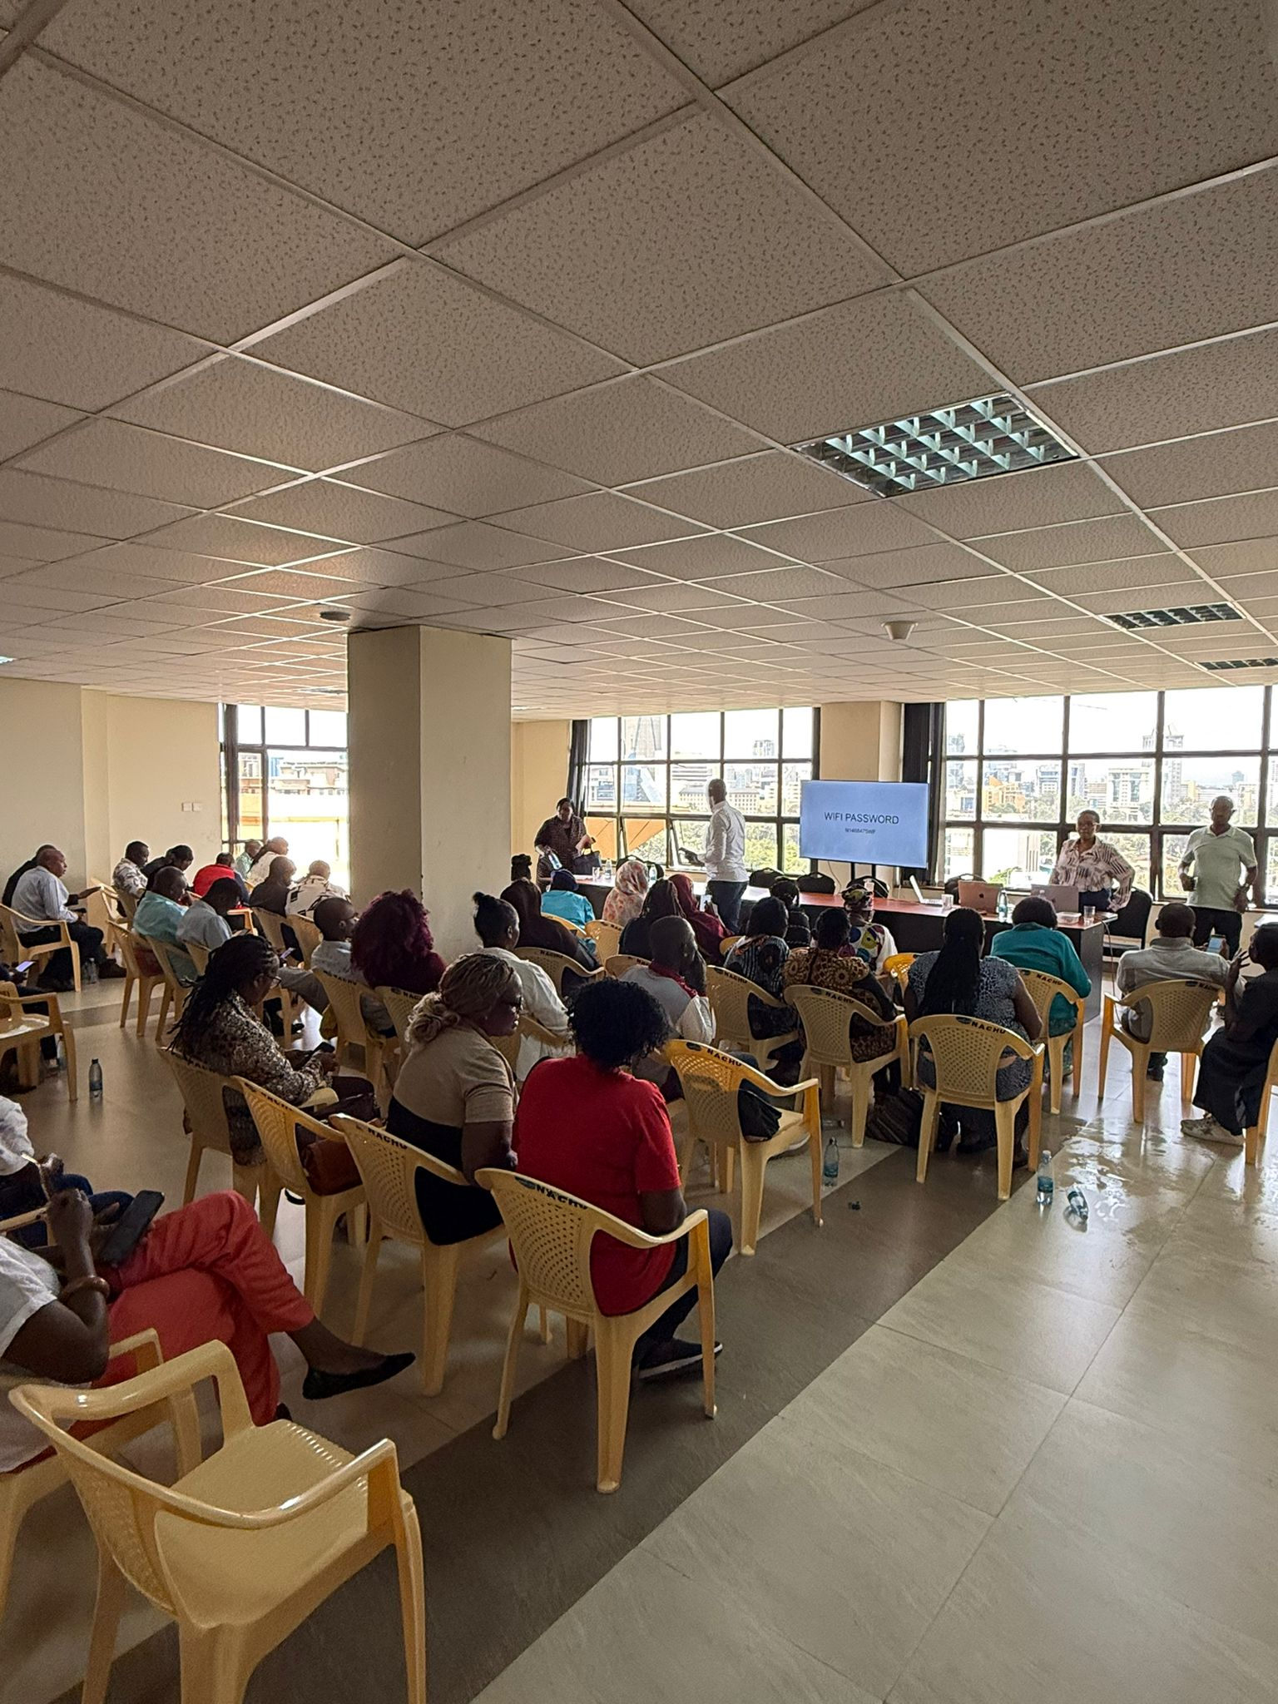
Pilot Execution
Over a 12–16 week pilot, the project achieved:
4 onboarding sessions
29 housing cooperatives engaged
214 total attendees
123 households onboarded
56 households with full digital profiles
18 Households Deemed “Housing Ready”
These households represent the first structured affordable housing waitlist within the NACHU ecosystem.

Slide 19
Waitlist Demographics
1. Core Demographic
Gender: The waitlist is majority Female (66.3%), with Male applicants making up 33.7%.
Marital Status: Most applicants are Married (61.8%), followed by Single (30.3%) and Widowed (7.9%).
Employment Sector: The informal sector is the primary driver of this waitlist at 61.6%, while 27.9% are in formal employment and 10.5% balance both.
Household Size: On average, applicants support 3.2 dependents, emphasizing the need for family-sized affordable units.
2. Employment Information
Employment Type: The majority of applicants work in the Informal sector (61.6%), while 27.9% are in Formal employment, and 10.5% balance both.
Experience: Applicants are generally well-established in their trades, with 65.9% reporting over 3 years of experience.
Top Trades: The most common occupations involve general Business, small-scale Trade, and Self-employment (e.g., farming, teaching, and real estate).
3. Household and Location
Dependents: On average, applicants support 3.2 dependents.
Primary Locations: Most applicants are based in Nairobi, with specific concentrations in areas like Kamulu, Kibra, and Mlolongo.
4. Rental Contribution Analysis
Overall Independence: 72.7% of all applicants are sole contributors to their rent payments.
Shared Responsibility: 27.3% of the waitlist relies on additional contributors (spouses, relatives, or children) to meet rental obligations
Notes:
Slide Script — Demographic & Household Profile
This slide gives us a clearer picture of who is actually on the cooperative housing waitlist.
First, looking at the core demographic profile, the waitlist is predominantly female, with women representing about two-thirds of applicants. Most applicants are married, and the majority of households support just over three dependents on average, which highlights the need for family-sized affordable housing units rather than small single-occupancy units.
In terms of employment, the waitlist is driven primarily by the informal economy. About 62 percent of applicants earn their income through informal work, while roughly 28 percent are in formal employment, and a smaller group combine both. Importantly, these are not early-stage earners — nearly two-thirds of applicants have been working in their trade for more than three years, which suggests relatively stable livelihoods even within the informal sector. The most common occupations include small business, trading, and self-employment across sectors like farming, teaching, and retail.
Geographically, most applicants are based around Nairobi, with clusters in areas such as Kamulu, Kibra, and Mlolongo. These locations are important because they align closely with areas where affordable housing demand is already concentrated.
Finally, when we look at how households manage housing payments, we see a strong level of financial responsibility. About 73 percent of applicants pay rent independently, while the remaining 27 percent rely on shared contributions from spouses or family members. This highlights that while many households operate independently, co-contributor models remain an important part of housing affordability for some families.
Overall, this profile confirms that the program is reaching working households with stable livelihoods, primarily in the informal economy, who are actively seeking pathways into affordable housing.

Slide 20
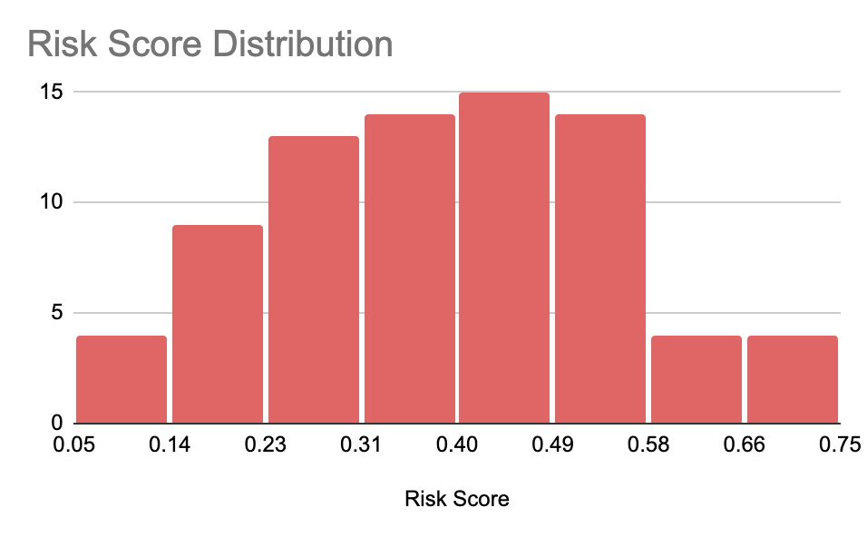
Financial Breakdown
Average Monthly Income
Metric | Pngme Income Model | Self-Reported | Mean of Means
Median | 10,299 KES | 25,000 KES | 20,149 KES
Mean | 27,228 KES | 38,348 KES | 34,468 KES
Self Reported: ~ 38,179 KES
Digitally Estimated: ~34,234 KES
Savings Behaviour
Group | Count | Median Self Savings | Median Digital Balance
Both Estimates Available | 48 | 5,000 KES | 1,746 KES
ONLY Self-Reported | 40 | 5,000 KES | N/A
ONLY Pngme Generated | 31 | N/A | 7,892 KES
Self-Reported Savings were higher on average than digitally verifiable savings.
Risk and Credit Stability
40% Average Risk Score (Pngme Risk Model)
20% of Members have defaulted on a cooperative loan
Key Insight
Consistent difference between self reported savings and balances in digital wallets shows reserves are not kept in current accounts - emphasizes the need to look at Cooperative held deposits
Notes:
1. The “Aspiration vs Reality Group”
For the 48 applicants with both metrics, there is a clear distinction between stated goals and digital liquidity. While they report a median ability to save 5,000 KES per month, their actual average daily digital balance sits at 1,746 KES.
Interpretation: This suggests that while these applicants have a strong "savings mindset," their actual liquid reserves are often kept elsewhere (e.g., in cash, physical assets, or non-digital accounts) or are utilized quickly for household expenses.
2. Consistency in Self Reporting
The 40 applicants who only have self-reported data maintain a median of 5,000 KES.
Interpretation: This figure appears to be a standard psychological benchmark for affordability within this community. Without digital verification, these applicants rely on their cooperative saving history to prove this capacity.
3. High Digital Liquidity in “Invisible” Savers
The 31 applicants who did not report a savings figure on their form but have digital data show a significantly higher median digital balance of 7,892 KES.
Interpretation: This group represents "Quiet Savers." Although they didn't explicitly state a savings goal, their transaction behavior shows higher-than-average liquidity. They are excellent candidates for the waitlist as they demonstrate a proven ability to maintain a cash buffer.

Slide 21
Affordability Ranking and Household Assessment Model
Variable | Scoring Criteria | Point Range
Payment Capacity (Self-Reported vs. Estimated): The system looks at how much the applicant claims they can pay versus what the system estimates they can pay based on data. | Self Reported Affordability is calculated by multiplying Self-Reported “Average Monthly Income” by 40% to get a baseline Housing Affordability Indicator. Higher payment brackets (above 15k KES) earn full points (12), while lower brackets (below 5k KES) earn half points (6). System Estimate Affordability if calculated by multiplying Pngme Estimated Income by 40% to get a baseline Housing Affordability Indicator. Higher payment brackets (above 15k KES) earn full points (12), while lower brackets (below 5k KES) earn half points (6). | 0- 24
Cashflow Stability “Cashflow Pattern”: The system looks at | If an applicant’s bank or mobile money records are "Consistently Positive," they earn maximum points (12). If they frequently spend more than they receive ("Consistently Negative"), they earn the lowest score (6). Pngme’s 90 Day Cash Flow Analysis also determines if Cashflow is dependent (“Situational”); in which case they earn 10 Points. | 0 - 12
Income Level: Applicants are categorized by High, Medum, and Low Income. | High income earn 12 points each. Conversely, those categorized as "Low" income receive 0 points for these sections. | 0-12
Risk Levels: Applicants are categorized by High, Medum, and Low Risk. | “Low” Risk earn 12 points each. Conversely, those categorized as "High" Risk receive 0 points for these sections. | 0-12
Affordability Consistency: This measures "truth-telling" and data agreement. | If an applicant’s ability to pay is confirmed by all data sources (self-reported, median, and estimated), they get 12 points. If they only qualify based on one source (like just what they said), the score drops. | 0-12
Spending Habits: Spending behaviour is analyzed through transaction categorization. | Applicants are rewarded for "Builder" behavior (investing or saving). "Essential" spenders (living paycheck to paycheck) get fewer points, and "Risky" spenders (gambling or excessive luxury spend) receive 0 points. | 0-12
The "Shared Income" Bonus: | If an applicant is not the sole contributor (meaning they have a spouse or relative helping with rent), they receive a 5-point boost. This recognizes that two or more incomes are more stable than one. | 0-5
1. Data-driven scoring model combining income, risk, cashflow behaviour, and spending patterns
2. Built using 183 potential data points per applicant.
3. Maximum base score: 84 points + 5-point shared income bonus
4. Integrates self-reported data, cooperative data, and Pngme digital financial intelligence
Notes:
The model rewards data completeness, financial stability, and consistency between reported and observed income, enabling transparent housing allocation decisions.
Logic and Limitations
The point system is designed to reward both Data Completeness, positive financial signals, and “truth telling” between self-reported and digitally verified data. The candidates with the highest data completeness increase their chances of making it to higher priority affordability Tiers.
Assessing Household Affordability vs Individual Affordability remained a challenge as Secondary and Tertiary contributors were often not present during onboarding sessions and thus - require digital outreach facilitated by NACHU or their respective Housing Cooperation.
The same outreach is required to increase overall Profile Completeness Across the 8-Tier Waitlist System by Leveraging the Digital Intervention Toolkit.

Slide 22
Waitlist Snapshot
Affordability Tier | Applicant Count | Median Score | Score Range (Min - Max)
Tier 3 - Second Highest | 18 | 65 | 62 – 77
Tier 2 - Middle | 56 | 52 | 40 – 58
Tier 1 - Low | 49 | 34 | 20 – 39
Risky | 1 | 18 | 18 – 18
Observations:
We identified a 'Tier 3' group (15%) – our 'housing-ready' top performers. They have a median income of 50,000 KES, high transparency, and are ideal for immediate allocation to rent-to-own schemes.
The largest segment is 'Tier 2' (45%) – the core of the informal market. They are reliable but have moderate liquidity. They need flexible payment products, like weekly or bi-weekly installments, that match their income rhythm.
And 'Tier 1' (40%) are members with lower financial capacity who may need more significant support and coaching before they are ready.
This isn't just a list of names; it's a portfolio of financial profiles that allows us to match the right unit to the right household with the right financial product.

Slide 23
The Housing Ready 18
 | Model Output |  | Pngme Data Variables |  |  |  |  | Self Reported Data |  |  | NACHU
Session Date | Total Score | Affordability Tier | Spender Type | Risk Score | Income Est. | Discr. Income | Cashflow Behaviour | Monthly Income | Monthly Commit | Monthly Rent | Balances
2/6/2026 | 77 | Tier 3 - Second Highest | Essential Spender | 16% | 115,542 | 114,532 | Consistently Negative | 50,000 | 20,000
2/6/2026 | 75 | Tier 3 - Second Highest | Essential Spender | 47% | 181,420 | 173,100 | Consistently Negative | 100,000 | 5,000 | 25,000
11/14/2025 | 74 | Tier 3 - Second Highest | Essential Spender | 44% | 46,368 | 31,148 | Situational | 120,000 | 5,000 | 30,000
2/6/2026 | 74 | Tier 3 - Second Highest | Essential Spender | 39% | 51,412 | 32,989 | Situational | 80,000 | 15,000 | 12,000
2/6/2026 | 73 | Tier 3 - Second Highest | Builder | 21% | 23,754 | 7,254 | Consistently Negative | 70,000 | 30,000 | 25,000
2/6/2026 | 70 | Tier 3 - Second Highest | Essential Spender | 31% | 162,312 | 147,179 | Consistently Negative | 50,000 | 5,000 | 10,000
12/5/2025 | 68 | Tier 3 - Second Highest | Builder | 56% | 10,368 | -30,058 | Consistently Negative | 50,000 | 3,000 | 12,000
2/6/2026 | 66 | Tier 3 - Second Highest | Mixed Spender | 51% | 31,841 | 31,841 | Consistently Negative | 90,000 | 15,000 | 10,000
2/6/2026 | 65 | Tier 3 - Second Highest | Mixed Spender | 42% | 100,599 | 100,291 | Situational |  | 5,000 | 8,000

Slide 24
The Housing Ready 18
 | Model Output |  | Pngme Data Variables |  |  |  |  | Self Reported Data |  |  | NACHU
Session Date | Total Score | Affordability Tier | Spender Type | Risk Score | Income Est. | Discr. Income | Cashflow Behaviour | Monthly Income | Monthly Commit | Monthly Rent | Balances
2/6/2026 | 65 | Tier 3 - Second Highest | Builder | 51% | 19,505 | 14,805 | Consistently Positive | 20,000 | 5,000 | 5,000
12/5/2025 | 64 | Tier 3 - Second Highest | Essential Spender | 28% | 10,330 | 5,680 | Consistently Negative | 50,000 | 20,000 | 20,000 | 100,000
12/5/2025 | 64 | Tier 3 - Second Highest | Essential Spender | 37% | 11,202 | -2,232 | Consistently Negative | 300,000 | 60,000 |  | 356,000
2/6/2026 | 63 | Tier 3 - Second Highest | Essential Spender | 34% | 54,019 | 54,019 | Situational | 25,009 | 15,000
12/5/2025 | 62 | Tier 3 - Second Highest | Essential Spender | 48% | 10,312 | 10,207 | Consistently Negative | 50,000 | 10,000 | 15,000 | 54,000
2/6/2026 | 62 | Tier 3 - Second Highest | Essential Spender | 34% | 10,224 | 9,934 | Consistently Negative | 50,000 | 15,000 | 0
11/14/2025 | 62 | Tier 3 - Second Highest | Builder | 17% | 124,216 | 107,216 | Consistently Negative
11/14/2025 | 62 | Tier 3 - Second Highest | Builder | 33% | 49,792 | 46,572 | Situational
11/14/2025 | 62 | Tier 3 - Second Highest | Essential Spender | 24% | 143,541 | 127,541 | Situational

Slide 25
Current Baseline for Unit Matching
Metric | Current observed baseline | Operational implication
Attendees engaged | 205 | Top-of-funnel interest is real but not the decision metric
Unique households onboarded | 123 | Current usable field base
Full dual-channel sign-ups | 56 | Current meaningful completion base
Immediate high-priority / guarantee-model prospects | 18 | Current near-term allocation-ready cohort
Middle affordability tier | 56 | Progression pool requiring deposit-building and readiness support
Onboarding conversion (onboarded / attendees) | 60.0% | Strong event conversion when sessions are well targeted
Full completion rate (full dual-channel / onboarded) | 45.5% | Completion remains the main operational bottleneck
Immediate high-priority rate (18 / 123) | 14.6% | Current observed “near-term ready” strike rate
High-priority share of full dual-channel records (18 / 56) | 32.1% | Stronger yield once records are complete
Notes:
Slide Script — Demographic & Household Profile
This slide gives us a clearer picture of who is actually on the cooperative housing waitlist.
First, looking at the core demographic profile, the waitlist is predominantly female, with women representing about two-thirds of applicants. Most applicants are married, and the majority of households support just over three dependents on average, which highlights the need for family-sized affordable housing units rather than small single-occupancy units.
In terms of employment, the waitlist is driven primarily by the informal economy. About 62 percent of applicants earn their income through informal work, while roughly 28 percent are in formal employment, and a smaller group combine both. Importantly, these are not early-stage earners — nearly two-thirds of applicants have been working in their trade for more than three years, which suggests relatively stable livelihoods even within the informal sector. The most common occupations include small business, trading, and self-employment across sectors like farming, teaching, and retail.
Geographically, most applicants are based around Nairobi, with clusters in areas such as Kamulu, Kibra, and Mlolongo. These locations are important because they align closely with areas where affordable housing demand is already concentrated.
Finally, when we look at how households manage housing payments, we see a strong level of financial responsibility. About 73 percent of applicants pay rent independently, while the remaining 27 percent rely on shared contributions from spouses or family members. This highlights that while many households operate independently, co-contributor models remain an important part of housing affordability for some families.
Overall, this profile confirms that the program is reaching working households with stable livelihoods, primarily in the informal economy, who are actively seeking pathways into affordable housing.

Slide 26
Family Unit Matching to 18-Near Term Ready Households
On that interim basis, and excluding bedsits for the purpose of family-unit matching, the Phase 1 family-unit mix is;
44.4% one-bedroom,
44.4% two-bedroom,
11.1% three-bedroom.
Applying that mix to the current 18 near-term ready households gives an indicative picture of what the present field base could support if Mlolongo were the first linked pipeline.
Indicative family-unit matching bridge using current near-term ready cohort (Bedsits excluded from this table; figures are illustrative planning equivalents, not final allocations.)
Typology | Phase 1 units | Share of family-unit mix | Indicative share of current near-term ready cohort | Indicative near-term ready households now | Indicative ready + progression pool*
1-bed | 78.2 | 44.4% | 44.4% | 8.0 | 32.9
2-bed | 78.2 | 44.4% | 44.4% | 8.0 | 32.9
3-bed | 19.6 | 11.1% | 11.1% | 2.0 | 8.2
Total (family units only) | 176.0 | 100.0% | 100.0% | 18.0 | 74.0
* Ready + progression pool = current near-term high-priority cohort (18) plus middle affordability tier (56). This is not current allocatable demand; it is the pool that may become matchable if progression support works.

