Slide 1
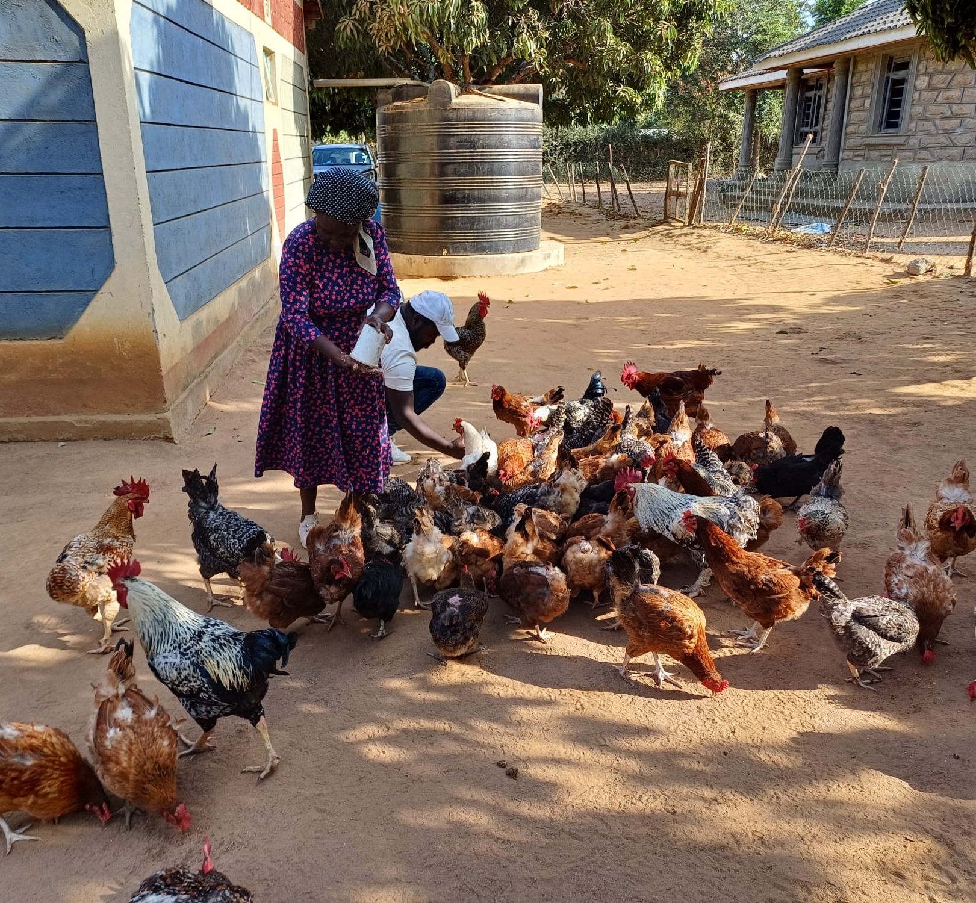
Hand in Hand East Africa and FSD Kenya poultry pilot project in Tala
April 2025

Slide 2
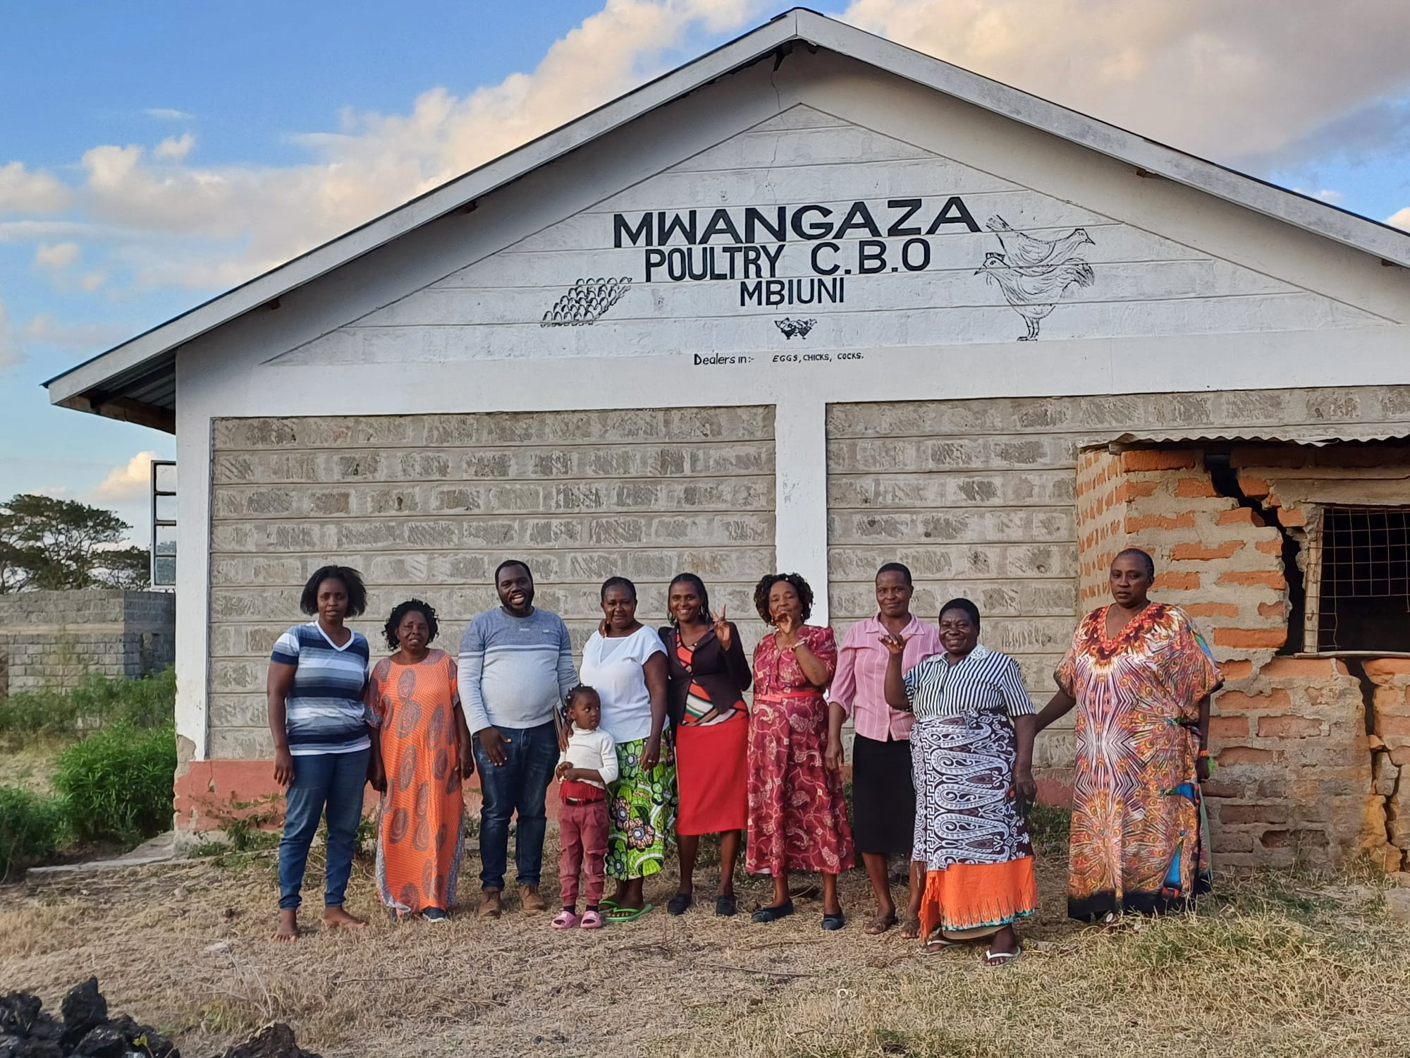
Contents
Project components and objectives
Project impact:
Improved poultry rearing and productivity;
Increased poultry profit;
Improved access to markets;
Improved access to finance
Increased resilience and inclusivity.
Project approach:
What worked;
What did not work;
Recommendations.
Interrogating the broader ToC

Slide 3
Project components and objectives
Problem statement: Low-income farmers are not able to maximise value from farming to strengthen livelihoods and incomes.
Approach piloted targeted different barriers such as lack of knowledge and skills. Four components:
Production - including training on various aspect of poultry rearing (LF model);
Vaccination and disease management – including training paravets in detecting poultry diseases and applying vaccinations;
Market access - including the establishment of marketing committees, training of groups in digital marketing and facilitating linkages with new markets, such as hotels;
Access to finance - aimed to address the main bottleneck experienced by farmers by providing groups with financial skill training and linking them with Equity. Access to credit was facilitated by providing a credit guarantee to cover 50% of the loan default loss.
The pilot aimed to develop a sustainable and scalable livelihood model using a market system approach, using the poultry value-chain as an entry point. The pilot also aimed to demonstrate how finance can add value in building poor households’ livelihoods.

Slide 4
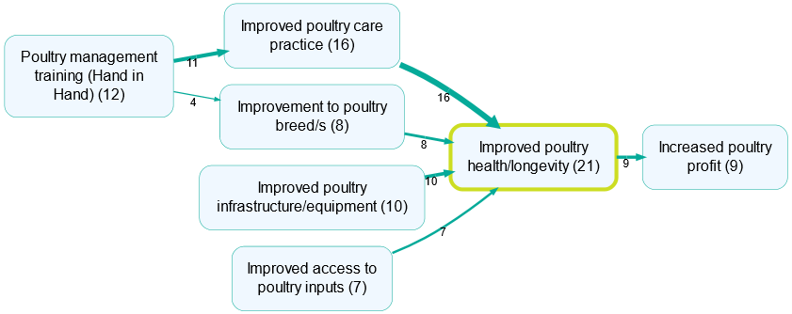
Impact: Improved poultry rearing practices and productivity
Context: Respondents grow a variety of crops, such as maize, beans, pigeon beans and mangoes, and keep livestock, cows, goats, sheep and poultry. For about 64% of respondents, farming is main source of income.
Impact:
44% of respondents reported that they had either started a new or expanded an existing poultry business during the project period.
Improved poultry health and longevity, and improved productivity.
86% of respondents kept poultry by the time of the study. Of those keeping poultry (31 respondents), 58% kept poultry for commercial purposes, and 42% kept poultry for non-commercial purposes. Considering the total sample of 36 respondents, half of respondents kept poultry for commercial purposes, and about 31% for non-commercial purposes.
Mechanisms: HiH training (LF model), paravet training (service-fee model).
Issue with sustainability of the approach: stronger incentives need to be built for local farmers to continue to train other groups, e.g., a fee-for-service approach.
“I now follow the immunisation schedule religiously, unlike before where l mixed herbal medicine like aloe vera with water and give them. All the new practices l introduced increased the quality and quantity of the chicken as l would tell from their weight.”
MUF30- Woman from Kitwii, aged 36-45

Slide 5
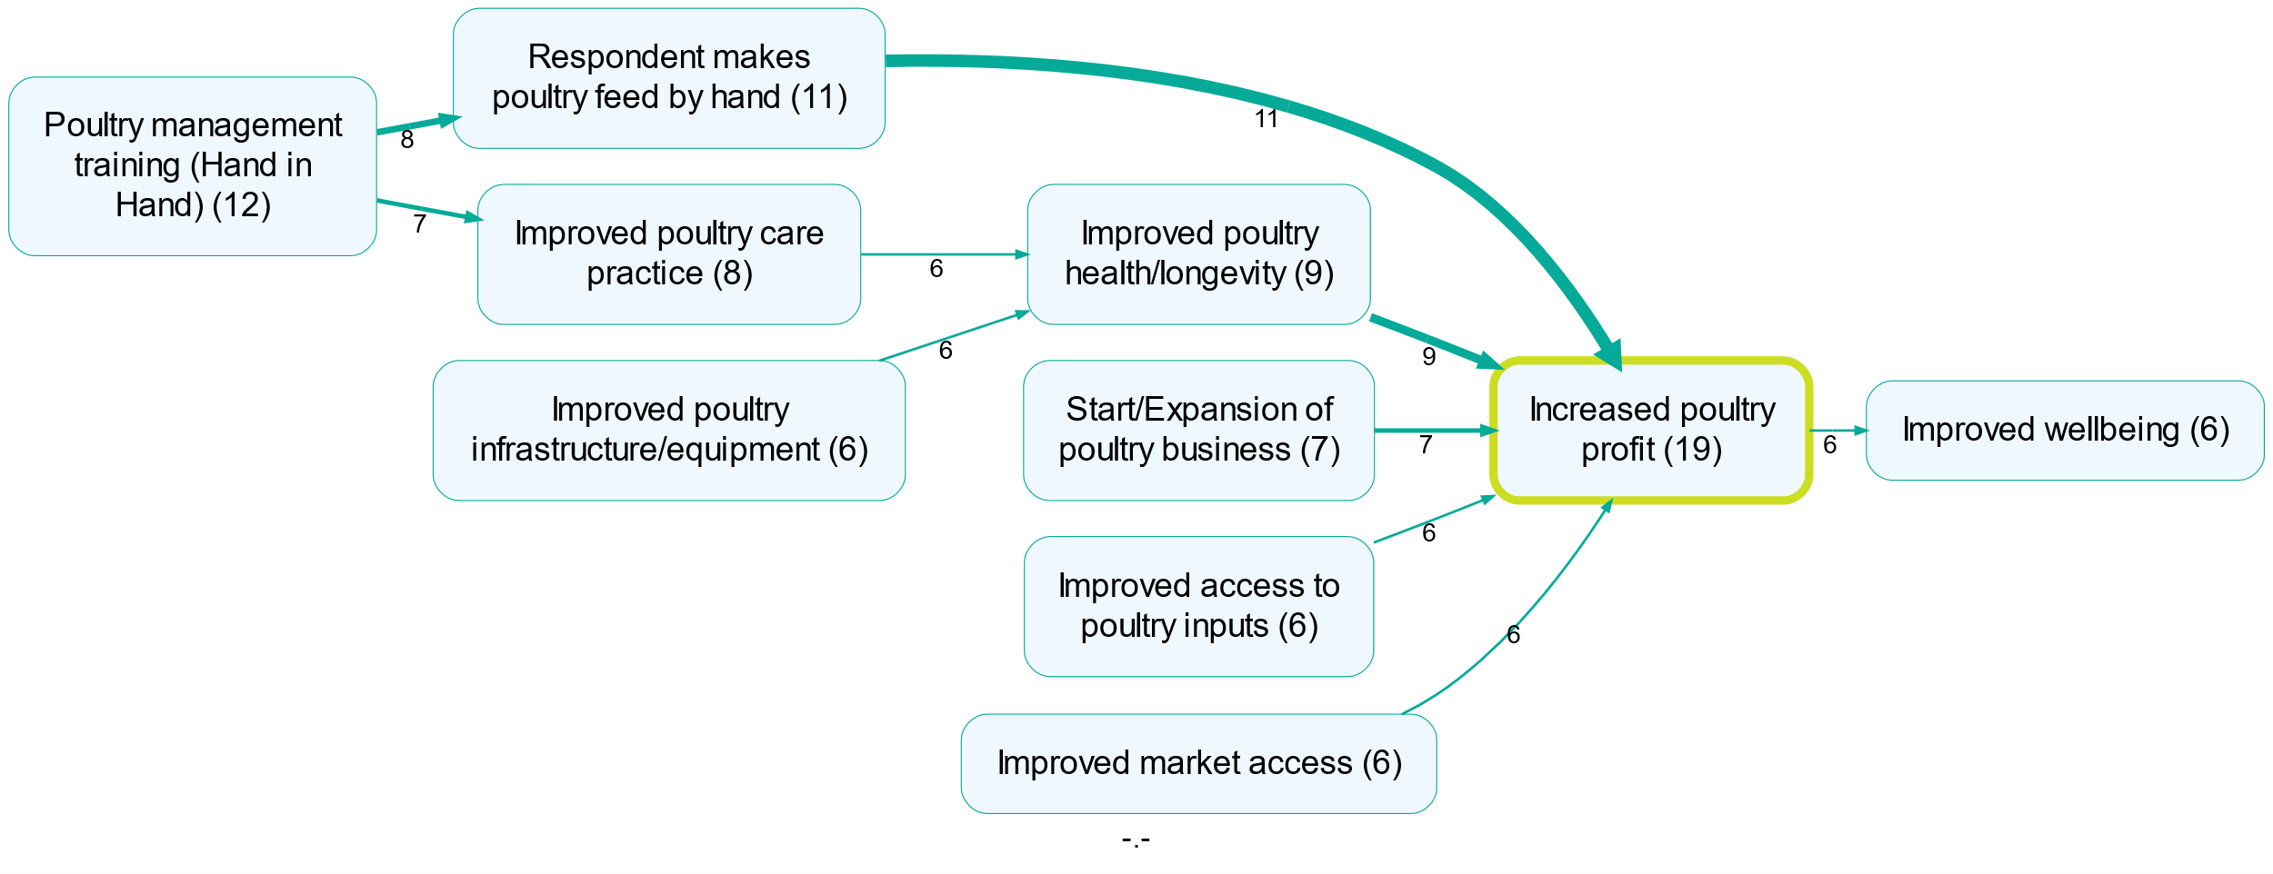
Impact: Increased poultry profit
Impact: 67% (24/36) of respondents mentioned an increase in profit from rearing poultry during the two years of the pilot project. However, the rise in the cost of poultry feed negatively impacted farmers who either stopped or reduced keeping poultry, leading to a decrease in profits for less than half of respondents.
Mechanisms:
making poultry feed by hand,
improved health and longevity of poultry,
starting new or expanding existing poultry businesses,
better access to poultry inputs, and
improved market access.
Issue with sustainability of the approach: promote diversification and adaptation of income-generating activities, by targeting multiple value-chains and multiple nodes along value-chains.
“Over the last 2 years I have made some changes in the way I feed my chicken, as I formulate my own feeds together with other group members from Kathome Dairy Farmers group. This is as a result of the training we received from Hand in Hand. This is very cost effective compared to buying ready-made feeds from agro-dealers which is much more expensive.”
KAF23- Woman from Kwa Kathule, aged 36-45

Slide 6
Impact: Improved access to markets
Impact - input market: Crowding in of inputs providers attracted to the area by the growing demand for inputs (expanded market opportunity), improved access to local and accessible inputs for poultry rearing, more accessible access (bulk buying, without transport fees). Most farmers mentioned better access to inputs.
Mechanisms:
An increase in the number of farmers keeping chickens led to a growing demand for products and services related to poultry, and as a result to an increased offer of inputs,
No transport costs when buying locally or in bulk,
Buying local inputs from CBOs.
Impact - output market: Access to new markets for poultry, especially for more organised groups. Individual farmers keep selling locally, also to brokers. But weak and informal market linkages with hotels and schools. Only a few groups – those with more experience and previous NGO support – mentioned positive changes in reaching new markets.
Mechanisms:
HiH training in digital marketing (e.g., Facebook and WhatsApp),
Linkages facilitated by HiH with hotels, but also schools, churches and local functions.
Issue with weak linkages to output market actors: Promote group approaches to access markets, strengthening the capacity of groups to negotiate and bulk-buy/bulk-sell, and support formalisation of contracts, for output markets.
“Hand in Hand have educated me on digital marketing skills, I currently have WhatsApp for business and a Facebook page which have enabled me to get customers from far away and I am now selling more to the hotels in town compared to before where I relied on brokers and middlemen to do marketing for me which was less effective, and they were exploitative.”
MWF2 - Woman from Kivandini, aged 36-45
“I had to use my friends to tell their friends and that’s how l attracted customers. I am proud that l started Wema agrovet as at the moment l am making enough income to meet all the needs of my children.”
DM35- Male from Kyeveluki, aged 26-35

Slide 7
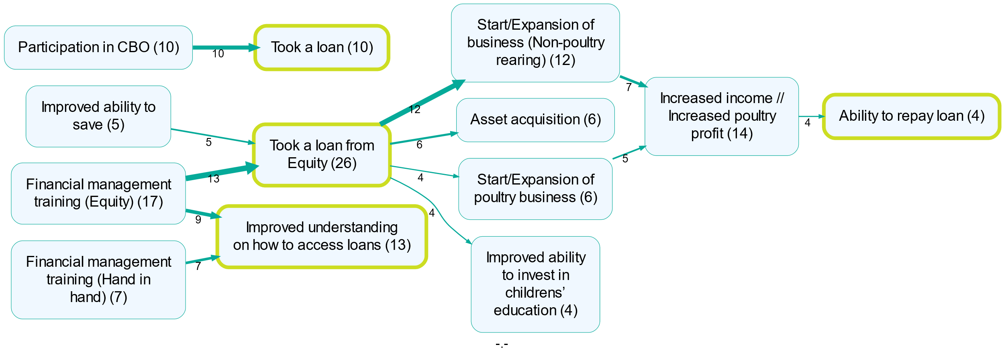
Impact: Improved access to finance
Context: Existing access to finance and saving through CBOs and chamas, and (less commonly) through microfinance institutions, SACCOs and money lenders. Groups had accessed the HiH loan (Enterprise Incubation Fund) for a maximum value of Ksh. 20,000 each.
Impact: Improved access to bank loans (265 active clients as of September 2024) and bank saving (200KSh per week) which led to increased investments in businesses and assets, as well as education.
Mechanisms: HiH and Equity financial training, the successful repayment of the HiH loan and participation in groups were used as screening mechanisms by the bank.
Issues with sustainable scalability of the approach:
Mandatory savings that cannot be withdrawn – develop more flexible products;
No potential for scale without the Credit Guarantee.
“In 2022, l was introduced to Equity Bank by Hand in Hand. They taught us on financial literacy, how to get loans and pay them and how to save. We opened a joint bank account as Mwangaza CBO but allowed us to take loans as individuals. I took a personal loan of KSh10,000 from Equity, bought 10 chickens, feeds and medicine for vaccination.”
MWF26 - Woman from Kivandini, over 55

Slide 8
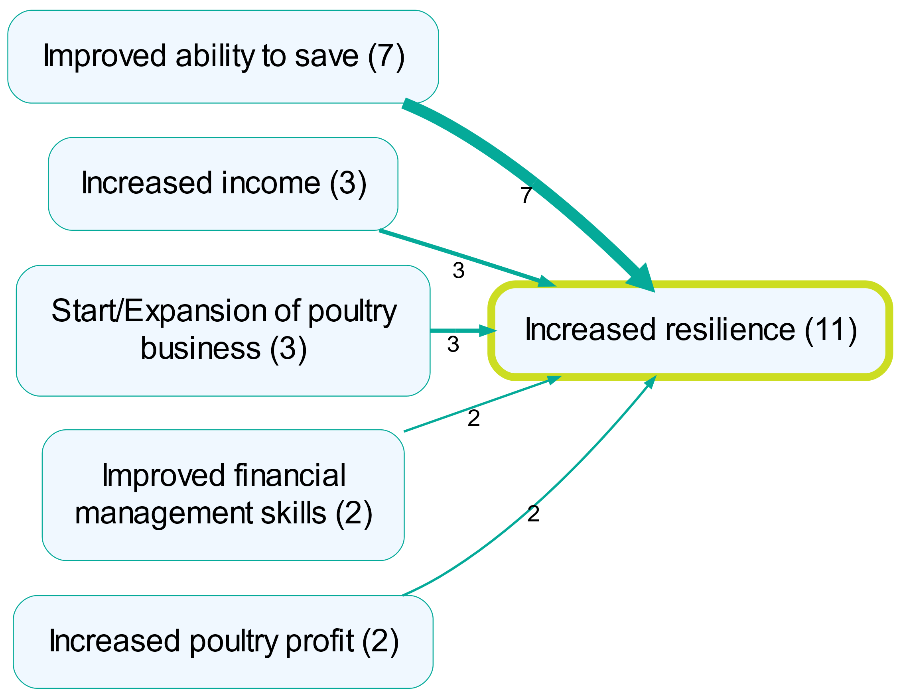
Impact: Increased resilience and inclusivity
Impact - resilience: Respondents reported feeling more resilient – e.g., having a fall-back option through savings or selling poultry to cope with a financial emergency rather than using other sources of money.
Mechanisms:
Increased ability to save;
increased income;
expanded or new poultry businesses, and
improved financial management skills.
Impact - inclusivity: increased female contribution to household expenses, increased business activities (poultry) and access to loans.
No change in decision-making roles with most households making joint decisions.
“I feel l am confident and well prepared in case of an emergency compared to two years ago because l started a chicken farming which l use as financial security, l sell them whenever l need money instead of taking money from my business”
MWF27- Woman from Kivandini, aged 26-35

Slide 9
Approach: What worked
Leveraging associations to build capacity in poultry rearing, production of feeds, and financial management training
Targeting a value-chain for which there was interest, previous experience and that is relatively inexpensive compared to others
Targeting a value-chain that was generally associated with women allowed them to build capacity and access finance
Setting up a fee-for-service approach for paravets to ensure the sustainability of the service
Facilitating links with input/output markets and training on digital marketing strategy was effective in reaching new output markets
Providing a CG to incentivise Equity to serve a new market and facilitating linkages through a trusted NGO (pre-screening of groups)

Slide 10
Approach: What didn’t work
Missed opportunity to build incentives for local experts to provide training after the end of the project (e.g., LF model was not fee-for-service, risk of developing aid dependency);
Reliance on a single value-chain can increase exposure to risks to market vulnerability (e.g., increased price of poultry feed);
Missed opportunity to promote value addition along the value-chain, risk of saturation of local markets – this could have been because of the limited project’s time and challenges of these processes;
Mixed incentives for project partners that delayed the linkage process: HiH loan vs Equity loan. Weak incentives for private sector to provide access to finance after end of CG;
Missed opportunity to build an iterative learning process between market actors and communities, to promote demand-led innovation, especially in relation to finance – e.g., Equity product not appropriate to the needs of community members with mandatory saving that cannot be withdrawn, with the risk to increase farmers’ vulnerability to shocks, and loss of groups for Equity.

Slide 11
Approach: Recommendations
To improve on the sustainability of the training approach, LF model could be built as a fee-for-service approach, explore opportunities to incorporate a mentorship approach to improve more sustainable leadership and technical skills in the communities;
Explore opportunities to target multiple value-chains at the same time or a staggered approach (similar to HiH broader approach), promote diversification and adaptability of income-generating activities, and improve resilience to external shocks;
Explore longer project’s timeframes, mentorship models, and strengthen links with extension services and market actors, as well as access to new markets (e.g., digital marketing skills) to strengthen market linkages in the long-term and development of other value-chain nodes;
Explore a step approach to access to finance with better identification of the financial needs of different segments in the community. This might involve cash transfers, supporting existing chamas and local SACCOs, matching grants and other financing instruments. The piloted market approach only worked for better-off groups;
Explore how FSDK can support an iterative learning process between market actors and communities.
Explore the role of partners in monitoring activities and results more closely throughout project’s implementation.

Slide 12
Interrogating the broader ToC
Was the problem statement well defined?
Missed opportunity to be more specific with the definition of the targeted market. The evaluation shows that the approach works for middle income farmers within the targeted communities. However, it is difficult to say whether the approach worked with the intended target being identified as “low-income farmers”.
Were the barriers well defined?
The barriers were correctly identified. However, as in the problem statement, there is an opportunity to be more specific with the barriers that different segments might have as this will help in designing a targeted approach that takes into account these differences. e.g., the link to Equity may not work for everyone.
What other potential solutions and approaches can be explored, based on the learning from the Tala project and the pilot in Marsabit?

