Slide 1



Warehouse Receipt Financing Feasibility Study
Key findings and insights
Monday, 26 August 2024

Slide 2


Introduction
Methodology
Feasibility Study Findings
Proposed product design/model

Slide 3
This study was jointly commissioned by Financial Sector Deepening (FSD) Kenya, AGRA, the Agricultural Finance Corporation (AFC) and the Warehouse Receipt System Council (WRSC).
One of the AFC’s strategic objectives is to drive financial inclusion in the agriculture sector. To do this, the AFC has prioritized a warehouse receipt financing model.
The Government of Kenya, has also prioritised the full implementation and roll out of the warehouse receipt system (WRS) and alongside it, the roll out of a warehouse receipt financing product.
The government seeks to promote the adoption and use of storage services offered by warehouses participating in the WRS (i.e., certified warehouses) by smallholder farmers (SHFs) in order to:
Minimize their post-harvest losses
Shield them from price volatility
Enable SHFs to access formal credit
The ultimate goal of the government and AFC is the increased agricultural output and incomes of SHFs through their participating in the WRS and WR financing.
Notes:
We know that this feasibility study and pilot framework are derived from two factors:
AFC’s strategic plans and business models prioritisation
The Government of Kenya’s desire to uplift the well being of SHFs

Slide 4

Situational Analysis
There are 7.5 million smallholder farmers (SHFs) in Kenya.¹ 94% cultivate farms smaller than 5 acres and have an annual median produce of 1,000 – 3,000 Kgs.²
Acreage of farms cultivated by smallholder farmers ²
Annual produce of smallholder farmers ²
6%
Less than 1 acre
All
11%
< 1000 Kg
12%
1 to 2 acres
1000 - 3000 Kg
2 to 3 acres
Female SHFs
3000 - 5000 Kg
16%
3 to 4 acres
> 5000 Kg
32%
4-5 acres
Male SHFs
Greater than 5 acres
Among the key challenges faced by smallholder farmers is:
1
Post-harvest losses of up to 50% ³
2
Exposure to high price volatility of produce
3
Inadequate access to finance
Storage facilities used by SHFs ²
Satisfaction with selling price of produce ²
Barriers to credit ²
On my farm
94%
6%
34%
19%
27%
14%
Inadequate collateral
40%
Private warehouse
9%
Access to quality storage facilities is a challenge
Very satisfied
Somewhat dissatisfied
Low income
31%
Public warehouse
6%
Somewhat satisfied
Very dissatisfied
Volatility of income
26%
Neither
Sources: 1. FTMA, Kenya Country Brief, 2022 | 2. FSD Kenya, WRS financing feasibility study, 2023 | 3. IGAD, Regional Postharvest Loss Management Strategy, 2021

Slide 5
The overall objective of this study was to assess the demand-side, supply-side and environmental factors for the design and roll-out of a warehouse receipt financing product.
Demand-side factors
The post-harvest management practices and needs of farmers and the relevance of the WRS and a WR financing solution to meet these needs.
The supply chains farmers participate in and the impact of this on farmer’s financial performance/economic well-being.
The value chains in which the WRS and WR financial solution would be greatly demanded and be an appropriate post-harvest management solution.
The extent to which SHFs engage with formal financial institutions and the impact of this for WR financing product.
Supply-side factors
The capacity of AFC and WRS to reach SHFs and roll-out the WR financing and WRS in different parts of the country. As well as means to bridge any capacity gaps, including integration between AFC and WRS.
Opportunities for partnerships to enhance the efficiency, effectiveness and sustainability of AFC’s WR financing solution.
The risks for AFC and WRSC in piloting and rolling out the WR financing solution.
Enabling environment factors
How the relevant laws, regulations and policies touching on the WRS and credit extension in the country impact on the WR financing solution design.

Slide 6

Introduction
Methodology
Feasibility Study Findings
Proposed product design/model

Slide 7
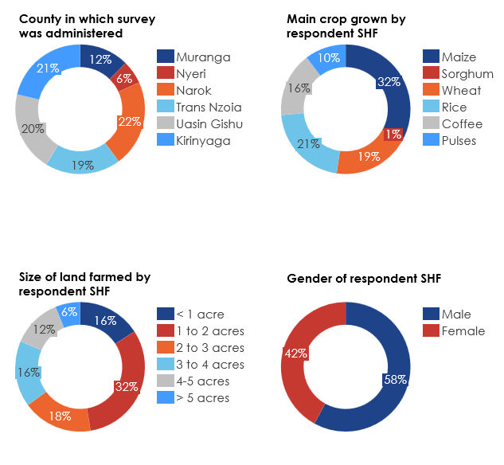
A survey of 291 SHFs was carried out. In order to identify SHFs to be surveyed, six value chains and six regions were shortlisted.
Shortlisted value chains
Characteristics of the sample of surveyed SHFs
Value chain | Average production 2019-21¹ (t) | Average area harvested 2019-21² (Ha) | Ease of long-term storage | No. of SHFs in value chain | Share of AFC lending by volume (2019-21) | Share of w/h receipts issued
Maize | 3,558,000 | 2,200,173 | High | > 3 million³ | 54% | 100%
Pulses | 1,164,110 | 1,623,281 | High | ~ 2 million⁴ | 0% | 0%
Wheat | 338,733 | 135,203 | High | N/A | 10% | 0%
Sorghum | 246,000 | 219,087 | High | ~ 240,000⁵ | 0% | 0%
Rice | 175,825 | 26,272 | High | ~ 300,000⁶ | 3% | 0%
Coffee | 34,500 | 113,950 | High | ~ 250,000⁷ | 4% | 0%
Regions in which the survey was undertaken
County | Sub-county | Potential towns | Rational
Trans-Nzoia | Kiminini | Kiminini | Growth of maize, pulses and sorghum
Uasin Gishu | Soy | Soy | Growth of maize and pulses
Narok | Narok-East | Ntulele | Growth of wheat
Kirinyaga | Mwea West | Mwea | Growth of rice
Nyeri | Mukurweini | Mukurweini | Growth of coffee and pulses
Muranga | Muranga South | Kiharu | Growth of pulses
Sources: 1. Food and Agriculture Organization Statistics | 2. Ibid. | 3. Njeru, Mwaura, Mbogo and Gerald, 2022 – accessed here | 4. Farms Trend, 2023 | 5. CRAFT | 6. Ministry of Agriculture, Livestock, Fisheries and Cooperatives, State Department for Crop Development and Agricultural Research, 2020 | 7. KALRO, Coffee Research Institute
Notes:
Survey of 291 farmers in Narok, Uasin Gishu, Trans Nzoia, Kirinyaga, Nyeri and Muranga; Value chains - maize, wheat, pulses, coffee, rice, sorghum

Slide 8
26 stakeholders were interviewed.
Stakeholders interviewed
Stakeholder group | Stakeholder | Person interviewed | Location of interview
Direct project stakeholders | WRSC | Head of IT Department | Remote/virtual
 |  | Company Secretary and Head of Legal Services | Remote/virtual
 | AFC | Head of Product Development | Remote/virtual
 |  | Chief ICT Officer and other IT officials | Remote/virtual
Government agencies | National Cereals and Produce Board (NCPB) | Officer, Warehouse and Hub Management | In-person, Nairobi
 | County Government of Uasin Gishu | Director, Agriculture | Field visit
 | County Government of Trans Nzoia | Director, Agriculture | Field visit
 | County Government of Kirinyaga | Director, Agriculture | Field visit
 | County Government of Nyeri | Director, Agriculture | Field visit
 | Business Registration Service (BRS) | Deputy Registrar MPSR | Remote (virtual)
International/Regional agencies supporting the WRS | International Finance Corporation | WRS support team | In-person, Nairobi
 | World Food Program | Country Director / Program Manager- Farm to Market Alliance | Remote/virtual
 | Alliance for a Green Revolution in Africa (AGRA) | Market Access Program Officer and Policy Officer | Remote/virtual
Certified/licensed warehouses and other warehouses | WRS NCPB Store No. 3 at Nakuru NCPB Depot | Warehouse manager | Field visit
 | WRS NCPB Store at Eldoret NCPB Depot | Warehouse manager | Field visit
 | WRS NCPB Store No. 14 at Kitale NCPB Depot | Warehouse manager | Field visit
 | AFEX Fair Trade Ltd (AFTL), Soy Mateeny (Uasin Gishu) | Warehouse manager | Field visit and Remote/virtual
 | Ace Global Depository | Collateral Manager | Remote/virtual
Co-operative Societies and Farmer Groups | Wamwinyi Soko Huru Farmers Co-operative Society | Co-operative chairperson | Field visit
 | Mateeny Soy Farmers’ Cooperative Society | Co-operative chairperson | Field visit
 | Mwea Rice Growers Multi-purpose Cooperatives | Co-operative warehouse manager | Field visit
 | Rumukia Farmers’ Co-operative Society | Co-operative chairperson | Field visit
Financial institutions | Co-operative Bank of Kenya | Head Agribusiness banking | Remote/virtual
 | Family Bank | Head of Agribusiness banking | Remote/virtual
 | Lainisha SACCO | Chief Executive Officer | Field visit
Others | Depositor in Nakuru NCPB depot | - | Field visit

Slide 9
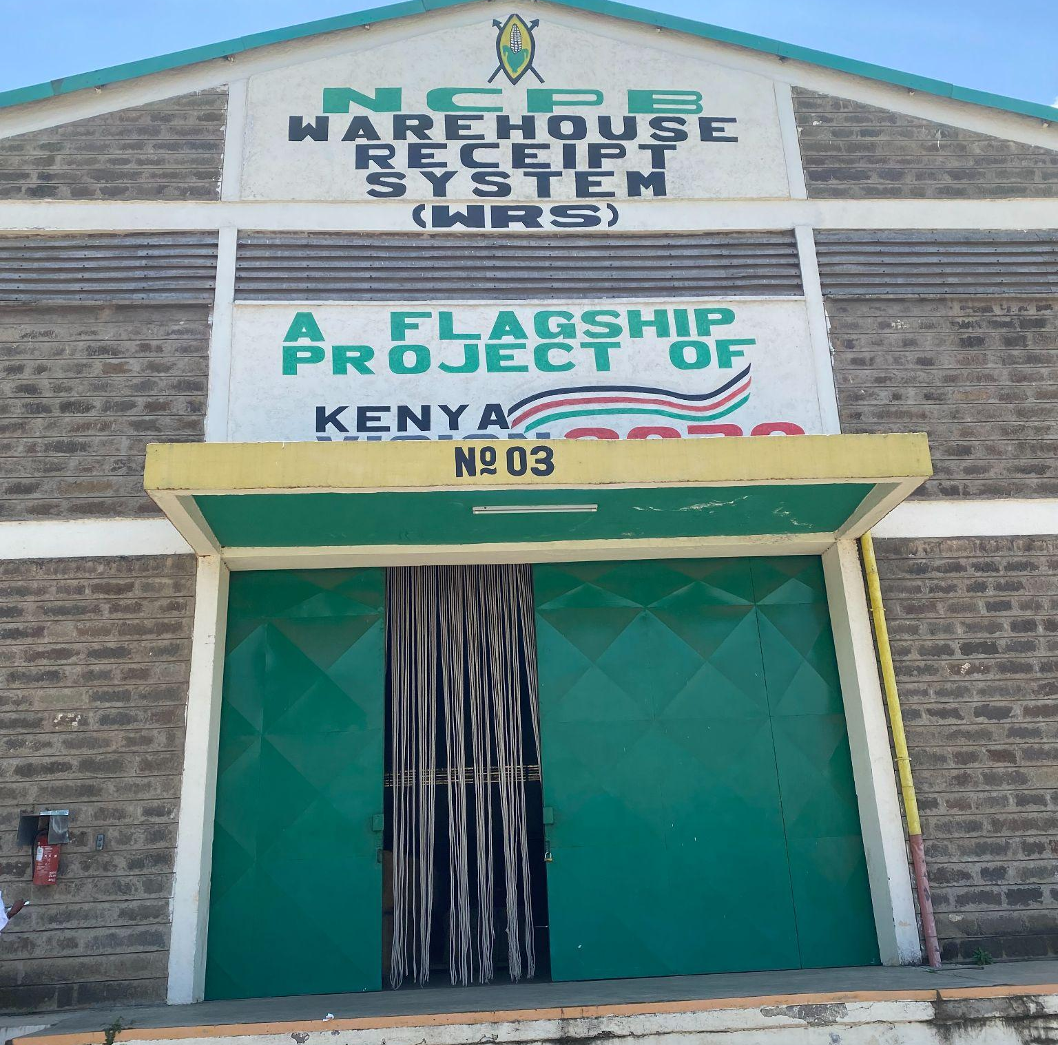
Introduction
Methodology
Feasibility Study Findings
Proposed product design/model

Slide 10
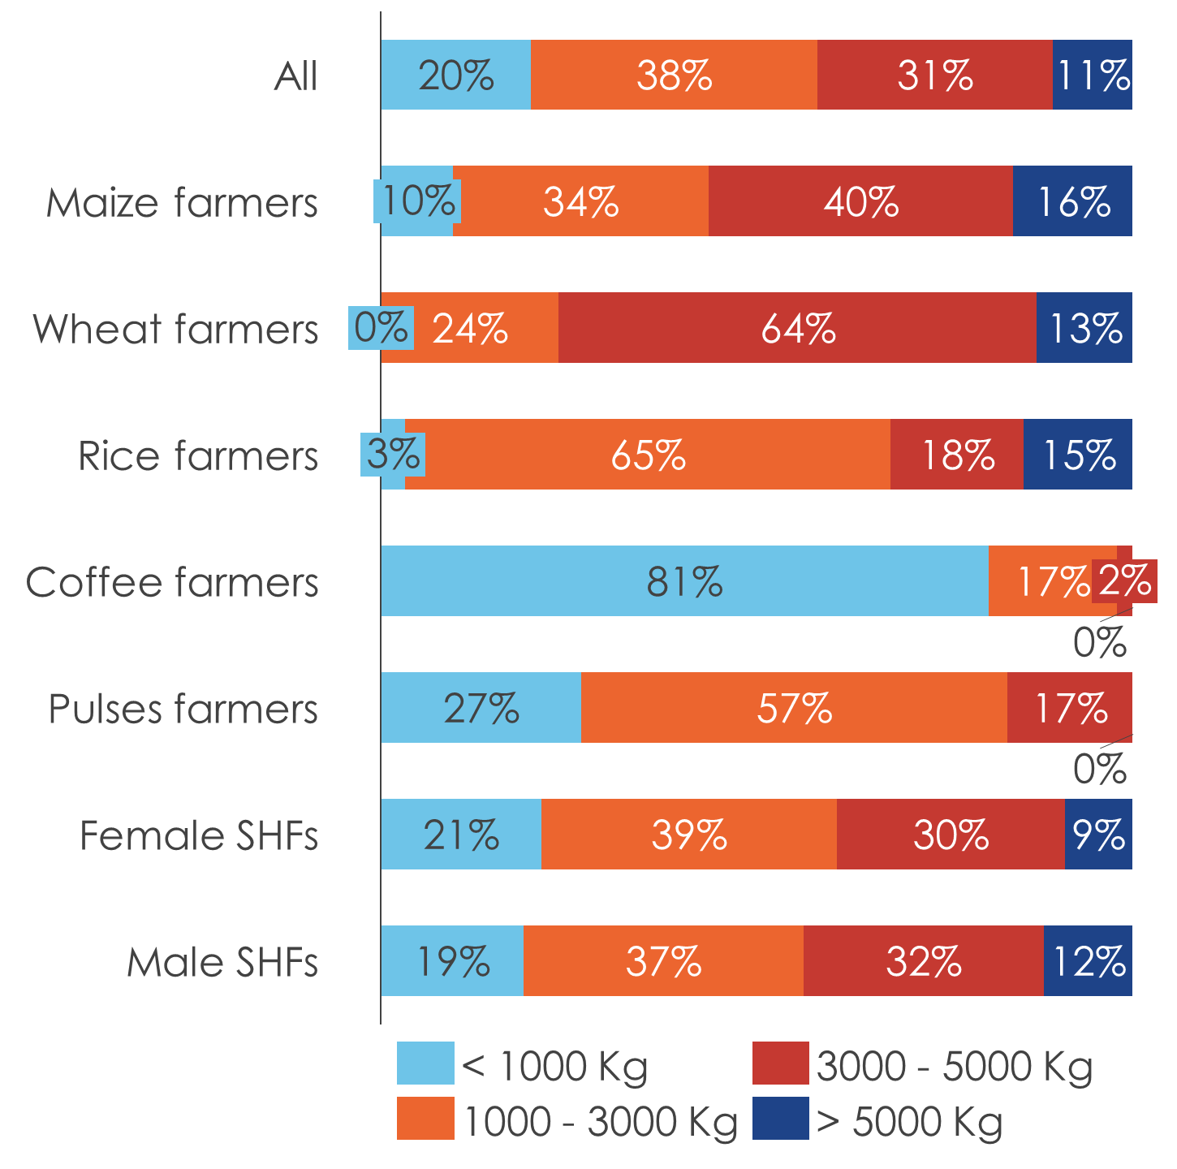
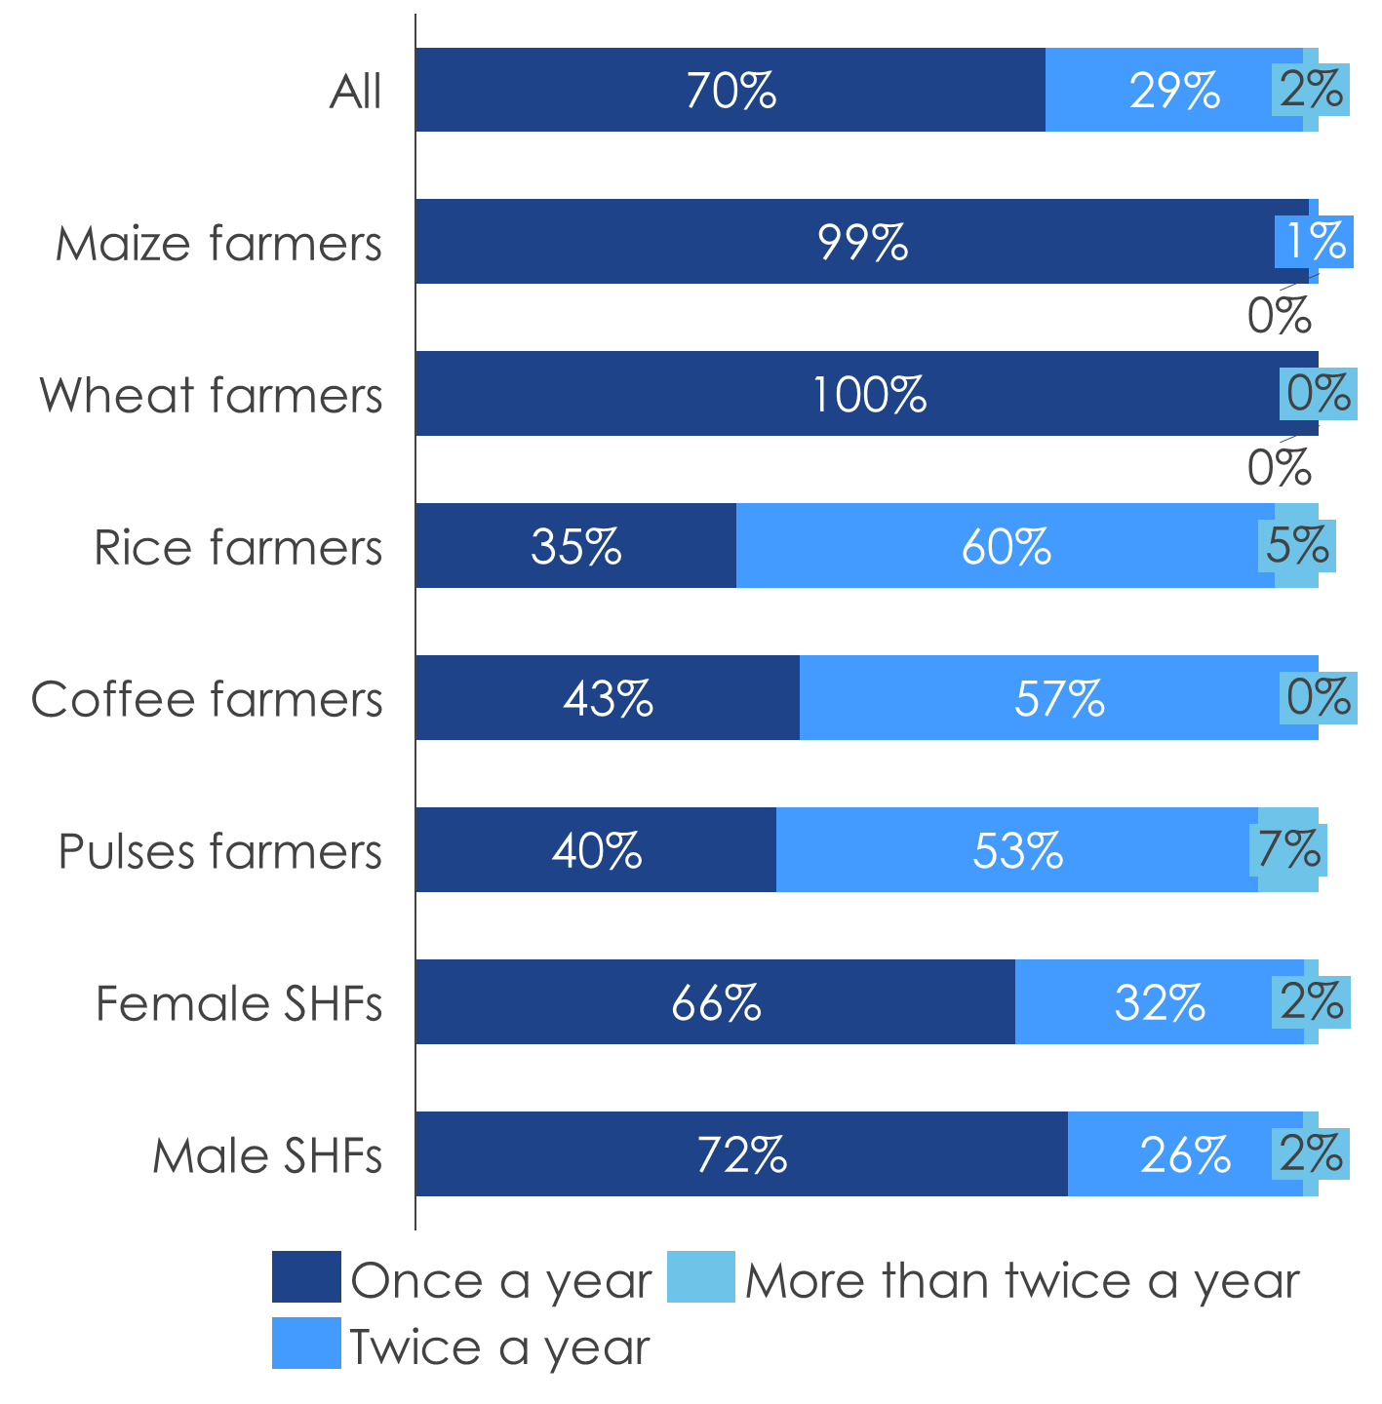
Demand-side
The vast majority of SHFs’ output per harvest of the main crop they grow is less than 5000 Kg. Additionally, the majority of SHFs harvest only once a year.
Average weight of harvested crop
Frequency of harvest
Notes:
A majority of SHFs harvest less than 5000 kg of produce per harvest/season, and for most they harvest once a year

Slide 11
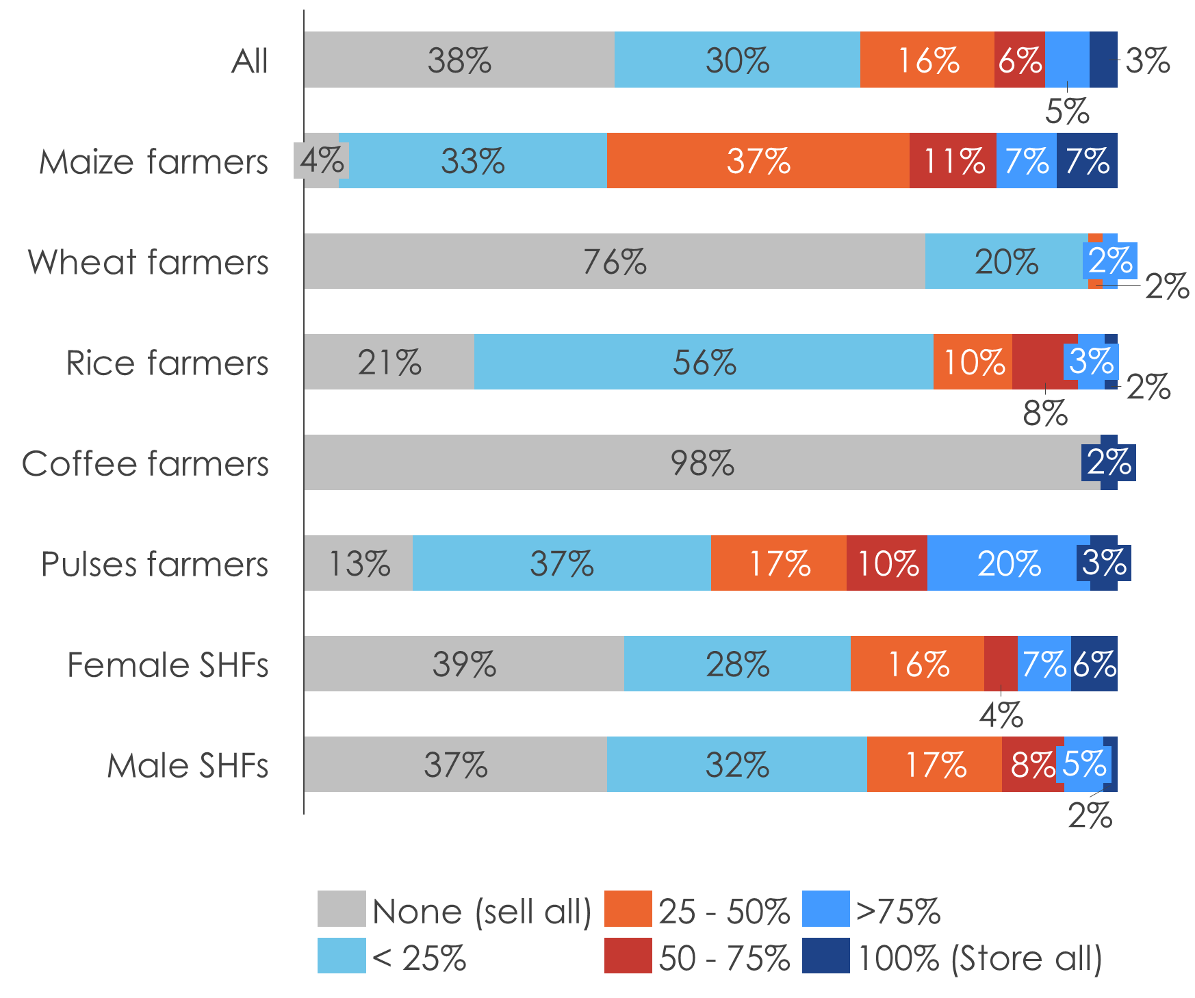
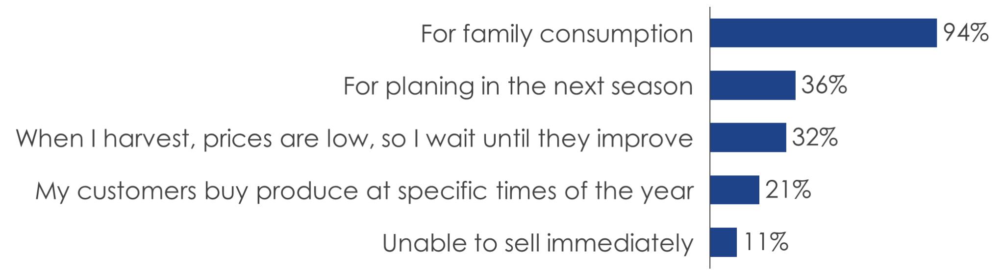
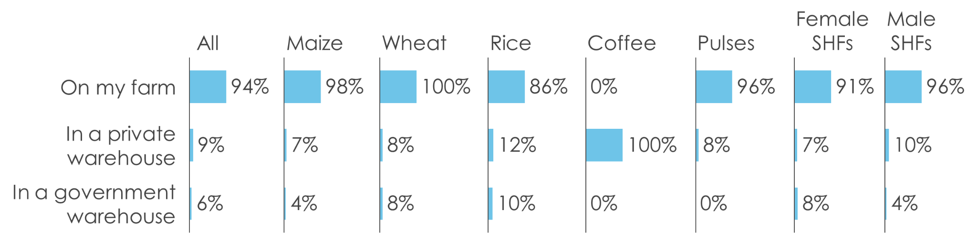
Demand-side
The majority of SHFs sell all their produce at harvest. The main reason for storing produce is for family consumption and the majority of SHFs store produce on their farm.
Proportion of harvest that is stored
Reasons for storing produce
Storage facility used
Notes:
Storage of produce is lowest in the coffee and wheat value chains. The use of warehouses for storage of produce among SHFs that store a part of their produce is highest in the coffee and rice value chains

Slide 12
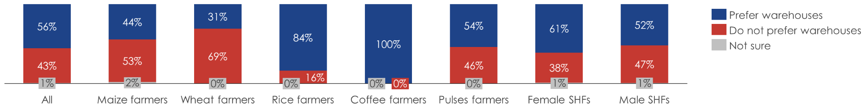
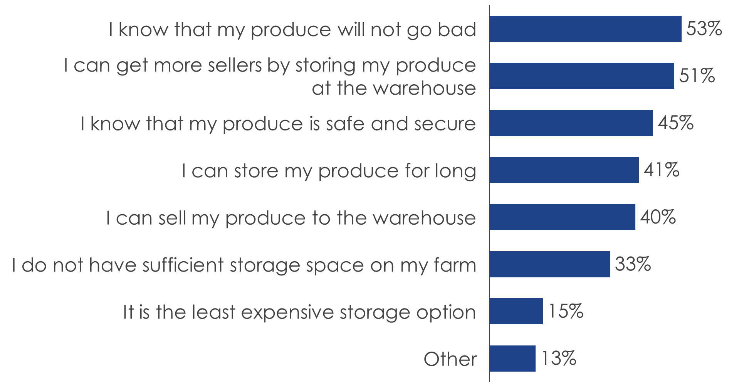
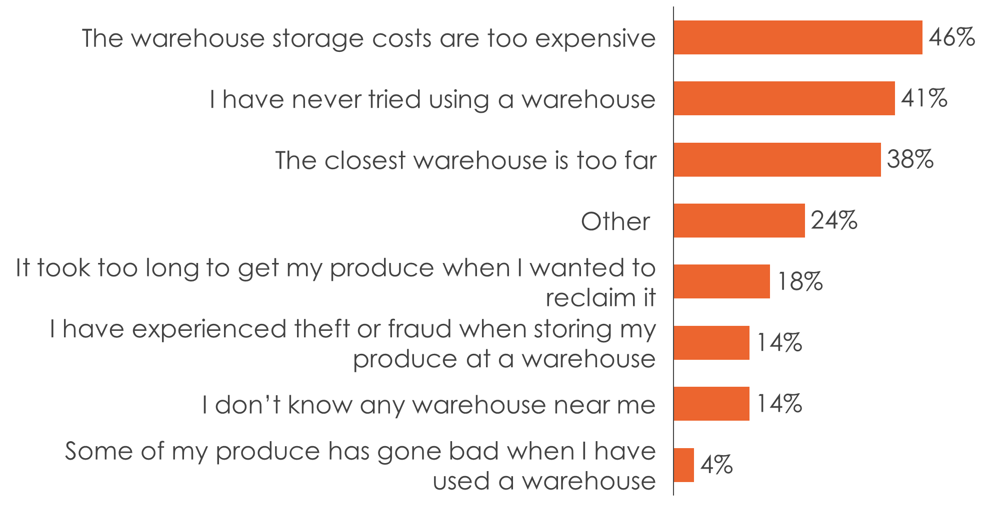
Demand-side
The majority of SHFs prefer using a warehouse for a variety of reasons. Reasons for not preferring a warehouse include the cost, unfamiliarity and transport distance.
Preference for storing produce at a warehouse vs. other alternatives
Reasons for preferring a warehouse
Reasons for not preferring a warehouse

Slide 13
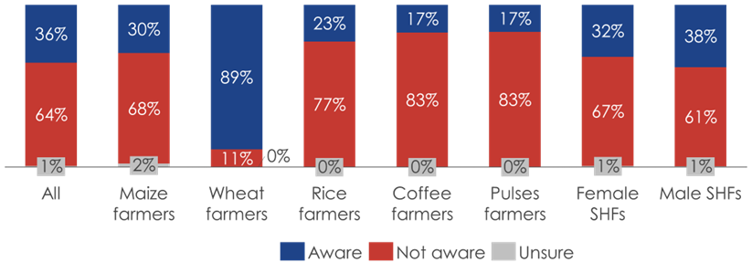
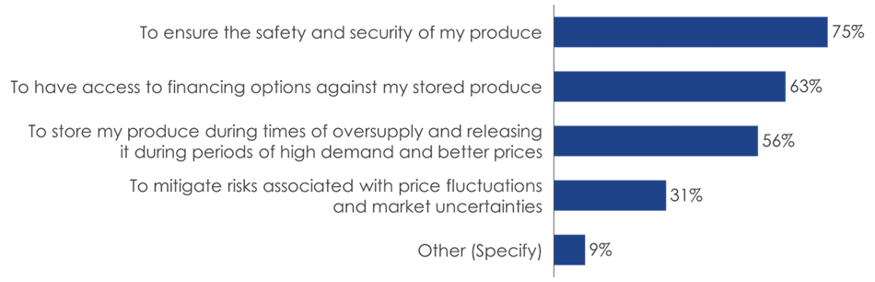
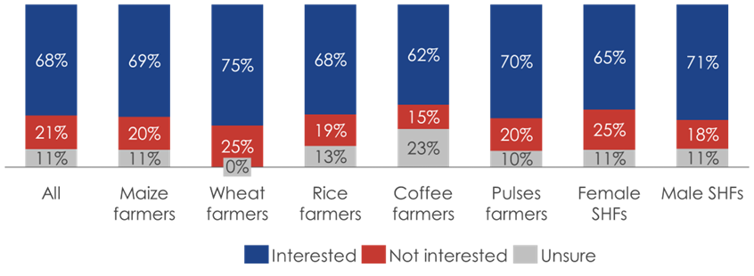
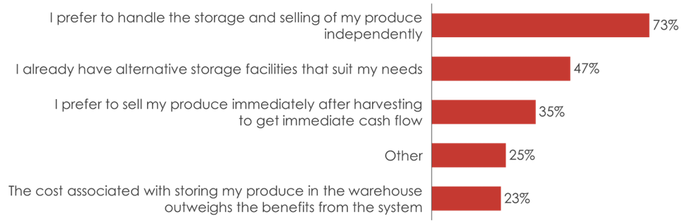
Demand-side
The WRS is not well known among SHFs, however, with the enumerators explaining what the WRS is, two-thirds of SHFs stated that they would be interested in participating. Various reasons for interest or disinterest in the system were cited.
Awareness of the WRS
Reason for interest in the WRS
Interest in participating in the WRS
Reason for disinterest in the WRS
Notes:
The main reasons for interest in the WRS are ensuring the safety and security of produce; access to financing options and achieving a better price for produce, by riding the high supply season. The main reasons for a lack of interest are the flexibility that comes with independent storage being valued greatly and having alternative storage

Slide 14
Demand-side
At a farmer group/co-operative level, there is greater awareness of the WRS and its potential benefits as well as its challenges.
The farmer groups and co-operatives recognized that the WRS provided a means of:
Stabilizing market prices of produce.
Reducing hasty selling among SHFs.
Reduce SHFs’ dependence in middlemen.
Enable access short-term credit for SHFs.
Increasing the potential buyers/markets accessible to SHFs.
The farmer groups and co-operatives recognized that a number factors made it challenging for SHFs to participate in the WRS:
High transportation costs to warehouses.
Stringent and time-consuming procedures when depositing produce in warehouses.
Delayed payments to farmers upon the sale of the produce by SHFs to the warehouses.
Based on the findings from this feasibility research, the following should be considered in the engagement of SHFs in the WRS and WR financing ecosystem:
It will be important to include an aggregation model into the WRS framework to promote SHF participation.
SHFs still need to be sensitized on how the WRS operates and the benefits from participating in it.
The WRS also needs to demonstrate the alternative markets/buyers that SHFs would access by participating in it.
Transparency and flexibility are key. This can be achieved through the incorporation of digital channels
The coffee and rice value chains have a low demand for WRS on account of their relatively formal structures and should not be considered for piloting the WR financing product.
There should be an effective WR financing ecosystem that is able to address SHFs’ liquidity needs.

Slide 15
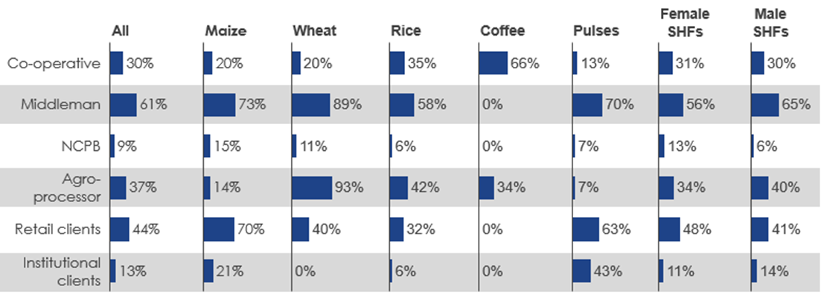
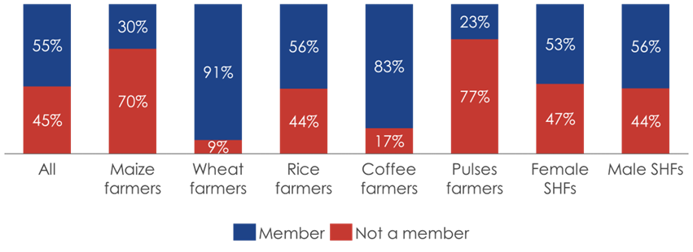
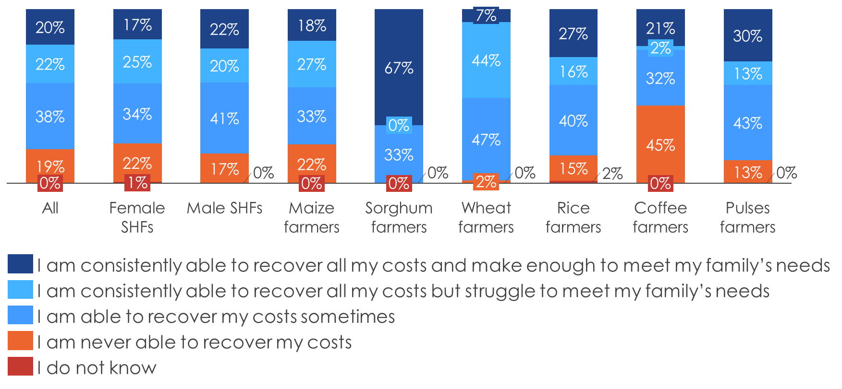
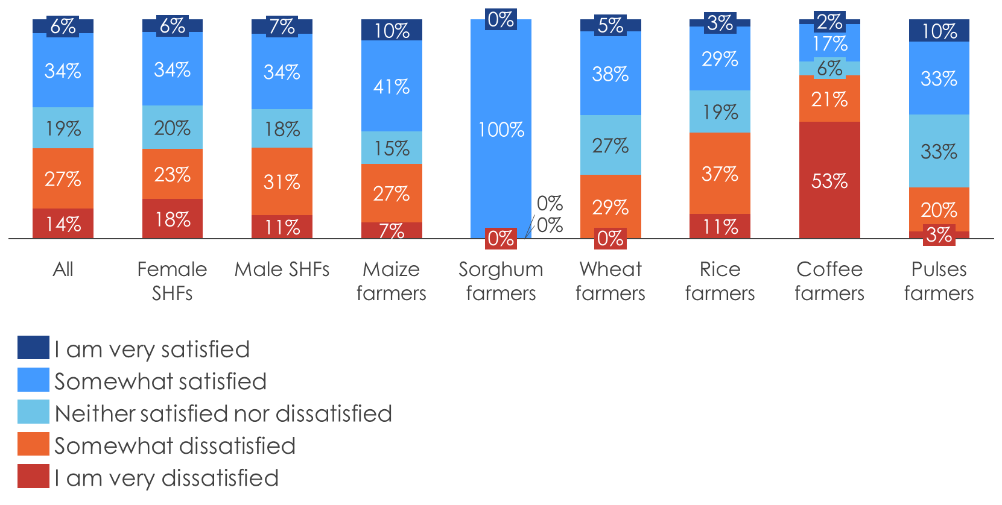
Demand-side
Most SHFs are members of farmers’ groups/co-operatives and sell their produce to a middleman. SHFs are rarely satisfied with selling price and are rarely very profitable.
SHFs’ customers
Proportion of farmers that are members of farmers’ groups or co-operatives
SHF profitability
SHF satisfaction with selling price for their produce
Notes:
For WRS to be competitive as a route for the disposal of produce by SHFs it must be able to offer SHFs the same variety of buyers they already have available to them, as well as offer higher prices as compared to selling immediately.

Slide 16
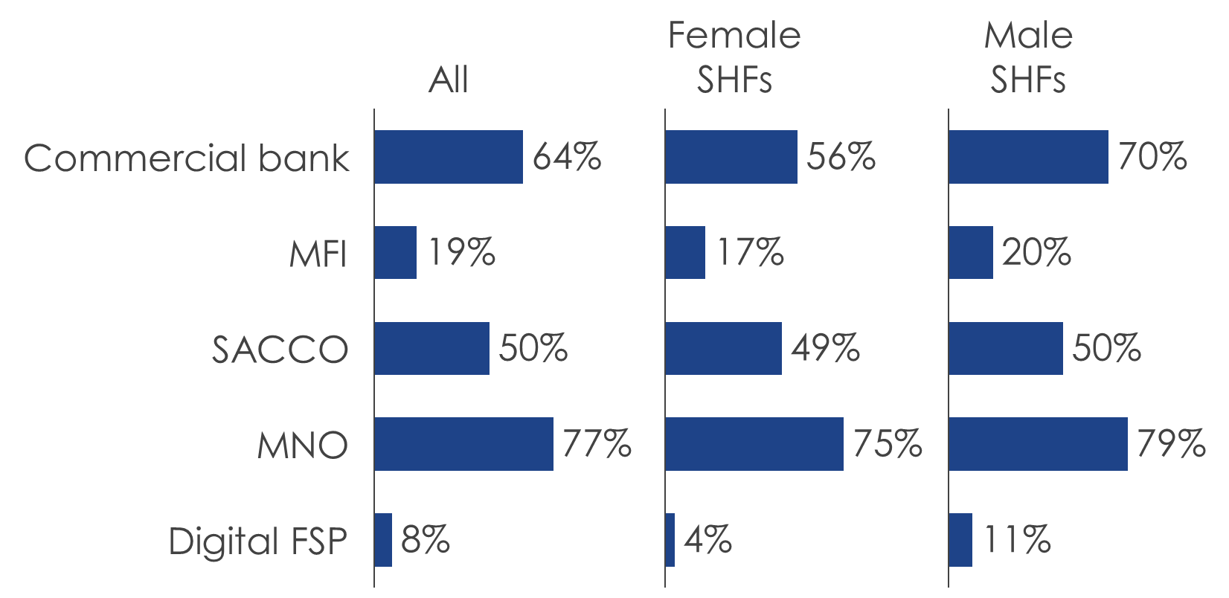
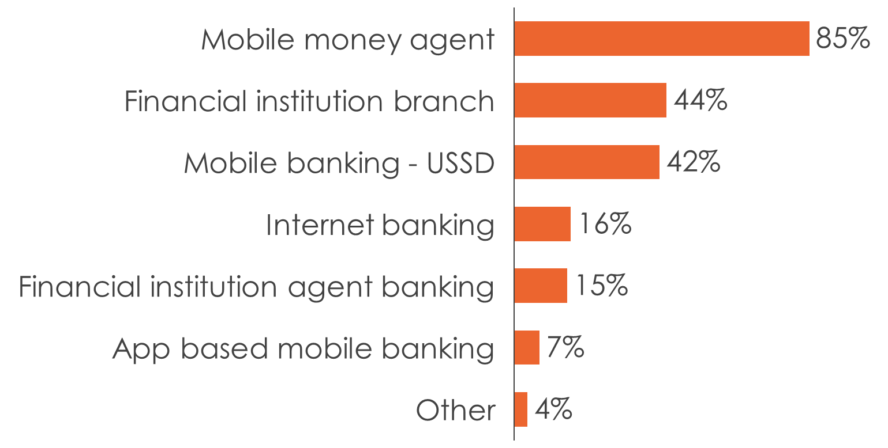
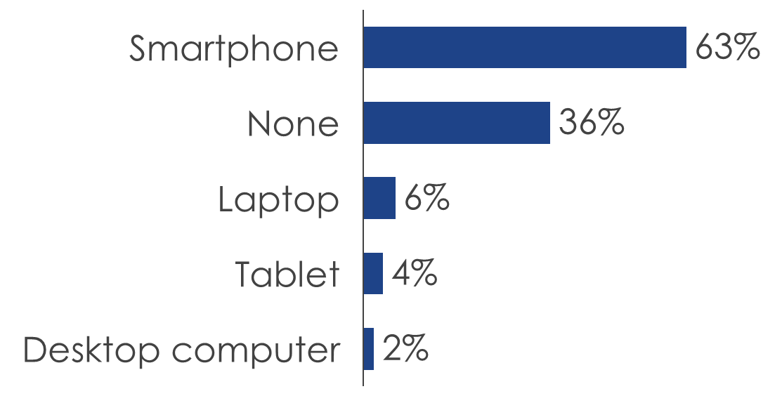
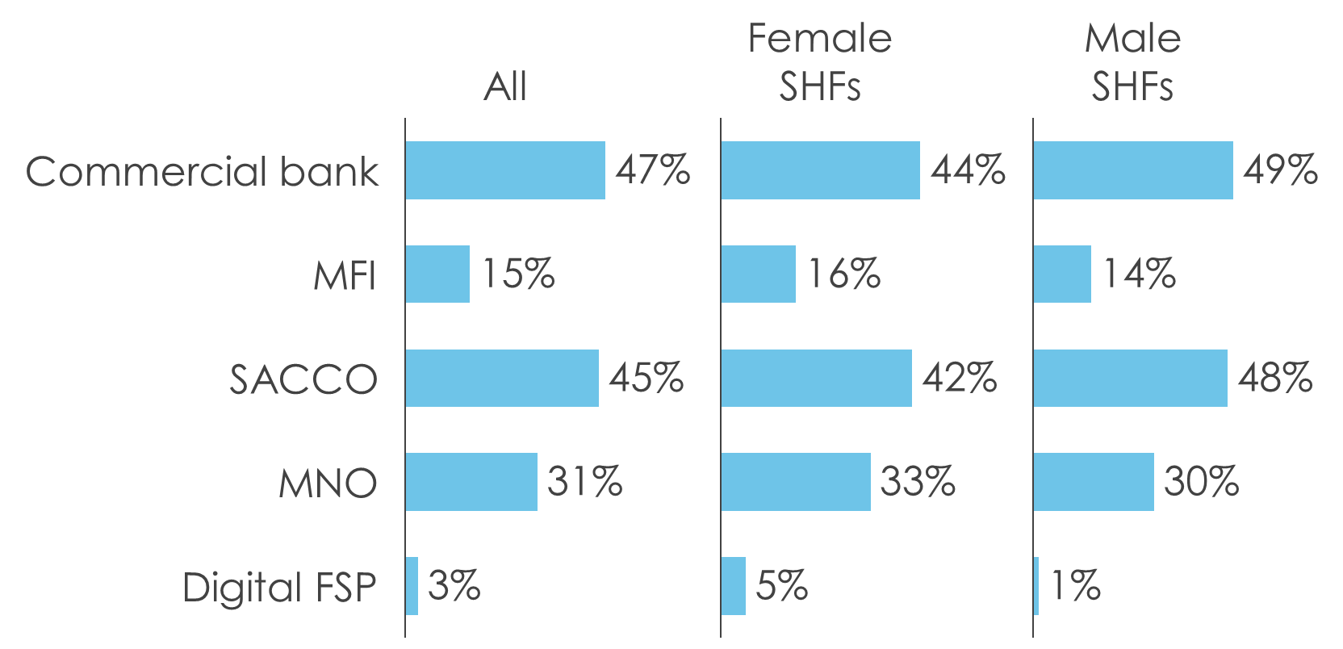
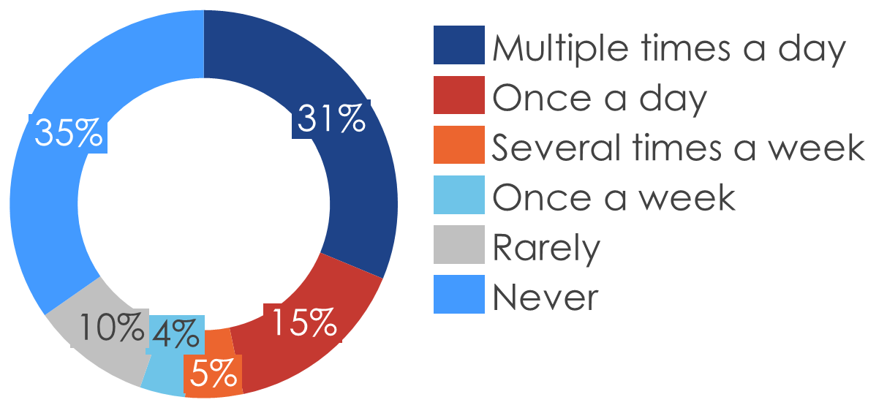
Demand-side
SHFs are formally financially included and mainly use a commercial bank or SACCO to obtain a farming loan.
Formal account ownership
Access of financial services
Digital device in use
Frequency of internet use
Usage of financial service provider for farming loan

Slide 17
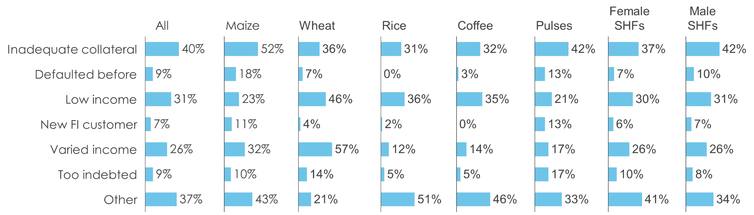
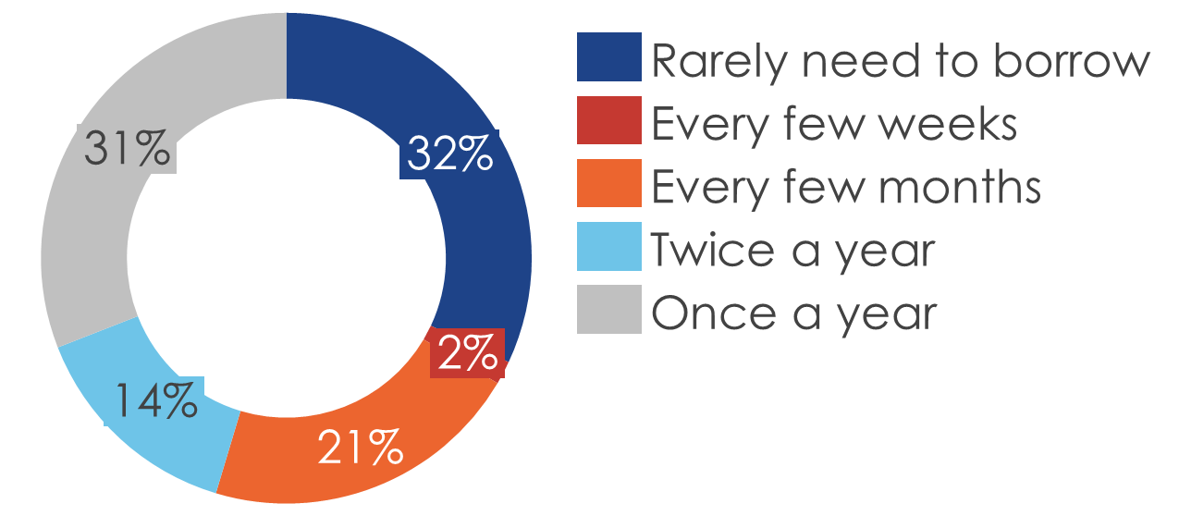
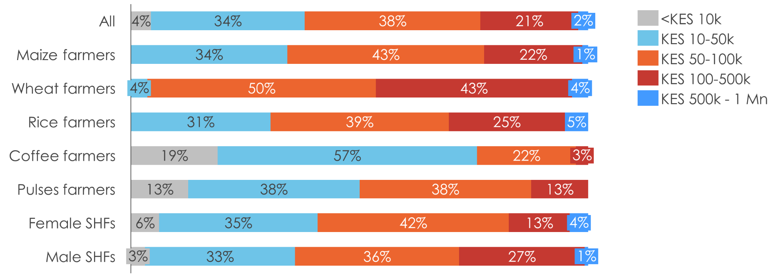
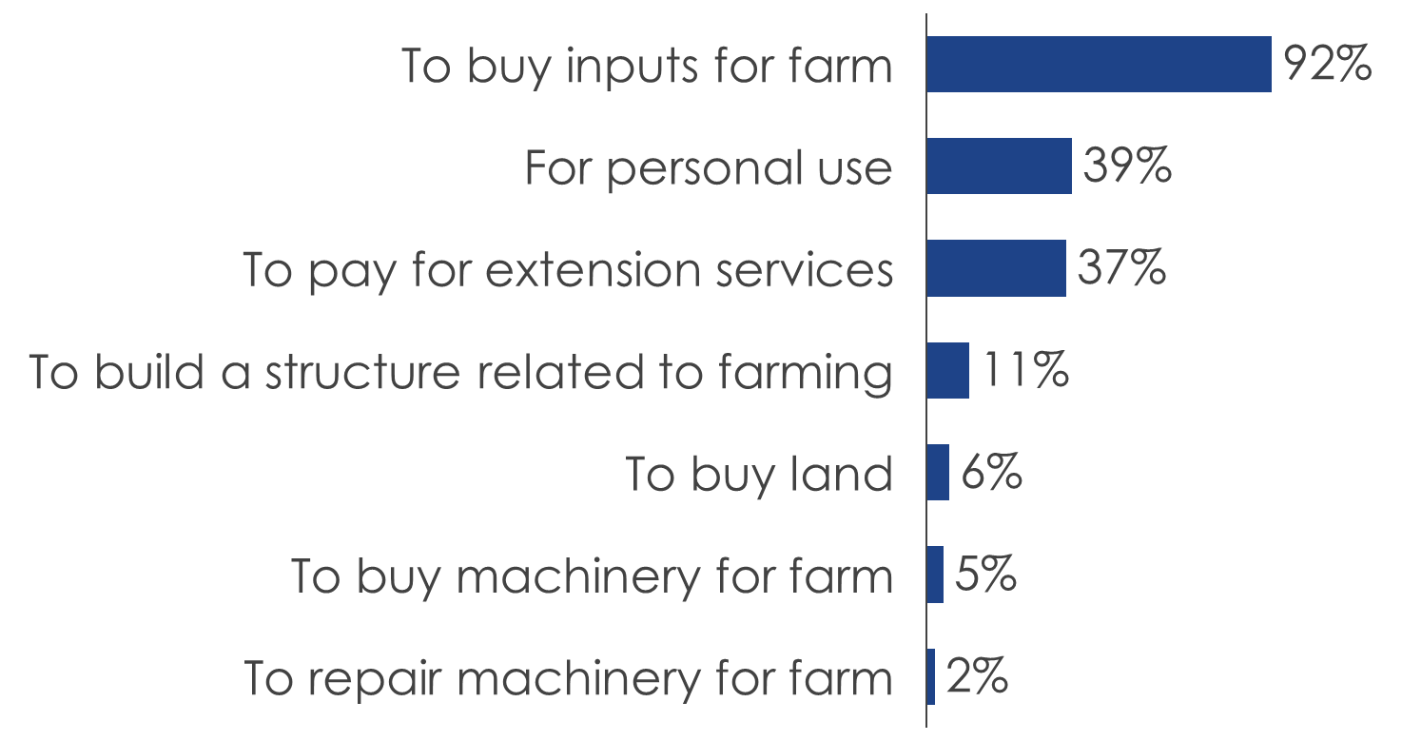
Demand-side
The primary obstacle hindering SHFs from obtaining loans when required is the lack of sufficient collateral and the annual financing requirements lie between KES 50-100k.
Frequency of borrowing
Challenges preventing access to loans when needed
Most common reason for borrowing
Annual financing requirements for farming businesses

Slide 18
Demand-side
The SHFs’ financial inclusion status have several implications.
Preference for mobile-based services: Investing in user-friendly WR financing mobile banking solutions may serve SHFs more effectively.
Gender equity in financial inclusion: There is a need for targeted financial inclusion programs that empower female SHFs to access formal financial services. Financial inclusion efforts should be sensitive to these gender differences and offer flexible financing options that cater to both segments.
Repayment of input loans: There is pressure on smallholder farmers to quickly repay input loans, usually at prices that are lower than if they were able to wait for a higher price. Addressing this issue through collaborating with existing lenders including cooperative societies, is a major objective of this project.
Diverse borrowing needs: It is important to consider the diversity in borrowing purposes and tailor the WR financing product to accommodate both types of needs. This can enhance the product’s appeal and utility to a wider range of SHFs.
Loan size and frequency: The fact that 38% of SHFs require loans in the range of KES 50,000 to KES 100,000 annually and 34% seek smaller loans suggests that the WR financing product should offer options in these ranges. Flexible repayments options should be available to match their cash flow from farming activities.
AFC marketing: The low utilization of loans from the AFC, despite awareness, points to a need for improved marketing and outreach efforts.

Slide 19



Supply-side
As FinTech and mobile payments have expanded in Kenya, SHFs are benefiting from increased choices from where to obtain short-term pre-harvest financing, however, post-harvest financing is limited.
Pre-harvest financing solutions:
DigiFarm: Provides a “one-stop” platform that allows SHFs to obtain financial services and other relevant information.
AFEX: Provides a number of financial solutions including short-term (9 month) input financing program for SHFs currently at 98% loan repayment.
Co-operative Bank: Provides short-term pre-harvest financing to members of cooperatives with the cooperative as the borrower and cooperative members (consisting mostly of SHFs) as “joint and several guarantors”.
How pre-harvest financing works:
Lenders that have extended pre-harvest credit are repaid when SHFs sell their harvest, most likely to a trader or aggregator. Lenders have liens against the SHF’s “biological assets.”
The trader and aggregator, who now have Title to the harvest, will be issued the warehouse receipts.
Thus, SHFs have no or very limited flexibility as to when they sell their harvest.
The benefit of warehouse receipt financing:
May allow lenders to transfer their security interests in “biological assets,” to harvests stored in a certified warehouse.
This could allow a lender to earn additional fees, from both pre and post-harvest credit.
This would give SHFs more flexibility in selling their harvest, hopefully at a higher price.

Slide 20
Supply-side
The AFC has already earned the trust and confidence of agricultural actors and is strategically poised to introduce the new WR financing product.
Several factors may impede the AFC’s capacity to directly extend loans to SHFs:
Loan ticket size: Historically, the AFC has primarily disbursed loans with a minimum threshold of KES 200,000. SHFs typically require smaller loan amounts, an area where the AFC lacks substantial experience.
Loan tenure: AFC’s existing portfolio offers loan tenures ranging from 12 to 36 months. Creating shorter term loan products tailored to SHFs and aligned with their crop harvest cycles represents a new challenge, as the AFC’s prior experience is limited in this domain.
Distribution network: The AFC’s branch network is relatively constrained, primarily concentrated in urban areas. For effective and direct lending to SHFs, establishing a more extensive presence in rural regions would be indispensable.
To overcome these obstacles, the AFC should consider a wholesale lending approach to cooperatives which have a deeper understanding of SHF dynamics.
Additionally, the operations of licensed warehouses need to be seamlessly integrated with those of the WRSC. This integration is crucial for maintaining a comprehensive central registry of warehouse receipts.

Slide 21
Supply-side
Collaboration between depositors, warehouse operators, financiers and buyers are essential for ensuring not only the efficient storage and management of goods but also the financial stability of all involved stakeholders.
Off-takers: They provide market access, quality assurance, price stability and payment guarantee. Their involvement facilitates the financing process for depositors and significantly reduces credit risk for financiers.
Input providers: By collaborating with input providers, farmer cooperatives could have the option to utilize warehouse receipts as collateral to obtain agricultural inputs.
Collateral managers: When cooperatives operate their own warehouses, they can opt to engage collateral managers as impartial third-party agents.

Slide 22
Enabling environment factors
WR financing in Kenya will exist within certain legal, regulatory and institutional frameworks which will have an impact on its success.
Legal framework | Regulatory framework | Institutional framework
Warehouse Receipt System Act (WRSA) | Warehouse Receipt System Regulations | Warehouse Receipt System Council
Movable Property Security Rights Act (MPSRA) | Movable Property Security Rights Regulations | Business Registration Services
The Co-operative Societies Act | The Co-operative Societies Rules | Commissioner for Co-operative Development
Banking Act | Central Bank of Kenya Prudential Guidelines | Central Bank of Kenya
Broadly, the different laws and regulations comprehensively cover the various elements of a WR financing transaction. However, there are some gray areas that create ambiguity on the implementation of various components of the WR financing transaction and make the operational costs of offering WR loans higher.

Slide 23
Enabling environment factors
Ambiguity and inefficiencies arise from the overlap of the MPSRA and the WRSA.
Must a creditor register a lien against deposited produce with the warehouse operator/WR central registry and the MPSR registry? If this is the case, this increases the loan processing procedures and hence the loan processing costs and turnaround times. This is because such a requirement would not only lead to the registration of charges on both registries but would also necessitate searches on both registries.
Who would have priority if two creditors register security interests in either registry, one in the MPSR registry and the other in the WR central registry? Stakeholders interviewed as part of this research stated that security interests registered in the MPSR registry have a higher priority over those registered in the WR central registry. This undermines the use of the WR central registry.
Given that both the MPSRA and the WRSA have provisions / guidelines on the enforcement of any liens on deposited produce, which guidelines should be followed by both the creditor, the warehouse operator and WRSC?
To address the ambiguity and inefficiencies arising from the overlap of the two laws, the MPSR Act should be amended to exclude produce deposited in a certified warehouse under the WRS from the scope of the MPSRA. However, this could take a long time. In the meantime, the WRSC should issue temporary guidelines that direct creditors to undertake searches and register security interests on the MPSR registry. The WR central registry portal could also be interfaced with the MPSR registry portal to enable searches and verifications of warehouse receipts undertaken on the WR central registry to show whether the associated produce is encumbered.

Slide 24
Other enabling factors include a licensing framework, adequate supervision of warehouses, a guarantee fund and importation guidelines.
No common framework has been developed to ensure clarity on the requirements for licensing or the reasons for possible suspension or revocation of a license by warehouses. As a result, licensing requirements vary from county to county and the licensing procedures have no defined timelines. This may result in very low growth in the number of certified warehouses.
The WRSC should be active in its supervisory role over warehouses. The council can have a web page on its website where it publishes details of warehouses it has inspected such as:
The last date of inspection
The status of the warehouse’s insurance covers
The status and amount of the warehouse’s performance bond
The integrity of the warehouses’ IT systems
The integrity of the warehouse’s storage facilities
To encourage FSPs to offer WR financing, the government will need to offer a risk-sharing mechanism to the lenders. This can be in the form of a credit guarantee fund.
Have very clear guidelines for the importation of agricultural produce which is stored in certified warehouses.

Slide 25

Introduction
Methodology
Feasibility Study Findings
Proposed product design/model

Slide 26
Warehouse receipts/double warehouse certificates can promote access to finance, incentivize better post-harvest management among farmers, and promote increased income for farmers resulting in a rise in productivity.¹
Warehouse receipt financing
Double warehouse certificate
The use of securely stored agricultural produce as collateral.
Primarily involves a producer/owner, a warehouse, a lending institution and a warehouse receipt registry:²
The producer/owner deposits the harvested goods with a certified warehouse.
The warehouse issues the producer/owner a warehouse receipt.
The warehouse registers the issued receipt in a central warehouse receipt registry.
This receipt forms the basis for collateralized lending to the warehouse receipt holder.
The collateral is perfected when the lender registers an interest in the warehouse receipt at the warehouse receipt registry.
Both a warehouse receipt and a pledge certificate.
The warehouse receipt is issued by a licensed warehouse in the name of the borrower and the pledge certificate is issued by the borrower in favor of the lender.
For a short-term extension of credit to a borrower, a double warehouse certificate, once assigned to a lender, can act as collateral and a secondary source of repayment for a short-term loan.
The primary source of repayment is the financial strength of the borrower, as established by credit analysis and underwriting conducted by the lender.
Sources: 1. USAID, 2000. | 2. Ibid.

Slide 27
We propose an interim and long-term WR financing product and model in order to shift from serving aggregators and medium to large scale farmers to SHFs.
Given the significant capacity gaps faced by both AFC and WRSC with respect to serving SHFs, it is not feasible to introduce a WR financing product targeted at SHFs in the time frame available. We recommend working with aggregators and medium to large scale farmers at this stage. Aggregators would serve as intermediaries between AFC and the SHFs, passing on the WR financing received from AFC to the SHFs by on-lending to them or simply by buying their produce.
In terms of value chain, the initial focus of the pilot should be the maize, wheat and pulses value chains. Based on the feasibility study, SHFs in these value chains show the greatest interest in WRS.
The options of regions in which the initial roll-out can be done is limited by the distribution of certified warehouses as well as the regions in which the focus crops are grown. We propose focusing on rollout in the North Rift (Eldoret, Soy and Kitale) and the Central Rift (Nakuru) given that they have most of the certified warehouses and that these areas have SHFs in the three value chains of initial focus.
We propose is that the WR financing product incorporates double warehouse certificates as collateral for credit extensions.

Slide 28
A short-term post-harvest financing product, secured in whole or in part by a double warehouse certificate, issued by a licensed warehouse acceptable to a lender contains four elements.
A loan agreement between a lender, usually a commercial bank, and a borrower, for purposes of this report a small and medium producer, a trader or an aggregator, collectively “the borrower.”
Loan amount or advance, equal to a percentage of the value of the commodity stored in a licensed warehouse, with interest payable, either monthly or payable upon loan maturity.
Additional security, in the form of a double warehouse certificate issued by a licensed warehouse. A form of a warehouse receipt is assumed to be consistent with the UNIDROIT Model Warehouse Receipt.
Additional collateral and/or guaranties that the lender may require from the borrower.
All credit extensions with double warehouse receipts as collateral will include the following parties:
Borrower
Lender
Licensed warehouse
The registry
And may include third-party service providers, an insurance company and an indemnity or bond.
The licensed warehouse is able to offer the following services:
Storing commodities, usually for a monthly fee
Lab facilities used for grading commodities in storage at the warehouse
May offer trucking services
Hedging services

Slide 29
We propose a term limit of up to nine months with a one-off loan repayment
Product loan term and repayment structure
Interest rates
It is recommended that the WR financing loan product have a term limit of six to nine months with a one-off loan repayment at the end of the loan-term. This one-off loan repayment would likely coincide with the sale of the deposit. AFC staff will likely need to be trained on various matters related to short-term lending including monitoring of short-term debts.
AFC can use its own pricing policy to determine the optimal interest rate regime for the product.
Channels for integration
In the interim, this product will be distributed through AFC’s branch network, utilizing the branch staff and relationship officers in the branches.
Channels for integration
Within the existing timelines, it is not possible to have some integration between AFC and WRSC. However, this may also not be necessary. The WRSC needs to ensure that AFC can access the WR central registry as a creditor to:
Make searches and verify warehouse receipts
To enforce a lien on a warehouse receipt

Slide 30
A majority of the features in the interim product will remain as they are even in the long-term. However, we propose a few changes or additions for the long-term product.
In the medium to long-term AFC should incorporate digital channels, specifically a mobile application and USSD platform, in the distribution of this product and servicing of its customers. Through these digital channels, customers should be able to:
Apply for the loan and submit all required loan application documents
Check the loan terms and other information about their loan
Make repayment of the loan
In the medium to long-term, as AFC’s capacity deficiencies with respect to this product and to serving SHFs are addressed, the corporation can start working directly with SHFs, especially through the use of digital channels. Incorporating digital channels will also potentially increase the reach of this product, beyond the initial regional focus area (i.e., North Rift and the Central Rift Valley).

Slide 31




Creating value through inclusive finance
Green Suites Palm Suite, Riverside, Riverside Drive,
P.O. Box 11353, 00100,
Nairobi, Kenya.
www.fsdkenya.org FSD Kenya @FSDKe

