Slide 1
MSE TRACKER SURVEY – SEGMENTATION
December 2022

Slide 2
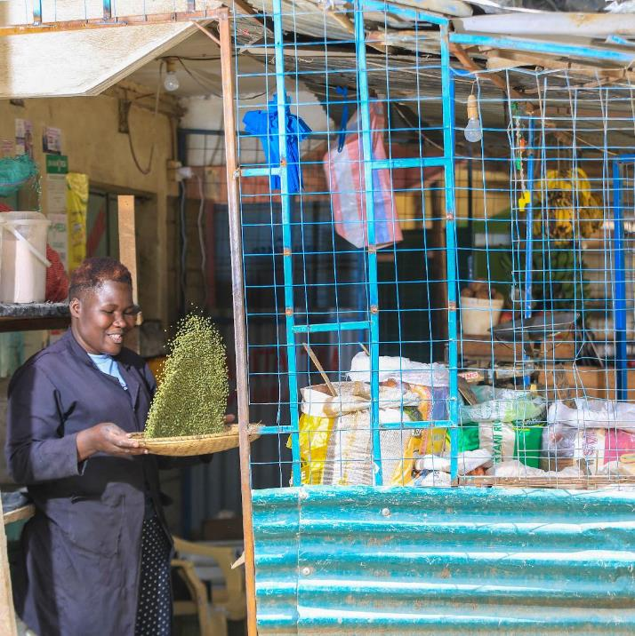


STUDY OVERVIEW
The Kenya National Bureau of Statistics (KNBS), The Central Bank of Kenya (CBK) and Financial Sector Deepening Kenya (FSD Kenya) conducted three waves of the FinAccess Micro and Small Enterprise (MSE) COVID-19 Tracker survey between November 2020 and July 2021
The objective of this pilot study was to better understand the impact of COVID-19 on micro businesses
Micro businesses (firms with 1 – 9 employees) account for 98% of all businesses in Kenya, according to the 2016 MSME Survey
Unlike the more formal MSME sector, which includes small and medium-sized businesses, micro enterprises tend not to exist in Government records, such as business license lists or the tax register
The FinAccess MSE COVID-19 Tracker survey attempts to fill some of these knowledge gaps on micro firms, specifically how they responded to and coped during the COVID-19 pandemic
To provide additional insight on the lived experience of business owners during the pandemic, six follow-up interviews were conducted with respondents who participated in the tracker survey
Analytical support was provided by 71point4 Consulting and the qualitative follow-ups were conducted by Gmaurich Insights

Slide 3
COVID-19 MSE TRACKER METHODOLOGY & SAMPLE
Sample
Sample was drawn from the 2019 FinAccess household survey
1,198 respondents who said that they were running a business in the 2019 FinAccess survey and who agreed to participate in follow up surveys were invited to participate in the MSE Tracker survey
Final sample consisted of 603 business owners who were actively running a business in February 2020 (pre-COVID)
Data collection
Implemented remotely using a Computer-Assisted Telephonic Interviewing (CATI) approach
Data collected in three waves:
Wave 1: November / December 2020
Wave 2: March 2021
Wave 3: July 2021
Wave 1 collected data for three periods: recall data for pre-COVID (February 2020), recall data for the lockdown period (April – July 2020) and data for November 2020
Wave 2 and 3 went back to the same sample of 603 business owners and attempted to reinterview them to track their business activity and performance overtime
After attrition, the sample for Wave 2 and 3 were 442 and 433 business owners respectively (around 73% of the sample of business owners that were active pre-COVID (603)). The sample of business owners that could be tracked across all three survey waves includes 347 respondents
Limitations
The findings in this report are presented based on the observations from the sample of 433 business owners who participated in the first and final survey wave (W1 & W3). The observations are not weighted and therefore not representative of all MSEs in Kenya, since no appropriate weights currently exist
As such, the findings from this survey are purely indicative. Further, due to the high survey attrition, sample sizes are small, particularly for the segmentation analysis. At all times, we have reported on the sample size together with the charts to draw the readers attention to this.

Slide 4

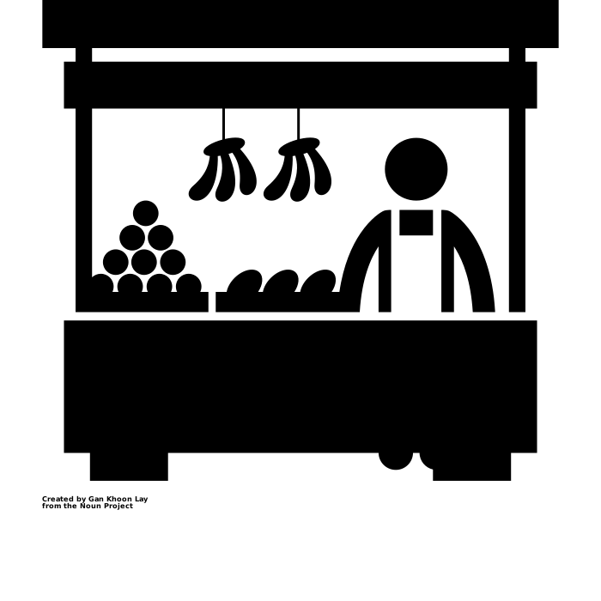




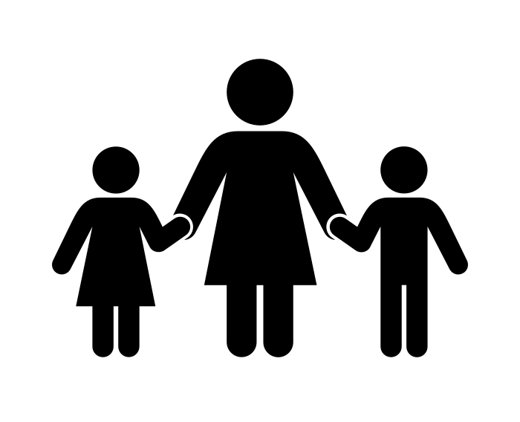

Snapshot of businesses in the survey sample
Mostly wholesale and retail traders selling agricultural produce (32%), clothing (12%), or general goods (10%).
Just over half of all business owners (across all segments) were residing in rural areas (53%) in July 2021.
A minority had any paid staff in their businesses pre-COVID (22%)
One third were operating in formal premises (commercial / industrial) pre-Covid (33%), while 30% were in less formal premises (open market / mobile). The rest were either already working from home pre-Covid (20%) or in more formalized market spaces e.g., a market stall (17%).
The median monthly revenue in February 2020 (pre-Covid) was KSh 43 000¹.
Close to half of the business owners either have no formal education or only a primary education (48%).
More female business owners than male business owners (58% to 42%), but relatively even spread across age groups.
In addition to their business income, one third of respondents were also generating income from farming activities and 20% from casual work in July 2021.
The majority are the sole income earners in their household (70%) and married or living with a partner (79%).

Slide 5
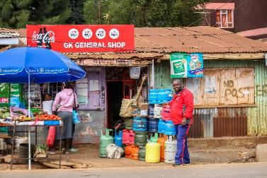
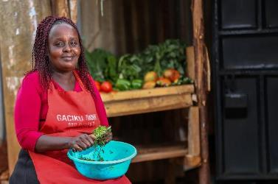
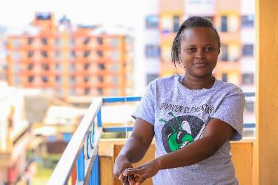
QUALITATIVE INSIGHTS
To provide additional insight on the lived experience of business owners during the pandemic, six follow-up interviews were conducted with respondents who participated in the MSE Tracker survey. Two respondents from the closed business segment were interviewed, three from the struggling segment and one from the recovered segment. The respondents selected for the interviews currently, or used to, work in or near Nairobi*.
RECOVERED (18%)
STRUGGLING (25%)
CLOSED BUSINESSES (34%)
>=75% pre-COVID revenue in July ‘21
<75% of pre-COVID revenue in July ‘21
Had a business pre-COVID but not operating any business in July ‘21
Male, 44, general retailer, Kawangware (Nairobi)
Female, 46, grocery retailer, Riruta Satellite (Nairobi)
Female, 28, previously hair salon owner, Thika (Kiambu)
The other respondents included a female (37) general retailer and a male (44) fruit trader, both from from Pipeline Embakasi
The other respondent was a female (31) who used to own a retail store (mostly fresh produce) in Kangemi
Note: *Nairobi was selected to limit the time and resources required to conduct the interviews. All interviews were conducted in-person and the appropriate COVID safety precautions were in place.

Slide 6
SEGMENTATION OVERVIEW
To understand how micro businesses coped during the pandemic and what helped or hindered their recovery, business owners who participated in the COVID-19 MSE Tracker survey were grouped according to their operational status and reported revenue between the first and third survey waves (W1 & W3)¹
KEY FINDINGS
Just over one third of business owners had stopped all business activity by July 2021
Of the remaining two thirds of business owners who were still active in July 2021:
18% were generating revenues in July 2021 that was at least 75% of their pre-Covid revenues. These businesses have been termed the ‘recovered segment’
25% had reported revenues in July 2021 that were less than 75% of their pre-Covid revenues. These businesses have been termed the ‘struggling segment’
A further 25% of respondents’ revenue status could not be classified due to inconsistent revenue reported in the first survey wave. These
RECOVERED
STRUGGLING
ACTIVE BUT UNCLASSIFIED²
CLOSED BUSINESSES
18%
n = 76
25%
n = 108
24%
n = 102
34%
n = 147
>=75% pre-COVID revenue in July ‘21
<75% of pre-COVID revenue in July ‘21
Did not provide reliable revenue data that could be compared between W1 & W3
Had a business pre-Covid but not operating any business in July ‘21
Had a business pre-Covid (Feb 2020) and in July 2021 (W3), and provided reliable revenue data that could be compared across the first and third survey waves
Note: Segment size (%) calculated using the full sample of businesses that could be tracked across W1 & W3 (433 business owners)

Slide 7
WHAT DOES ‘RECOVERY’ MEAN?
As noted, the segmentation used the change in reported business revenue between pre-COVID (February 2020) and July 2021 (when the final wave of the survey was conducted) to classify business owners as either ‘recovered’ or ‘struggling’
While a return to pre-COVID revenue levels is one measure of ‘recovery’, it is certainly not the best measure
As highlighted in the qualitative research, some businesses ‘recovered’ to pre-COVID revenue levels simply because the ticket prices of their goods increased, driven largely by increased stock prices
Changes in business profitability would have been a better measure of recovery. However, given the nature of this study (telephone survey), we would not have been able to collect profit data reliably
Given this, it is important to keep in mind when reviewing these findings that the ‘recovered’ segment are not necessarily the better performing / thriving businesses
Instead, what seems to emerge from the findings is that it was perhaps the smaller (in terms of revenue) and more informal businesses that recovered quicker / were less likely to close
RECOVERED
STRUGGLING
ACTIVE BUT UNCLASSIFIED²
CLOSED BUSINESSES
18%
n = 76
25%
n = 108
24%
n = 102
34%
n = 147
>=75% pre-COVID revenue in July ‘21
<75% of pre-COVID revenue in July ‘21
Did not provide reliable revenue data that could be compared between W1 & W3
Had a business pre-Covid but not operating any business in July ‘21
Had a business pre-Covid (Feb 2020) and in July 2021 (W3), and provided reliable revenue data that could be compared across the first and third survey waves
Note: Segment size (%) calculated using the full sample of businesses that could be tracked across W1 & W3 (433 business owners)
Notes:
Excel file: MSE Tracker segmentation data
Tab: Segment size

Slide 8
WHICH MICRO BUSINESSES WERE ABLE TO RECOVER?
The size of the business, as measured by its turnover (revenue), appears to have played an important role in determining which businesses were able to ‘bounce back’
Businesses with lower pre-COVID revenues appear to have recovered quicker than businesses with higher revenues;
39% of business owners who reported pre-Covid revenues of Ksh 30 000 or less per month had recovered by July 2021, compared to only 9% of business owners who reported revenues of Ksh 100 000 or more per month pre-Covid
This is likely because it is comparatively easier to ‘bounce back’ from a low base than it is a higher base
However, as noted previously, recovery in revenue does not necessarily imply the business owner is better off
MONTHLY REVENUE PRE-COVID (FEB 2020) BY SEGMENT¹
Sample size
68
50
64
107
I have been able to record income of Ksh3,000 by the fact that prices of basic products stocked in my shop has gone up…this is why you can see the rise in sales
- Male, general trader, Kawangware (recovered segment)
Sample n = 289 (analysis excludes the respondents with unclassified revenue and outliers)
Notes:
Excel file: MSE Tracker segmentation data
Tab: __Pre-covid revenue

Slide 9
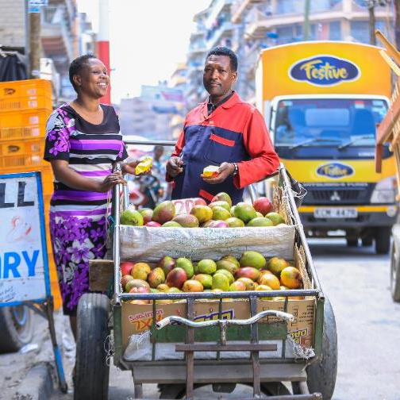
WHICH MICRO BUSINESSES WERE ABLE TO RECOVER?
Slight differences in recovery were observed between different types of businesses based on aspects such as their premises and location. For example:
Businesses operating in more informal arrangements such as an open market or hawking (mobile) were the least likely to close compared to businesses operating in other premises
The high fixed costs of commercial premises is likely to have contributed to the closure of businesses operating in these environments
Whereas the informality of mobile / hawker businesses somewhat contributed to their resilience
BUSINESS PREMISES PRE-COVID (FEB 2020) BY SEGMENT
Sample size
103
101
69
58
RECOVERED
STRUGGLING
CLOSED
What are some of the things that helped you cope during this time?
I would say the use of the Handcart and Wheelbarrow to hawk I have been able to reach customers and also spread my net in making some sales.
- Male, fruit vendor, Pipeline Nairobi (struggling segment)
Sample n = 331 (analysis excludes the respondents with unclassified revenue
My business kept going further down, and it reached a point where I was not even able to pay rent for the business and I had to involve my husband for rent and electricity payment. He paid for 3-4 months before I closed down
- Female, salon owner, Thika (closed segment)
Notes:
Excel file: MSE Tracker segmentation data
Tab: _Pre covid premises

Slide 10
WHICH MICRO BUSINESSES WERE ABLE TO RECOVER?
Urban businesses were slightly more likely to remain active compared to their rural counterparts
40% of urban business owners in the sample had closed operations by July 2021 compared to 47% of business owners based in rural areas
Differences in recovery across different sectors, for example trade versus manufacturing businesses, could not be explored in detail due to the small sample sizes
However, within the trade sector, the dominate sector in this sample¹, food trade businesses were less likely to close compared to clothing and general retail trade businesses. This is not surprising given the necessity of food purchases
LOCATION OF BUSINESS OWNER BY SEGMENT*
Sample size
152
175
MAIN BUSINESS ACTIVITY PRE-COVID (FEB 2020) BY SEGMENT
Sample size
115
34
32
Sample n = 331 (analysis excludes the respondents with unclassified revenue
Notes:
Excel file: MSE Tracker segmentation data
Tab: _Demographics / _Pre covid activity

Slide 11
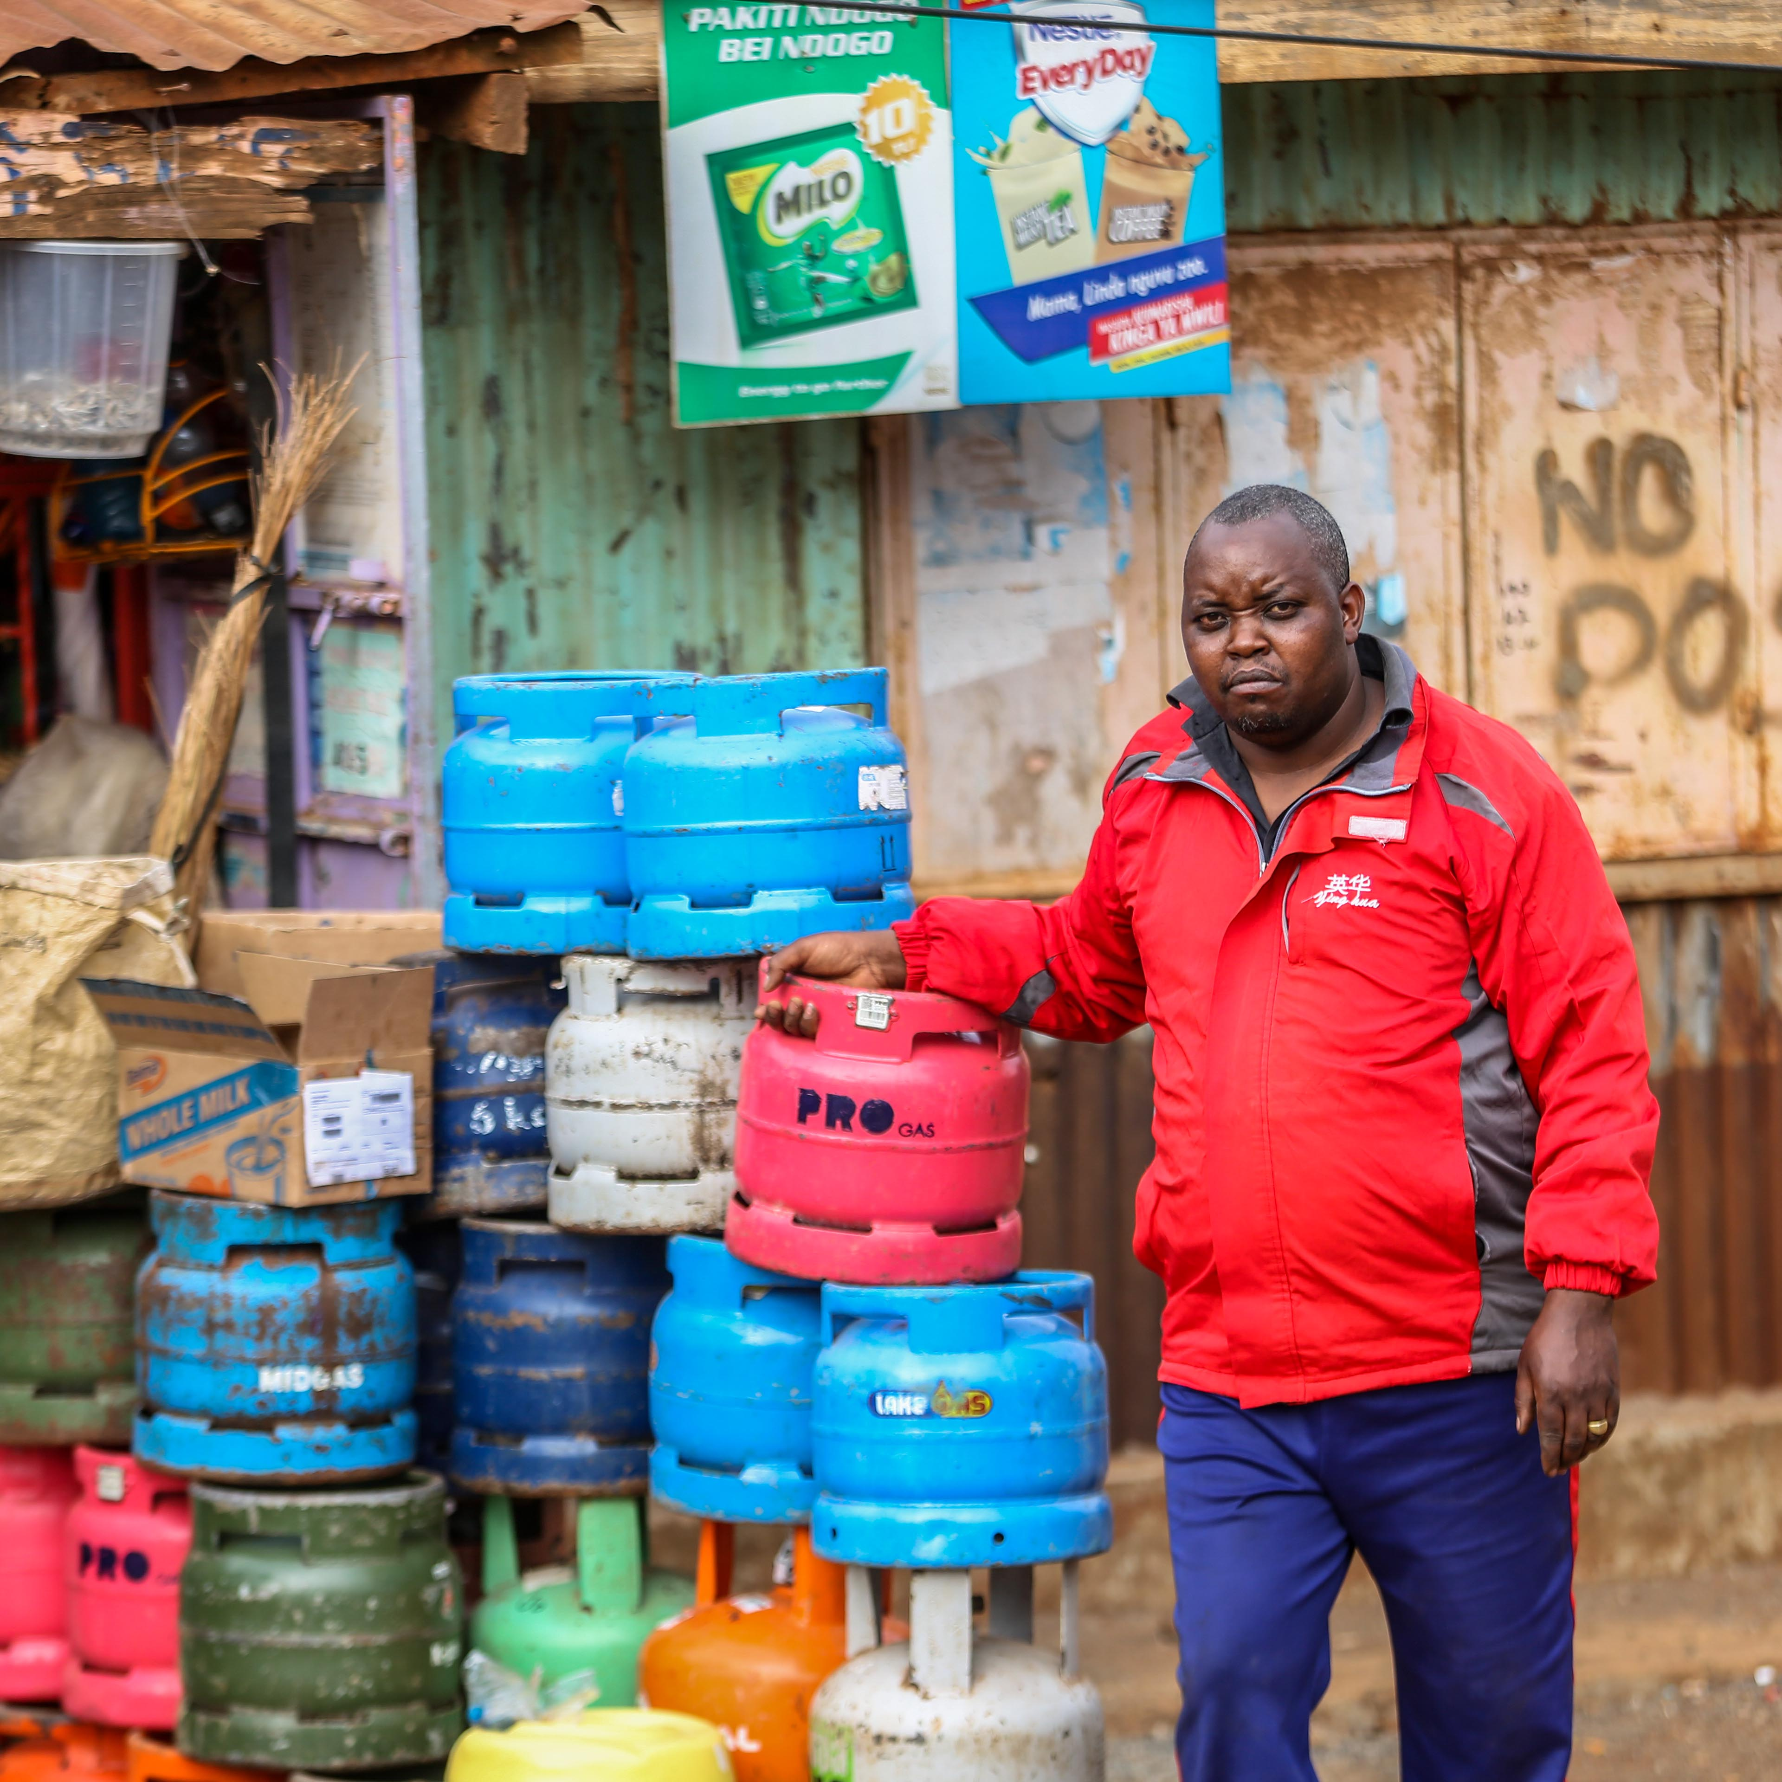
WHICH MICRO BUSINESSES WERE ABLE TO RECOVER?
Differences in the recovery of businesses was also observed based on the gender of the business owner:
Male business owners were slightly more likely to have recovered by July 2021, compared to female business owners
Spousal support in the business and/or household may explain some of the difference in recovery between male and female business owners; 89% of men in the sample were married / living with a partner compared to 69% of female business owners
Interviews with business owners highlighted the critical support spouses play in enabling them to conduct other activities related to the business, such as buying stock, or separate from it, such as looking for casual work. The ability to generate income separate from the business was particularly important during COVID due to reduced customer demand
GENDER OF BUSINESS OWNER BY SEGMENT
Sample size
139
190
RECOVERED
STRUGGLING
CLOSED
GENDER OF BUSINESS OWNER BY MARITAL STATUS
What things helped you cope during this time?
The fact that my wife is always here helping with the shop, I get opportunity to go look for some casual work.
- Male, general trader, Kawangware (Recovered segment)
Married/living with partner
Single / widowed / divorced
Sample n = 331 (analysis excludes the respondents with unclassified revenue
Notes:
Excel file: MSE Tracker segmentation data
Tab: _Demographics

Slide 12
WHICH MICRO BUSINESSES WERE ABLE TO RECOVER?
Beyond practical assistance in the household and / or business, financial support from spouses was also highlighted as a critical lifeline for business owners
However, the survey data also suggests that a lack of financial support from a spouse or other income earner in the household may have contributed towards business continuity. This is most likely because these business owners had no choice but to keep going –
Business owners who were the sole income earner in their household had lower levels of business closure (41%) compared to business owners who were not (52%)
Other demographic factors such as the age and education level of the business owner did not appear to play a role in the recovery of businesses in this sample
BUSINESS OWNER IS SOLE INCOME EARNER IN HOUSEHOLD*
Sample size
232
99
RECOVERED
STRUGGLING
CLOSED
Sample n = 331 (analysis excludes the respondents with unclassified revenue
Notes:
Excel file: MSE Tracker segmentation data
Tab: _Demographics

Slide 13
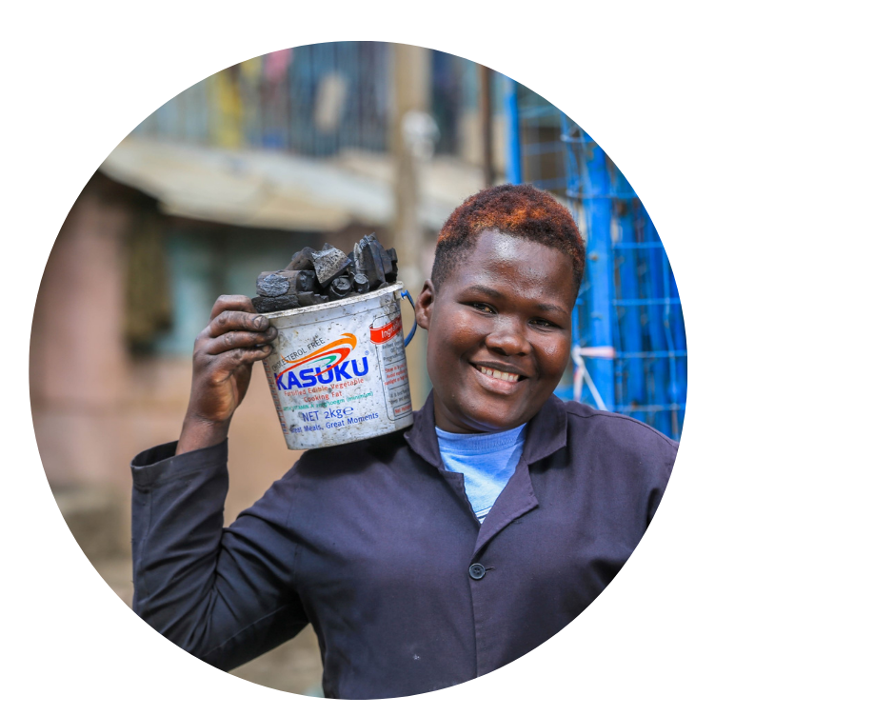
WHAT CHALLENGES DID MICRO BUSINESSES FACE DURING COVID?
Reduced customer demand was the biggest challenge business owners faced during Covid
Demand was suppressed due to customers migrating to rural areas either because of job losses in the urban centres and the need to seek cheaper accommodation, or due to the fear of contracting COVID-19
Those that remained in the cities had less money to spend at businesses, again due to job losses / income opportunities. For example, domestic work opportunities reduced due to people not wanting others in their homes
Government curfews also had a material impact on businesses operating hours
Businesses were also affected by issues with the quality of supplies, stock prices, as well as the availability and cost of transporting goods
Anecdotally, government communication regarding the risk of contracting Covid-19 from informal businesses, such as Mama Mboga’s*, also decreased demand in certain sectors – “customers disappeared and went to buy at the supermarkets”
STRUGGLING
(n = 108)
RECOVERED
(n = 76)
MAIN BUSINESS CHALLENGE¹:
July 2021
When covid was announced, so many of my customers lost their jobs and others opted to go to the rural areas to avoid contracting the virus. Also, most of my customers would come to the store in the evening, but because of the 7 pm curfew so many of them would not come. During curfew time the police would come to our area and throw teargas to force us into our homes. - Female trader, Embakasi (struggling segment)
Source: FinAccess MSE Tracker: Wave 3 and in-depth interviews
Note: [1] What is the main risk or challenge facing your business right now? *Operating costs includes paying business rent and utility costs. Top six challenges shown.
*See: https://www.tuko.co.ke/362851-mama-mboga-stop-chopping-vegetables-customers-covid-19-guidelines.html
Notes:
Excel file: MSE Tracker segmentation data
Tab: _Business challenges

Slide 14
WHAT CHALLENGES DID MICRO BUSINESSES FACE DURING COVID?
In addition to low demand, business owners also faced challenges with customers not being unable to repay money owed to them
This bad debt impacted on business cash flows, but perhaps more damaging was the negative impact it had on their customer relationships
In response some business owners stopped offering customers goods on credit
71% of businesses in the ‘struggling’ segment were offering customers credit pre-Covid. This dropped to 55% by July 2021
RECOVERED
(n = 76)
STRUGGLING
(n = 108)
Offered customers goods and services on credit pre-COVID?
YES
YES
Offered customers good and services on credit in July 2021?
YES
YES
Some of my customers also took debts that they did not pay back so this also made relationships with some of my customers really strained. Female, general retailer closed during Covid, Kangemi
Median amount of credit owed by customers¹
Feb 2020 (pre-COVID) | KSh 500 | KSh 1 500
July 2021 | KSh 1 500 | KSh 1 500
Source: FinAccess MSE Tracker: Wave 3 and in-depth interviews
[1] All businesses were asked how much outstanding credit was owed to them
Notes:
Excel file: MSE Tracker segmentation data
Tab: _Customer credit

Slide 15
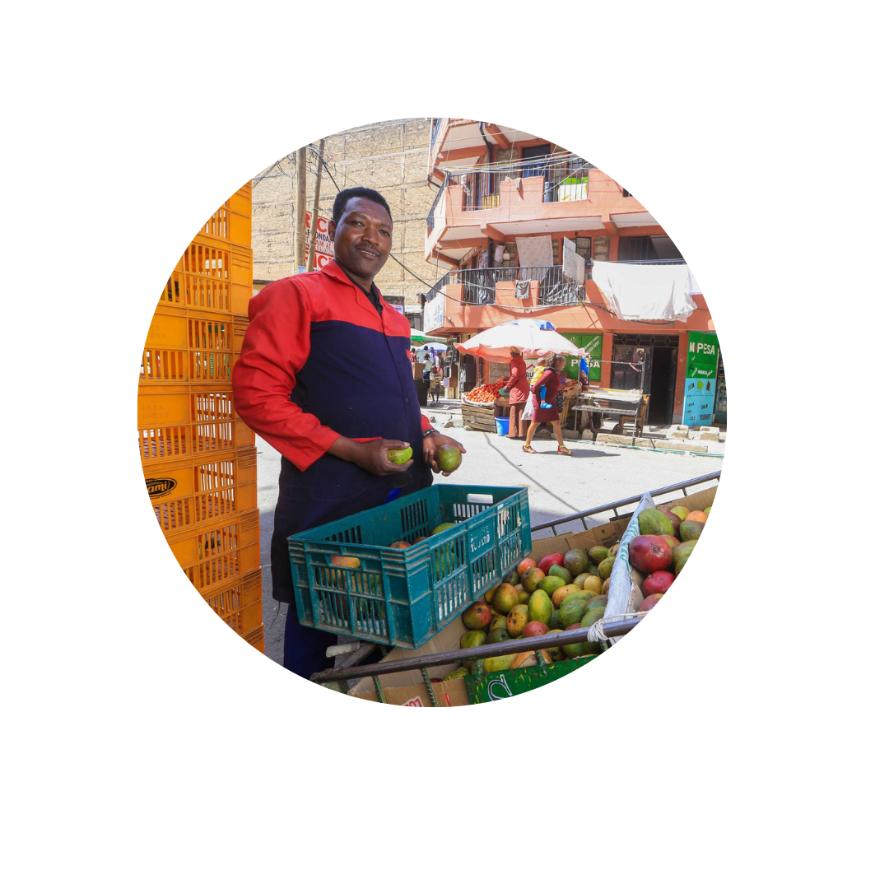
WHAT CHALLENGES DID MICRO BUSINESSES FACE DURING COVID?
Challenges with suppliers, particularly increased prices of goods and services, was another major challenge for business owners
Travel bans to get in and out of the cities and transport permit requirements resulted in fewer transport providers operating during COVID, driving the price up of transport
Some business owners also felt that the disruptions to the normal bargaining practices during COVID also drove stock prices up -
“In Meru market, the chief was chasing the crowd of people. It meant a buyer couldn't properly bargain with the seller, so it was better to order on phone but again they take advantage and hike the prices.”
Access to markets, fewer suppliers in the market and changes in supply schedules (when stock was delivered to the market) also made getting stock and supplies more difficult for business owners
RECOVERED
(n = 76)
STRUGGLING
(n = 108)
SUPPLIER CHALLENGES¹:
July 2021
From the suppliers side the challenge was getting goods to Nairobi from Meru because you remember the zoning and the lockdown, the few vehicles with travel permit hiked their cost to up to 350 shillings per bunch of bananas, we used to pay 150 to 200 shillings and also getting space in such trucks became a problem too. – Male, fruit vendor, Nairobi (struggling segment)
Source: FinAccess MSE Tracker: Wave 3 and in-depth interviews
Note: [1] Currently, what challenges, if any, are you facing accessing supplies for your business?”
Notes:
Excel file: MSE Tracker segmentation data
Tab: _Business challenges

Slide 16

WHAT CHALLENGES DID MICRO BUSINESSES FACE DURING COVID?
Reduced access to trade credit and unfavourable payment terms was another major challenge business owners faced with their suppliers
The lack of access to credit to purchase stock put a lot of strain on businesses, driving down the quantities they were able to purchase and therefore sell
This was particularly challenging for those with higher fixed costs, many of whom were already operating at the margin prior to COVID, but ultimately the additional strain from COVID-related challenges created a downward spiral leading to business closure for many
RECOVERED
(n = 76)
STRUGGLING
(n = 108)
Could access trade credit from suppliers pre-COVID?¹
YES
YES
Could access trade credit from suppliers in July 2021
Limited access to credit
YES
YES
Purchased smaller quantities of stock
Have less to sell to clients
For suppliers there was uncertainty that my shop will be able to survive…in the first week we got goods on credit and I think because of the trend and people were not able to pay, they changed their terms to cash payment which became a challenge to us in business. I ended up having rent arrears (for the house he rents, which is also where he operates his business). – Male, general retailer, Kawangware (recovered segment)
Less revenue
Less profit
Less capital to purchase stock, and the cycle repeats until…
Business closure (temporary or permanent)
Source: FinAccess MSE Tracker: Wave 3
[1] Recall data for Feb 2020 collected in the Wave 3 survey (not included in the previous survey waves). Only asked to active businesses therefore no data shown for the closed business segment
Notes:
Excel file: MSE Tracker segmentation data
Tab: _Business challenges

Slide 17
WHAT CHALLENGES DID MICRO BUSINESSES FACE DURING COVID?
In the absence of any targeted social support programmes to help businesses withstand the impacts of COVID, business owners had little choice but to dip into whatever available savings they had
This clearly was not enough though – the availability of savings pre-Covid appeared to have little impact on the recovery of businesses and most of this money was already used by November 2020
No doubt some of this money had to be diverted to help cover household expenses and other emergencies
RECOVERED
(n = 76)
STRUGGLING
(n = 108)
CLOSED
(n = 147)
HAD ANY SAVINGS PRE-COVID (FEB 2020)
Not applicable**
STATUS OF SAVINGS IN NOVEMBER 2020
Have no savings left
Used at least half
Used less than half
During covid, one of my children was sick, and I had to rush him to the hospital. I took Ksh 4,000 which was supposed to buy stock for my business in order to take care of his consultation and buy him medicine. I was never able to return the money I took from the business, and this contributed to it's downfall.
– Female, used to be a general trader in Kangemi
Business owners were also asked what they had originally set aside the savings for. The top reasons included for the business (41%), for education for myself / family (39%), for an emergency (38%)
*Business was closed by November 2020 and therefore were not asked about status of savings pre-Covid
Notes:
Excel file: MSE Tracker segmentation data
Tab: _Savings

Slide 18
DID FINANCE HELP MICRO BUSINESSES COPE DURING COVID?
Around half of the businesses that remained active had at least one open loan in July 2021
Digital credit (mobile banking loans) was the top source of credit
Chamas were also an important source of financial support. Though during the qualitative interviews, some described how COVID ‘broke up’ their groups and weakened their relationships with other members
These loans were used to support both household and business liquidity, but the recovered segment were more likely to take the loans for business purposes
RECOVERED
(n = 76)
STRUGGLING
(n = 108)
HAD ANY OPEN LOAN IN JULY 2021
(formal or informal)
Source of loan (top 3):
45% – Mobile banking loan
31% – Loan from Chama
10% – Loan from bank
Main source of loan (top 3):
39% – Mobile banking loan
27% – Loan from Chama
19% – Loan from bank
TOP 3 REASONS FOR TAKING OUT THE LOAN
To purchase stock / supplies
For general household expenses
Business expenses
To purchase stock / supplies
For general household expenses
Business expenses
I was also part of a merry go round, which had 10 members. We used to contribute Ksh 50 every day, this really helped boost my stock, but after covid was announced, half of the members moved to their rural homes, and the other half didn't have money to spare so we dismantled it.
- Female, vegetable trader, Kawangware (struggling segment)
Source: FinAccess MSE Tracker: Wave 3
Note: *Includes SMS/Phone call, own website, or online store / marketplace. SMS / phonecalls were the most commonly used channel to reach customers
Notes:
Excel file: MSE Tracker segmentation data
Tab: _Loans

Slide 19
DID DIGITISATION HELP MICRO BUSINESSES COPE DURING COVID?
Even the most rudimentary usage of technology, such as SMS and phone calls, seems to have made a difference in the recovery of businesses
Both the recovered and struggling segments had relatively high acceptance of digital payments, but the recovered segment were more likely to use technology to reach their customers
Combining these two factors, the recovered segment were twice as likely to be ‘digitally advanced’ compared to the struggling segment in July 2021
The need to support further digitization and technology usage among business owners also emerged as a key theme during the qualitative interviews
RECOVERED
(n = 76)
STRUGGLING
(n = 108)
ACCEPTS DIGITAL PAYMENTS
(July 2021)
USED AT LEAST ONE DIGITAL MARKETING CHANNEL*
(July 2021)
I don't have a smart phone but when I get one I would be able to create a page on whatsapp to market my bananas because I have never seen anybody marketing fruits online apart from Twiga Foods
- Male, fruit trader, Pipeline (struggling segment)
I would say technology really has helped because 8 out of 10 of my usual customers call me first to enquire what I have, then make an order and come get it or send their children.
- Female, vegetable trader, Kawangware (struggling segment)
DIGITALLY ADVANCED
Use digital payments and at least one digital marketing channel* to reach customers
Source: FinAccess MSE Tracker: Wave 3
Note: *Includes SMS/Phone call, own website, or online store / marketplace. SMS / phonecalls were the most commonly used channel to reach customers
Notes:
Excel file: MSE Tracker segmentation data
Tab: _Digital status

Slide 20
IMPACT OF BUSINESS CLOSURES ON MICRO BUSINESS OWNER HOUSEHOLDS
The culmination of the challenges faced by business owners resulted in an increase in food insecurity for business owners and their families between February 2020 and July 2021
This is most pronounced in the closed business segment; 20% of those who had closed their businesses by July 2021 reported that their families often went without enough food to eat in July 2021, up from only 3% in February 2020 (pre-Covid)
Beyond food insecurity, the qualitative research also revealed other household impacts such as falling behind on school fees, as well as personal psychological impacts of not being able to meet their household’s needs
RECOVERED
(n = 76)
STRUGGLING
(n = 108)
CLOSED
(n = 147)
In the past month, how frequently did your family go without food?
Feb ’20*
July ‘21
I used to be able to chip in and pay school fee for my child, I was able to help my husband. I was also able to help my mother and was also supporting my nephew by paying his school fee. I have now paused on helping my mum and stopped paying school fees for my nephew, I feel like I have failed in my responsibility. We are also now struggling to pay for my child’s school fees. For this term my husband has only managed to pay KSh 2 000 out of Ksh 6 500. I would have paid if it was before corona and the business was operating. – Mary, 28, used to own a hair salon, husband works as a taxi driver
Source: FinAccess MSE Tracker: Wave 1 & Wave 3
Note:: *Recall data for February 2020 (pre-Covid) collected in November 2020 (Wave 1 survey data collection)
Notes:
Excel file: MSE Tracker segmentation data
Tab: _Food security

Slide 21
BUSINESS OPTIMISM
Despite the extensive challenges micro business owners faced, many remained optimistic for the future, even those that were still struggling to recover from COVID in July 2021
At least half of the business owners who had stopped activity by July 2021 had intentions to re-start their businesses (54%), but access to capital is the key constraint
The need to diversify their business risk going forward also emerged during the follow-up interviews with closed business owners
HOW DO YOU FEEL ABOUT THE REST OF 2021, WILL IT BE BETTER, WORSE OR THE SAME FOR YOUR BUSINESS COMPARED TO LAST YEAR?
RECOVERED
(n = 76)
STRUGGLING
(n = 108)
BETTER
BETTER
Beside the plan of setting up another salon with cosmetic shop and having supporting cereal business, I wouldn't say I have another plan. Those are the major plans I have and Corona has made me think of creating that supporting business and not relying just on one business.
- Female, used to own a salon (closed business segment)
I have a plan to expand this business, you can see I even added shelves in the shop which have nothing on them. If I was able to get a loan or grant of just Ksh 20,000, I know I could be able to stock variety of items and even my customers wouldn't need to go anywhere else, because they would get everything they needed here. I am very optimistic about the future. – Female, vegetable trader, Kawangware (struggling segment)
Source: FinAccess MSE Tracker: Wave 3
Notes:
Excel file: MSE Tracker segmentation data
Tab: _Optimism

Slide 22
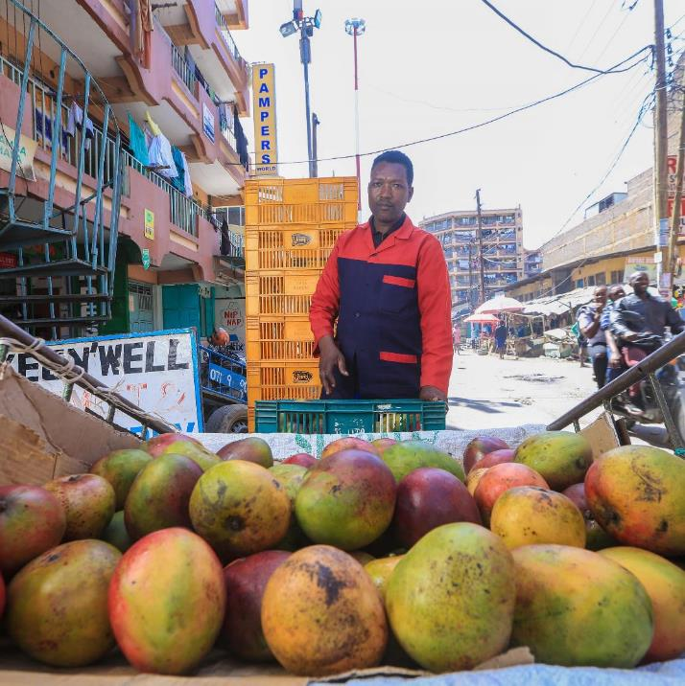
MSE BUSINESS OWNER CASE STUDIES

Slide 23
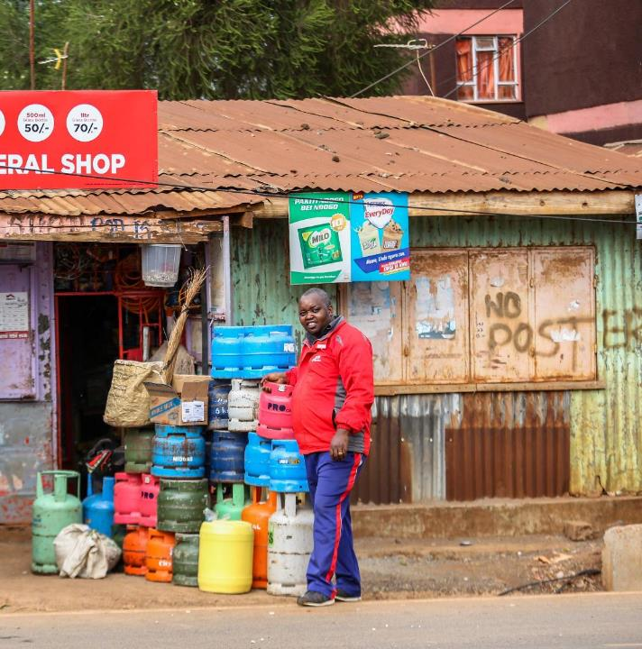

Other sources of income from casual work, spousal support in the business, and low fixed costs helped Daniel to recover from the pandemic.
CASE STUDY: RECOVERED BUSINESS
Danie
Daniel’s business revenue has returned to pre-COVID revenues, around Ksh 3 000 – 4 000 per day. During COVID, and particularly when the 7pm curfew was in place, the store would generate less than half of this revenue.
However, while daily sales are back up, Daniel’s profits are still suppressed due to the increase in stock prices –
I have been able to record income of by Ksh 3,000 by the fact that prices of basic products stocked in my shop has gone up. It has been a challenge passing the cost to my customers. Prices of goods like cooking oil, flour, rice, soaps…almost everything has gone up by bigger percentage some even double price
Daniel’s business was able to survive COVID due to the income he earned and “ploughed back into the business” from casual work. Without his wife manning the shop in his absence, this would not have been possible -
I was working as a mason or would go around with plastics which we exchange for other items for example old clothes, shoes and also electronics (mali mali). My wife is always here helping with the shop, so I get opportunity to go look for some casual work. I would use that money to continue operating the shop
Another advantage Daniel has is that his business operates from the house he rents, so his monthly business costs are lower than others that have to rent separate retail spaces.
Daniel’s Chama was another important source of financial support for him during this time -
I am grateful that I am in a chama which was helpful, as you could borrow, pay suppliers and pay when you get money. I regularly borrowed 5-10k to run the business
While Daniel had previously borrowed from Equity Bank and Faulu micro-finance institution, he didn’t borrow from either of these sources during COVID but considers them both important source of loans for the future
Daniel*, 44-year-old married male, owns a general retail store in Kawangware informal settlement, Nairobi

Slide 24
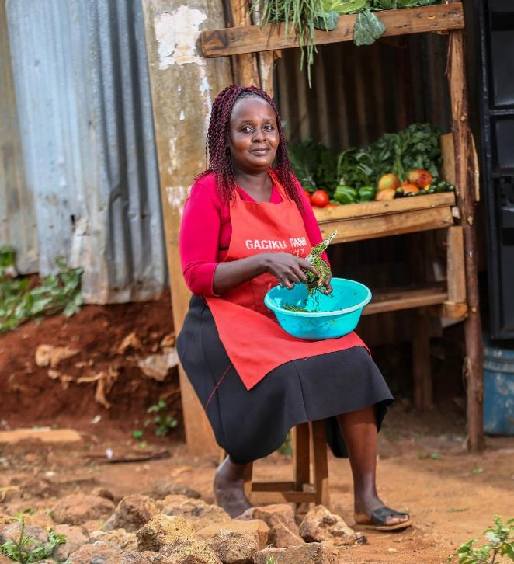
CASE STUDY: STRUGGLING BUSINESS
Valerie* is a survivalist who runs a small vegetable trade business and does laundry in people’s homes to supplement the business income. Both her business and casual work took a huge knock during COVID.
I had 3 regular [laundry] customers who called me every week but once covid hit one of them moved to Jamhuri estate, the other brought her sister from the rural home to help her with the housework. Now I only have one customer left
By July 2021 Valerie’s business income has not yet recovered, daily sales were 30% - 50% of what they were pre-COVID. As the sole income earner in the household, this put a lot of strain on her -
This business helped me pay school fees, rent for both my house and the business and also feed my children, so when it took a hit due to COVID, so did we. My children never lacked food, but I wasn't able to feed them as well as I would want to
One of Valerie’s biggest challenges during COVID was finding the capital to purchase stock.
Part of the reason they also spent less on my shop is because I didn't have enough stock. I am not able to stock up the business as I would want to because of lack of funds.
Prior to COVID Valeria used to save for stock purchases through her ‘merry-go-round’ but the group dismantled during COVID. It has since got back together but she believes the relationship has weakened – “I don’t rely on them as much as I used to”.
Despite extensive challenges, Valerie kept her business running. She largely attributes this to her sympathetic landlord. She used to operate from a table in front of his property but got “chased away” when the County Government worked on the road. When he saw this, he offered her the small store at a reduce rent -
I would say the owner of this plot really helped me cope because he gave me a permanent space that I would feel safe in. It was not easy to keep up with the rent but I have a good landlord, who lets me pay in installments. Some of these landlords who owned other business premises were not very sympathetic
Technology has also been an important enabler for Valerie’s business; most of her regular customers call her to enquire what products she has and then send their children to collect the goods. She also estimates that four out of her 10 regular customer pay via Mpesa. She hopes to sell her produce online one day.
Valerie*, 46-year-old single mother of three, owns a small fresh vegetable business in Kawangware, Nairobi

Slide 25
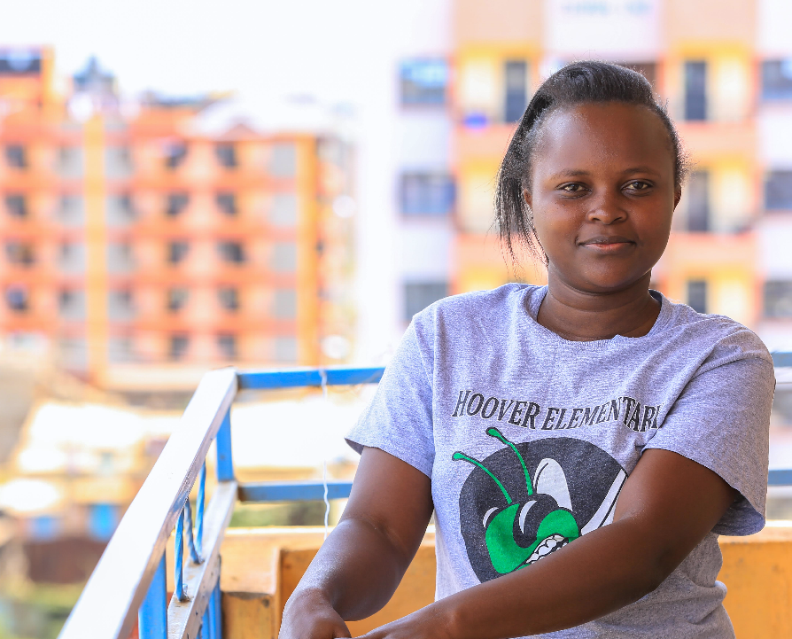
CASE STUDY: CLOSED BUSINESS
Before COVID, Monica felt that her business was doing “fairly well”. She estimates that her average monthly revenue in February 2020, pre-COVID, was KSh 36,000. This dropped by more than 80% during the first lockdown –
So many of my customers moved due to lack of money to pay rent and the few customers I had left, started spending less. They used to spend 150 shillings but when COVID struck, they would spend 80 – 100 shillings
During COVID, Monica’s suppliers also started demanding cash on delivery which negatively affected her cash flow and ability to purchase sufficient stock to sell -
I would only take stock worth the money I had sold the previous day, which was an average of Ksh 400. That wasn't enough to give me good profits. It became very difficult for me to even make rent for the business
Beyond COVID, Monica faced other financial shocks that also contributed to her business’s downfall. Her child fell ill and her parents house burnt down which cost Monica close to KSh 20,000.
Monica’s main source of support during this time was her family –
Business was so bad to a point where my husband and sister helped me out, but when I couldn't get it back on track I decided to close it
Monica has now turned to casual work, doing people’s laundry, to earn money but she is hoping to find a permanent job. She would like to find a job that pays her KSh 15,000 a month so that she can start contributing towards her household expenses again, especially the cost of her children’s education
Monica*, 31-year-old married mother of two, used to own a small food trade business in Kangemi, on the outskirts Nairobi

Slide 26
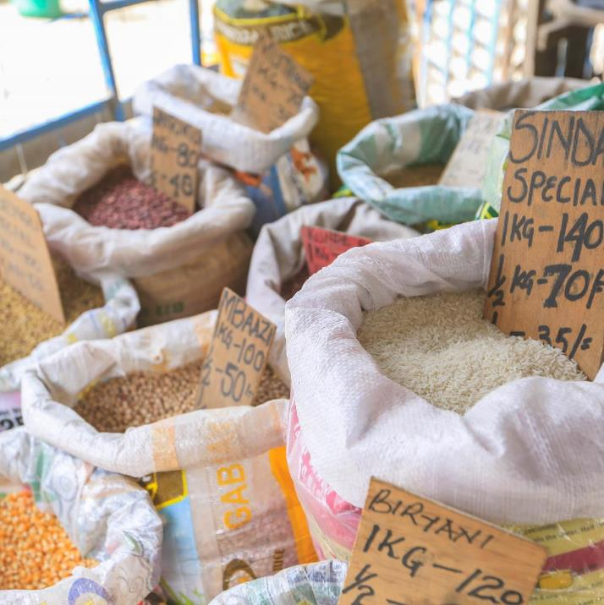
APPENDIX
- Summary data slides

Slide 27
BUSINESS SECTOR & WORK PREMISES: FEBRUARY 2020 (PRE-COVID)
SEGMENT | RECOVERED | STRUGGLING | CLOSED | TOTAL
Revenue in July ’21 vs Feb ’20¹ | 75% or more of pre-Covid revenues | Less than 75% of pre-Covid revenues | Not involved in any business activity in July 2021
Segment size² | 76 respondents (18%) | 108 respondents (25%) | 147 respondents (34%) | 433 respondents
TOP 5 BUSINESS ACTIVITY
BUSINESS PREMISES
Source: FinAccess MSE Tracker: Wave 1 & Wave 3 datasets
Note: [1] Segments based on the reported revenue amounts from the sample of business owners who participated in Wave 1 and Wave 3 and, for those that remained active, provided reliable revenue data that could be compared across the two periods. [2] Proportion show is relative to the total sample of 433 respondents who participated in Wave 1 and Wave 3. 102 respondents (24% of the sample) could not be classified into either the recovered or struggling segments due to the unreliability of their reported incomes in the first wave of the survey

Slide 28
BUSINESS OWNER DEMOGRAPHICS
SEGMENT | RECOVERED | STRUGGLING | CLOSED | TOTAL
Revenue in July ’21 vs Feb ’20¹ | 75% or more of pre-Covid revenues | Less than 75% of pre-Covid revenues | Not involved in any business activity in July 2021
Segment size² | 76 respondents (18%) | 108 respondents (25%) | 147 respondents (34%) | 433 respondents
GENDER
AGE
HIGHEST EDUCATION LEVEL
Male
Female
Source: FinAccess MSE Tracker: Wave 1 & Wave 3 datasets. Demographic data from Wave 3 survey conducted in July 2021
Note: [1] Segments based on the reported revenue amounts from the sample of business owners who participated in Wave 1 and Wave 3 and, for those that remained active, provided reliable revenue data that could be compared across the two periods. [2] Proportion show is relative to the total sample of 433 respondents who participated in Wave 1 and Wave 3. 102 respondents (24% of the sample) could not be classified into either the recovered or struggling segments due to the unreliability of their reported incomes in the first wave of the survey

Slide 29
BUSINESS OWNER DEMOGRAPHICS
SEGMENT | RECOVERED | STRUGGLING | CLOSED | TOTAL
Revenue in July ’21 vs Feb ’20¹ | 75% or more of pre-Covid revenues | Less than 75% of pre-Covid revenues | Not involved in any business activity in July 2021
Segment size² | 76 respondents (18%) | 108 respondents (25%) | 147 respondents (34%) | 433 respondents
LOCATION
SOLE INCOME EARNER
MARITAL STATUS
Urban
Rural
Yes
No
Married / living with partner
Married / living with partner
Married / living with partner
Married / living with partner
Single
Single
Single
Single
Widowed / divorced
Widowed / divorced
Widowed / divorced
Widowed / divorced
Source: FinAccess MSE Tracker: Wave 1 & Wave 3 datasets. Demographic data from Wave 3 survey conducted in July 2021
Note: [1] Segments based on the reported revenue amounts from the sample of business owners who participated in Wave 1 and Wave 3 and, for those that remained active, provided reliable revenue data that could be compared across the two periods. [2] Proportion show is relative to the total sample of 433 respondents who participated in Wave 1 and Wave 3. 102 respondents (24% of the sample) could not be classified into either the recovered or struggling segments due to the unreliability of their reported incomes in the first wave of the survey

Slide 30
BUSINESS OWNER DEMOGRAPHICS
SEGMENT | RECOVERED | STRUGGLING | CLOSED | TOTAL
Revenue in July ’21 vs Feb ’20¹ | 75% or more of pre-Covid revenues | Less than 75% of pre-Covid revenues | Not involved in any business activity in July 2021
Segment size² | 76 respondents (18%) | 108 respondents (25%) | 147 respondents (34%) | 433 respondents
OTHER PERSONAL INCOME SOURCES (July 2021)
None
Farming
Casual work
Money from family/friends/spouse
Running another business
Employed
Renting property/equipment
Source: FinAccess MSE Tracker: Wave 1 & Wave 3 datasets. Demographic data from Wave 3 survey conducted in July 2021
Note: [1] Segments based on the reported revenue amounts from the sample of business owners who participated in Wave 1 and Wave 3 and, for those that remained active, provided reliable revenue data that could be compared across the two periods. [2] Proportion show is relative to the total sample of 433 respondents who participated in Wave 1 and Wave 3. 102 respondents (24% of the sample) could not be classified into either the recovered or struggling segments due to the unreliability of their reported incomes in the first wave of the survey

Slide 31
BUSINESS REVENUE
SEGMENT | RECOVERED | STRUGGLING | CLOSED | TOTAL
Revenue in July ’21 vs Feb ’20 | 75% or more of pre-Covid revenues | Less than 75% of pre-Covid revenues | Not involved in any business activity in July 2021
Segment size* | 72 respondents (18%) | 95 respondents (25%) | 121 respondents (34%) | 288 respondents
FEB 2020 (PRE-COVID)
ESTIMATED MONTHLY REVENUE DISTRIBUTION
MEDIAN MONTHLY REVENUE | KSH 22,000 | KSH 59,000 | KSH 45,000 | KSH 43,000
JULY 2021
ESTIMATED MONTHLY REVENUE DISTRIBUTION |  |  | Not applicable
MEDIAN MONTHLY REVENUE | KSH 36 000 | KSH 18 000 |  | KSH 23 000
Note: *Segment size is lower than on previous slides due to the filtering out of those who did not report revenue figures and the exclusion of those that did not have reliable revenue figures in Wave 1

Slide 32
SAVINGS
SEGMENT | RECOVERED | STRUGGLING | CLOSED | TOTAL
Revenue July ’21 vs Feb ’20* | 75% or more of pre-Covid revenues | Less than 75% of pre-Covid revenues | Not involved in any business activity in July 2021
Segment size | 17% | 24% | 33%
HAD SAVINGS PRE-COVID¹
CURRENTLY HAVE SAVINGS
Not applicable**
FEB 2020 (PRE-COVID)
Not applicable**
JULY 2021
Note: *Segments based on the reported revenue amounts from the sample of business owners that remained active between Wave 1 & Wave 3 and who provided reliable revenue data. **Business was closed by November 2020 and therefore were not asked about status of savings pre-Covid [1] February 2020 data collected by recall in questionnaire conducted in November 2020

Slide 33
PAID STAFF EMPLOYMENT: FEBRUARY 2020 (PRE-COVID)
SEGMENT | RECOVERED | STRUGGLING | CLOSED | TOTAL
Revenue in July ’21 vs Feb ’20* | 75% or more of pre-Covid revenues | Less than 75% of pre-Covid revenues | Not involved in any business activity in July 2021
Segment size | 76 respondents (18%) | 108 respondents (25%) | 147 respondents (34%) | 433 respondents
HAD ANY PAID STAFF (PRE-COVID)
Yes
No
YES
YES
YES
YES
Source: FinAccess MSE Tracker: Wave 1

Slide 34
-END

