Slide 1
THE VALUE OF (IN)FORMALITY?
A CASE STUDY OF MSES IN THE NAIROBI CBD
October 2020
Research conducted on behalf of FSD Kenya and the SME Advisory

Slide 2
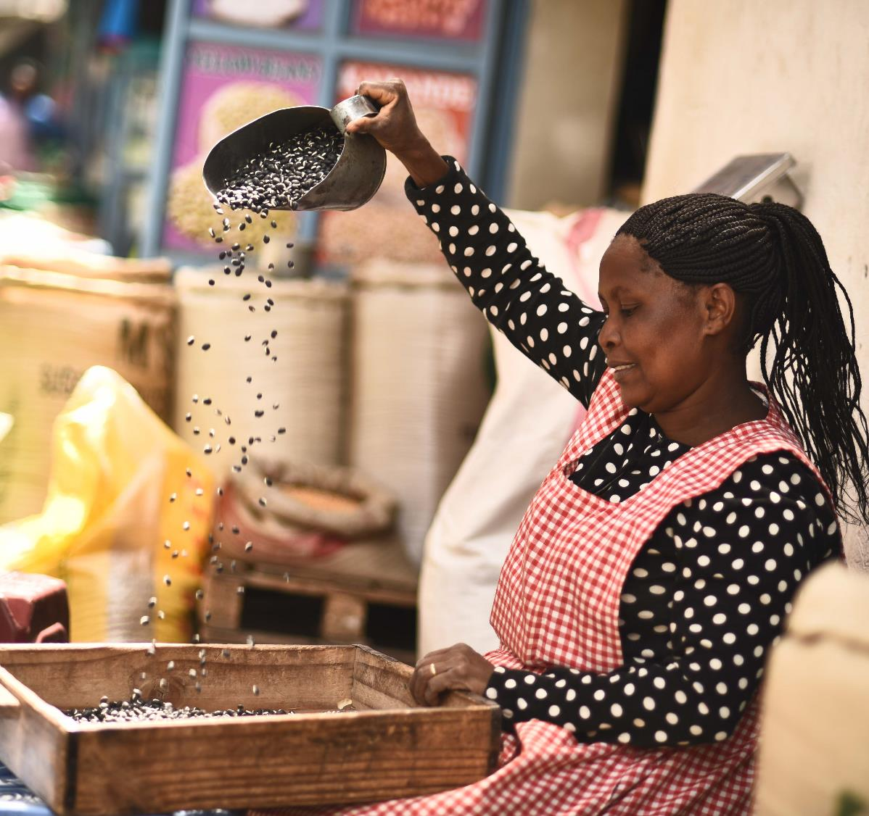

Study overview
Segmentation of MSEs
Dimensions of formality/informality
Impact of COVID-19
Stakeholders’ perspective
Recommendations

Slide 3
Research objectives
The study aims to deepen the understanding of the incentives, dynamics and organisation of MSE segments, to support the development of a more enabling environment for business resilience and growth. In addition, it aims to answer key policy questions, including:
1
What are the different incentives that underlie MSE decisions on whether to and how to formalise?
2
How do MSE segments contribute to employment, growth and household resilience, and how does this vary across gender and age?
3
What has been the effect of COVID-19 economic disruption on different MSE segments?
4
What role could the government play in creating an enabling environment for informal MSE segments?

Slide 4


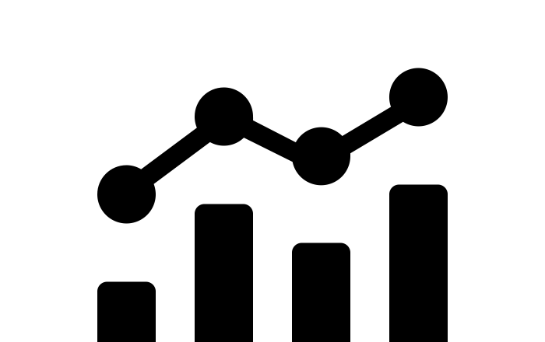
Methodology
A mixed-method approach was followed consisting of:
QUALITATIVE INTERVIEWS
KEY INFORMANT INTERVIEWS
ANALYSIS OF SURVEY & ADMINISTRATIVE DATA
34 interviews with MSE business owners across various sectors, genders and ages (see annex for respondent profile)
All business owners were located within the Starehe constituency with a specific focus on downtown CBD, Kariokor, Kamukunji , Gikomba, Muthurwa etc.
Detailed network mapping exercise with six respondents to probe relationships with suppliers, customers and financial service providers
Segment personas developed based on interviews with similar business owners
Stakeholder discussions with:
Kenya Revenue Authority (KRA)
Business Registration Services (BRS)
Micro and Small Enterprise Authority (MSEA)
Nairobi City County (NCC): Dept. of Trade Licensing, Dept. of Cooperative Societies, Dept. of Gender Affairs
Kenya National Chamber of Commerce and Industry (KNCCI)
Kenya National Federation of Jua Kali Associations (KNFJKA)
Quarry Road Association (Gikomba)
Wakulima All Traders Association
MSME 2016 survey
FinAccess 2018 survey
Nairobi City County licensed businesses database

Slide 5
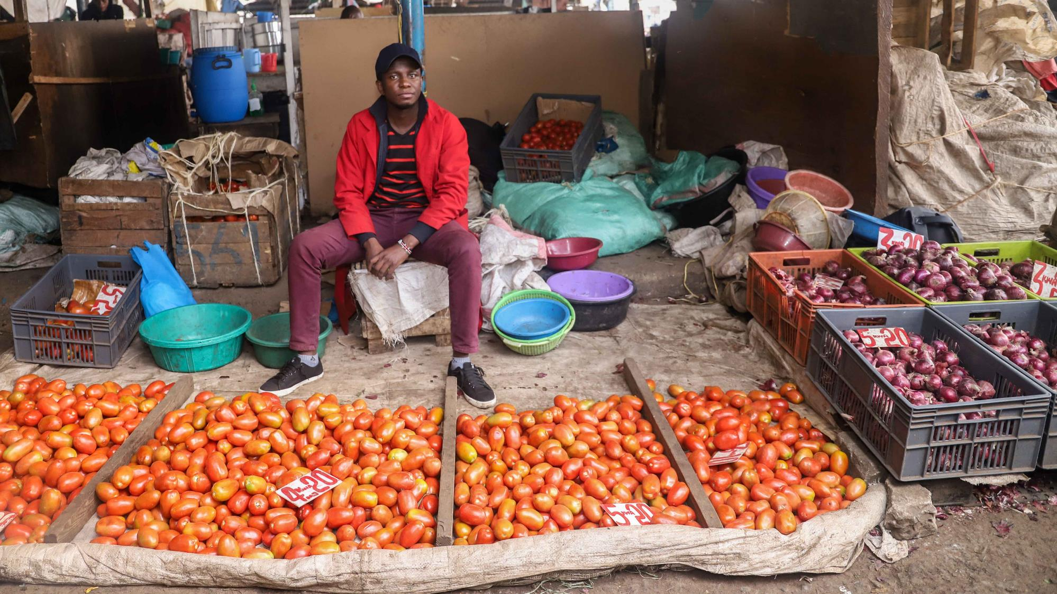
xxxxx
THE CONTEXT
MSEs account for 24% of GDP, over 90% of private sector enterprises and 93% of total labour force in the economy*
COVID-19 has revealed the structural challenges faced by MSEs, at micro, meso and macro levels
MSEs are increasingly a policy priority because of their importance for household resilience and inclusive growth (new policy bills)
Note*: State Department for Industrialization. Kenya Micro and Small Enterprise Policy, Sessional Paper No. 05 of 2020

Slide 6
What is an MSE?
MSE definitions focus on turnover and employees
Micro: < 10 employees & < Ksh 1 million; Small: 10 – 50 employees & Ksh 1 – 5 million¹
Using the number of employees to classify businesses, almost all businesses in Nairobi are micro enterprises
Businesses in Nairobi
(classification by size - workforce)
40,000 (4%)
3,800 (0.4%)
1.0 M (96%)
Source: MSME Survey 2016
[1] State Department of Industrialization, Kenya Micro and Small Enterprises Policy, 2020

Slide 7


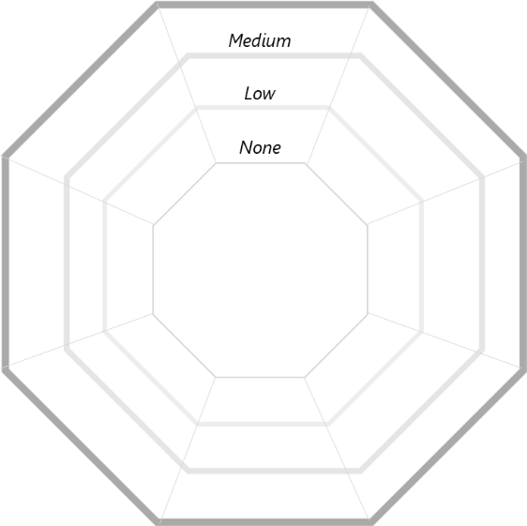






Businesses operate formally AND informally across multiple dimensions
MAPPING FORMAL AND INFORMAL BUSINESS RELATIONSHIPS (illustrative example)
Government compliance
(e.g. level of compliance with licensing, registration, certification, tax)
Business premises
(e.g. type of structure, tenure arrangement)
High
Business associations
(e.g. member of registered business association)
Labour
(e.g. size of workforce, trust and relationship based vs employment contracts, employee benefits)
Record keeping
(e.g. sales data, profit & loss statements)
Financial services
(e.g. Banks, SACCO s, Informal groups, Friends and family)
Formal
Customers
(e.g. type, trust and relationship based vs contracts, digital payments vs cash)
Suppliers
(e.g. type, trust and relationship based vs contracts)
Informal
Notes:
Formality is typically linked to the legal status of the business, is it registered or not. But, this study argues that there are multiple dimensions of formality AND informality. It is important to segment MSEs on a formality/informality spectrum to understand the nuance, and uncover some of the structural challenges that hinders their progress and development

Slide 8
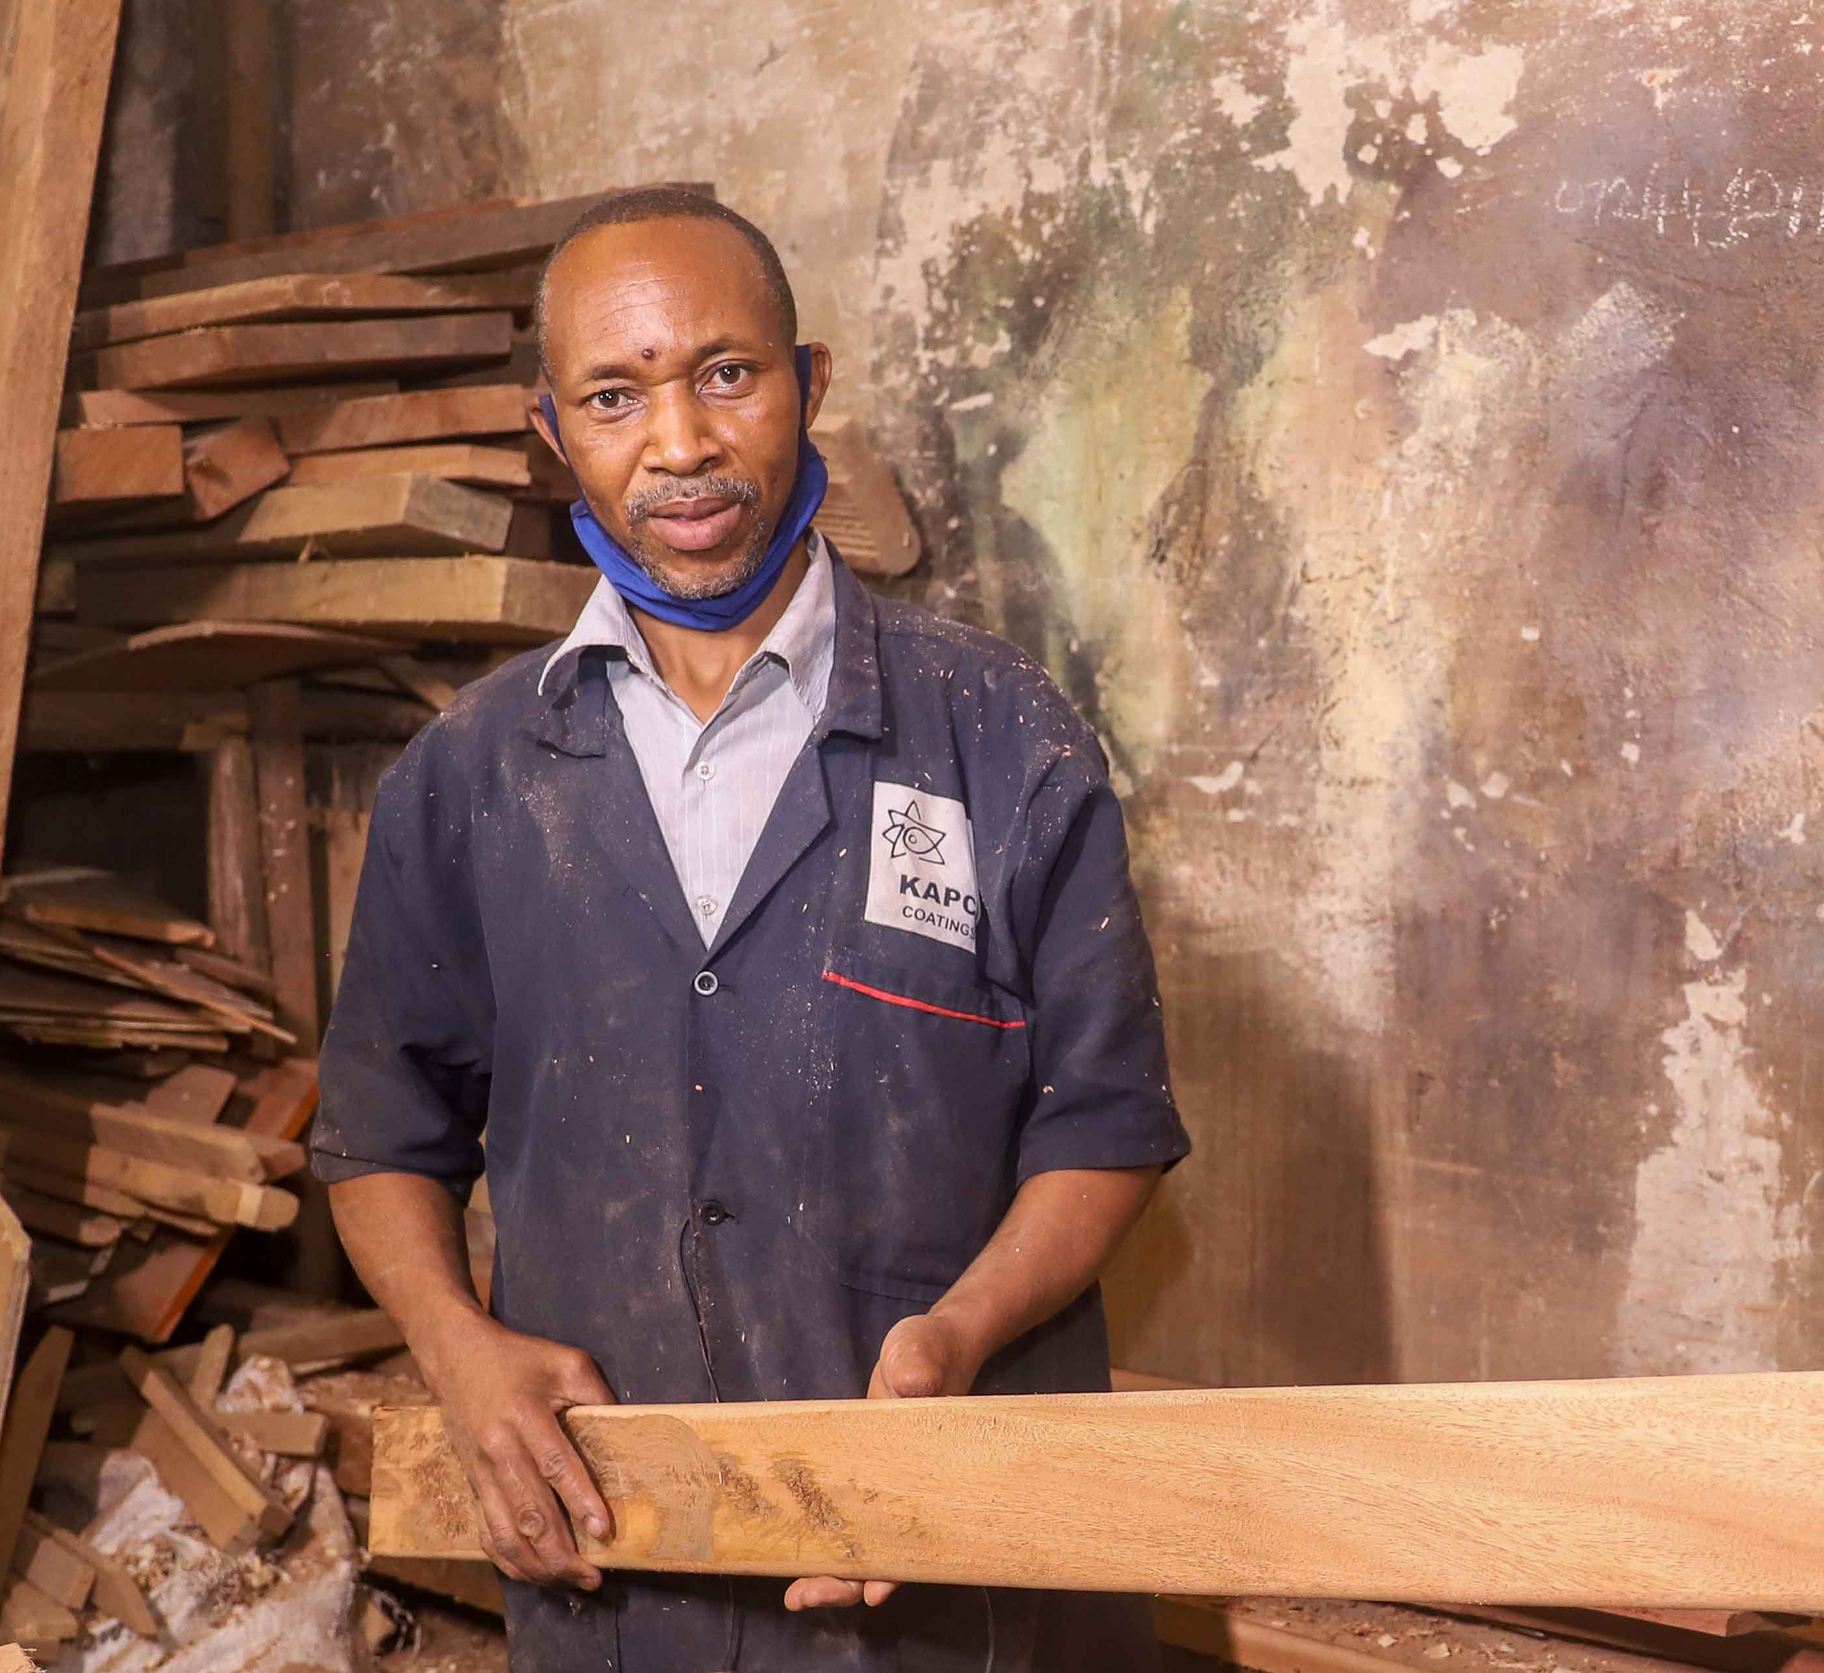
Study overview
Segmentation of MSEs
Dimensions of formality/informality
Impact of COVID-19
Stakeholders’ perspective
Recommendations

Slide 9

How are businesses operating in Nairobi?
Note: Data is from 2016; the current MSE landscape may look quite different
Using KNBS MSME 2016 survey data, an exploratory cluster analysis was run to segment businesses based on their level of formality/informality. Three distinct segments were identified
Median annual revenue* KSh 3.6M
Median annual revenue* KSh 180,000
Median annual revenue* KSh 540,000
Operate mostly informally
In-betweens
Operate mostly formally
770,000
73%
200,000
19%
80,000
8%
Mostly informal
Tend to operate out of temporary structures/open spaces
Tend to not pay County permits and are not registered with Companies Registrar
Rely mostly on informal finance
In-betweens
Tend to operate out of permanent premises
Usually have County permit but unlikely to be registered
Use both formal and informal finance
Mostly formal
Operate out of a permanent premises
Registered businesses
Use formal finance
Have employees with contracted relationships
Note: *Business revenue likely to be under-reported in survey data

Slide 10







Note: Data is from 2016 and may not reflect current state of sector (e.g. level of registration across segments)
 | MOSTLY INFORMAL 770,000 enterprises | IN-BETWEENS 200,000 enterprises | MOSTLY FORMAL 80,000 enterprises
 | No county permits/ licenses Not registered | Have county permits/ licenses Mostly unregistered | Have county permits/ licenses Registered
 | Open space/ temporary structures | Permanent premises | Permanent premises
 | Unlikely to use a bank account for business, no Till number* | Most use a bank account for their businesses, use Mobile Money in business | Use a bank account for business, have business insurance
 | Do not have employees | Some have employees Usually only one or two employees | Have full-time paid employees Usually have five or more employees
 | No records, or very basic records in the form of personal notes | Keep simple records | Keep sophisticated records such as audited accounts
 | Mostly MSME’s and individuals No contracted relationships | Mostly MSME’s and individuals No contracted relationships | More likely to uses non-MSME’s and imports and have contracted relationships
 | Mostly individuals No contracted relationships | Mostly individuals No contracted relationships | More likely to have MSME’s and larger companies as customers
Government compliance
Premises
Financial services
Labour
Record keeping
Suppliers
Customers
Source: MSME Survey 2016. Note: * Mobile Money business account

Slide 11
The aspirations of MSEs and their reason for going into business is linked to their formality and growth
MOSTLY INFORMAL
770,000 enterprises
IN-BETWEENS
200,000 enterprises
MOSTLY FORMAL
80,000 enterprises
No other alternative
Prefer self employment
Better income
Skilled in this activity
Availability of capital required
High demand/ready market
Advised by others
Other
SURVIVALISTS
GROWTH ENTREPRENEURS
Source: MSME Survey 2016

Slide 12
Segments by sector
MOSTLY INFORMAL
770,000 enterprises
IN-BETWEENS
200,000 enterprises
MOSTLY FORMAL
80,000 enterprises
Wholesale and retail trade; repair of motor vehicles
Manufacturing
Accommodation and food service activities
Other service activities
Agriculture, forestry and fishing
Financial and insurance activities
Professional, scientific and technical activities
Administrative and support service activities
Information and communication
Source: MSME Survey 2016

Slide 13
Segments by gender of business owner/s
Note: The MSME survey does not include an ‘Age of business owners’ variable
MOSTLY INFORMAL
770,000 enterprises
IN-BETWEENS
200,000 enterprises
MOSTYLY FORMAL
80,000 enterprises
Female only
Male only
At least one male and one female partner
Only female partners
Only male partners
Source: MSME Survey 2016

Slide 14
Segments by business classification: micro, small and medium businesses
MOSTLY INFORMAL
770,000 enterprises
IN-BETWEENS
200,000 enterprises
MOSTLY FORMALY
80,000 enterprises
Micro (1-9 employees)
Small (10-49 employees)
Medium (50-99 employees)
Over half of ‘mostly formal’ businesses are classified as Micro
Source: MSME Survey 2016
Note: *Revenues are likely highly understated

Slide 15
Segments by estimated annual turnover
Data is for 2016; average exchange rate in 2016 was 1 USD = 101.50 KSh
MOSTLY INFORMAL
770,000 enterprises
IN-BETWEENS
200,000 enterprises
MOSTLY FORMAL
80,000 enterprises
Less than KSh 100,000
KSh 100,000 – 299,999
KSh 300,000 – 499,999
KSh 500,000 – 1M
KSh 1M – 3M
KSh 3M – 5M
KSh 5M +
NA
In 2016, one in five Nairobi businesses (20%) operated on less than 3,000 KSh ($30) per month
Source: MSME Survey 2016
Note: * Based on ‘normal monthly revenue’ multiplied by 12 months – may be over or understated

Slide 16
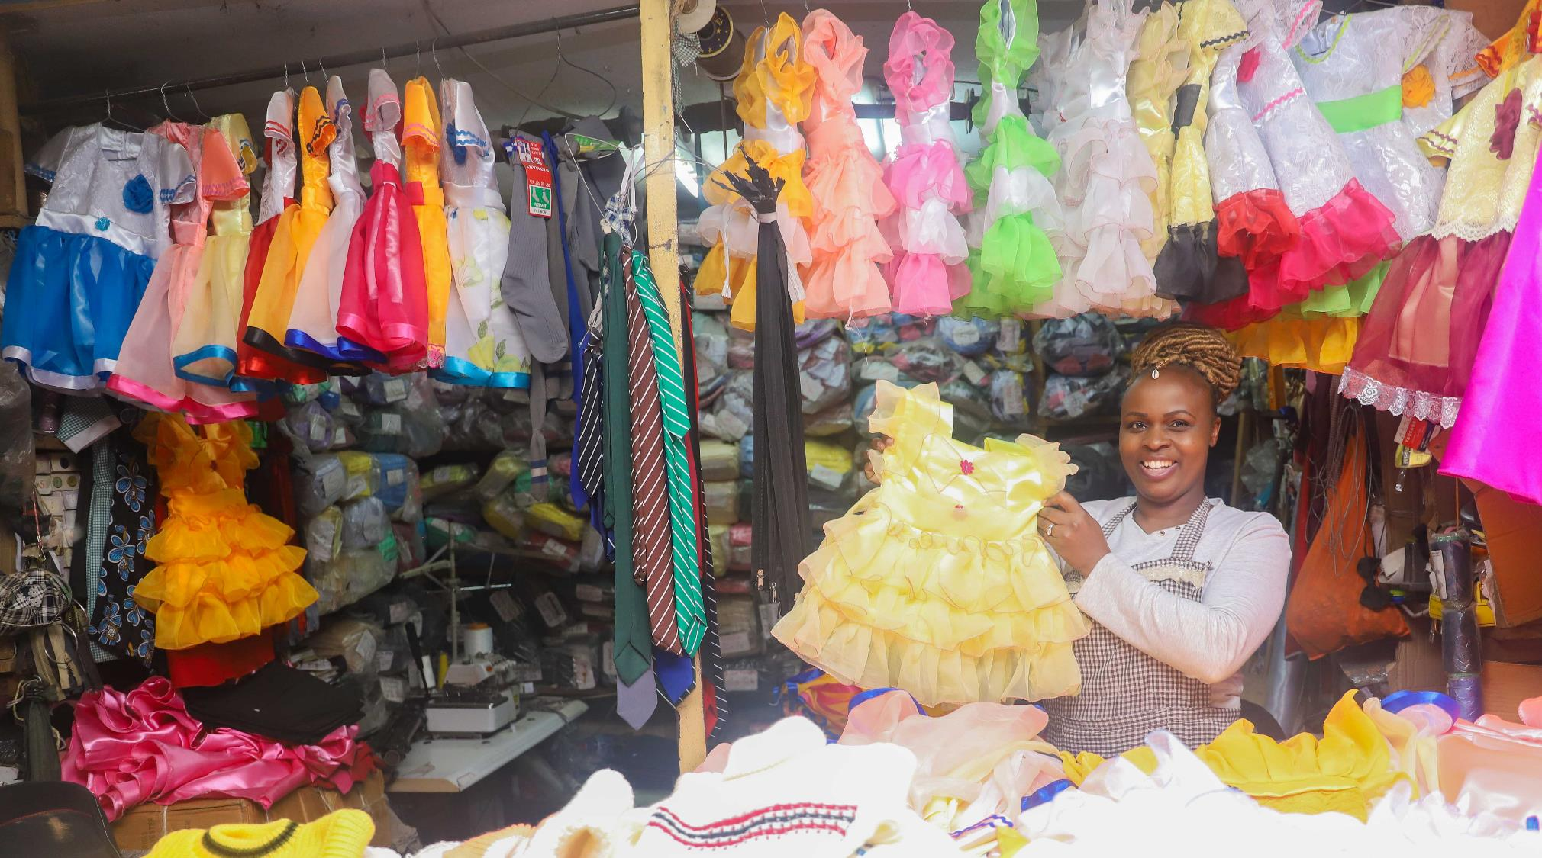
BUSINESS PERSONAS
Personas developed based on interviews conducted with similar business owners during this study

Slide 17
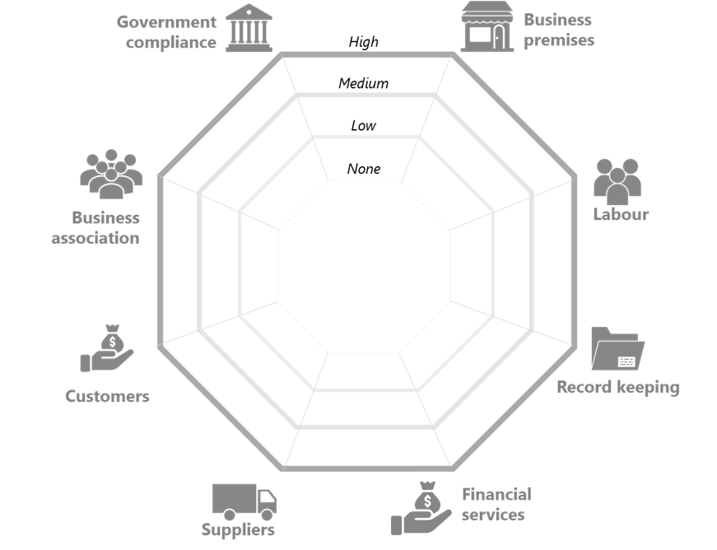
A multi-dimensional framework has been used to illustrate each persona’s degree of formalisation and informalisation across various areas of their business
Drawing on the findings from the in-depth interviews, each persona’s relationships have been summarised on the spider diagram, as follows:
The blue line indicates their formal relationships
The pink line indicates their informal relationships
In addition, certain relationships have been highlighted and classified as either a:
Valued relationships (√) which are working well for the business; or
Extractive relationships (x) which are currently not adding value to the business
X
X
√
√
√
Formal
Informal
Notes:
For example, the illustrative business shown on this slide, operates out of an temporary structure (informal) in a local market, the poor condition of the premises detracts value from the business thus it is marked as ‘extractive’. Conversely, the business is a member of a registered business association (formal) and derives value from this relationship by way of group bargaining power and protection from demolition.

Slide 18

Michael
MOSTLY INFORMAL
Business
Age
Education
2011
Completes college
Vegetable trader
27
College
2012- 2014
Employed in various contract jobs, including at a bakery and at a hotel; struggles to secure full-time permanent employment
Decides to rather try self-employment;
Starts out by helping his mom sell vegetables; learns skills of the trade
2014
Turning point when mom provides him with some space in the market and stock to start his own venture
2015

Slide 19
Michael – Vegetable trader (‘mostly informal’)
County: permit not required because operating from temporary location, but daily market fee and Cess equate to high annual costs (> KSh 60k per year)
County: Lack of receipts issued by officials raises concerns about legitimacy of payments made
Not registered with Companies Registrar
Temporary structure – no security of tenure inhibits business growth
My biggest worry is that we are in a temporary space which is prone to demolition anytime and it limits you in having long term plans
X
X
Registered, paying member of association; derives some value from the relationship, believes they look after the “well-being” of businesses in the market
X
COVID-19 IMPACT
√
The sales have gone down because the flow of customers has reduced. And most of my customers now buy goods on low quantity. My revenue has gone down with around 70 percent I am now operating at 30 percent.
We have a market chairman who is in charge of the market so whenever there are such issues we report then he solves them, though some are not solved
√
Close, supportive relationships with customers - invaluable for business
Trade credit from suppliers helps with liquidity management
√
Personal bank account but limited usage
SACCO for savings and loans
Payments primarily in cash
I have worked with my customers for a long time and they are loyal to my business. Even when we have a function we invite each other. We help each other
Formal
Informal

Slide 20








Michael does not require an annual county permit but he pays KSh 100 per day to the County as a daily market fee (Ksh 50 per space). He describes this as his ‘tax’. Often, he is not issued a receipt by officials collecting the fee which raises his suspicions of potential fraud. He also pays produce Cess, the cost differs depending on the amount he buys. Cess together with the daily market fee amount to a substantial annual cost for his business (> Ksh 60 000). Michael has not registered his business; he believes that his business is still “too small” to be registered and worries about the extra costs linked to registration, specifically tax. He currently files annual KRA returns as “nil returns”
He keeps basic handwritten records on his daily sales & profits
N/A - no employees
Record keeping
Labour
Gov compliance
Michael has numerous suppliers. He uses brokers to get onions from Tanzania; he is not loyal to one broker but rather chooses based on price and quality. He buys tomatoes from the market or directly from farmers. He has close relationships with some suppliers and gets credit from them, usually to be paid back within a day. This provides invaluable liquidity support to his business.
X
X
Suppliers
√
His customers include individuals, hawkers and other small businesses in the area, mostly retailers and restaurants. He has very good, long-standing relationships with his regular business customers, and will allow them to buy on credit. He calls many of his regular customers friends, and some will even loan him small amounts of money when he is short of cash to buy stock. His mother played a key role in introducing him to many of these customers. COVID-19 has had a large negative impact on his customer base.
He operates out of a temporary structure in a large market. His mom gave him the space when she was still working in the market, also as a vegetable trader. She originally got the space for free when she was moved from Gikomba market. Besides the daily market fee there is no rent charged on the space. Michael worries about the security of tenure in the market and fears the area may be demolished one day.
Customers
Premises
√
X
He has a personal bank account, but he does not use it for business purposes as most of his customers pay in cash, and he saves through SACCOs. In the past he has accessed a SACCO loan (KSh 400k) to grow his business and purchase some land. He has recently started accepting digital payments into his personal Mobile Money account but he does not encourage it due to the withdraw charges he incurs. He doesn’t think his business needs a Till number given the amount he currently transacts.
Michael is registered with a large association operating in the market and pays a monthly fee of Ksh 50. He describes membership as mandatory and regards the association as his “representatives”. He believes the association offers some value in terms of dispute resolution and addressing issues with the county. He also values the practical support they provided during COVID-19 (e.g. providing traders with water buckets to wash their hands in during COVID-19).
Financial services
Assoc-
iations
√

Slide 21

Beatrice
IN-BETWEEN
Started first business selling fruits and vegetables from a temporary Kibanda (stall)
Business
Age
Education
1993
Metal fabrication
53
Form 3
After her family relocates, Beatrice learns about the metal fabrication business from a friend
1996
Acquired start-up capital from her husband to rent space and hire artisans
1997
2000
Acquires some land and builds a temporary structure
2000 - 2016
Uses numerous loans from SACCO and bank to grow her business
Upset by MFI group loan structure; turns to informal sources for loans
2017
2020
Registers business & starts marketing and selling products on Facebook

Slide 22
Beatrice – Metal fabrication (‘in-between’)
COVID-19 IMPACT
Negative impact – less demand and informal savings and credit groups have stopped operations
Registered business name, valuable to business
Not required to have County permit because operating in temporary structure
Business has really gone down, even regular Somali clients are not buying as regularly as they used to with schools closed, and we do not have any walk in [customers] buying the metal boxes;
Since I registered my business name and advertised it on my Facebook page, I’ve been getting so many inquiries from companies and businesspeople
√
Has ‘full-time’ and casual employees
Has no employment contracts but only hires people she knows
Had to let go of employees due to COVID-19
X
√
Registered, paying member of an association
Associations can extract value from the sector by way of gatekeeping & corruption
My employees are from my homeland, these are people I am familiar with and in case of any problem, I can trace them back to their parents’ home
√
√
Government support does not always trickle down
√
√
√/X
Close, trust-based relationships with her customers, primarily work on verbal agreements
But, recently got first contract-based tender
No supply contracts but knows suppliers through her business association, some provide trade credit
Used to use formal sources for loans but now relies more on informal sources (husband & friends) to avoid MFI group loan structure
Also uses informal savings group (merry-go-round), but it stopped operating during COVID-19
Formal
Informal

Slide 23
Beatrice is not required to have a county permit since she operates from a temporary structure. She did however recently register her business in response to a small tender from the UN. She has quickly realised the benefits of registering and thinks other businesses like hers should also do so. She also files annual returns using her personal KRA pin with the help of her husband
Beatrice has two full time employees who help in her shops and four artisans who assist her on a casual basis during peak season. She has no employment contracts with her staff and pays them in cash on a daily or piecemeal basis. She is highly reliant on the skills of her staff and tries to maintain long-term relationships with the trustworthy ones; staff stealing goods and money is a challenge for her business.
Gov compliance
Labour
√
√
Beatrice acquired some space on an empty piece of land. Overtime she has constructed numerous temporary structures on the land including two shops to display items, two storage rooms, a workspace and two other stores that she rents out. She herself does not pay any rent for the land.
She primarily buys her materials from suppliers who are members of the same business association she is a member of. Price is the main factor she considers when selecting which supplier to buy from, but she also has a few select suppliers who will give her goods on credit. She also maintains close relationships with two Boda Boda drivers that she trusts to deliver goods to customers.
Premises
Suppliers
√
Beatrice’s husband provided her with the initial capital to start her business. Over the years she has used numerous loans from her bank to grow her business. These loans are typically taken out to buy materials when she receives large orders. However, she strongly dislikes the group loan structure offered by these institutions due to bad past experiences of other members defaulting on their loans. She is now relying more on informal sources for loans, either from her husband (who borrows from his employer) or from friends in business. She’s also decided to save more in an informal savings group, a ‘merry-go-round’, to “boost” her business when needed. However, the merry-go-round stopped during COVID-19. In terms of payments, most clients pay in cash but some pay her via her personal Mobile Money account.
Financial services
Her main customers are six Somali businessmen who sell in the north and east regions of Kenya. While she has never met them face-to-face and has no written contracts with them, they both honour the verbal agreements they make to one another. She also markets her products on Facebook, but her husband and daughter help her with this as she is still learning how to do things online
√
X/√
Customers
√
√
She is a registered member of the Jua Kali association which she joined voluntarily. She pays a monthly fee of KSh 40. She was previously chairlady of the association and sees numerous benefits to being a member including access to tenders, dispute resolution, protection from demolition and welfare support. However, she worries that government support does not always trickle down to the businesspeople
Assoc-
iations
She keeps records of sales and expenses, and her husband moves her records onto a computer. She is aware of the importance of keeping good records in order to access loans
X
Record keeping

Slide 24
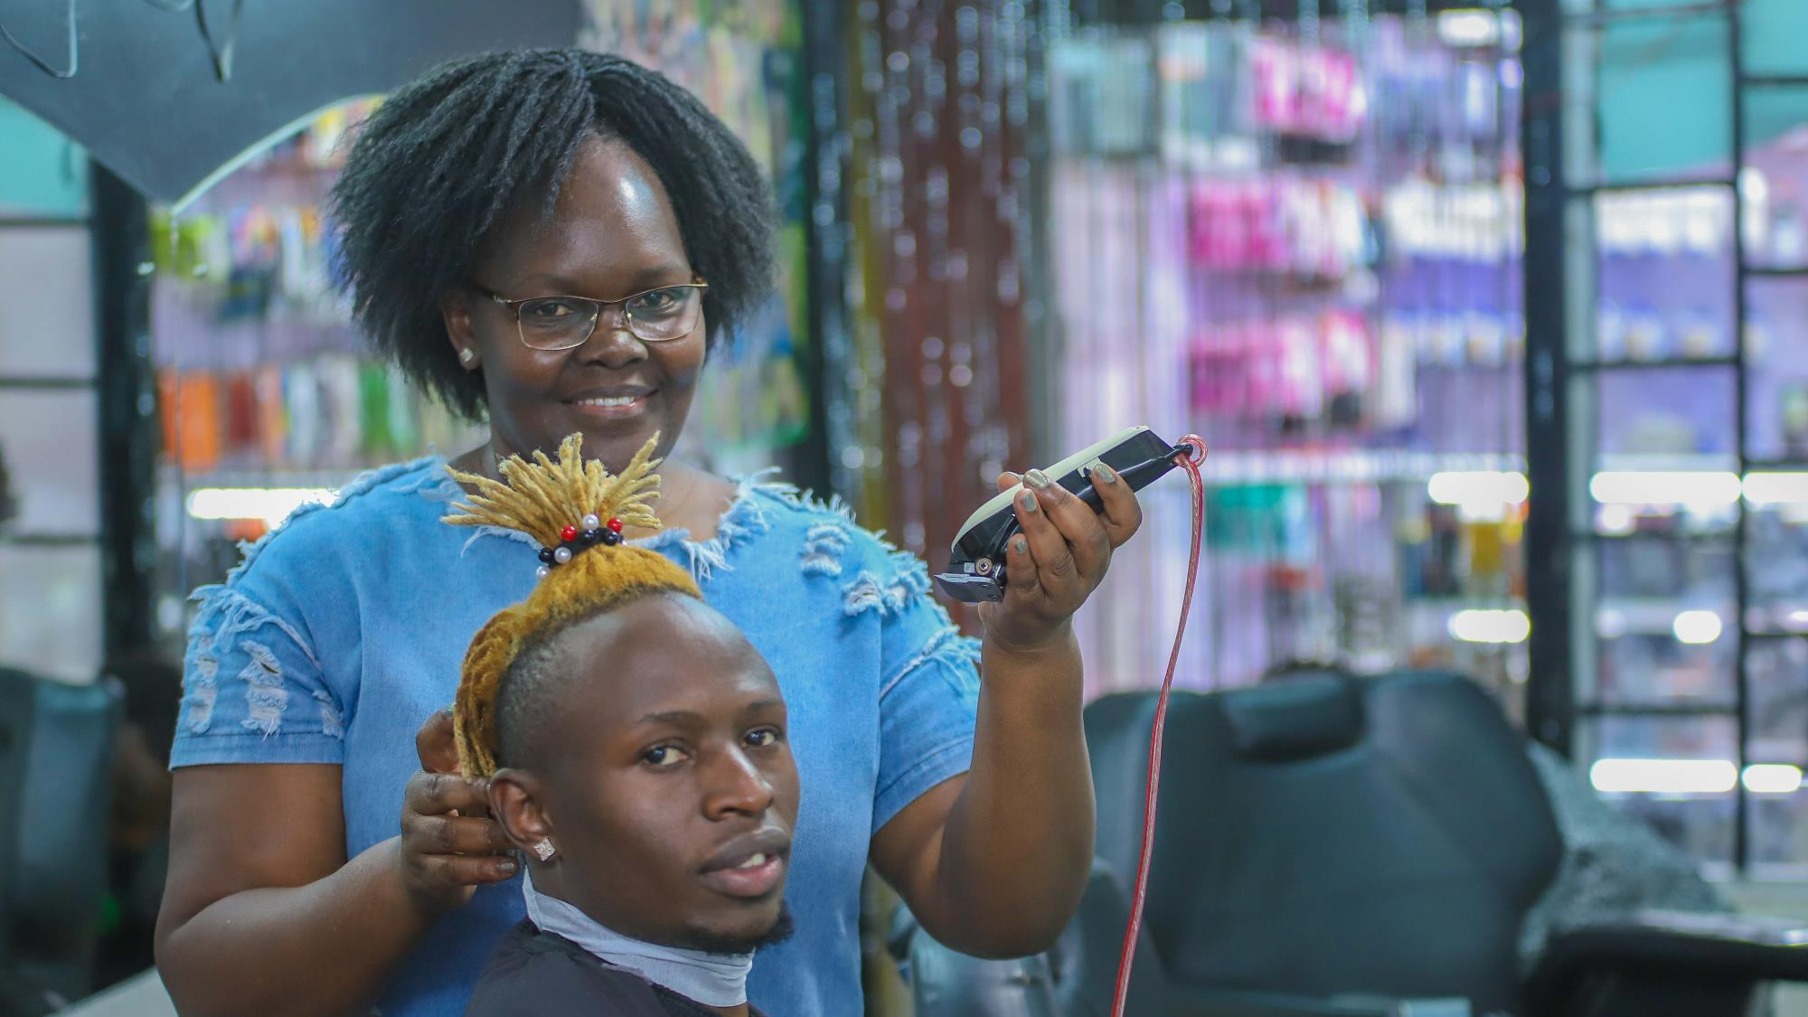
Ruth
IN-BETWEEN
Ruth is employed in hospitality and uses some savings so start selling second-hand clothes
1998
Business
Age
Education
Salon owner
53
Class 7
Decides to try something new – opens a salon outside of the CBD using a SACCO loan and leveraging savings built up from her salary
2000
2002 - 2003
Finds a space in the CBD – it is small but well positioned. Moves due to police harassment of staff and customers in the evenings, stays in next location for 1 year
2004 - 2015
Moves into current space and acquires three more spaces in same building to expand business
Closes one salon, receives KSh 200k in goodwill which has helped her cope with loss of income from COVID-19
2020

Slide 25
Ruth – Salon owner (‘in-between’)
Rents three spaces in the same building in the CBD
Has verbal agreement with landlord
Location critical to attract walk-in customers
Pays annual County permits for each of her premises - perceives cost to be too high and “unfair”
Believes other license requirements (health, fire, music) also too burdensome for small business
Has registered business name
X
Five employees, paid on a commission basis. Business reliant on their skills
Recently lost 4 hairdressers (and their customers) over a wage dispute
No employment contracts
√
Having all the permits and documents needed to operate for me is like throwing money away
X
Workers can come and go as they please
COVID-19 IMPACT
Accesses formal loans to fund business growth but also uses loans from Shylock for quick liquidity needs
Actively encourages customers to pay via Till number to create cashflow visibility and record keeping purposes
Gave up one of her premises to access a goodwill payment to help her cope
There are no customers and you know in this business all you do is sit and wait for the customers to come. I am not getting anything from [my employer] and I can’t get a loan from my SACCO. Right now I want to pay rent for this shop but there is no money
√
√
The one thing that has supported me and helped me grow in this business journey is the ability to get loans
Formal
Informal

Slide 26
Ruth pays for multiple permits and licenses – three county permits (one for each premises) as well as fire and music permits. On top of these, one of her employees was required to get a health permit because they sell soft drinks in the beauty shop. She perceives the County requirements to be “unfair” and a burden on small business owners like herself.
Ruth registered her business name the year she opened it and perceives it to be highly valuable in terms of the credibility it adds to her business. She is considering incorporating her business and has already made enquiries about the process at her local Huduma Centre
Ruth keeps good records to ensure she pays her employees the correct commission every month. She also keeps records of each item sold through her beauty shops and keeps all purchase receipts. Her employees must deposit all the cash they receive into her Mobile Money account– this also helps her keep a record of all payments received.
Record keeping
Gov compliance
X
Ruth currently has five employees – two women in the salon and three male barbers. She recently lost four hairdressers due to a dispute over their wages which was a big challenge for her business. She has no contracts with her employees, so it was easy for them to leave. Ruth pays her staff via her bank account into their Mobile Money wallets
Labour
X
Ruth currently rents three premises, all located next to each other in the same building in the CBD. She recently gave her fourth premises up due to COVID-19. She pays KSh 23,000 monthly for each premises and was required to pay ‘goodwill’ for two of the premises at a cost of KSh 250,000 and KSh 350,000 respectively. Ruth funded these investments through bank and SACCO loans
Premises
Ruth sources stock for her shops at the mall depending on price. She is not loyal to any particular supplier and does not get access to any trade credit at any of the shops she purchases from.
√
Suppliers
She has a mixture of ‘walk-in’ and regular customers. Often customers are loyal to their hairdresser/ barber so she lost a number of customers when four of her hairdressers left.
Ruth has used multiple loans from her SACCO (which is linked to her employer), and her bank. Her ability to leverage her salary to access loans is a major benefit for her business. Ruth is consciously building a relationship with the bank to ensure that she can access more credit in the future (e.g. taking loans she doesn’t need and repaying them on time) She also occasionally uses a Shylock to obtain smaller loans – “quick and easy”. She has an Mobile Money account and moves all the cash from it to her bank account to create visibility of her cash flows.
Customers
Financial services
Ruth is not a member of any business associations
√
√
Assoc-
iations

Slide 27
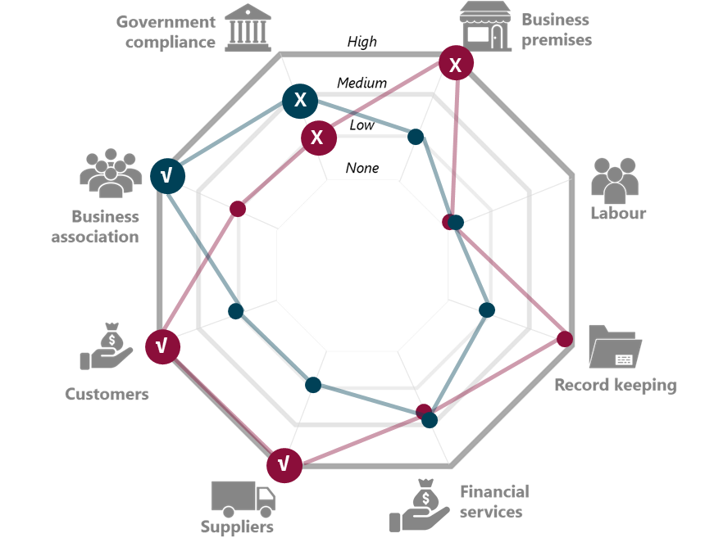
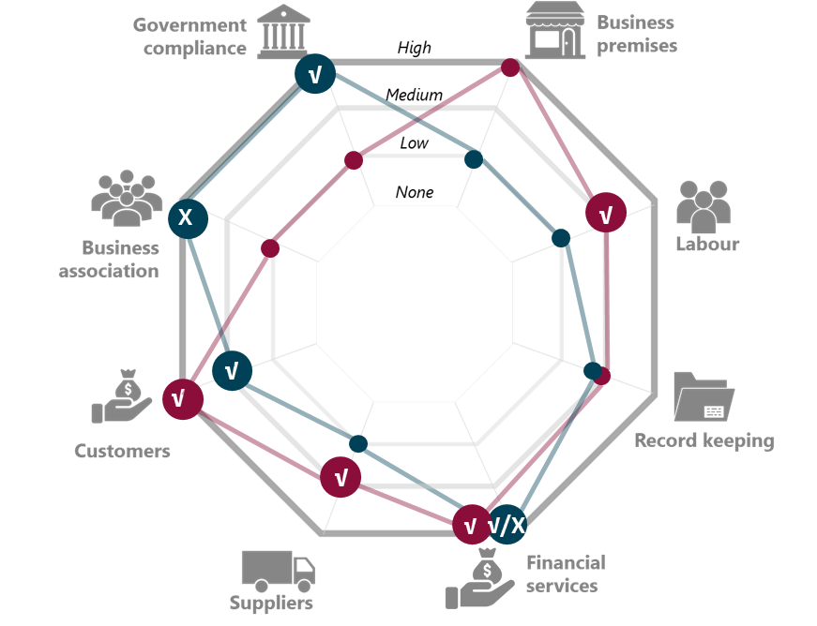
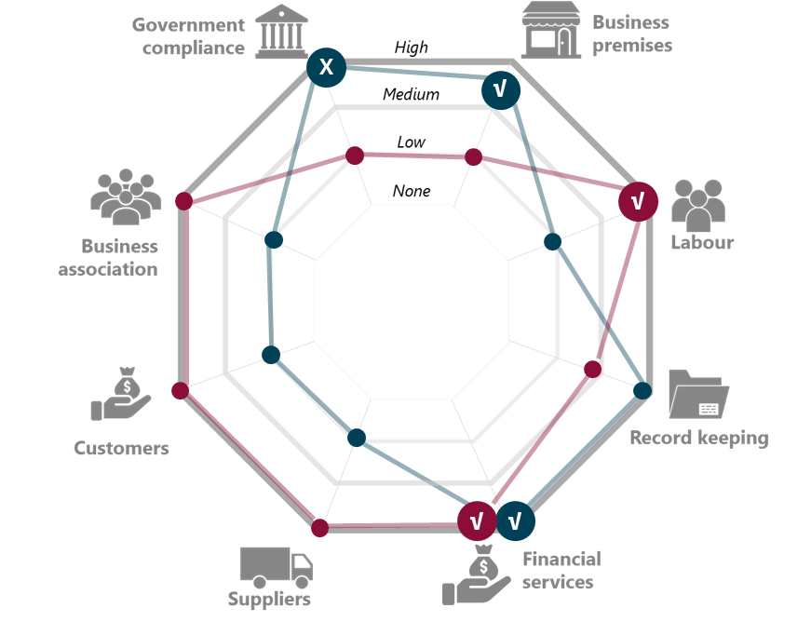
PERSONA TAKEAWAYS
The MSE sector in Nairobi is highly diverse and comprises a range of businesses and entrepreneurs with different needs, wants and ways of operating
MSEs make extensive use of both formal and informal relationships
MSEs choose to formalise or informalise based on a range of factors including the value derived from the relationship, coercion (force), or lack of choice/alternative. Other factors also shape this ‘choice’ including business owner characteristics (e.g. age, gender, mindset), the sector the business operates in, and business characteristics (e.g. size).
Michael – Vegetable trader (segment: ‘mostly informal’)
Beatrice – Metal fabrication
(segment: ‘in-between’)
Ruth – Salon owner
(segment: ‘in-between’)
Formal
Informal

Slide 28
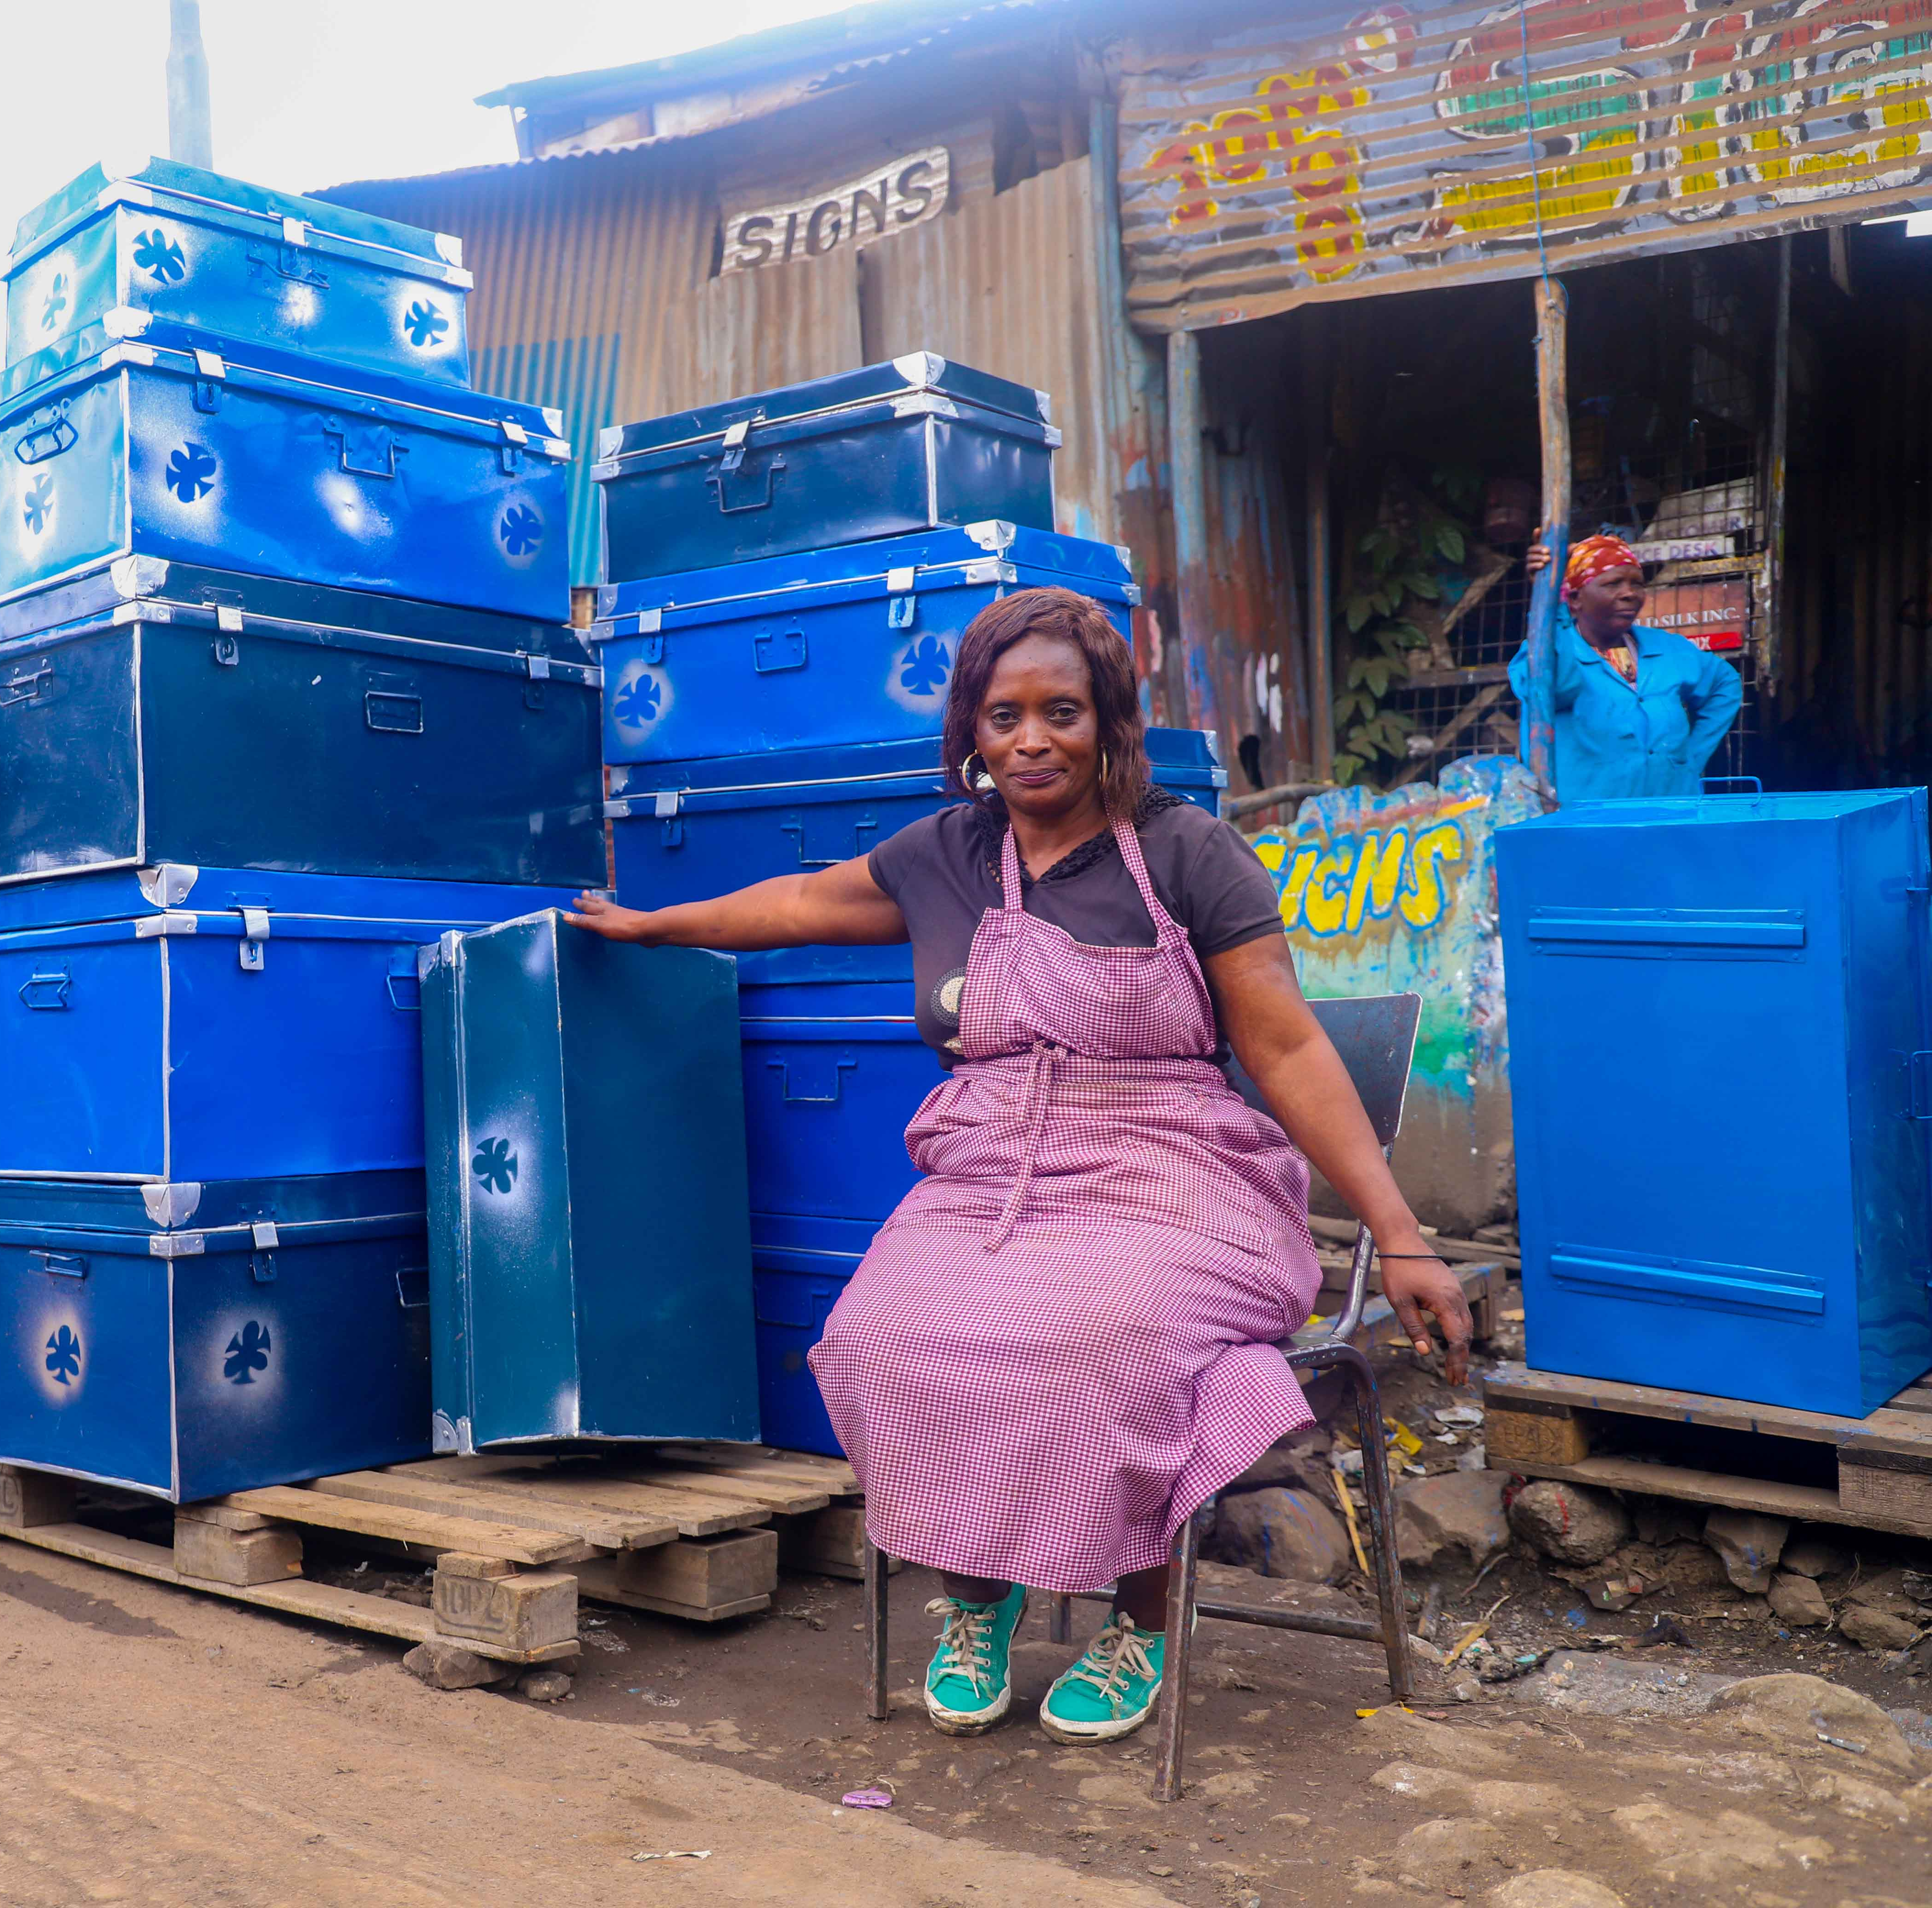
Study overview
Segmentation of MSEs
Dimensions of formality/informality
Impact of COVID-19
Stakeholders’ perspective
Recommendations

Slide 29

KEY FINDINGS
Based on analysis of available survey data & qualitative research with MSEs
Government compliance
Business premises
High
Business association
Labour
Record keeping
Financial services
Customers
Suppliers

Slide 30

Government compliance
MOSTLY INFORMAL
770,000 enterprises
IN BETWEENS
200,000 enterprises
MOSTLY FORMAL
80,000 enterprises
NAIROBI TOTAL
1 M enterprises
Enterprise has a license to operate
11%
96%
100%
34%
Type of license:
Authority from County Gov
License from State Agencies
License from National Gov
Business is registered by the registrar of companies
0%
32%
93%
13%
Source: MSME Survey 2016

Slide 31
Government compliance: county permits, fees and licenses
Requirements - Trade businesses as per Nairobi City County Trade Licensing Act 2019: annual business permit and various licenses (e.g. fire clearance certificate, food/ health related permits, etc.). Businesses operating in County markets: daily market fees and Cess levied on agri-trade businesses
Having all the permits and documents needed to operate for me is like throwing money away but I am forced to pay for my peace of mind and because then I am sure my workers are free to work and will not be harassed by anyone - Female, 53, Salon owner
High compliance because of effective collections
County is efficient at ensuring compliance, business owners comply to avoid harassment by officials
Harsh consequences for non-compliance - confiscating stock or arresting business owners
Permits and fees paid to County viewed as extractive
Perceived as costly, and concerns around fraud – business owners told to pay in cash and no receipts given, some business owners also admitted to bribing officials
Cost burden is uneven – businesses in permanent locations pay between Ksh 9,500 and Ksh 22,500 per premises per year (permit plus license), yet an agri-trad business operating in a temporary structure can pay up to KSh 65 000 per year (Ksh 13,000 annual market fees and Ksh 52,000 in Cess, which excludes additional costs they incur to access toilet facilities and for garbage collection)
Businesses typically also pay separately for garbage collection, security and even sanitation
Process to renew permits online seen as simple and fast
However, some business owners were unaware they could renew online
COVID-19 impacts
Some reported dodging officials and renewing permits in 2020 due to inability to operate out of premises during COVID-19
We used to be given receipts before Covid but since Covid started we pay but the receipts are not issued of which we are not sure whether that amount is being accounted for or it is going into someone’s pocket. Whenever we ask for the receipts the response we get is they are out of stock – Female, 40, Leather products
It [county permit] only helps me when I am taking a loan. I have not seen any other benefit. Whenever you go to apply for a loan they ask to see the business permit – Female, 34, Tailor

Slide 32


MARKET FEES AND PRODUCE CESS CAN BE A SIGNIFICANT COST BURDEN FOR AGRI-TRADERS
Case study: Banana trader in Muthurwa market
ANNUAL COST:
ASSUMPTION:
Market fee: | KSh 50 per day | KSh 13,000 | Works 5 days a week
Cess (charged on delivery of agri-produce) | 40sh per bunch of bananas or KSh 200 per sack (holds 8 bunches). | KSh 52,000 | Sells one sack per day
Other costs | KSh 10 to access toilet facility per use | KSh 5,200 | Accesses toilet facility twice a day
 | KSh 300 for garbage collection per month | KSh 3,600 | Pays for garbage collection for 12 months
TOTAL
Approx. KSh 74,000 per annum

Slide 33
Government compliance: business registration (Companies Registrar)
Low levels of registration due to unclear incentives and limited awareness
Business owners confuse being ‘registered’ with having a county permit
Perceive registration to be only for ‘big’ businesses, businesses in certain sectors (e.g. hotels), or those operating out of permanent structures
Low awareness of benefits of registration and it being not mandatory reduces incentive to register – businesses can still operate without registration (unlike with county permit requirements)
Also concerns around the cost implications of registration
Particularly visibility to the ‘tax-man’. Businesses that have been operating without a registration worry about penalties and back-taxes
Those who have registered found the process to be simple and see numerous benefits to it
Reported benefits include access to markets, building trust with customers and accessing finance
Even some businesses in the ‘mostly informal’ segment appear to be registering
While the MSME 2016 survey data shows very low levels of registration, several business owners in this study’s sample who are operating out of temporary structures have registered. This is often triggered by new business opportunities
COVID-19 impacts
Some evidence that business owners who were considering registering their business are delaying this now due to COVID-19 related loss of income
I haven’t heard of anyone who has registered their business here. Maybe businesses like hotels and bars are the ones that cannot work without a license but not in the Jua Kali sector – Male, 38, Metal products
It makes me feel so good, I can tell people I have a salon, I have a company and its registered…Recently I made inquiries at Huduma Centre about getting a bigger registration for my business; the one I have is small – Female 53, Salon owner
I used to get customers who wanted to know the company name before they could give me any work so that is why I decided to register – Male, 35, Metal products
Business has not been good hence I have no moral to go for the big certificate; when business is good it motivates you to do a lot of things… but I will still do it - Female, 53, Barber/ salon

Slide 34

KEY FINDINGS
Based on analysis of available survey data & qualitative research with MSEs
Government compliance
Business premises
High
Business association
Labour
Record keeping
Financial services
Customers
Suppliers

Slide 35

Business premises
MOSTLY INFORMAL
770,000 enterprises
IN BETWEENS
200,000 enterprises
MOSTLY FORMAL
80,000 enterprises
NAIROBI TOTAL
1 M enterprises
Type of main structure:
NA (mobile/no structure)
No structure/open
Temporary
Semi - Permanent
Permanent
Source: MSME Survey 2016

Slide 36
Business premises
Moving to a permanent premises creates visibility and can be an important trigger for government compliance
Will prompt businesses to register with County and obtain necessary permits & licenses
However, premises may be less important in the future as a form of business identity as businesses move to digital and home-based operations
But, securing a premises in the CBD is a major barrier to entry
Limited space, high rental costs and large upfront payments (‘goodwill’) are a challenge
Rents for permanent spaces ranged from Ksh 10,000 – 45,000 per month and for temporary structures from KSh 1,500 to Ksh 15,000 per month
Goodwill payments are also common and can range from Ksh 100,000 for a temporary structure to KSh 1.5 million for a permanent space
Markets are highly congested and infrastructure in some markets is poor
Can impact directly on a business owners' ability to grow business (congestion, no space to expand, customers avoid area)
Highlighted as a major challenge by the County Department of Gender Affairs
Lack of security of tenure inhibits business owners from investing in their businesses
Uncertainty suppresses business owners’ ability to think long-term and plan for future growth and expansion
COVID-19 impact
Business owners worry that rents will increase further due to an influx of previously employed people looking to start businesses
It is also very hard to get space here unless someone squeezes/creates space for you. You can’t just come from nowhere and get space… You have to keep savings because for one, the chance to get a space comes unexpected. So you must have some savings ready in case an opportunity arises – Male, 33, Electronics retailer
My biggest worry is that we are in a temporary space which if prone to demolition anytime and it limits you in having long term plans. – Male, 48, Leather products
We are afraid that storeowners will soon hike the rent because of the new arrivals; if you are not willing to accept new rent you may be asked to move out – Male, 43, Metal products

Slide 37

KEY FINDINGS
Based on analysis of available survey data & qualitative research with MSEs
Government compliance
Business premises
High
Business association
Labour
Record keeping
Financial services
Customers
Suppliers

Slide 38

Labour
MOSTLY INFORMAL
770,000 enterprises
IN BETWEENS
200,000 enterprises
MOSTLY FORMAL
80,000 enterprises
NAIROBI TOTAL
1 M enterprises
Types of employees
None (no employees, apprentices, or unpaid staff)
Full time paid
Casual
Unpaid
Number of FULL TIME PAID employees
None
One
Two to four
Five or more
Source: MSME Survey 2016

Slide 39
Labour
We have to give the young men some work to do; we have brought some of them from the rural area to work so we must support them – Tom, metal work
Business owners in the CBD contribute significantly to employment
Pre-COVID-19, the combined labour force of 24 of the 34 respondents, who had employees, was over 80 people
MSEs provide an important platform for skills building (especially for people coming from rural areas and youth)
They also provide an important gateway for unemployed individuals to learn critical on-the-job skills and competencies
Some staff leverage these skills and the knowledge gained to start their own businesses in the future
Some MSEs interviewed even reported that their previous employer provided them with the initial stock to start up their own business
Employment is largely casual in nature and based on trust and traceability
Employee relations are rarely governed by written contracts, but rather through social and community networks
Casual employment provides business owners the flexibility they require to cope with seasonality and large shocks (e.g. Covid)
Despite ‘casual’ nature of employment, many business owners have long-term relationships with their employees, partly because the business is often highly reliant on the staffs’ skills
Permanent employees are usually paid monthly but other employee benefits are not common. Paying staff on a piecemeal or commission basis is also common
COVID-19 impact
COVID-19 had a significant impact on the ability of businesses to support employees with many business owners reporting that they had to let go of their staff over the hard lock-down period. However, there is some evidence that employees are starting to return to the businesses
Without them there is nothing I can do by myself, when customers come in, I need to have employees to attend to them. They also have to do excellent work so that customers can come again and again – Female, 53, Salon
My employees are from my homeland, these are people I am familiar with and in case of any problem, I can trace them back to their parents’ home – Female, 53, Metal products
Before Covid, I had 20 employees but I had to let them go when the Pandemic started; I closed the shop for 2 weeks; when I came back, I started with the masks hence I had to get employees skilled in the same. However, things are slowly going back to normal some of my old employees are back – Female, 38, Tailor

Slide 40


KEY FINDINGS
Based on analysis of available survey data & qualitative research with MSEs
Government compliance
Business premises
High
Business association
Labour
Record keeping
Financial services
Customers
Suppliers

Slide 41

Financial services
MOSTLY INFORMAL
770,000 enterprises
IN BETWEENS
200,000 enterprises
MOSTLY FORMAL
80,000 enterprises
NAIROBI TOTAL
1 M enterprises
Business uses a bank account for business
Use Mobile Money in business
Business has a pay bill/ till number
Business contributes to NHIF/ NSSF
Business has other insurance
Source: MSME Survey 2016

Slide 42
Financial services
Formal Finance
Bank loans are being utilised by MSEs and are valued, particularly due to the larger loan sizes that are granted. But, they are still are regarded as expensive and the requirements onerous for small businesses
The majority of business owners interviewed have personal bank accounts, but business cash flows are generally not reflected in these accounts
Some purposefully create a history with their bank (through loans and channelling cash through account) to increase chances of accessing future loans
Relationships with SACCOs are considered very important, many business owners rely on them for loans and saving to invest in their businesses
SACCOs are also valued for the group support they provide and are perceived to have lower interest rates than banks. However, many respondents dislike the group loan structure, loans sizes are perceived to be too small, and the requirement to attend group meetings is seen as time consuming
Informal Finance
Chamas and Merry-go-rounds are commonly used and provide a vital layer of support for MSEs; some groups were specifically set up to provide cheaper access to finance for business owners
Family members are another critical source of financial support for MSEs. For example, married women reported relying heavily on their spouses for start up capital
Suppliers provide one of the most significant sources of credit for MSEs. This is usually short-term (e.g. goods delivered in the morning and the business owner must pay at the end of the day), but it fills a key liquidity need for MSEs
COVID-19 impact
COVID-19 has significantly affected SACCOs and informal groups with many ceasing their operations and stopping any lines of credit or granting loans to their members
We decided to open a joint bank account and transfer the money we had on mobile money lock account; we did that to create a history with the bank just in case we decided to borrow at some point. - Male, 30, Restaurant
The conditions are not favourable [at the SACCO], you need 4 guarantors and you cannot take an individual loan, also you can only take the amount equivalent to your savings - Male, 41, Barber/ salon
With savings group we are given quick loans at 1% interest payable after a month; these has boosted many businesses here – Female, 38, Tailor
I can’t be able to get a loan from my SACCO, let alone ask for it since things are tough [due to Covid-19]. Like right now I want to pay rent for this shop but there is no money – Female, 53, Barber/ salon

Slide 43
Financial services
I would lose some customers because I did not have a Till number, so I saw it is essential to have a Till number… The advantage with a aspects of the Mobile Money is that a customer cannot reverse the amount sent like it is in Mobile Money - Male, 42, Electronics retailer
Accepting payments
All businesses interviewed accept at least some digital payments from customers, but cash still dominates
The trigger to accept payments is often from customer. The Government directive to accept non-cash payments during COVID-19 has also encouraged uptake (perhaps only in the short-term)
Many business owners discourage Mobile Money payments as they can be reversed (if to personal Mobile Money account) and digital payments are perceived as being expensive due to the withdrawal charges
Till Numbers provide numerous benefits to the few that are using them including the ability to access statements, no reversals and the transaction is free for customers
Till numbers are not commonly used by businesses in the ‘mostly informal’ segment. None of the business owners operating out of temporary structures that were interviewed had Till numbers, possibly due to a lack of awareness and cost barriers
NHIF and NSSF
Usage of NHIF is common, but the same is not true for NSSF (none of the business owners interviewed contribute to the NSSF)
COVID-19 impact
There appeared to be a short-term positive impact on digital payments, however in the segment that operates ‘more informally’ many businesses appear to be reverting back to cash
Many business owners have stopped contributing to NHIF as a way to cope with the loss of income
We keep records of Mobile Money transactions. We encourage most of our customers to pay via the Mobile Money; we print the statements every month. These statement can also help us acquire loans - Male, 30, Restaurant
I haven’t started using Till number because I don’t know much about it, if enlightened about it would think of using it – Female, 40, Leather products
I used to contribute for NHIF but even before Covid pandemic I had stopped the contributions but now Covid has worsened everything therefore not been able to pay. My NHIF covers my child and myself, just the 2 of us. I will have to go and renew it later – Female, 34, Tailor

Slide 44

FINANCIAL PRODUCTS AND SERVICES NETWORK ANALYSIS
Beatrice owns a metal fabrication business in Nairobi. She operates out of a temporary structure situated within a Jua Kali worksite. Due to where she operates she is not required to have a County permit, but she did recently register her business name in response to a small tender. She makes use of both formal and informal financial products and services, and has used several bank and SACCO loans to grow her business
FSPs used for business purposes
FSPs for personal use
Informal relationships
Formal relationships
Family
Merry-go-round
Microfinance Bank
Receives financial support as well as operational support from her family
Her husband provided her with start-up capital of Ksh 50k
Over the past few years Beatrice has relied more heavily on family for loans due to bad experiences with group loans from formal institutions
In 2017 her husband took a loan from his workplace on her behalf
It is unclear how COVID-19 may impact on this support
Beatrice is a member of various groups – a daily, weekly, monthly and annual contribution group
She contributes Shs 100 to the daily group and KSh 2000 to the weekly group; she does not specify how much she contributes to the other groups
Some of these groups are specifically with other business owners
Beatrice generally reinvests the money she receives back into the business
Beatrice refers to this as a SACCO
She opened an account with them about 20 years ago and has taken at least two loans from them to grow her business, one of which was KSh 200k
Beatrice does not like the group loan structure as this has affected her negatively in the past when group members missed payments
While icrofinance bank has supported her business she stopped using them around four years ago because of this bad experience
Bank
Her account at Bank appears to be primarily for the purposes of accessing loans
She has accessed numerous loans for her business from her bank (based on her savings with them) of between KSh 20k and KSh 150k
However, these are also group loans which she does not like because of her negative experience with other group members defaulting
Colleagues / friends
Welfare group
Beatrice has two colleagues (or “friends” as she refers to them) who she borrows small amounts from
It is a reciprocal relationship as she will also occasionally lend money to them
She is a member of the Jua-Kali Welfare group which supports members in case of sickness or death of a family member
She has received support from this group on three occasions
Mobile money
Beatrice has a personal Mobile Money account
On occasion she will allow customers to pay her via her personal mobile money account but she does not encourage it due to risk of payment reversals

Slide 45
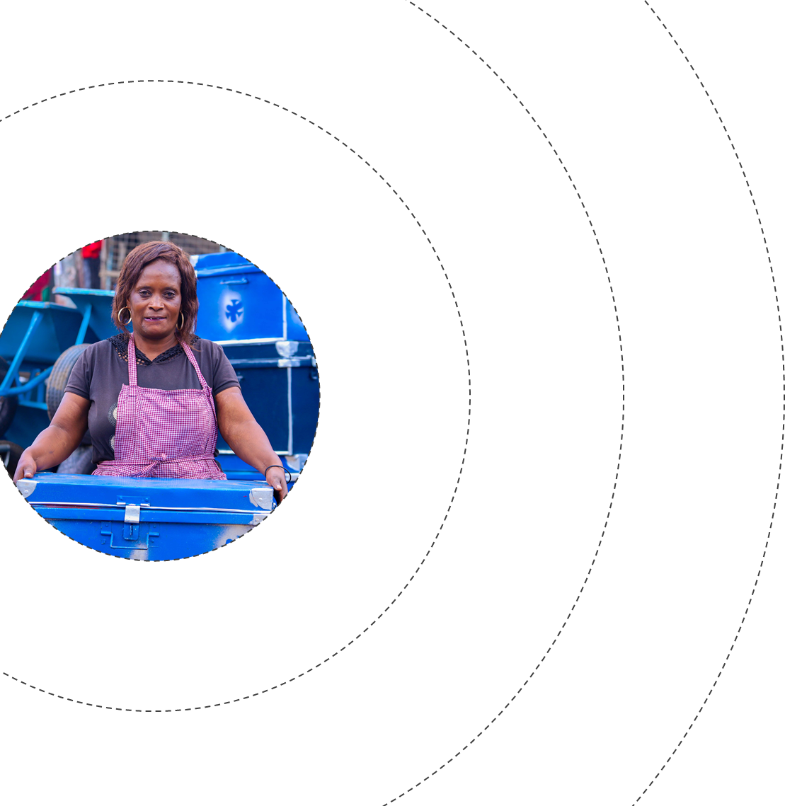

BEATRICE: PERCEIVED ‘IMPORTANCE’ OF FSP RELATIONSHIPS
Not close
I noticed people were doing some merry-go rounds and I decide to join and later I got my contribution of 30k which I used to boost the business
Moderately close
Very close
We now started having the SACCOs where we would access loans, like my bank where I took my first loan of 100k. I invested it in the business and everything worked well…but it got to a point some people were not able to pay their loans and you know we were signatories for each other so we had to pay so as not lose our savings…There is a way it benefited me and at the same time if affected my business negatively
Family
Deprioritised formal sources for loans due to bad past experiences. But, will family/friends be a reliable source for loans going forward?
Merry-go-round
SACCO
SACCO
I have borrowed close to 8 times from her bank amounts ranging from 20k- 150k and every time I borrowed was to boost my business especially when I got big orders and I did not have enough money to fulfil the orders…The last loan in 2016 was 150k from my bank and I made a decision never to borrow again from any lending institution because I can only borrow as part of a group yet others who I guaranteed did not honour their payment terms, which resulted in me paying for loans taken by others.
Bank
Bank
Colleagues / friends
Welfare
I sometimes need extra money to use at work, but I do not have the money at hand, like I need 10k or 5k, then I would borrow from them (friends/ colleagues)
FSPs used for business purposes
Formal
FSPs for personal use
Informal

Slide 46


KEY FINDINGS
Based on analysis of available survey data & qualitative research with MSEs
Government compliance
Business premises
High
Business association
Labour
Record keeping
Financial services
Customers
Suppliers

Slide 47

Suppliers
MOSTLY INFORMAL
770,000 enterprises
IN BETWEENS
200,000 enterprises
MOSTLY FORMAL
80,000 enterprises
NAIROBI TOTAL
1 M enterprises
Main source of inputs/ purchases:
MSMEs
Individual suppliers
Farmers
Non-MSMEs
Direct imports
Other (Specify)
Government
Source: MSME Survey 2016

Slide 48
Suppliers
The suppliers are people who trust us as we have dealt with them for a long time now….Let us say you agree to pay tomorrow but you are unable to get the whole amount at the same time then you just pay what you have. But you must make an effort to raise the balance to avoid breaking the trust – Female, 25, Food and produce seller
MSEs uses a wide range of suppliers
Including individuals, other MSEs, large corporates, cross-border and international suppliers
MSEs appreciate the smaller suppliers’ flexibility and willingness to break bulk (sell individually packed, smaller quantities of goods)
Cross-border trade is typically facilitated by middle-men who business owners develop strong, trust-based relationships with
Relationships are largely based on trust, not contracts, and are vital to the businesses
Some larger suppliers will sign contracts with MSEs operating from permanent addresses; they are not concerned if the MSE is a registered business
Many suppliers provide short-term credit (1 – 7 days) to business owners, which is invaluable to them as it helps MSEs meet customer demand
MSEs are also highly reliant on their suppliers to deliver quality produce and remain strongly loyal to those that do
Business owners realise how important these relationships are and will often prioritise supplier payments over other expenses
COVID-19 impact
Covid has impacted negatively on the availability as well as the cost of supplies, particularly for those MSEs buying stock from different counties or countries
I have about 5 suppliers and we have a good relationship I can take goods on credit from any of them. They give up 2 days to pay but even if I take longer there will be no problem. But I ensure I pay as soon as I get the money. Most of them have a book where they record anything they sell on credit. I have never had an incident where I took materials on credit and was unable to pay – Male, 36, Leather products
Some materials have become very expensive because of scarcity and also because of the lockdown we cannot get supply from out of the country – Male, 48, Leather products

Slide 49

CHRISTINE: PERCEIVED ‘IMPORTANCE’ OF SUPPLIER RELATIONSHIPS
MODERATELY CLOSE
NOT CLOSE
They have contributed to the growth of my business. They support my business even if I call them and tell them to send me supplies yet I don’t have money, they do so
VERY CLOSE
Kenya, Ukambani
We trust each other. When I tell him I am coming this day, he gets the goods ready and keeps them for me. But the others, if you get there late you may find they have sold the goods to other buyers. He also organizes transport for me up to Nairobi and negotiates for the cost.
Tanzania
Uganda
Kenya, Ukambani
Kenya, Kisii
She is the one who gets what my customers want, she does not mix rice, others mix different qualities of rice, some bring broken rice, but she gives me quality
Kenya, Narok
Kenya, Narok
Kenya, Nairobi CBD
Those from you Uganda you must give them cash, but their faithfulness is high. The Ugandans will make sure the supplies reach when they send. They will also give you quality supplies…they are close to my business, but not as close as the Tanzanians
Kenya, Mwea
Kenya, Ukambani
Kenya, Eastleigh
Give credit
Hold goods for her
Organise delivery
High quality produce
No credit
High quality produce
Organise delivery
The rest are the ones that have to think about business first…That’s their nature they are unreliable and you cannot trust that they will keep the goods for you
No credit
Do not hold goods
Do not organise delivery
Cross border supplier
Local
supplier

Slide 50


KEY FINDINGS
Based on analysis of available survey data & qualitative research with MSEs
Government compliance
Business premises
High
Business association
Labour
Record keeping
Financial services
Suppliers
Customers

Slide 51
Customers
MOSTLY INFORMAL
770,000 enterprises
IN BETWEENS
200,000 enterprises
MOSTLY FORMAL
80,000 enterprises
NAIROBI TOTAL
1 M enterprises
Main buyer of products or services
Individual consumers
MSMEs
Government
Non-MSMEs
Other (Specify)
Direct exports
Source: MSME Survey 2016

Slide 52
Customers
Somali businesspersons are the best to work with because they will never rob or short-change you. Though I have never met some of them physically we have a mutual trust that I will deliver good quality goods and that they will pay as promised and that’s how I work with them. No contracts or agreements written down yet we have a good verbal business understanding. – Female, 53, Metal products
MSE customers are generally individuals and other small businesses
MSEs tend to have very close, supportive and mutually beneficial relationships with their customers
None of the businesses interviewed reported supplying to large businesses or Government entities
Business owners often provide advice to their customers. For example, a tailor mentioned that she will advise business clients what colour garments to purchase depending on the county they are selling the goods in
MSEs only grant credit to a few, select customers
Concerns around bad debt / late payments are high and business owners know they have no recourse for non-payment
The CBD is unique because there is more reliance on walk-in customers
‘Walk-in customers’ are generally not well known to the business owner, they are infrequent purchasers and there is no relationship with the business owner
However, most MSEs have some regular customers that they rely on - individuals or other MSEs who they have formed close relationships with and will give credit to
Regular customers are often the main source of referrals and new business
Some business owners have started using digital platforms
COVID-19 triggered some businesses to start selling via social media
However, usage of digital platforms to market and advertise products is generally limited. This is in part due to low comfort levels and familiarity with digital technology in general, particularly among older female business owners
COVID-19 impact
Significant negative impact due to the cessation on movement in and out of the CBD, customers moving home to rural areas, reduced purchasing volumes due to their income loss, or were forced to cease operations (e.g. restaurants, schools)
My regular customers will come even if my tomatoes are not that good, they’ll tell me: ‘Shadrack today they are not that good but I’ll just carry a few with me’. So, I do count them as my close customers because they are loyal to me – Male, 27, vegetable trader
The biggest challenge has been customers buy less than normal, a customer who would buy goods 100 shs would buy for 30 shs or less – Female, 23, Food and produce seller

Slide 53
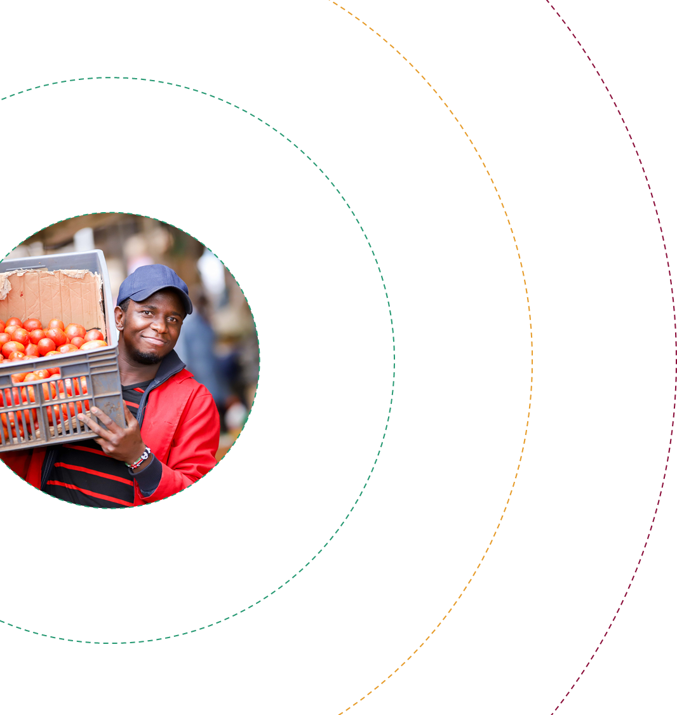
MICHAEL: PERCEIVED IMPORTANCE OF CUSTOMER RELATIONSHIPS
MODERATELY CLOSE
NOT CLOSE
My regular customers will come even if my tomatoes are not that good, they’ll tell me: ‘Shadrack today they are not that good but I’ll just carry a few with me’. So, I do count them as my close customers because they are loyal to me
VERY CLOSE
Hotels
Hotels
He stands with me in bad times and good times. We share personal issues and advice with each other on business. I also sell to him on credit which he pays on time. We also borrow from each other
Hotels
Retailers
Individuals
Customers have always been with me even if the Tomato prices fluctuates and goes high. Even when it is Tomato season and they are sold everywhere, and even if there are cheaper at other places, they will still come and buy from me
Retailers
They are loyal to the business. Also when we have functions we invite each other which is the social aspect of placing them close. We help each other
Individuals
She is not regular a customer she might come today then fail to come tomorrow but even if she misses once she will still come back, so that’s why I value her, even if they don’t buy daily but at least can come and say hi.
Regular customers (most buy daily)
Highly loyal
Refer other customers
Semi regular
May use other suppliers
She is an inconsistent customer. she comes daily but at times she can come and tell me today I’m not taking your tomatoes and then she moves to another place, that’s why she is outside
Irregular customers
Use other suppliers
At times she even lied to me that she has closed down of which is not the case, she has been buying from someone else
Hotel (restaurant)
Retailer
Individual

Slide 54


KEY FINDINGS
Based on analysis of available survey data & qualitative research with MSEs
Government compliance
Business premises
High
Business association
Labour
Record keeping
Financial services
Customers
Suppliers

Slide 55

Record keeping
MOSTLY INFORMAL
770,000 enterprises
IN BETWEENS
200,000 enterprises
MOSTLY FORMAL
80,000 enterprises
NAIROBI TOTAL
1 M enterprises
Keep any business records
28%
75%
100%
57%
Personal notes
Cash sales and receipts
Sales book and monthly sales ledger
Purchases book & monthly purchases ledger
Cashbook and petty cashbook
Bank reconciliation statements
Complete set of accounts
External Accountancy Services
Source: MSME Survey 2016

Slide 56
Record keeping
Recording keeping is for big barber shops, those that have employees - Male, 41, Barber/ salon
Businesses operating ‘more informally’ often keep no records
View the task as unnecessary and report that they keep track ‘in their heads’
Also assume that record keeping is only necessary for larger businesses that have employees
But, the majority of businesses interviewed in this study report keeping basic records
Typically with the purpose to keep track of business cash flows and profits and to use the records to access credit
Records are generally hand written
None of the businesses interviewed makes use of computer or digital systems aside from Till numbers, which were highlighted as being useful for record keeping purposes
One business owner gets help from her husband to move her records onto a computer every evening, she uses these records to access credit
Reasons for not using a computer include:
Perceived to be only necessary for big businesses
Cost - many believe that they cannot afford such a system
Practical challenges - cannot safely keep a computer system at their premises, difficult to operate if in a temporary location
We encourage most of our customers to pay via the Till number; we print the statements every month. These statement can also help us acquire loans – Male, 30, Restaurant
It is very important to keep such records because KWFT would ask for these records when I applied for a loan from them. Therefore, when I apply for a loan I do take the hand written records to be typed so that I can attach them to the loan forms. - Female, 53, Metal products
I keep written records…. For computer, I have never tried because of space and storage, I am worried it may get spoiled especially if I have to keep it at the store. - Male, 48, Leather products

Slide 57


KEY FINDINGS
Based on analysis of available survey data & qualitative research with MSEs
Government compliance
Business premises
High
Business association
Labour
Record keeping
Financial services
Customers
Suppliers

Slide 58

Business associations
I am very close to them because this is about our wellbeing as businesspeople and through this association we are able to support one another and also ensure our businesses are well secured – Male, 48, Furniture maker
Business associations vary widely in form, function and size
Range from informal Whatsapp groups to registered associations that require members to register and pay fee (monthly or annual)
In some cases association membership is by default (for example market based associations) and some MSEs are unaware they are part of an association (which limits their ability to derive value from it)
Those that participated in the groups noted various benefits to being a member
Benefits include increased bargaining power, dispute resolution, disseminating government information, sharing tenders, and welfare
Associations are perceived to be particularly important for segments who operate ‘more informally’, typically without secure tenure, as they provide protection against eviction and demolition
However, governance issues with associations are well known and are a major risk for the sector
Issues of gatekeeping, nepotism and tribalism as well as a lack of proactivity were noted by respondents
Numerous business owners also felt that government tenders and support does not always trickle down to members
Governance issues create risks for government and private sector strategies that rely on associations as an avenue through which to provide support and assistance to MSEs
They protect us from the city council; they settle disputes between traders, artisans and other parties involved in Jua-kali trade. I do not see any other benefit of being a member… I feel like the association should be able to help more because they are close to the government and the ministry concerned; like the challenge with shortage of material and the issue with suppliers manufacturing and exporting too, they should intervene and maybe standardize prices – Tom, metal manufacturer
The officials use the name to get aid from the government but it never gets to the members. – Male, 38, Metal products

Slide 59
Summary of key relationships
We asked a selection of respondents to rank their relationships in terms of value. Highly valued relationships were classified as ‘green’, relationships that add some value to the business as ‘orange’ and those that have not added any value to the business as ‘red’. Relationships with customers and suppliers (largely informal) were ranked the highest, while relationships with government were ranked the lowest.
Add limited/ no value
-
+
Add value
County Government
Business Colleagues
Employees
Suppliers
Chamas
Friends & Family
Customers
National Government
Banks
SACCOs
Associations
Mostly formal
Mostly informal
Note: Exercise was conducted with six respondents

Slide 60
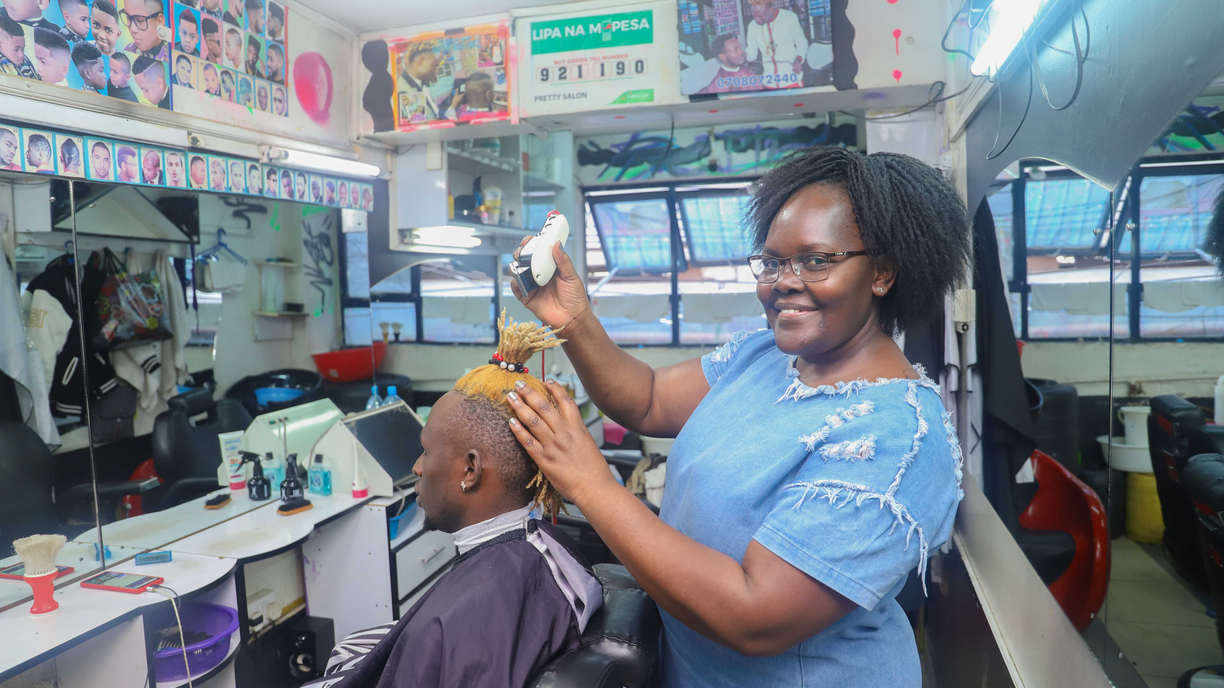
SUMMARY:
Opportunities and Challenges for creating VALUE for MSEs

Slide 61
 | Opportunities | Challenges
Government compliance: County fees, permits & licenses | Digital payment mechanisms can be leveraged for County revenue collection to encourage and promote transparency, root out corruption and build businesses’ trust in the County. Provision of basic services by the County such as refuse removal and toilet facilities in market areas would also help demonstrate to businesses how County revenue is being utilised for their benefit. | MSEs view the relationship with the County as largely extractive – compliance is driven by strict enforcement and businesses feel that little value is received in exchange for the fees paid. Negative perceptions are also fuelled by experiences of bribery and perceived corruption by County officials. The cost burden of County fees is also uneven and disproportionately burdensome for businesses operating out of temporary structures and market locations and in the agri-trade
Government compliance: Business registration (National) | MSEs that have registered report seeing the benefits in terms of increased access to markets, business opportunities and improved brand recognition and client trust. The process is also perceived to be relatively easy and straight forward and the cost did not emerge as a barrier. Targeted awareness campaigns could help drive higher levels of registration among MSEs. | There is limited awareness of the purpose of registration, its applicability to MSEs and the benefits to businesses. A limited understanding of taxation also appears to drive some of the resistance to registration.
Business premises | Upgrading market infrastructure and providing businesses with more permanent premises to operate from could be an important catalyst for improved government compliance in terms of business registration. It is also likely to encourage business owners to invest more in their businesses given the greater sense of security, both physically (ability to safely store goods) and mentally/emotionally (less threat of demolition, eviction). However, physical premises may become less important as some sectors move more towards online and home-based operations. | Securing premises in the CBD is a major barrier to entry for new businesses due to limited space and high costs. Upgrading market infrastructure will require extensive financial investment. It is also a lengthy process and logistically complicated as businesses need to be moved to different locations so as to allow them to continue trading during the upgrading process. For as long as businesses have insecure tenure, confidence to invest in business growth and expansion will be suppressed.

Slide 62
 | Opportunities | Challenges
Labour | MSEs are a critical source of employment for unemployed and unskilled individuals. By providing on-the-job skills development and training, MSEs provide ‘informal’ apprenticeships for individuals who often go on to start their own businesses in the same or similar sector and trade. Recognition of the role that MSEs play with regards to employment and skills development could boost perceptions of the sector and encourage more public and private support and investment. | MSEs tend not to have the resilience to provide job security to staff members in the face of large shocks (e.g. COVID-19). Employment relationships are also typically causal in nature creating risk for both the employee and employer. Insurance or safety nets may help to reduce the burden of economic volatility on employees. However, enforcement of current labour laws without consideration of their suitability to MSEs may increase the cost of labour for businesses and disincentivise employment.
Financial services | MSEs are using a combination of formal and informal financial services to meet their needs and are deriving value from both. Bank and SACCO loans are regarded as important source of capital for business growth with bank loans regarded as more important for larger-scale investments. Encouraging greater usage of digital payments would help MSEs create more reliable data on cashflows and, in turn, help lenders accurately asses their credit risk. Alternative data sources on MSEs, such as history of payments to the County, trade credit history with suppliers, rental payments etc., could also be explored and potentially leveraged for improved credit risk assessment. | Access to affordable credit that is sufficient in size (loan value) to facilitate business growth and expansion is limited. The cost of digital payments is also a barrier to more widescale usage, as is the risk of certain channels (i.e. payments made to business owners personal mobile money accounts which can be reversed). Group loan structures, both formal (SACCOs) and informal (Chamas), are not resilient in the face of large scale shocks and, as seen during COVID-19, may not be a reliable avenue for credit for MSEs during these times.
Suppliers | Some suppliers provide critical support to MSEs in the form of trade credit, without which many businesses would struggle to operate. The application of supplier incentives to provide trade credit, particularly for the larger suppliers/enterprises, could be explored as a way to support and strengthen the resilience of MSEs. Access to bulk discounts could be facilitated through online platforms that link businesses operating in the same locality or members of the same business association. | MSEs relationships with suppliers are typically informal in nature and, in the event of issues (e.g. non-delivery, poor quality goods), MSEs lack access to formal recourse mechanisms through which to claim damages. Due to small order quantities, often a result of limited capital and lack of storage space, MSEs are often not able to access bulk order discounts which in turn affects their profit margins.

Slide 63
 | Opportunities | Challenges
Customers | MSEs are starting, albeit slowly, to leverage digital technology to reach new and existing customers and markets. Digital literacy and awareness programmes could help encourage greater uptake and usage, particularly among certain segment such as female and older business owners. Business incubator and accelerator programmes can be developed to identify growth-orientated MSEs and to help them navigate the process of tendering for larger contracts with public and private entities to diversify their customer base, as well as prepare their businesses to undertake larger orders. | MSEs client base typically consists of individuals or other small businesses; few manage to get contracts from larger enterprises or access Government procurement opportunities either due to a lack of awareness of such opportunities, capacity to undertake and deliver on large scale orders, or lack of proper accreditation (e.g. business registration, quality assurance). Thus, MSEs rarely benefit from economies of scale and are highly susceptible to large demand shocks, such as COVID-19.
Record keeping | Encouraging greater uptake and usage of digital payment systems, such as Till numbers, would help MSEs generate more reliable data on cash flows and generate records which can be leveraged for credit purposes. Affordable and intuitive digital retail systems with flexible payment structures, such as payments linked to monthly cash flows, would provide MSEs with more reliable data on business performance and improved business intelligence (e.g. data on fastest moving goods, stock levels etc.). | Few MSEs keep sophisticated business records; most use handwritten records in a physical notebook that is easily lost or damaged. The perceived usefulness and benefits of record keeping is a barrier to usage, particularly among the more informally-run / ‘survivalist’ businesses. Other barriers to good record keeping practices include the costs of digital payment solutions and digital retail systems.
Business associations | Business associations can be an effective channel through which Government and private entities can engage with MSEs en masse They can also be utilitised to disseminate important information (e.g. tender and procurement opportunities). | Governance issues with associations are well-known with issues ranging from ‘gatekeeping’ (reserving opportunities for a select few), nepotism and tribalism. Improved monitoring and regulation of associations may help improve their effectiveness. Safe and anonymous channels for members to report complaints against association leadership may also improve their accountability.

Slide 64

Study overview
Segmentation of MSEs
Dimensions of formality/informality
Impact of COVID-19
Stakeholders’ perspective
Recommendations

Slide 65
Overview – Impact of COVID-19
Substantial drop in sales- some sectors affected more than others
Closure/downgrading of business: e.g. from stall to hawking
Sale of business assets: - e.g sewing machinery
Changes in employment terms - moving from daily wage to commission; replacement of employees with household members
Compliance postponement
Pausing/reduced SACCO and chama contributions
Holding savings in cash
Uncertainty
Adoption of E-commerce and other value-adding services (e.g. delivery)
Adapting / pivoting business away from high personal contact services
Opening outlets outside Nairobi- Nairobi is perceived most affected by COVID-19
The top challenge remains suppressed demand
FinMark Trust, June 2020

Slide 66
Unsurprisingly, interviews with business owners confirmed that COVID-19 has had a significant negative effect on business owners in the CBD
Customer numbers decreased
The cessation on movement meant that some customers were unable to get into Nairobi
Some customers moved back to rural areas or ceased operations (e.g. hotels, schools)
Rules around the number of customers that can be within a space at a time reduced revenue potential
Customers have/had less purchasing power
Business owners report that regular customers purchased smaller volumes / spent less
Supply shortages and cost increases affected business operations
Certain sectors were affected more than others (e.g. agri-traders reliant on cross-county or cross-border supplies)
Concern over potential increase in competition
Some business owners are also concerned about increased competition from those who have lost jobs and may turn to self-employment to earn an income
Immediate perceived risk is increase in demand for space and the impact on rent prices
However, some evidence that things are starting to return to normal
It has affected me in many ways, first number of customers has gone down and even if they visit the shop, they don’t purchase similar volume they used to purchase. Also, I have had to adjust the prices as some materials have become very expensive because of scarcity and also because of the lockdown we cannot get supply from out of the country – Male, 48, furniture maker
I cannot say things are good now, business has gone down since the Pandemic; price of produce is so high. I buy green pepper in kilograms and a kilo was initially 60 sh and now it’s at 100 sh or 110 per kg, which is not a good price. The biggest challenge has been customers buy less than normal, a customer who would buy goods worth 100 sh would buy for 30 sh or less – Female, 24, vegetable trader
We are afraid that storeowners will soon hike the rent because of the new arrivals; if you are not willing to accept new rent you may be asked out – Male, 43, Metal works

Slide 67
Business owners have reduced their expenditures, withdrawn savings, stopped social security contributions and sold assets to cope through COVID-19
During this Pandemic I closed one of the salons and am currently looking for someone to buy the shop and the equipment in it. Am asking for 450k [goodwill & purchase of furniture and a few equipment that are still in the shop] - Female, 53, salon owner
I am now coping with the little that am getting and even getting into my savings to settle some bills. For the rent I would request the landlord to allow me settle on the deposit paid and when things will be back to normal I will settle those arrears. The competition is even becoming higher because people are entering into this business trying to make ends – Male, 42, electronics retailer
We do personal contribution towards NHIF, though I am not able to continue with the monthly contribution due to lack of money – Male, 41 barber shop owner
We also had to let some of our employees go and the few that remained work on rotation to give everyone a chance – Male, 30, restaurant owner
I used to have two employees but when Covid came I had to lay off an employee and remain with one who I can afford to pay – Male, 41, barber shop owner
I am coping with the little savings I had and also from a few home investments that I had but I am still finding it hard. For the rent of the premises I had to talk to the landlord to allow me pay after 3 months with the hope that by then things would have come back to normal – Female, 62, secondhand clothes seller
I have been funding the business through savings and had to sell goods at low prices to attract customers so that we can be able settle bills - Male, 48, furniture maker

Slide 68
Some business owners have been proactive in finding new ways to access customers and adapt businesses to manage sales through COVID-19
New product offering using existing skills
New digital marketing channels
Rose, 38, makes uniforms and baby and children’s wear in Gikomba market, started making and selling face masks
Elias, 38, owns an electronics store, started advertising online to reach more customers
We started making masks; it was good business and I would make 2-3k profit in a day. When I started doing masks I posted on my Facebook page and I got orders; I had so many customers, hawkers would come and buy in bulk; I had orders from as far as Mombasa and other counties. Business was good until the scandal about Covid funds was exposed. People suddenly stopped using masks since the corruption allegations were made
The online advertisements through Facebook, ‘Pigia Me’ and ‘JIJI online’ have been working well for us during this time as we are able to get customers who need our services. We just take a photo and post then wait for customers. Before Covid-19 we were not so much into the online marketing but now we have been pushed to do it more. So this has been our way of coping with Covid19 as a business
New product offering, new skills
New service offering
Joe, 33, owns an electronics store, got a motorcycle from his mom and uses this to operate a pick up and delivery service for phone repairs
Gerald, 30, operates a barber shop in Gikomba, started selling shoes because it does not require close contact
Due to restriction on movement and the social distance, barbershops have been hit hard and so I decided to start a side hustle that did not involve close contact - selling plastic shoes; I used my savings to buy the shoes and that is how I have been coping with effects of Covid
When Covid-19 came, it was difficult for customers to come because maybe they don’t have the time or maybe due to fear. I thought since I have the ability to repair that phone I need to look for a way to reach such customers. So I started a pick up and delivery service for the phones…it is something new I am trying to venture into and see if it will work for me

Slide 69
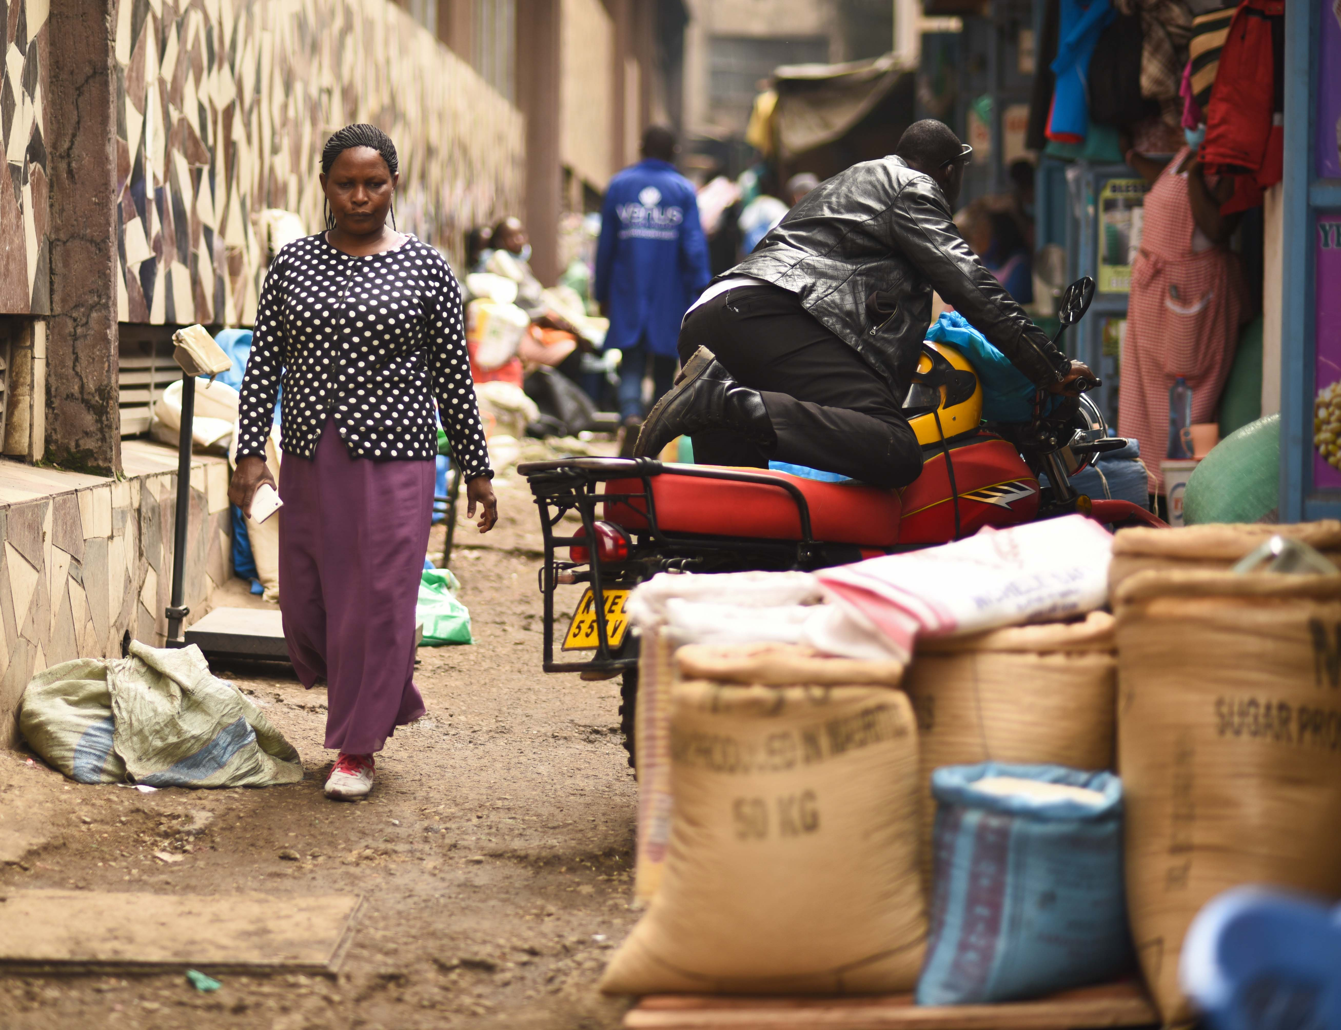
Study overview
Segmentation of MSEs
Dimensions of formality/informality
Impact of COVID-19
Stakeholders’ perspective
Recommendations

Slide 70
Several stakeholders were interviewed, including:
Stakeholders’ comments and perspectives are summarised into five themes:
State actors
Kenya Revenue Authority (KRA)
Business Registration Services (BRS)
Micro and Small Enterprise Authority (MSEA)
Nairobi City County (NCC)
Dept. of Trade Licensing
Dept. of Cooperative Societies
Dept. of Gender Affairs
State Department of Industrialisation
Non-state actors
Kenya National Chamber of Commerce and Industry (KNCCI)
Kenya National Federation of Jua Kali Associations (KNFJKA)
Quarry Road Association (Gikomba)
Wakulima All Traders Association
1
What is informality?
2
What are the barriers to compliance for MSEs?
3
What are the incentives for MSEs to formalize?
4
What are the main challenges facing MSEs?
5
What is the role of business associations?

Slide 71

1
What is informality?
2
What are the barriers to compliance for MSEs?
Government stakeholders’ views on informality are strongly tied to the visibility of the business in terms of registration on some official list (at the national or county level)
Visibility in terms of having a known physical premises and location is also regarded as a marker of formality and conversely informality
The permanence (or resilience) of the business is regarded as another factor – “informal businesses are here today, gone tomorrow”
Informality is also synonymous with the Jua Kali sector in Kenya*. The Kenyan National Federation of Jua Kali Associations (KNFJKA) regard all of their members to be in the informal sector and are strongly opposed to any other classification or categorisation
Discussion focused on compliance with respect to registration with Companies Registrar (BRS)
Several Government stakeholders noted that the main barriers to registration include:
Lack of awareness of the need to register and potential benefits of registration
Fear of visibility to the KRA
Fear of punishment / retribution for the years the business was operated unregistered – “they fear the shirt will be taken off of their backs” (MSEA)
The process and cost of registration is not regarded as a barrier; the same finding was noted in the interviews with MSEs
Among non-government stakeholders, lack of compliance appears to be driven by a general aversion to the concept of ‘formalisation and the perception that formalisation yields little value for MSEs
We would want specific policies that address the informal sector, not policies that address SMEs or MSEs in general. Most of the SMEs or MSEs are very formal, we are lost in that categorisation – (KNFJKA)
*However, this research found that many Jua Kali artisans are starting to formalise their businesses by registering it in order to access procurement opportunities (see segment persona for Ruth)
Let us improve the standards of our people first; let us sensitize them on the importance of registration. You can ask a trader if they can register and they will ask for what? - (Association)

Slide 72
3
What are the incentives for MSEs to formalize?
Most government stakeholders perceive the main benefits to formalisation to include:
Improved access to finance (e.g. Micro & Small Enterprises Development Fund (still in development), KNCCI, Mastercard Foundation COVID-19 fund for MSEs)
Improved access to large procurement opportunities (e.g. Kenya Affordable Housing Programme procurement from Jua Kali sector)
Networking opportunities (e.g. Trade fairs and market access opportunities provided stakeholder such as the KNCCI)
Access to the support services offered by government (e.g. improved worksites and technology through MSEA) and skills development programmes (e.g. KNCCI export readiness programme)
And, the more general benefit of being a “legitimate” business
The same sentiment was not always shared by the business associations interviewed. KNFJKA noted that formalisation* of MSEs in the Kamakunji market as a result of the Kenya Affordable Housing Project procurement has created conflict in the area
There is war in Kamakunji as a result of the formalisation – (KNFJKA)
The need to better demonstrate value of compliance by communicating how tax and license / registration revenue is spent for the benefit of the MSE sector was also noted by government stakeholders as a factor affecting MSEs incentives to formalize
Improved data-sharing, harmonization of business license requirements and policies targeting MSEs in general was also noted as key strategies to make compliance, and the monitoring thereof, easier, more efficient and value adding for all stakeholders involved, including business owners
We have a national trade policy but it doesn’t speak well when it comes to counties, there are gaps between the two levels of government as to whose responsibility it is – (KNFJKA)
Improved monitoring and evaluation activities for the MSE sector including data collection and dissemination, as well as the harmonisation and streamlining of licensing requirements are addressed in a recent MSE policy paper by the State Department for Industrialisation**

Slide 73
4
What are the main challenges facing MSEs?
5
What is the role of business associations?
Stakeholders’ perceptions of the main challenges facing MSEs include:
Cess charges for MSEs trading in agri-produce. KNCCI referred to this as the issue of “double taxation” and have recently published a policy brief on the topic¹
Poor infrastructure (worksites and market places): Several stakeholders noted issues related to the lack of facilities and basic services (e.g. sanitation, water, shaded areas) and overcrowded working conditions in marketplaces and worksites. The Nairobi City County office responsible for gender affairs perceive this to be the biggest challenge facing the sector, more so than access to capital
Lack of access to equipment and machinery: KNFJKA noted that Jua Kali artisans lack access to up-to-date manufacturing equipment and machinery at their worksites which significantly affects their productivity and the quality of goods produced
Market linkages: KNFJKA also noted the lack of proper forward and backward market linkages as a common problem across all sectors, though some sectors are harder hit than others
Inadequate credit risk assessment by formal lenders: Business associations believe banks place too much weight on account savings and traditional collateral (e.g. property, land). They also believe banks do not properly assess business risk before granting loans leading to high defaults; they believe banks should better assess if there is a market for the goods (where will they be sold?) to reduce defaults. They also suggest that associations could be utilised to assess the credit worthiness of businesses
Business associations are perceived to be a critical linkage between government and MSEs
Both state and non-state actors (KNCCI) noted the benefits of engaging business associations on issues related to MSEs. For example, KRA noted that recent engagements led to them reducing the Turnover Tax applicable to MSEs from 3% to 1%
Interviews with associations confirmed a previous finding that association ‘membership’ is relatively fluid and open concept. KNFJKA noted that “80% of our members do not subscribe to any association…they belong to other community groups and we adopt them”
Associations describe their main objectives to include:
Lobbying, activism and stakeholder engagement
Providing access to and managing worksites & markets (security, garbage collection, dispute resolution)
Facilitating access to markets and trade shows
Skills development and recognition
Associations do not appear to be actively encouraging business formalisation among their members
About 90% of artisans have no form of registration but we are lucky because they are a member of an association, so the association becomes the vehicle for trade until that point where an opportunity emerges for them as an individual artisan to get some basic formal registration – (KNFJKA)

Slide 74
DATA NEEDS
DATA CHALLENGES & OPPORTUNITIES
A recent policy paper* on MSEs highlights the need for effective monitoring and evaluation of implemented policies with an emphasis on data collection and usage, this includes:
Establishing an M&E Plan to outline the resources necessary for the M&E function including baseline data, stakeholders responsible and data collection tools
Undertaking monitoring through continuous data and information collection
Undertaking frequent research to inform policy decisions
Undertaking surveys every five years aimed to inform policy decisions
Systematically reviewing, analyzing and assessing MSEs policies and programmes
Currently only two survey datasets contain information on MSEs in Kenya– FinAcccess 2018/19 and the MSME Survey 2016, both KNBS surveys.
While the datasets provide some useful insight on MSEs, several challenges exist:
The datasets are not comparable as the unit of measurement differs (FinAccess counts business owners, the MSME survey counts establishments)
The sample design is not able to support more detailed and focussed analysis due to small sample sizes (e.g. geographic or sector-focussed analysis is limited)
There is an opportunity for future surveys to be designed and implemented to collect more regular and detailed data on MSEs that consider the Government and private sectors’ analysis requirements (e.g. demographic data on business owners)
Administrative data on MSEs could also be better leveraged to understand the sector and to facilitate the design and implementation of effective interventions
It would be useful to map all the stakeholders who are currently collecting data on MSEs to:
Identify who is collecting data and what data they are collecting
Who is the data currently be shared with, and who could/ should the data be shared with
The extent to which different datasets be linked via unique identifiers
The extent to which data collection processes be improved
Identify data gaps and how these can be filled
Example: The Nairobi City Council licensing dataset includes business name, business activity, physical address, annual license fee paid and ward.
It would be useful if the dataset contained demographic data (e.g. age and gender of business owner/s)
Data collection processes can be improved. Currently business activity is collected as an open text field which makes the data difficult to analyse and track trends in sectors and movement between sectors
Data-sharing should be encouraged. The data is currently being shared with the KRA, who else would benefit from the data?
Note: *State Department of Industrialisation, Kenya Micro and Small Enterprises Policy, Sessional Paper No. 05 of 2020

Slide 75
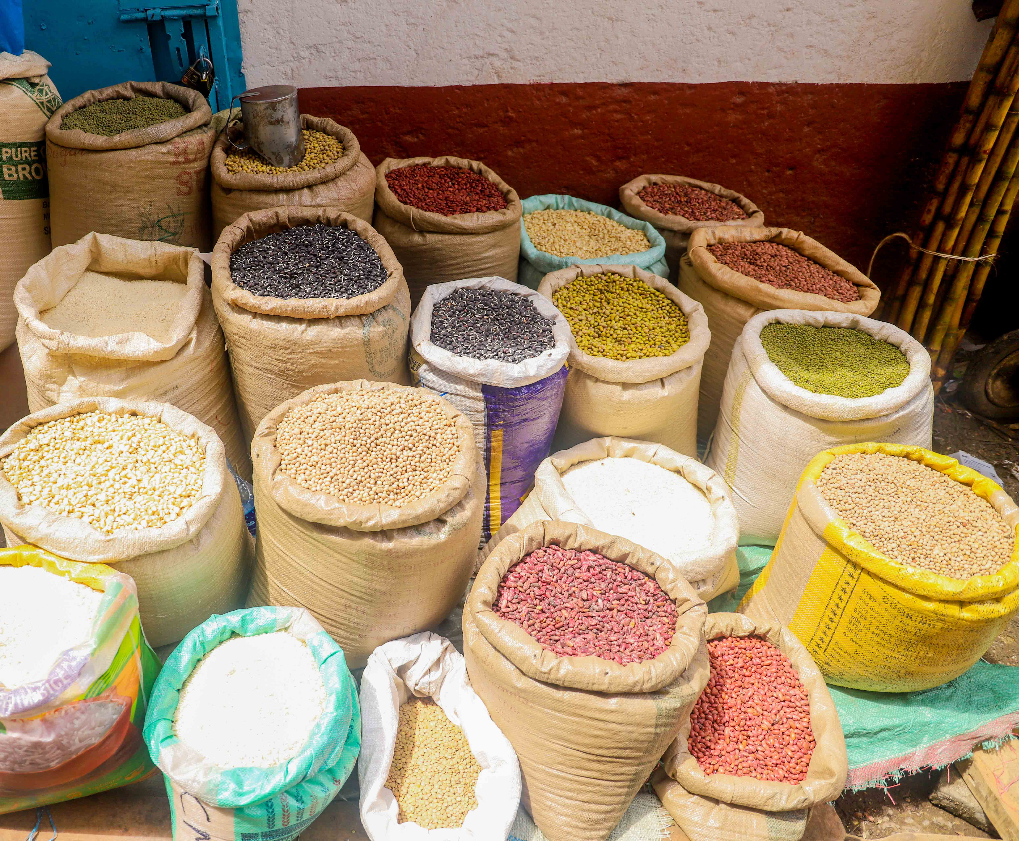
Study overview
Segmentation of MSEs
Dimensions of formality/informality
Impact of COVID-19
Data challenges & opportunities
Stakeholders’ perspective
Recommendations

Slide 76
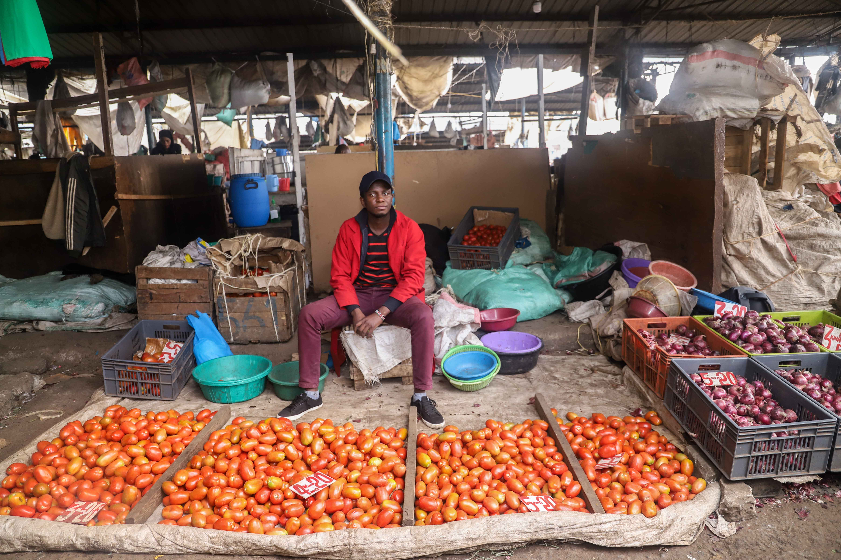
RECOMMENDATIONS

Slide 77
Govt. compliance | Business premises | Labour | Financial services
Create awareness of business registration, its implications, and benefits for MSEs as well as the process to register Create awareness of the online renewal process for County permits Review the total cost burden levied by the County and National Government on MSEs including permits, market fees, produce Cess and other taxes Improve transparency, especially for County payments, through digitising B2G payments for permits and other fees Ensure that any efforts to improve formality are based on corresponding investments in value creation for MSEs by demonstrating how money collected from MSEs is utilized for their benefit (e.g. provision of basic services and improved market areas) For County permits consider removing any penalties for non-compliance due to COVID-19, or partial rebate for those who did comply despite not being able to operate full Allow citizens/ entities to check the registration status of a business for free (currently costs Ksh 650 on the E Citizen portal) | Improve the infrastructure and services in market areas and worksites to better meet the needs of MSEs (e.g. WASH facilities), with consideration for the specific needs of women-run businesses (e.g. space for childcare facilities), and improved security (e.g. lights) Develop and communicate land development / zoning plans to MSEs operating in areas not yet secured as designated MSE worksites (e.g. Pate bay road, Kariakor road), to enable those business owners to make informed decisions regarding future investment in their businesses Where space is provided by the government/ county, create a digital record of MSE space allocation Given the continued risk of COVID-19, ensure that all markets and worksites are COVID-19 compliant (adequate space, hand washing facilities, etc.) | Recognise that MSEs are a major employer, albeit, often in a more casual nature. With this in mind, review labour laws and their applicability and appropriateness in balancing MSEs need for flexibility and for their employees need for job security and fair labour practices Explore insurance and safety net models for employees to mitigate the impact of economic volatility on livelihood security Explore apprenticeship models to encourage and support MSEs to employ and up-skill young people | Encourage business owners to accept digital payments to create reliable data on cashflows to enable improved credit risk assessment Identify sectors, value chains and payments that could be digitised, for example B2G payments for County permits, NHIF, and all payments related to government-led procurement Ensure any planned financial literacy programmes cover the importance of keeping a good credit score, responsible credit usage and the risks of being blacklisted Map alternative data sources linked to businesses which lenders can utilise in credit risk assessment (e.g. leveraging county data permit payments, data held by registered associations, trade credit history, rental payments, etc.) Provide avenues for MSEs to access funding, for example via an online platform for business owners to enter their information and funding requirements and match them with potential public and private sector funders Consider how the proposed MSE Fund could be expanded to formal financial institutions that interface with MSEs such as SACCOs Review NHIF penalties for missed payments and consider amnesty to business owners under COVID-19

Slide 78
Suppliers | Customers | Record keeping | Business associations
Conduct research to understand the impacts and risks of trade credit through suppliers and explore systems, tools and incentives to improve access to credit through this route, particularly for larger suppliers/enterprises Develop and encourage the uptake of online platforms or systems that link businesses operating in the same locality or members of the same business association, so that MSEs are able to access bulk discounts Develop online platforms for MSEs to access market information on available suppliers, potentially enabling group buying opportunities for MSEs to access bulk discounts | Provide digital literacy and awareness programmes to encourage greater uptake and usage of digital technology to access new and existing customers and markets Develop business incubator and accelerator programmes to identify growth-orientated MSEs and help them navigate the process of tendering for larger contracts with public and private entities, as well as prepare their businesses to undertake larger orders Create Wifi hot spots in areas with large numbers of MSEs, such as market areas and work sites, to encourage the usage of digital technologies to access new and existing markets | Encourage greater uptake and usage of digital payment systems, such as Till numbers, which can be used by MSEs generate more reliable data on cash flows and generate records which can be leveraged for credit purposes | Leverage associations to share information on government tenders (implementing AGPO), financing opportunities, market development plans and other opportunities. Share new market information for export markets in particular, and how to access them (i.e. with KEPROBA and MSEA) Emphasise the monitoring of associations to ensure good governance and to ensure that government support and information does actually trickle down to MSEs Ensure that MSEs have safe mechanisms to lodge complaints and grievances against associations without any fear of repercussions

Slide 79
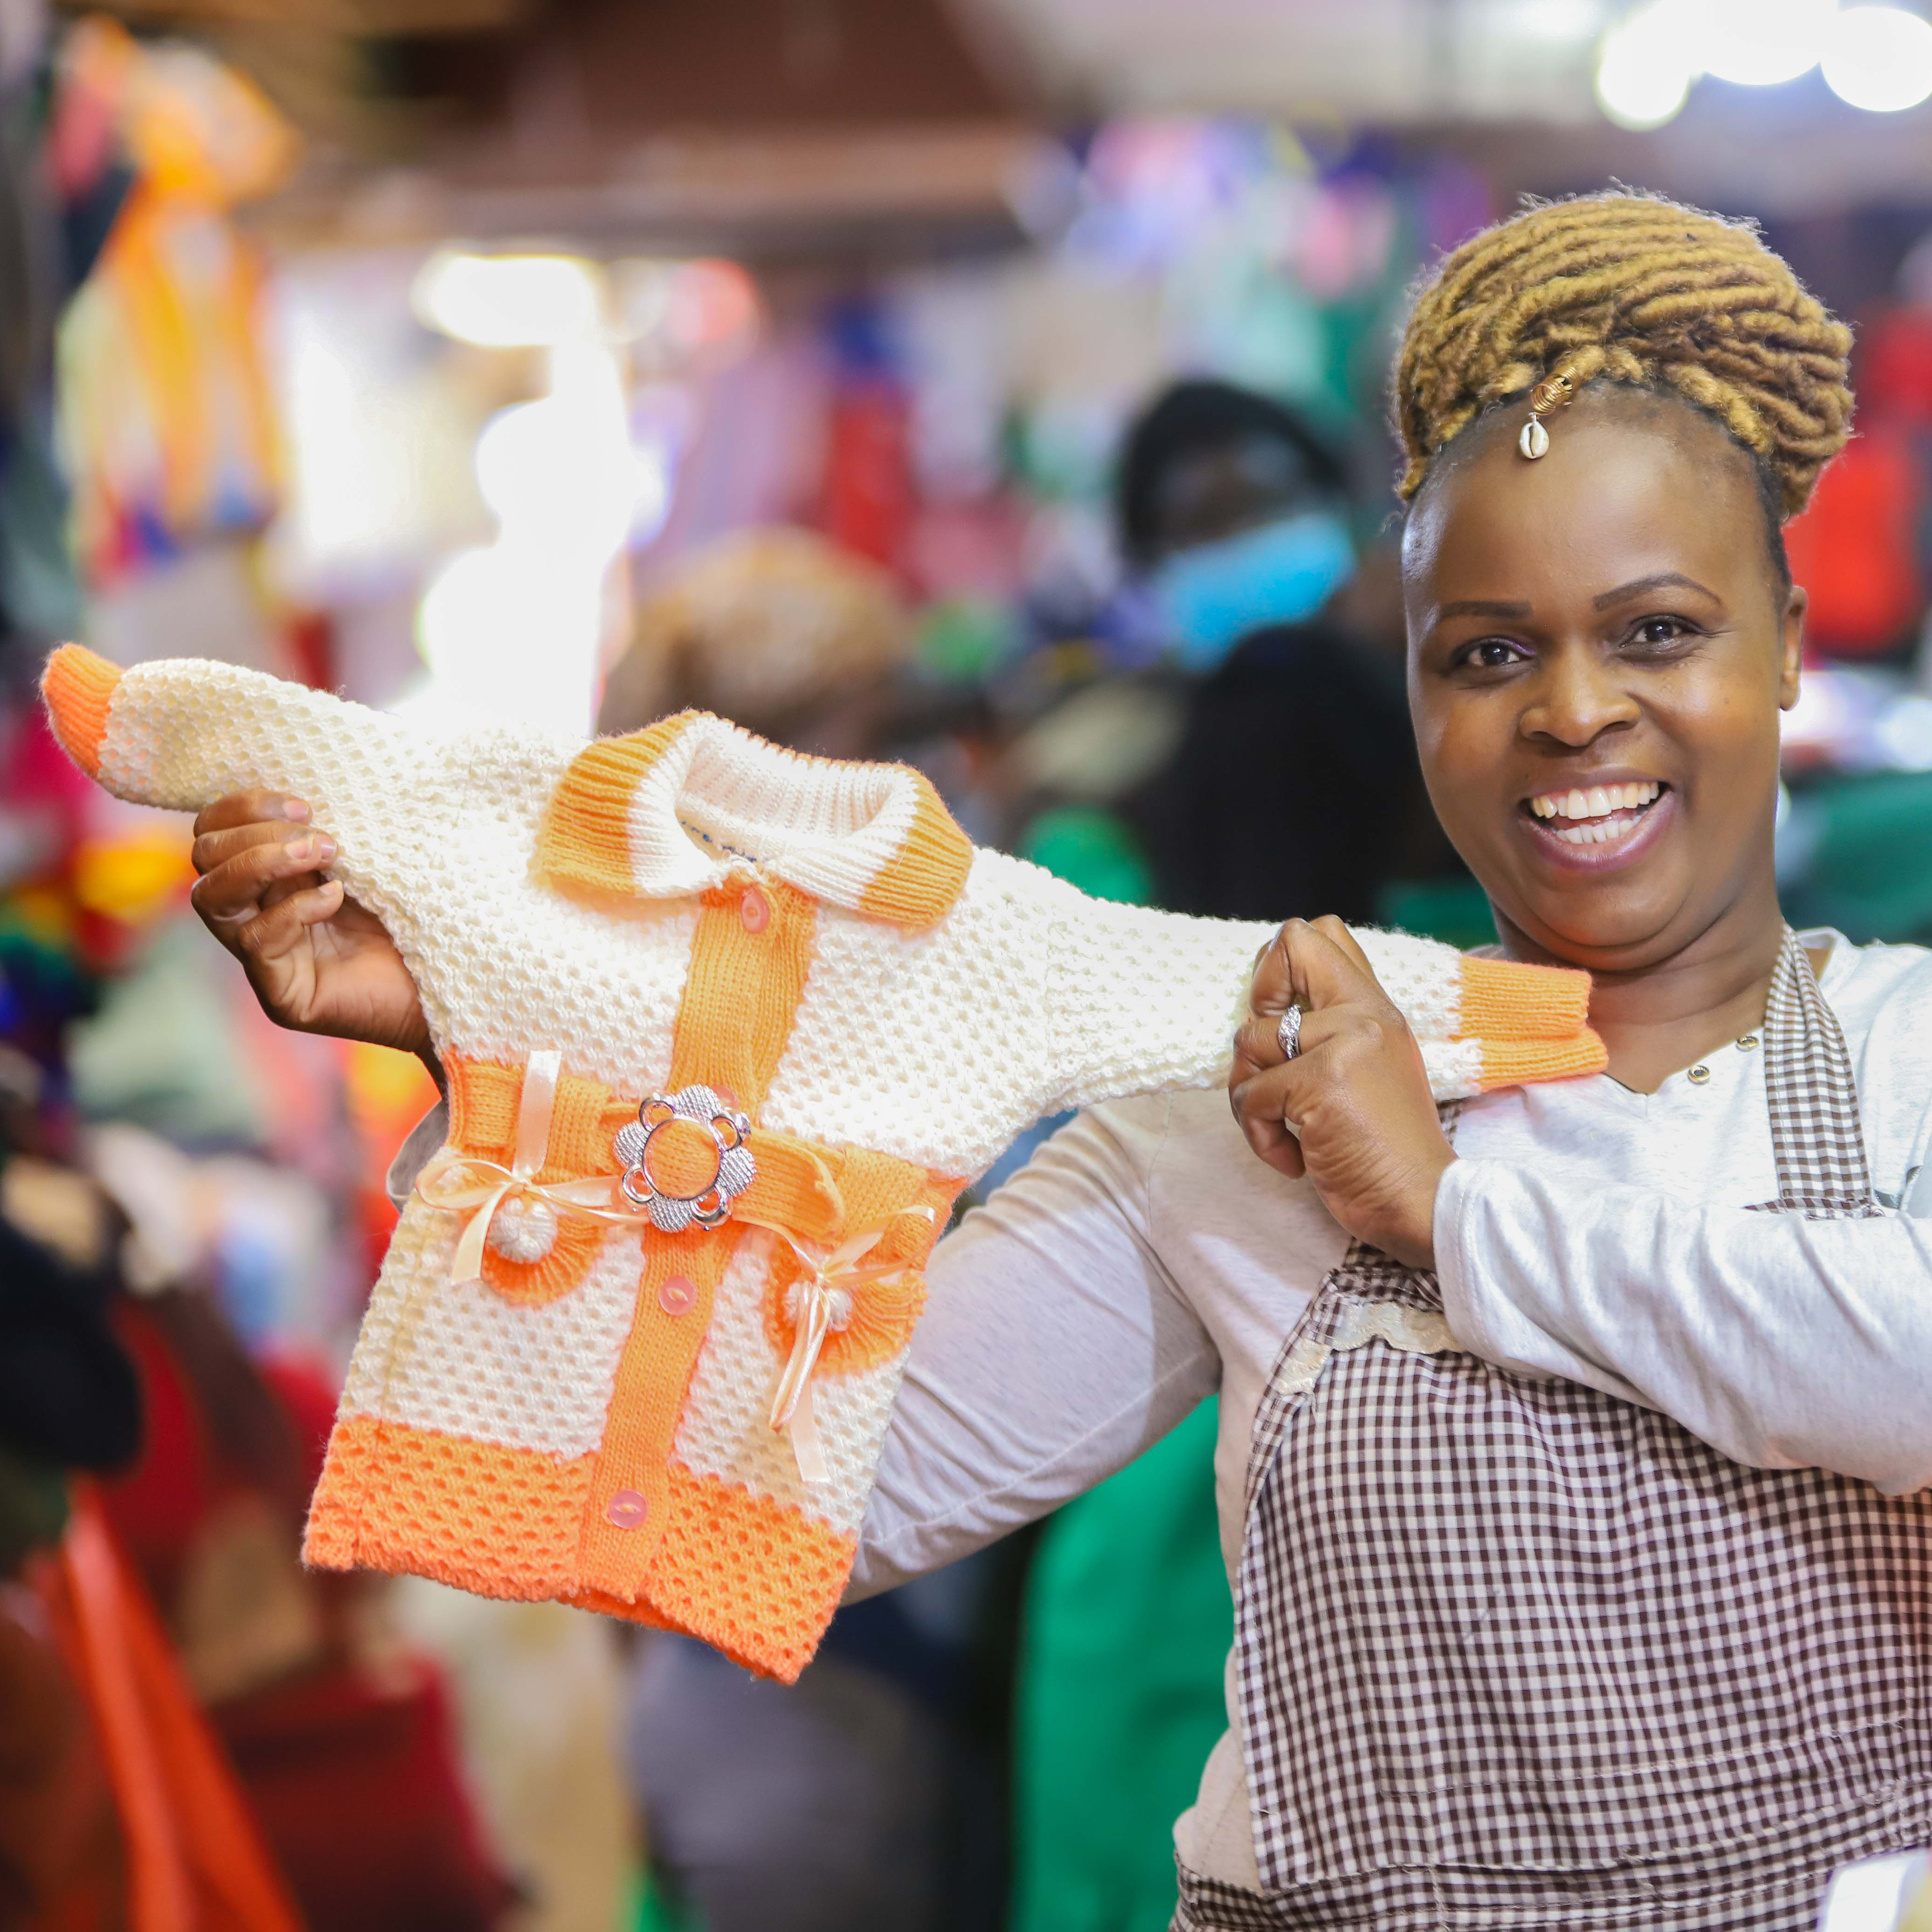

Additional recommendations
PARTNERSHIPS: Establish an MSE working group which brings together various stakeholders across public and private entities. This group can be used to improve the communication and coordination of the different stakeholders in the sector. It can also help encourage data sharing between entities, forge new partnerships and collaboration on key issues facing the sector, and monitor the impact of policy changes on the MSE sector
DATA: Review available data on the sector by mapping key stakeholders and identifying the data collected and data collection practices to assess where data gaps exist. Develop a data agenda to plan how data gaps can be filled and how data collection practices can be improved going forward

Slide 80

ANNEXURE

Slide 81
Profile of qualitative interview respondents (34 in total)
All respondents were operating businesses located in the Starehe constituency with a specific focus on downtown CBD, Kariokor, Kamukunji , Gikomba, Muthurwa
STRUCTURE OF BUSINESS PREMISES
YEARS OPERATING BUSINESS
SECTOR OF WORK
Manufacturing
GENDER OF BUSINESS OWNER
AGE OF BUSINESS OWNER
Retail
Services

Slide 82
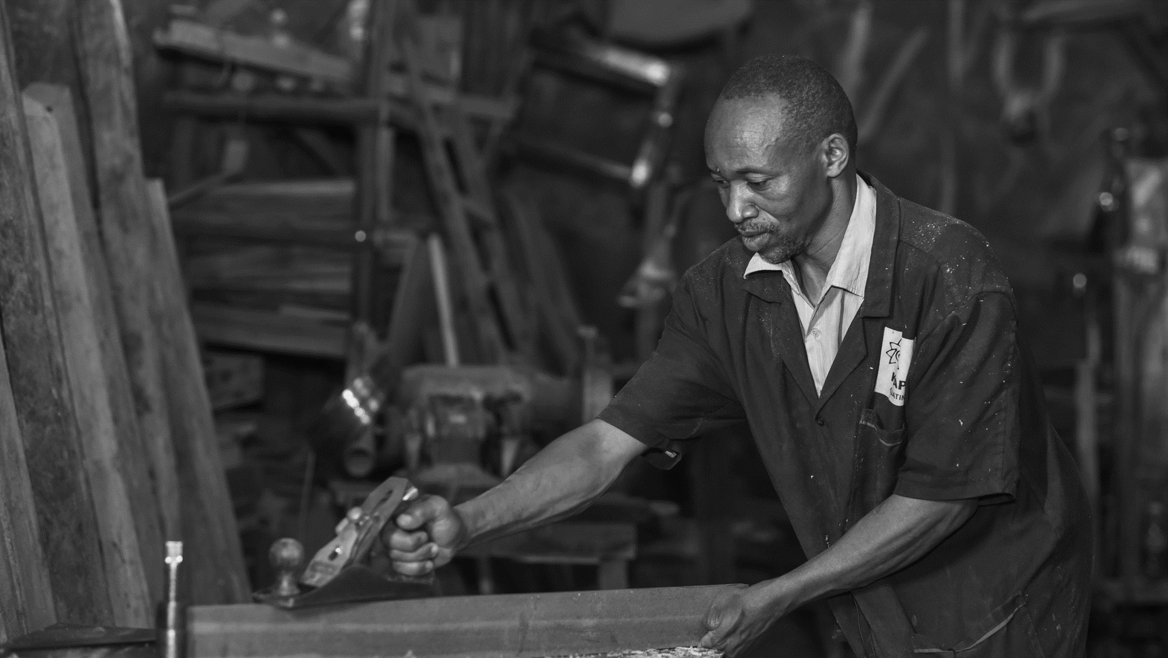
THANK YOU

