Slide 1
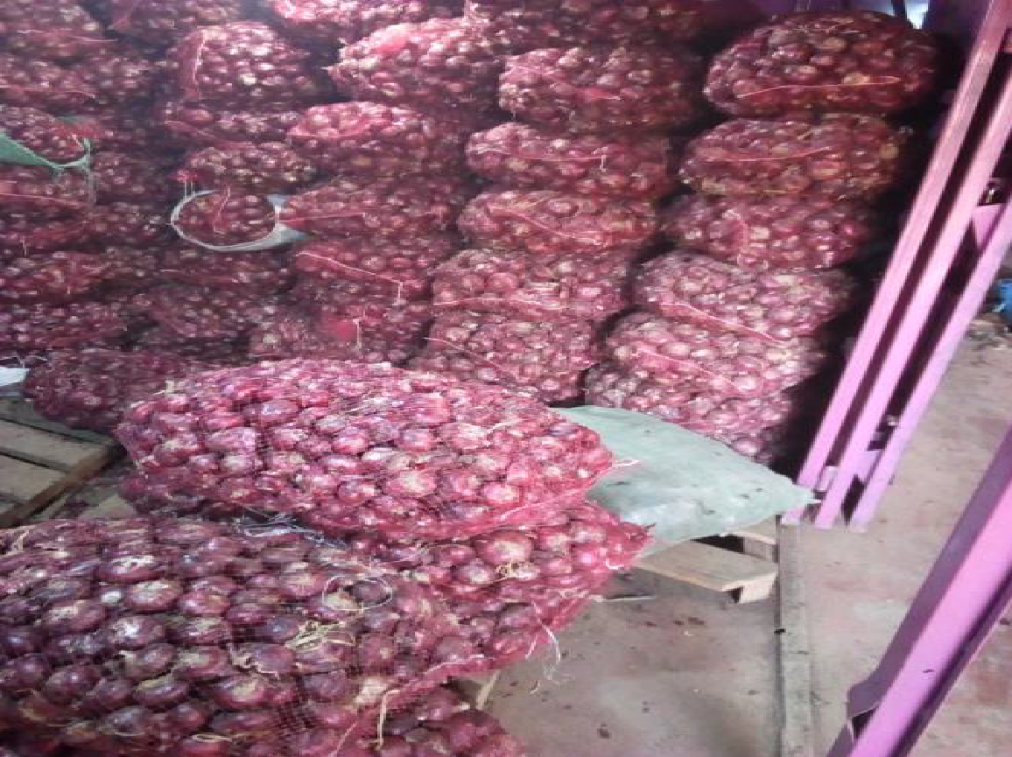
Understanding Packhouses
Changes since November 2019
Impact of Covid-19
November 2020

Slide 2
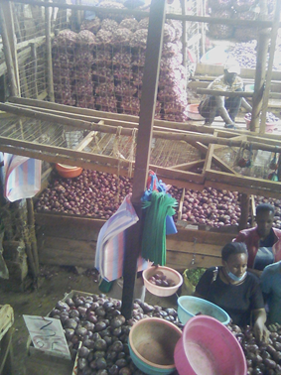
Background
The overall study seeks to understand the rural-urban food supply chain in Nairobi with an aim to assess the value proposition of digitizing the supply chain. Secondly, the study seeks to provide insights for equitable and sustainable pathways to a digital economy.
Purpose
To gain an in-depth understanding of the operations of the packhouses
Objectives
To understand the preliminary impact of COVID on their operations
To gain deep qualitative insights into the workings of the market.
To provide insights to developers of digitization solutions that target this segment

Slide 3
Areas Explored
Topics explored
How packhouses source and sell produce on the basis of negotiated relationships.
How packhouses develop and leverage their particular relationships with brokers and customers to manage risk.
The different strategies that packhouses employ in managing risk along each supply chain
The role of credit in shaping market relations,
Practices of classifying/categorizing produce
Practices of accounting and record-keeping
Practices of pricing, potential gaps in payments
Attitudes toward digitization
Guided by 3 Hypothesis
Financing constraints are an important obstacle to the efficiency of agricultural value chains affecting all players in the chain
Financing constraints are primarily caused by information asymmetries, which in turn limit trust amongst players and opportunities to expand markets beyond existing trade networks
Informational and financing constraints could be addressed through digitization of value chain data and establishment of data platforms

Slide 4
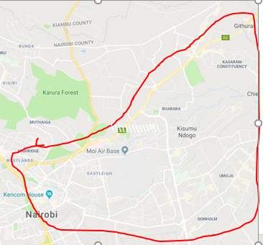
The follow-up approach
Northern Nairobi
Ngara, Pangani, Mathare, Eastleigh, Umoja, Zimmerman, Pipeline, Ruaraka, Kasarani, Githurai and Donholm
4 packhouses that had participated in the 30day collection exercise in August to September 2020 – mainly quantitative data
A 10-day data collection exercise between 30th September 2020 to 18th October 2020, qualitative and quantitative data
All serve Northern Nairobi
All did some sorting /grading
All had indicated willingness to use a digitized sytem during the 2019 survey
Northern Nairobi

Slide 5
The 4 pack houses
Mercy: Tomato packhouse Pipeline near Mukuru Kwa Njenga | o Road and market are currently under construction, no stalls, traders move around o Claims Mungiki is active and collects fees from market traders. Has expanded during COVID and has brought more people on board to work for her.
Henry: Onion packhouse Githurai Market | o Highly organized and very large operation o Primarily deals with one broker in Tanzania whom he considers like an employee o Has also expanded his operations during COVID but constrained by transportation.
Kevin: Melon packhouse Githurai | o Has been struggling during COVID. o Is considering alternatives and side hustles to supplement his income
Brenda: Mango s Marikiti / Wakulima Market | o Also sells tangerines and passion fruit o Main customers used to be juice vendors, but they sell far less juice than they used to.

Slide 6
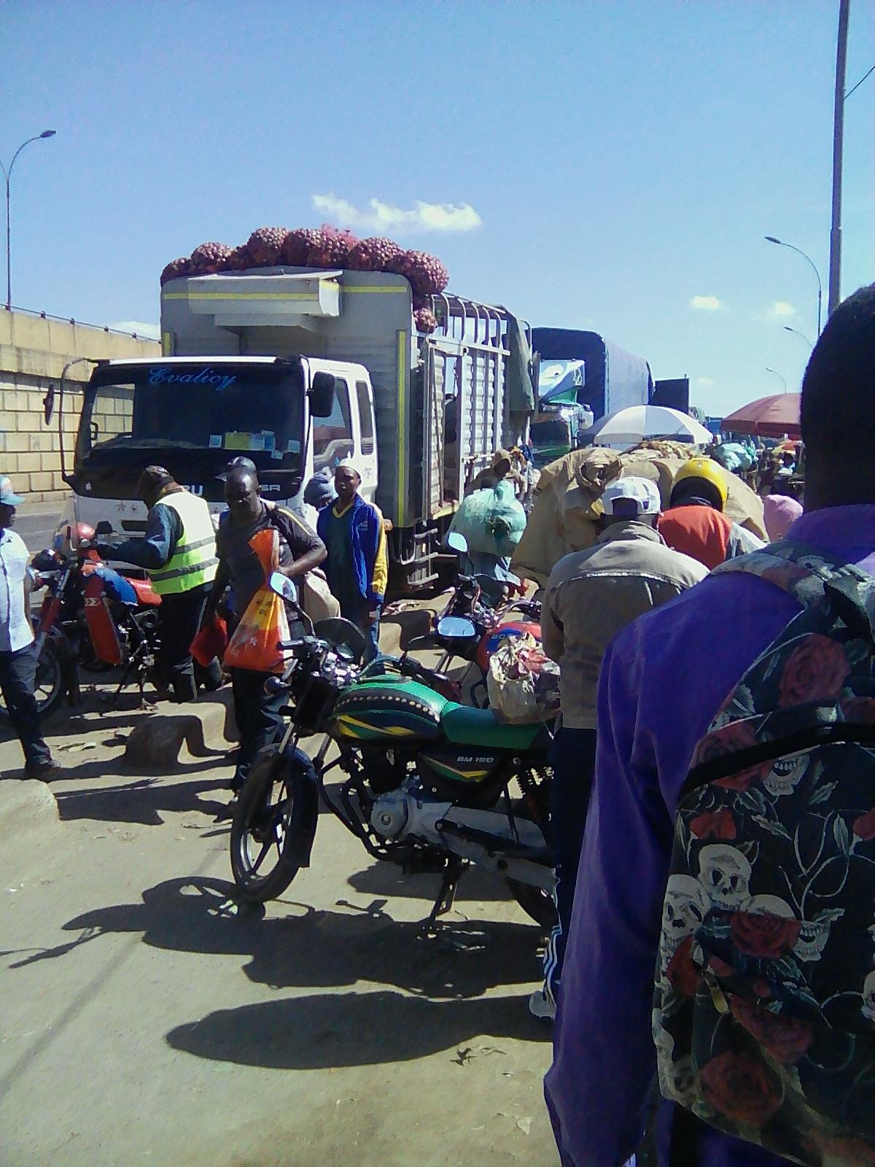
Impact of Covid-19 on packhouse operations

Slide 7


Covid has resulted in changes in customer base and increased spoilage
o Reduction of bulk purchases/buyers - with closure of schools, hotels, and restaurants. Packhouses focusing on stocking quality and size for domestic buyers, e.g. smaller onions for household consumption
o Changing profile of fagilia (broken food item) buyer from small hotel to pig farmers
o Older clients - avoid visiting the markets due to fear of Covid
o Using referrals word of mouth to build new customer base
Tomato and onion sales showed little signs of abating, they are staple household items, packhouses trading in the two items have expanded their business during this time
Changes in customer base
Increased losses & spoilage
o Reduced client traffic , slow moving produce
o Closure for a few weeks at the height of the pandemic (April –May 2020) resulting in
Infestation by rodents during the closer
Theft of produce during the closure
Melon packhouse was hardest hit with losses estimated at 248K in 3 months ( 30k in April, 48k in May, 170k in June, and 80k in July). Mango packhouse complained of a major loss of customers though not of stock; while onion and tomato packhouses seemed to have transitioned well.

Slide 8


Covid has resulted in turnover of traders and tightening of credit
o Older traders perceived at higher risk of getting Covid left the market, their slots were taken up younger traders (possibly related )
o New entrants who had lost their jobs during the pandemic
o Growth in number retailers, whereas some wholesalers have moved out
o More established packhouses (onion) took up slots that were vacated
Onion, Tomato and melon packhouses have all expanded their businesses taking advantage of empty slots. However the melon business has suffered and the expansion has not resulted in significant sales
Turnover in Markets
o Tightening access to credit - informal lender such as Mpesa float are no longer willing to lend. One packhouse notes a tightening of credit from the bank
o Tightened their own disbursement of credit, either eliminating completely or limited to fewer customers.
o More active efforts to collect on credit
Reduction bulk-regular clients who would be the typical profile to get credit has a bearing on tightening own disbursement of credit
Tightening of credit

Slide 9


Covid has transport inefficiencies and identification of new supply lines/product lines
o The pandemic and cessation of travel reduced the number of available trucks
o With borders closed/screening , transportations of lots took longero
o Prices shot up in this time as demand for trucks outstripped supply.o
o Wholesalers were sharing trucks when buying produce, therefore buying fewer goodso
o Packhouses with own truck were better able to navigate the criseso
Trucks are hired on a daily basis, lot aggregation and transport days have a direct bearing on this expenses. Though individual wholesalers who shared a truck were buying fewer goods, with depressed demand there is the possibility that shortage of produce in these markets was minimal.
Shortage of trucks
New supply lines /product lines
o Border closures in Tanzania forced packhouses to identify new sources such as Ethiopia border for oniono
o Border closure forced some packhouses to identify new product lines that can be sourced locally, such as moving from tangerines to passions from Eldoret
Onion broker started sourcing from Moyale along the Ethiopian border. He just went with a driver and found a broker in Moyale. The broker, however, only spoke Oromiffa, and he had to find a translator. Even after the opening of the Tanzanian border, he continues to source onions from Moyale. His driver checks onion quality and he wires the payments.

Slide 10
Changes in quantifiable measures

Slide 11
The observation period is much shorter for the 2020 data collection period therefore the focus is to compare averages
2019; (Aug 28 – Sept 30); with a 30 days tracking of quantitative data
2020; (Sept 28 – Oct 6); with less than 10 days tracking of quantitative data.
We compare averages from both periods. We use per day or per kg metrics to ensure comparability across periods.

Slide 12
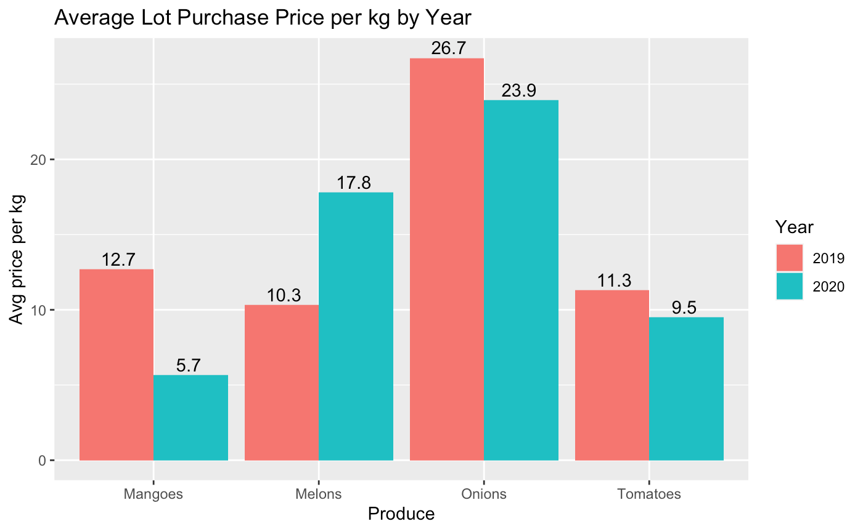
Purchase price (Ksh) per Kg
Packhouse | Purchase price (Ksh) per kg
 | 2019 | 2020 | % change
Mangoes | 12.7 | 5.67 | -55%
Melons | 10.33 | 17.81 | +72%
Onions | 26.74 | 23.93 | -11%
Tomatoes | 11.29 | 9.52 | -16%
The average purchase price of mangoes has dropped precipitiously from 12.7 Ksh/kg to 5.7 Ksh/kg while the average purchase price of melons has increased from 10.3 to 17.8.
Purchase prices of onions and tomatoes have not changed appreciably
Demand for both mangoes and melons has fallen, so price changes must have something to do with broker organization or supply upstream

Slide 13
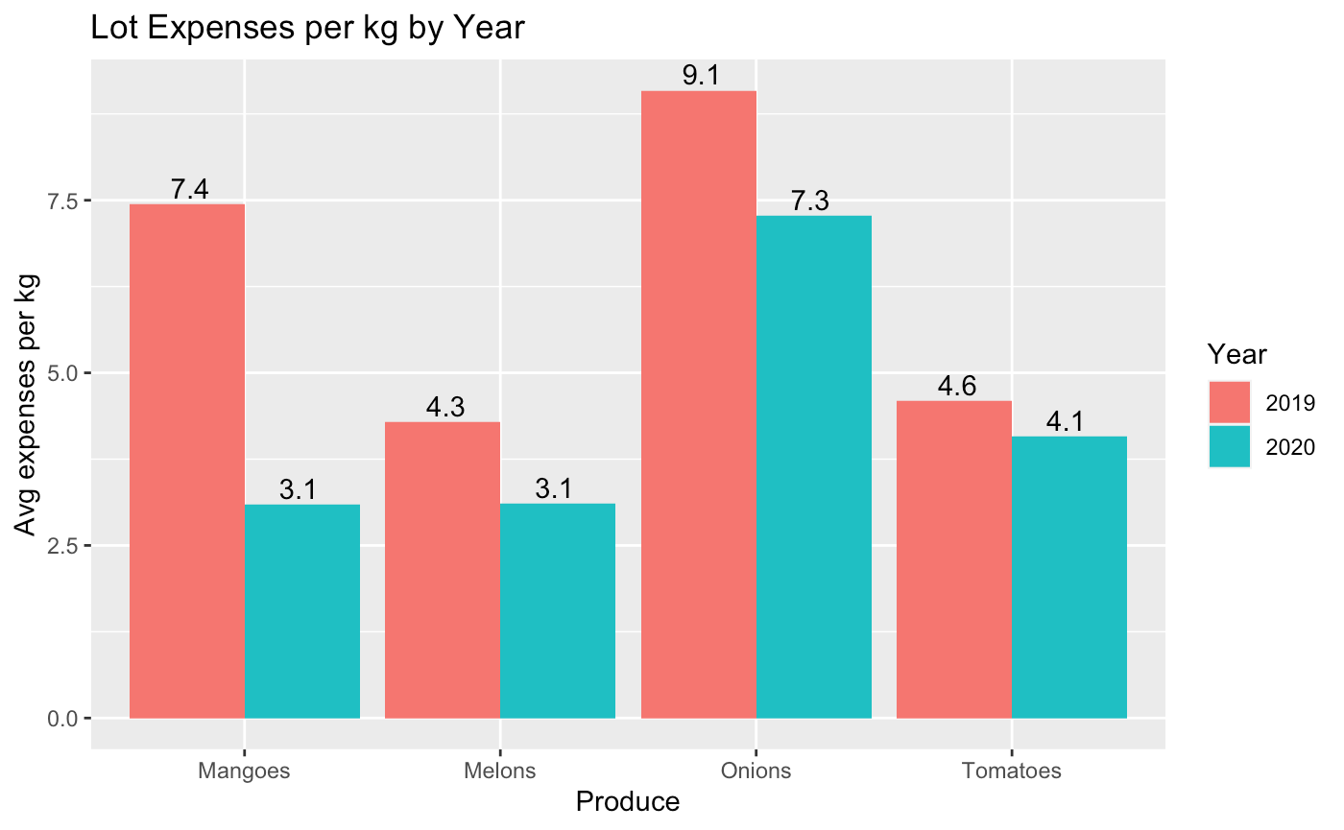
Expenses per kg (Ksh)
Packhouse | Expenses per kg
 | 2019 | 2020 | % change
Mangoes | 7.44 | 3.09 | -58%
Melons | 4.29 | 3.11 | -28%
Onions | 9.09 | 7.27 | -20%
Tomatoes | 4.59 | 4.08 | -11%
Lot expenses (transport, loading, unloading, and packing) have held relatively steady with slight decline across the board.
Mangoes are the exception– we see a significant decrease in lot expense costs. We are not sure why this is. It could be because the mango market overall has dramatically declined; although, we do not see a decrease in melon lot expenses despite similar decline in demand for melons.
This could also be related to the fact that Mango Packhouse is using a diﬀerent and unique broker– a powerful broker in Marakwet who has apparently consolidated control over much of the mango brokerage in the region.

Slide 14
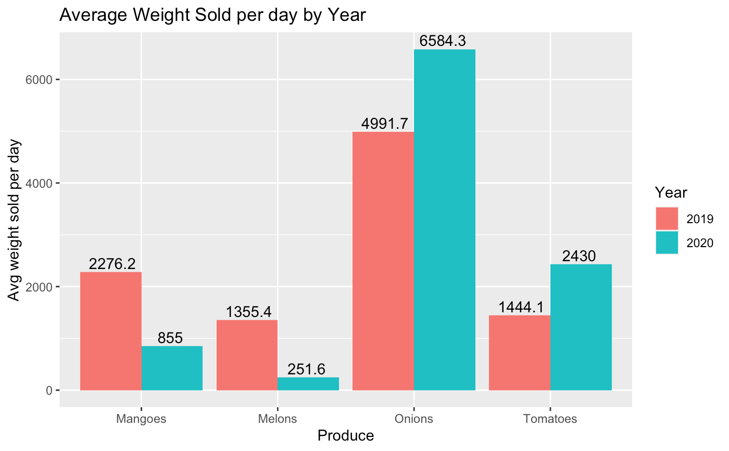
Average weight (kg) sold per day
Packhouse | Average weight sold per day (kg)
 | 2019 | 2020 | % change
Mangoes | 2276.2 | 855 | -62.5%
Melons | 1355.4 | 251.6 | -81.5%
Onions | 4991.7 | 6584.3 | +31.9%
Tomatoes | 1444.1 | 2430 | +68.2%
We see that the average weight of mangoes and melons sold has cratered while the flow of onions and tomatoes through their respective packhouses has in fact increased.
The mango and melon packhouses have both described purchasing less and sharing trucks to reduce the risk of spoilage amidst uncertain and low customer demand.
The onion and the tomato packhouse on the other hand have opened up new supply connections and increased the number of trips they take. The onion packhouse hopes to buy another truck to increase sales further (transportation is his biggest limiting factor), but he has been unable to secure a second loan for the truck as he is still paying off the loan for his first truck.

Slide 15
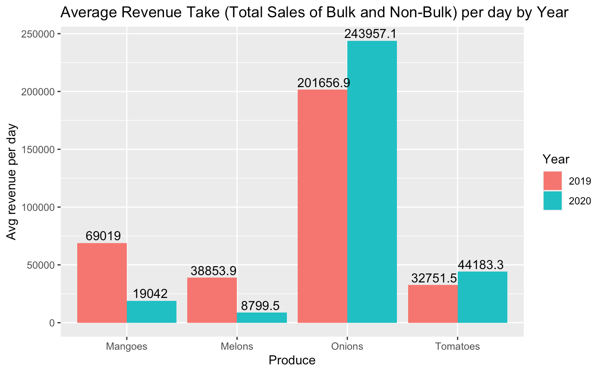
Average revenue per day
Packhouse | Average revenue per day (Ksh)
 | 2019 | 2020 | % change
Mangoes | 69,019 | 19,042 | -72.5%
Melons | 38,854 | 8,799 | -77.4%
Onions | 201,657 | 243,957 | +21%
Tomatoes | 32751 | 44183 | +35%
Unsurprisingly given the discussion so far, revenue for the mango and melon packhouse has fallen dramatically while revenue streams for the onion and tomato packhouse has increased.

Slide 16
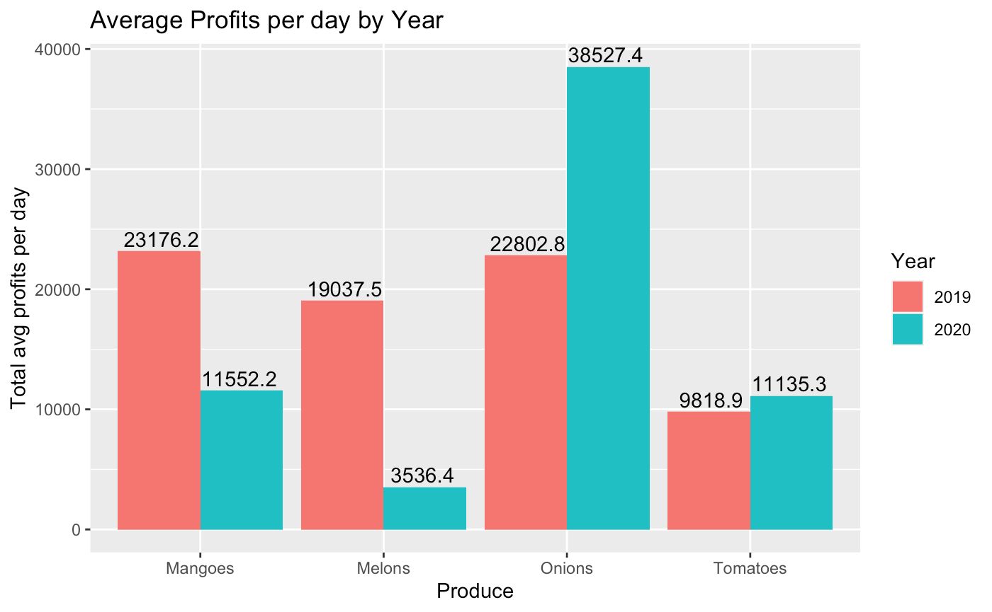
Average profits per day
Packhouse | Average profits per day (Ksh)
 | 2019 | 2020 | % change
Mangoes | 23,176 | 11,552 | -50%
Melons | 19,037 | 3,536 | -81.5%
Onions | 22,803 | 38,527 | +69%
Tomatoes | 9,819 | 11,135 | +13%
Profits per day = Profits per kg * Average kg sales per day.
These numbers don’t include spoilage. Moreover, these numbers don’t include employee pay, fixed costs of the business such as rent and mobile charges, and other operating costs (e.g. personal transport). These ‘profits’ are just cashflow net of lot-purchase associated costs.
The findings again reflect what we have been seeing so far. A point of interest: While the tomato packhouse is selling far more tomatoes (+68%), they are doing so at thinner margins so profits per day increased only 13%

Slide 17
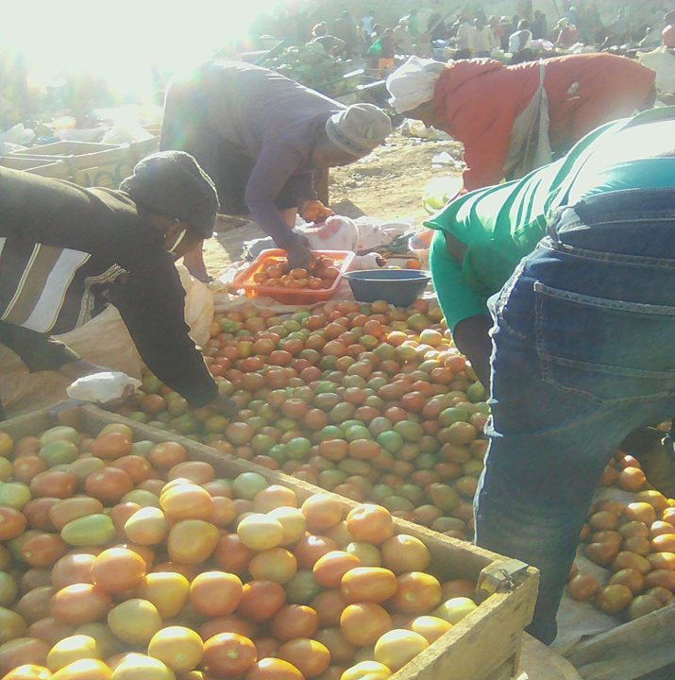
Managing Uncertainty and Risk

Slide 18

One widespread risk that packhouses face is uncertain prices; they have adopted various coping strategies
Issues
o Changes in negotiated on-farm price on the day of collection. brokers state a lower price over the phone to attract the packhouse to the farm which may change once on the farm especially where more willing buyers are available
Tomato broker was asked to leave the farm while her graders had already begun picking and sorting tomatoes because the farmer decided to sell to someone else and she was not able to meet that price. She quickly found another farm to pick tomatoes from since she had already paid for use of the truck. Quality in the latter farm was not as good
o Purchased lots aren’t of same quantity as expected. The difference is usually made up in the following lots; however, this can be costly for traders since they have fixed transport costs.
Coping strategies
Maintain a wide network of brokers across regions
Tomato packhouse keeps at least 40-45 brokers. 15 in Loitoktok, 15 in Kajiado, several in Laikipia, Matuu, Tanzanian border, etc
Work closely with 1-2 brokers with fixed intervals large purchase intervals
Onion packhouse works with one broker who he considers “almost his employee”. He purchases truckloads every 2 days and prices are fixed in advance before money for purchasing is wired to the broker. Onion season in Tanzania covers most of the year so the broker in engaged all year round, he can engage others once he fulfills the packhouse’s orders. The packhouse will at times do spot checks by hiring another broker despite the trust relationship
Maintain a wide network of other traders in the market with whom they sometimes share brokers, trucks and information on prices
Confer on price with several of these brokers
Access fast and easy credit/cash . Cash remains king for some farmers who are wary of reversals/fraud on Mpesa.
*Loading, offloading, packing, and brokers fees tend to be quite stable. Sometimes road fees/ bribes add extra unexpected costs

Slide 19
Uncertain quality Is another challenge as they use brokers to aggregate
Coping strategies
Doing farm visits by the broker, driver or even another farmer
Melon packhouse acknowledges that “it takes too much time to develop the contacts with farmers”.
Maintaining either a wide network of brokers to find the right quality when needed or developing close ties with one or few dedicated brokers whom they can trust
Providing specific instructions to graders who can still find good quality amidst a poor crop.
Identifying different customer segments who require different quality (e.g. small onions for households, small melons for retailers)
Discounting poor quality produce
Mixing the lower quality with the higher quality or using optics/displays such umbrellas used to cover melons make them look redder than usual
Issues
o Main brokers subcontract another level of “sub-brokers” to aggregate .
o Brokers selling off agreed quality to other buyers and seeking to sell off poorer quality to packhouse
Tomato packhouse found aphids on a lot and accused Muli, her broker, of witchcraft. The broker had convinced the packhouse to come out to a farm only to have the farmer sell his produce to someone else. Packhouse had to settle for unripe tomatoes from another nearby farm
o Issues with product handling and packaging - Onion packhouse attended a Twiga workshop when they tried to recruit him to their platform, and while he did not join Twiga, he did learn how to better store his onions to preserve them
o Seasonality affects quantity and quality

Slide 20

One ever-present risk in a market is competition. Ideally, traders want to limit extreme competition in the market
Market space is at a premium (invaluable asset). Even highly informal markets tend to have governance structures in the form of market associations that can create some barriers to entry
New vendors typically must come through an existing network of vendors
Strong social connections - sometimes packhouses associate closely with other traders in the market to share information, brokers, trucks, offer each other loans , sell for the other packhouse when sick or unavailable, form chamas etc
Passion/Mango packhouse is the most involved version of the above. She and other traders knew that black passions were going out of season, so they got shipment and released it slowly and increased the prices. They also share information with each other about customers who try to push down prices. The tomato packhouse indicated no price-fixing, however there was a norm of not undercut each other; spoilt tomatoes can however be sold at a cut price without upsetting other traders.
The strong social connection to the extent of collaborating with other traders on pricing was more evident amongst female owned packhouses

Slide 21
Managing risk of spoilage is key to how packhouses organize their business and market relationships
During the pandemic, unpredictable demand led some packhouses to share trucks (and reduce purchases) in order to reduce risk of spoilage
Hiring competent packers and owning or making good storage space is key for packhouses
Risk of spoilage drives differential pricing in the market
Produce that is starting to spoil is sold at a steep discount to reduce losses and clear up space for fresh produce
Packhouses establish certain customer relationships in order to move different quality goods. E.g. broken tomatoes are sold to hotels for cooking; overripe magoes are sold to juicers; spoiling melons among other produce can be sold to pig farms
Packhouses can sell through fagilia system-- similar to the above, certain areas of the market are known to sell overripe produce and they may buy spoiling produce at a steep discount
For more perishable goods (e.g. tomatoes, mangoes), the key is to move goods as quickly as possible.
As a result, the tomato packhouses maintains a wide network of brokers since tomatoes can’t be left on the farm too long. There is a narrow window for picking, and they need to be in the right place at the right time.
For less perishable goods (e.g. onions, melons), good storage space is critical as goods can keep for a period of time.
Onion and melon packhouses may maintain ties to fewer brokers since timing is less of a concern.

Slide 22
Maintaining Credit Relationships a Key Market Practice
Offering goods on credit means that packhouses can make more sales and move more fresh produce. At the same time, selling goods on credit presents the risk of delinquency. Determining to whom and when to offer credit is an important skill for traders.
I dont give credit to non regular customers though if any of the new customer has been referred by my regular customer then i give partial credit and monitor how committed they are to repaying the credit, some would do daily repayment in the evening after sale.
Offering credit to customers creates a special relationship with the customers and may offset risks of poor quality produce and competitive risk. Even when packhouses may not have the best quality or best price, loyal customers will buy from the packhouse as part of maintaining the special credit relationship.
Some customers will even buy from a packhouse as a matter of ritual or superstition-- kismet
Other measures to maintain clients include: setting aside quality produce for regular/loyal clients, informing clients of arrival of fresh produce
Traders will also maintain good relationships with other traders in the market, mpesa agents, or others in the market who may be able to offer credit when needed.
Other actors in the market may also offer loans-- loan agents from banks, chamas, digital credit, etc. How packhouses manage/decide between different credit sources is specific to trader needs (e.g. loan size, terms of repayment) and trust in agent

Slide 23
Cultivating Market Relationships Key to Managing Risk
More generally, packhouses cultivate a variety of market relationships in order to manage risk.
Maintaining a good relationship with brokers means brokers will ensure that they call you (and not others) when supply is tight or demand is high. Moreover, finding well-connected, trustworthy, and skilled brokers is not easy, so packhouses would want to maintain a positive working relationship with them
This sometimes means not negotiating on price or accepting higher prices in the moment
This also could mean buying from them even if there were other options available
At the same time, having backup and alternative options available is important
Good relationships with market heads can mean preferential parking in the market when trucks come in. This speeds up produce handling, reduces risk of breakage, and reduces costs.
Good relationships with other market traders mean they will share information on prices, produce, and customers; share broker contacts; share trucks; help each other out with credit, etc.
A good relationship with clients means they will bring more clients-- reputation spreads through word of mouth

Slide 24
Some key questions for the prospect of digitization
To what extent can digitization minimize existing uncertainties in the value chain? Can they do so more effectively than current packhouse strategies? Does digitization create new risks and uncertainties?
How does digitization affect existing relationships in the marketplace? Given that these market relationships fulfill a wide range of needs, how can we ensure that digitization does not substitute for them?
Diverse market relationships are based on negotiation and flexibility (e.g. flexibility in price, credit, grading of produce). Can digital platforms be designed to be flexible in such regards?
In attempting to digitize markets, how are existing practices of exchange being changed?
.

Slide 25
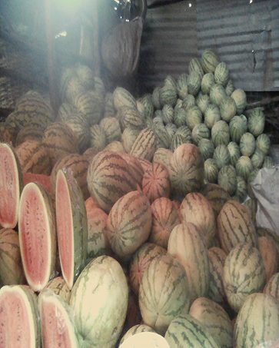
Measurement, accounting, and record-keeping

Slide 26
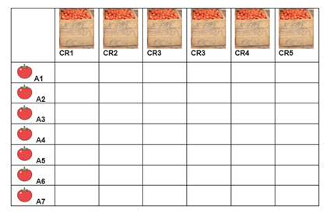
MEASUREMENTS stock-keeping unit (SKU) vary and are not standardized. Further, classification is based on visuals not standard dimensions
Tomato Crates Basis for purchase, paying brokers graders, pricing and selling A crate is estimated to hold 200kg when leveled but it usually packed high Brokers sometimes use slightly larger crates than the standard but indicate “farmers don’t seem to notice” Classification Based on a grading system guided by variety and size Broken tomatoes are sold to hotels for cooking | Onion Nets Each holds 45 - 50 Kg and packhouses randomly selects nets for checking weight Buyers can buy per net or by weight or by piece Classification Onions have 3 categories- large, medium & small, the latter mainly for household use Quality based on level of dryness | Melon Pieces Packhouse weighs melons at purchase and weights for bulk purchases But for non-bulk, packhouse estimates weight by looking Classification Melons have 2 categories - large & small, the latter is prefered by retailers Quality assessed by tapping Assumes quality is standard within a farm | Mangoes Nets sold in 30 kg nets Classification Based on ripeness and variety Packhouse will sometimes set certain nets aside for customers as she “knows what they are looking for” Overripe mangoes are best for juice
Displays tend to have “Camera” the best looking produce on show
How can digitization incorporate the various computations?

Slide 27

How is price determined?
Packhouses tend to follow a strategy of sufficing instead of maximizing. They estimate what is needed to turn a profit, but they don’t try to maximize profits through careful accounting.
They often follow certain rules of thumb to determine what is needed to turn a profit and live well. For example, they know roughly by how much to mark up their produce.
Prices are disciplined by the market. Customers will come in and complain if their prices are too high compared to others in the market
Q What really does it mean to state that prices are determined by demand and supply?
How do consumers and traders know if there is low/high supply or low/high demand?
Information about prices is channeled through networks of brokers and traders. Sometimes maintaining good relationships with brokers and clients takes precedence over getting the best price.
Some traders, especially those that share brokers, confer on prices. E.g. the mango traders sometimes set prices together to reduce competition.
How might the flow of pricing information and choices about pricing change on a platform?

Slide 28
Accounting and Record keeping
Each packhouse keeps records on credit-- to whom they have given credit, how much they owe, or if they have taken credit out from someone. Records help prevent disputes and ensures the packhouses remember (though they mostly have excellent memory about who owes what).
Most packhouses do pricing by lot. They calculate costs associated with the lot and decide on a sale price that allows them to make a profit after paying fixed costs. These calculations are typically back of the envelope and are not formally stored or accounted.
Movement of goods are not accounted for. Accounting for each kg for each sale (especially nonbulk) is impossible and lots often get mixed with leftover produce. Identity of customers is known informally, not recorded in sales books.
Melon packhouse starting keeping records of expenses and costs after previous study. Used his records to cut back on mobile phone expenses.
Onion packhouse is unique in that he keeps a detailed record book (at home) of total costs, sales, and profits.
Records are not digitized, nor for the most part, even kept in a systematic fashion. When records are made, they are typically useful in the moment and discarded after.

Slide 29
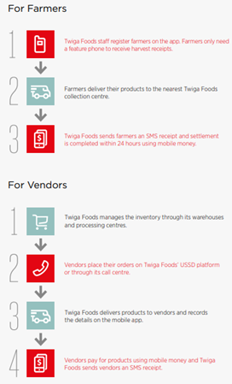
Packhouses’ have had some interactions with platform providers

Slide 30
Prices offered to packhouses are high (60% higher than what packhouses pay)
“A few months ago they came back to the market but now with offers to supply me tomatoes but their prices were not competitive; they were offering to sell me 50kgs of tomatoes [bread crate] @ 800shs. At the time they were offering that price, the buying price for a 200+ kg crate was between 2000-2100 shs [1 big crate = 5x50kgs because of the heaped crates]. But when I told the [platform’s] agents the prices I get from the farm they laughed it off and said I was lying to them.” Although the above scenario suggests a 60% higher price than what packhouses pay, its all inclusive of sorting, grading and transportation
Platforms demand quality that is difficult to achieve and expensive for the packhouse
“In kwa Njenga market we can get away with compromised quality but not with [the platform], you need to be sure of the quality from the farm otherwise they will not buy. It would need you to have a team of quality control in the farm, who understand the quality [the platform] wants and all that means spending more yet their prices are not that friendly. ”
Relationship is one of employer-employee, not one of business partners
“Accepting to supply them would be like agreeing to be their employee; they would be using me to source and deliver to them at no cost, you can't make profits working with them.”

Slide 31
These platforms are looking for suppliers who already have networked with formal large buyers who have set quality
“The officials from [the platform] came back after one week on a different day just to confirm if I have enough stock and they were interested if I have steady customers and if I supply to the high end supermarkets like Naivas, Tuskys and malls in Westland which I was not doing. The only supermarket I supply to is Quickmatt Githurai branch.”
Packhouses may not have the time to adhere to the various requirements and waiting time
“These conditions included: finer Sorting; cleaning to ensure no soil or dirt and not hairy; well packed; timely delivery like if they say by 6am you are supposed to be at their store by specified time; waiting time at their store to be cleared; payment process after approval...Waiting time and delivery to [the platform] stores was also a challenge to me for example if you get several trucks, then you will spend more time waiting to be cleared. It is a waste of time.”
These platforms were perceived to target higher segment clients that conduct their transaction exclusively through the system, this does not seem to be the case
“[The platform] is a threat to other businesses given that sometimes they have been sported hawking their product using trucks in the estates especially the bananas and Tomatoes, that means we are competing for the same customers and I thought they were targeting the high end market and exporting their products.”

Slide 32
These platforms are perceived as a major threat to packhouses
Lowering selling prices Currently [platform] is offering to supply melon at between 28 -30shs per kg while I am selling at 35, customers will opt to buy from them, in that case tell me where will I go?
Pushing up farm-gate prices “They are able to book a whole farm of melons, they are given the chance to pick all the sizes they need, then what is left the farmer will want to sell at the same price as [the platform] bought. They usually buy grade 1, i.e. 5kgs and above, so the farmer will sell them at a higher price than he would sell grade 2, maybe 20 shillings a kg. That way it will not be easy to convince the farmer to drop the price to maybe 14/15 shillings. I believe they are also charged higher by the farmer as they consider many things before, they buy e.g. sugar level, shape and size.”
· Buy in large quantities have access to remote localities “...they use large trucks ... as compared to traders like myself. They also have brokers on the ground who are able to go to the most interior farms looking for the melons since they have their own motorbikes, something that some of the brokers I use cannot do because of lack of resources”
Aggressive integration “I heard they are already doing tomato farming in parts of Taita Taveta, meaning they might be planning to start melon farming too, which will destroy the market prices as they will sell lower than the rest of us now that they will be farming. But it will not be easy for them to do everything, i.e. Farming, marketing and supplying. They should just concentrate on one thing. They will slowly destroy packhouses and other small traders.

Slide 33
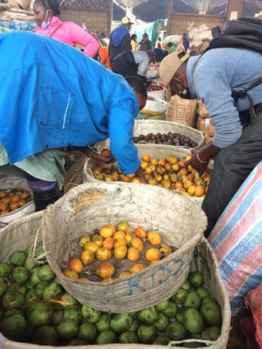
Emerging Questions and Lines of Research

Slide 34

Questions
Who is being onboarded to the platforms?
How do the platforms engage brokers? Do brokers become platform employees?
How do platforms interact or compete with existing public markets?
Instead of replacing or competing against packhouses, can platforms help them manage risks in the value chain? Can digital platforms be integrated into existing market structures?
What kinds of relationships do platforms encourage or maintain?
Do platforms replace existing market relationships with different ones?
Can they help reduce risk without creating new forms of risk?
Presumably platforms rely on high quality data to function.
How do platforms collect high quality data? Who do they rely on to input data?
What kinds of market practices allow for high quality data? What kinds of market practices hinder data collection?
What kinds of market practices do platforms encourage? What are the consequences of such?

Slide 35

Method
In addition to the approach in following the supply chain as is, there is the possibility of:
Exploring from the platform providers how/which market actors are asked to attend the training session.
Attending a training session and following the market actors who agree to join the platform and those who don’t agree to join). (Will platform providers agree to this?)
Discussions with leaders in the digital platform space to understand the directions they see the market moving.
Interviews with platform data scientists and market engagement associates to shed light on how informal market information is channeled into a data structure.

Slide 36
THANK YOU

