Slide 1
(IN)FORMAL MSEs IN NAIROBI
Network Analysis and rankings – Overview of Findings
November 2020

Slide 2
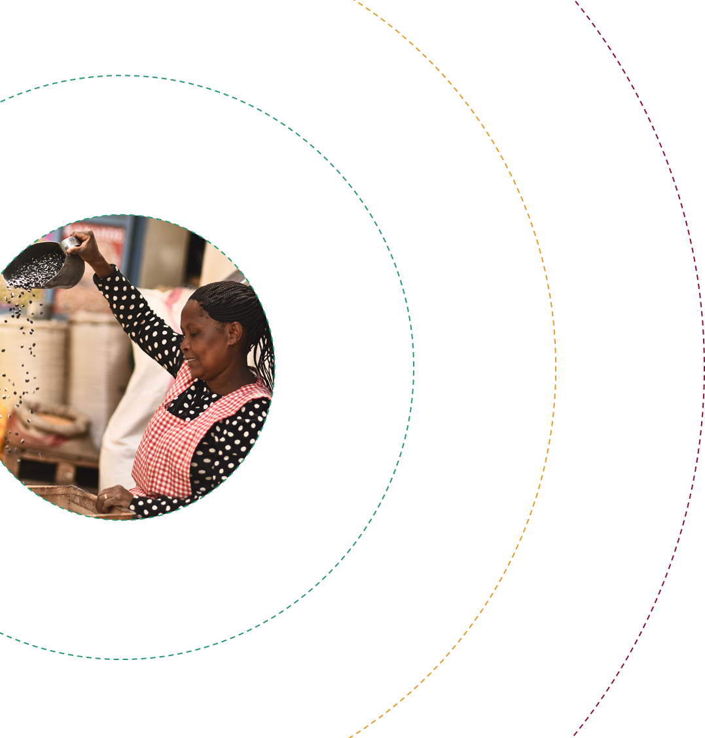
MSE NETWORK MAPPING DEEP DIVE - METHODOLOGY
Moderately close
Not close
The exercise was conducted with six business owners and split into three themes – supply relationships, customer relationships and financial service provider (formal and informal) relationships
Two business owners were interviewed per theme
Respondents were introduced to the exercise and told what the three circles mean – inner circle to outer circle, closest to least closest relationships
Respondents were not prompted on what a “close” or “not close” relationship” is but rather were asked to describe their relationships with these individuals / organisations and then plot them on the map where they think they fit
Each shape represents a single supplier / customer or organisation. The shapes indicate different types of suppliers/ customers (based on location or type), with a key provided at the bottom of the slide
Very close
Cross-border relationships
Kenyan-based relationships
Kenyan-based relationship
Kenyan-based relationships
Illustrative example

Slide 3
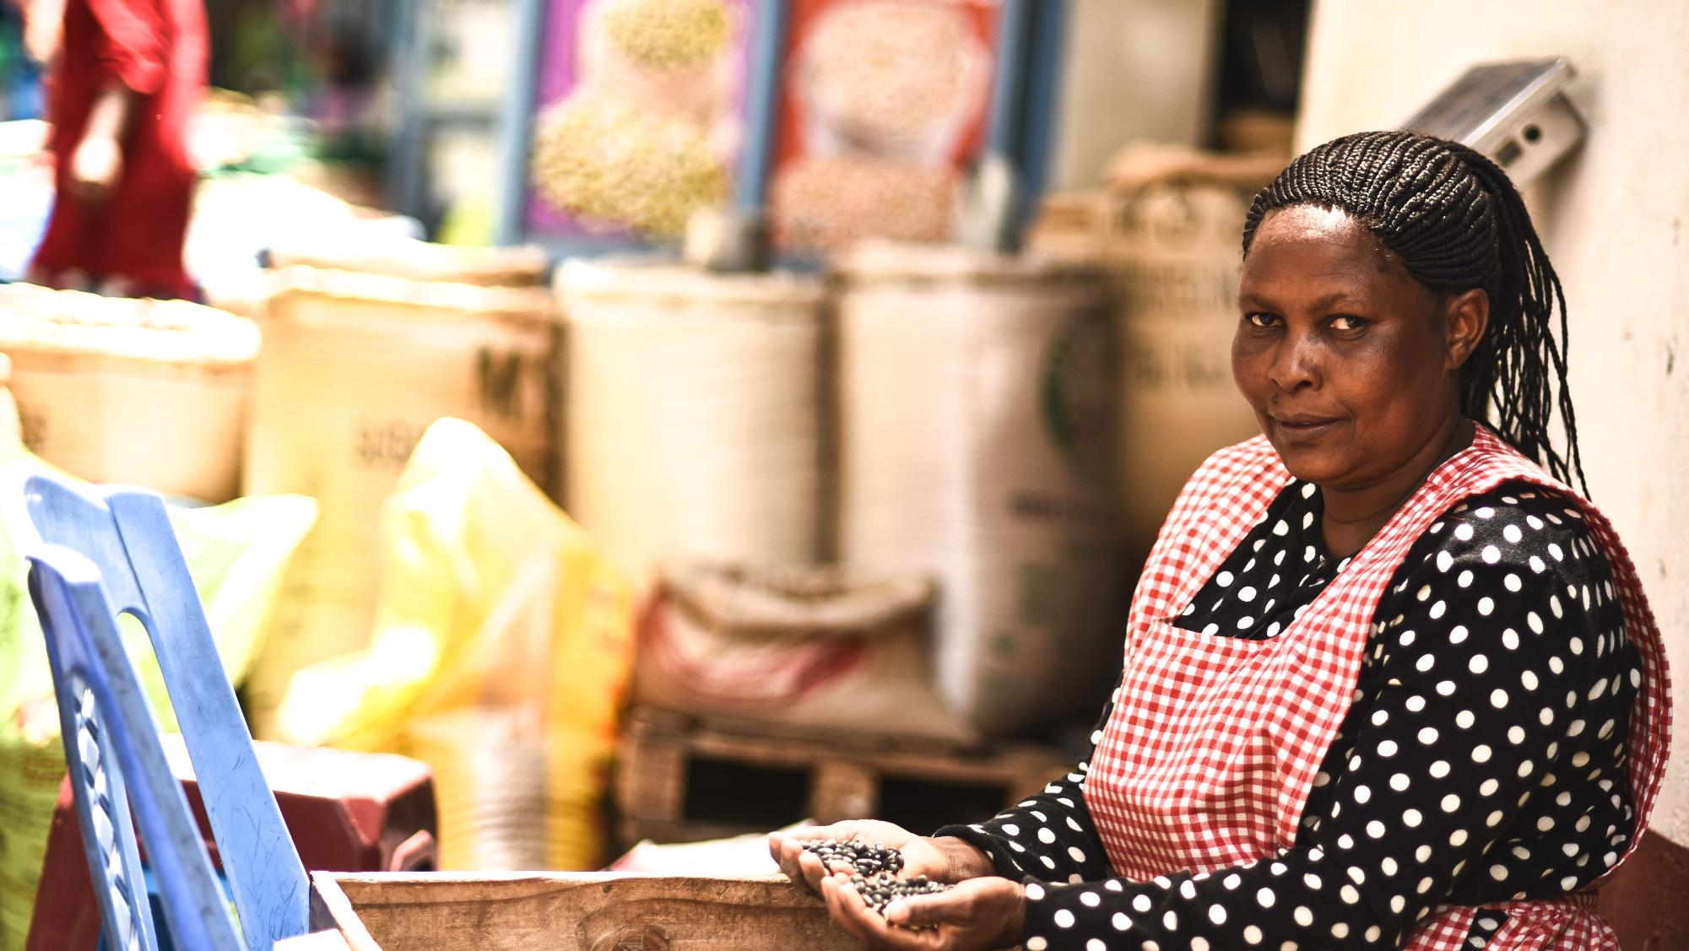
Supplier network
Christine sells cereals and grains from her shop in Nyamakima market
Christine has around 17 suppliers, of which six are considered to be very close relationships and a further 4 are ‘moderately close’
Relationships with her closest suppliers have been built over many years, 6 – 8 years in some cases, and are characterised by mutual trust and support
70% of her supply is sourced from brokers in Tanzania and Uganda who buy produce directly from farmers (supply alternates between the two depending on the season)
Her Tanzanian suppliers are regarded as being particularly close to her business because they offer her credit
She usually pre-pays both cross-border brokers ahead of receiving the goods via her bank account
She also has three main suppliers in Kenya in Mwea, Narok and Ukambani who she sources rice and other items from. She pays these suppliers in cash
Christine uses additional suppliers when required, but does not regard these as important relationships

Slide 4

CHRISTINE – SUPPLIER RELATIONSHIPS:
Not close
They have contributed to the growth of my business. They support my business…even if I call them and tell them to send me supplies yet I don’t have money, they do so
Moderately close
Very close
Kenya, Ukambani
We trust each other. When I tell him I am coming this day, he gets the goods ready and keeps them for me. But the others, if you get there late you may find they have sold the goods to other buyers. He also organizes transport for me up to Nairobi and negotiates for the cost.
Tanzania
Uganda
Kenya, Ukambani
Kenya, Kisii
Kenya, Narok
She is the one who gets what my customers want, she does not mix rice, others mix different qualities of rice, some bring broken rice, but she gives me quality
Kenya, Narok
Kenya, Nairobi CBD
Kenya, Mwea
Kenya, Ukambani
Those from you Uganda you must give them cash, but their faithfulness is high. The Ugandans will make sure the supplies reach when they send. They will also give you quality supplies…they are close to my business, but not as close as the Tanzanians
Kenya, Eastleigh
Give credit
Hold goods for her
Organise delivery
High quality produce
No credit
High quality produce
Organise delivery
No credit
Do not hold goods
Do not organise delivery
The rest are the ones that have to think about business first…That’s their nature they are unreliable and you cannot trust that they will keep the goods for you
Cross border supplier
Local
supplier

Slide 5
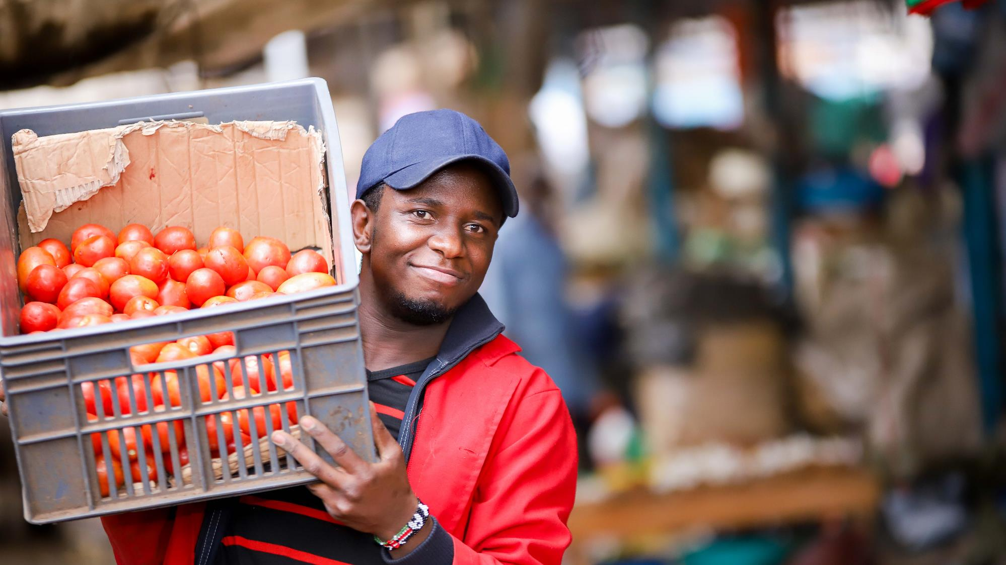
Customer network
Shadrack sells tomatoes and onions in Muthurwa market
Shadrack’s main customers are hotels and retailers which purchase his goods wholesale, although he does also have some individual customers
He considers five hotel customers and five retailers as very close relationships
Close customers visit him regularly, usually on a daily basis
They are loyal to him, and will purchase from him even when the quality is lacking or cheaper options are available
They also refer other customers to him
Shadrack allows his close customer to take goods on credit, he will also borrow from them when he needs money to purchase stock
He will also organise delivery for close customers, give them discounts and will try to get the best quality produce for them
He has worked with many of his close customers for over four years, some were introduced to him by his mom who operated the shop before him
His customers pay him with cash and Mpesa

Slide 6
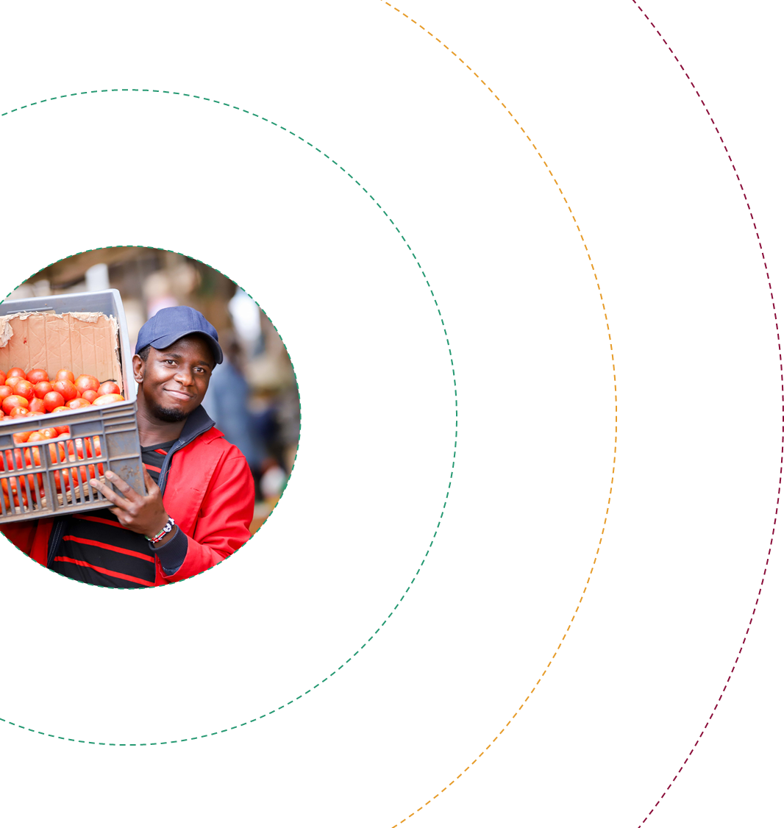
SHADRACK – CUSTOMER RELATIONSHIPS:
My regular customers will come even if my tomatoes are not that good, they’ll tell me: ‘Shadrack today they are not that good but I’ll just carry a few with me’. So, I do count them as my close customers because they are loyal to me
Moderately close
Not close
Very close
Hotels
He stands with me in bad times and good times. We share personal issues and advice with each other on business. I also sell to him on credit which he pays on time. We also borrow from each other
Hotels
Hotels
customers have always been with me even if the Tomato prices fluctuates and goes high. Even when it is Tomato season and they are sold everywhere, and even if there are cheaper at other places, they will still come and buy from me
Retailers
Individuals
Retailers
They are loyal to the business. Also when we have functions we invite each other which is the social aspect of placing them close. We help each other
Individuals
She is not regular a customer she might come today then fail to come tomorrow but even if she misses once she will still come back, so that’s why I value her, even if they don’t buy daily but at least can come and say hi.
Regular customers (most buy daily)
Highly loyal
Refer other customers
She is an inconsistent customer. she comes daily but at times she can come and tell me today I’m not taking your tomatoes and then she moves to another place, that’s why she is outside
Semi regular
May use other suppliers
Irregular customers
Use other suppliers
At times she even lied to me that she has closed down of which is not the case, she has been buying from someone else
Hotel
Retailer
Individual

Slide 7
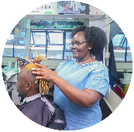
Financial products and services network analysis
Christine runs a salon in the Nairobi CBD. She operates out of a permanent premises. She pays for a county permit annually and her business name is registered. She is employed at a hotel and runs her salon to make extra income. She makes use of both formal and informal financial services in her business
FSPs used for business purposes
FSPs for personal use
Informal relationships
Formal relationships
Shylock
Employer SACCO
Mpesa
Christine takes small loans for her business
She usually takes KSh 20k loans, which must be repaid in 3 months with 20% interest
She contributes every month (deducted from her salary)
Can get loans of up to three times her savings. She has used numerous loans to invest in her business
Can access ‘quick loans’ of less than Ksh 40k, or larger loans over KSh 40k which require five colleagues as guarantors
Repayment is made directly from her salary
Has a Till number for her business and a personal Mpesa account
Encourages customers to pay via Till Number
All funds from Till number are deposited into Cooperative bank account
All day-to-day transactions done via Mpesa
She gives quick loans to small businesses, sometimes I want to stock more sodas in my fridge then I take 20k from her at 20% interest; when I take money from her it is always for the business
Cooperative Bank account
It has been a very long time since I went into the banking hall to transact over the counter or even the ATM, I do all transactions over the phone
Chama
Opened an account to build up a relationship with the bank for when she is no longer employed and will not have access to her employer SACCO
Deposits funds from Till number into her bank account “the more they see me save with them the more they will give me loans when I want”
Pays her employees from her account into their Mpesa wallets
Took a Ksh 300K loan in 2016 for her business and to start building a credit history with the bank
Contributes KSh 3K per week
When it is her turn to get paid out she usually uses the money for personal expenses
Mobile loans
Christine has used multiple mobile loans from different providers (Branch, Tala, Zenka, M-Shwari)
She uses these for emergencies and personal payments, but never for her business
Sometimes I feel so bad when the money is used on other things and I just wish I could use it on the business
Family
When I apply for a loan, they come here to see which street we are located; they also want to see the current business license, and they want to see what I have in the business that can cover for the loan payment in case I default
Most of the time I use the mobile loan apps for emergencies, my mother would call me and say she wants to buy a cow or something personal, so I borrow from the apps for other purposes not for the business
Sometimes receives money from her brother, usually around KSh 10,000
This is usually used to buy food, never to support her business

Slide 8
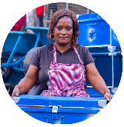
Financial products and services network analysis
Agnes owns a metal fabrication business in Nairobi. She operates out of a temporary structure on an open piece of land. She does not pay any money to the County, but did recently register her business name in response to a small tender. She makes use of both formal and informal financial products and services, and has used several bank loans to grow her business.
FSPs used for business purposes
FSPs for personal use
Informal relationships
Formal relationships
Family
Merry-go-round
KWFT (Kenyan Women Microfinance Bank)
Her husband supports her business both by assisting her with her record keeping and by providing finance when needed
He supplied her with Ksh 50k for start-up capital
In 2017 her husband took a loan from his employer on her behalf
Agnes’s sister also helps her out if she does not have money to pay back one of her loans
Agnes is a member of various groups – a daily, weekly, monthly and annual contribution group
She contributes Shs 100 to the daily group and KSh 2000 to the weekly group; she does not specify how much she contributes to the other groups
Some of these groups are specifically with other business owners
Agnes generally reinvests the money she receives back into the business. On one occasion she received KSh 30k which she used to “boost” the business
Agnes refers to this as a Sacco
She opened an account with them about 20 years ago and has taken at least two loans from them to grow her business, one of which was KSh 200k
Agnes does not like the group loan structure as this has affected her negatively in the past when group members missed payments
While KWFT has supported her business she stopped using them around two years ago
Equity Bank
Her account at Equity Bank appears to be primarily for the purposes of accessing loans
She has accessed numerous loans for her business from Equity (based on her savings with them) of between KSh 20k and KSh 150k
However, these are group loans which she does not like because of her experience with other group members defaulting
Colleagues / friends
Agnes has two colleagues or “friends” as she refers to them that she borrows small amounts from
Occasionally she will also lend money to them
Welfare
She is a member of the Jua-Kali Welfare group which supports members in case of sickness or death of a family member
She has received support from this group on three occasions
Cooperative Bank
Agnes also has an account here but has not used it to access any loans
I sometimes need something to use at work, but I do not have the money at hand, like I need 10k or 5k, then I would borrow from them
Mpesa
Agnes has a personal Mpesa account
On occasion she will allow customers to pay her via her personal mobile money account but she does not encouraged it due to risk of payment reversals

Slide 9
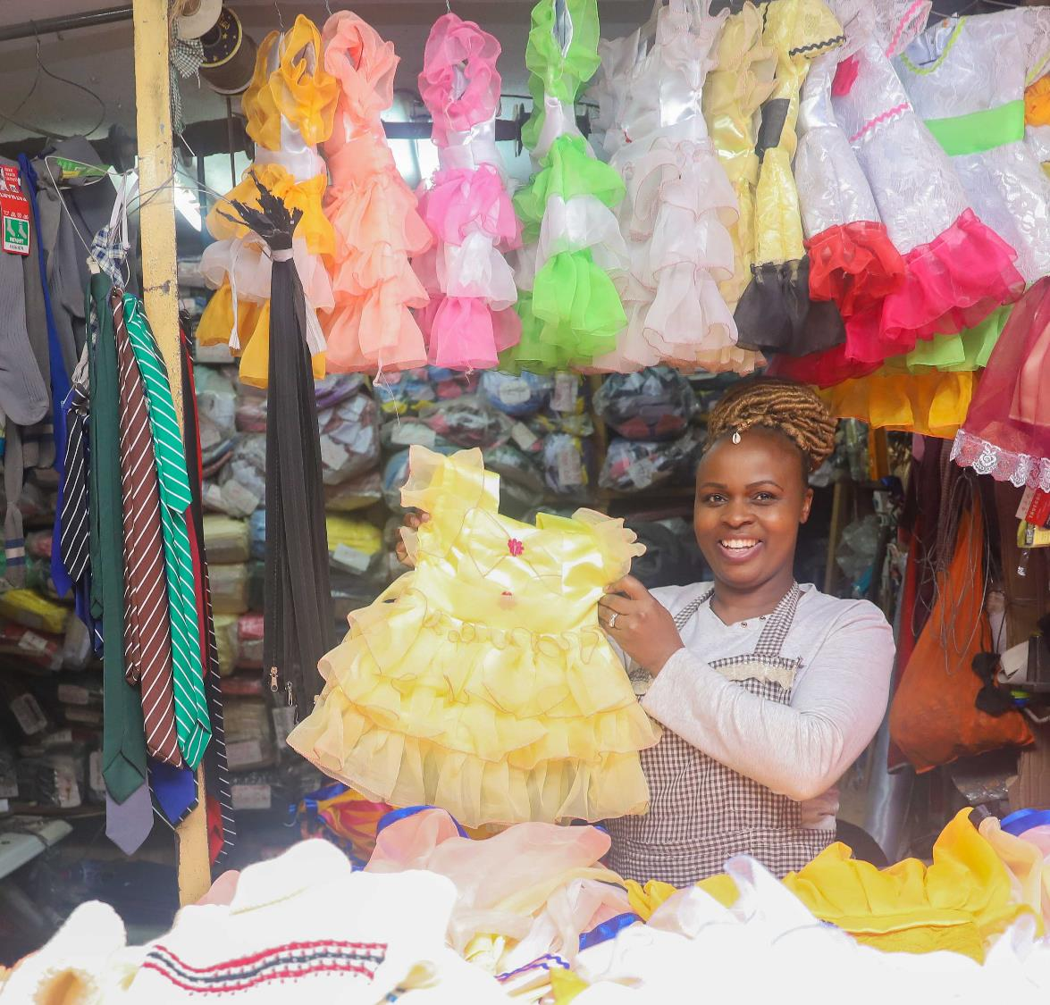

Relationship ranking exercise
Six business owners were asked to rank various relationships by classifying them as green, red or orange where:
Green indicates the relationship has added a lot of value to the business
Orange indicates the relationship has added some value to the business
Red indicates the relationship has not added any value to the business

Slide 10
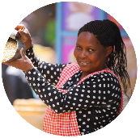
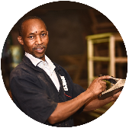
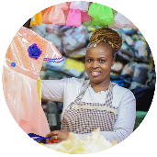
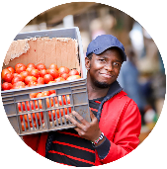
Perceived value of network relationships - Summary of ranking results
High value
Medium value
Low value
 | Christine Sells grains and cereals | John Wood work / furniture maker | Christine Hair salon owner | Rose Dress maker /Tailor | Shadrack Vegetable trader | Agnes Metal work
Customers
Suppliers
Employees
Colleagues
Friends / family
Banks
Chamas
Saccos
Associations
County Govt.
National Govt.
V

Slide 11
Perceived value of network relationships - Summary of ranking results
High value
Medium value
Low value
 | Christine Sells grains and cereals | John Wood work / furniture maker | Christine Hair salon owner | Rose Dress maker /Tailor | Shadrack Vegetable trader | Agnes Metal work
Customers
Suppliers
Employees
Colleagues
Friends / family
Banks
Chamas
Saccos
Associations
County Govt.
National Govt.
V
Without customers I wouldn’t be calling it a business, I have really grown because of their existence and the fact that they buy goods from me.
They are the reason why I am here, just to say customers are the ones who has contributed the most because through them I sell my products hence my survival in my business.

Slide 12
Perceived value of network relationships - Summary of ranking results
High value
Medium value
Low value
 | Christine Sells grains and cereals | John Wood work / furniture maker | Christine Hair salon owner | Rose Dress maker /Tailor | Shadrack Vegetable trader | Agnes Metal work
Customers
Suppliers
Employees
Colleagues
Friends / family
Banks
Chamas
Saccos
Associations
County Govt.
National Govt.
V
They are the key people in business because they supply me with materials to use, offer trade on credit and the fact that they offer me quality materials which ensures that my customers are satisfied
Let’s put them on orange because they add some value but I have to pay them to get supplies, they don’t give credit
They’ve contributed a lot, because through them I get my products to sell and not only product but quality products and also on time and also their services to me was one of a kind and through them I can say my business has excelled

Slide 13
Perceived value of network relationships - Summary of ranking results
High value
Medium value
Low value
 | Christine Sells grains and cereals | John Wood work / furniture maker | Christine Hair salon owner | Rose Dress maker /Tailor | Shadrack Vegetable trader | Agnes Metal work
Customers
Suppliers
Employees
Colleagues
Friends / family
Banks
Chamas
Saccos
Associations
County Govt.
National Govt.
V
Without them there is nothing I can do by myself, when customers come in, I need to have employees to attend to them. They also have to do excellent work so that customers can come again and again
Without them I cannot be in business. Personally I don’t know how to make the sweaters so I depend on them
There are some who stole from me, I gave them credit but they never came back again

Slide 14
Perceived value of network relationships - Summary of ranking results
High value
Medium value
Low value
 | Christine Sells grains and cereals | John Wood work / furniture maker | Christine Hair salon owner | Rose Dress maker /Tailor | Shadrack Vegetable trader | Agnes Metal work
Customers
Suppliers
Employees
Colleagues
Friends / family
Banks
Chamas
Saccos
Associations
County Govt.
National Govt.
V
They have supported me in terms of giving advice and due to the union we have as business colleagues we have been able to look at ways of growing and also offer protection to our businesses
They don’t give me anything put them on red; that is competition
For example if a customer needs a particular color of sweater that I do not have, I will take it from a colleague

Slide 15
Perceived value of network relationships - Summary of ranking results
High value
Medium value
Low value
 | Christine Sells grains and cereals | John Wood work / furniture maker | Christine Hair salon owner | Rose Dress maker /Tailor | Shadrack Vegetable trader | Agnes Metal work
Customers
Suppliers
Employees
Colleagues
Friends / family
Banks
Chamas
Saccos
Associations
County Govt.
National Govt.
If get an order that needs a lot of money and I don’t have it I will call my family, my brother or a friend and they will assist me. Let’s say I will be away tomorrow, I cannot close the business, I will leave a friend or my sister to take care of the business
They add some value because when you are down someone will come and talk to you, encourage you that things will be okay. They give you moral support but not financial
V
Because family members and friends I can count on like let’s say I’m running low of stock and I don’t have money I can call my brother to lend me or even a friend and they will boost me if they have. And my hero now is my Mum because she is the one who introduced me here, taught me the way to go and even still supporting me whenever possible.

Slide 16
Perceived value of network relationships - Summary of ranking results
High value
Medium value
Low value
 | Christine Sells grains and cereals | John Wood work / furniture maker | Christine Hair salon owner | Rose Dress maker /Tailor | Shadrack Vegetable trader | Agnes Metal work
Customers
Suppliers
Employees
Colleagues
Friends / family
Banks
Chamas
Saccos
Associations
County Govt.
National Govt.
It has not helped a lot in the business. Equity and KCB have contributed just a little. I use to save with them but they gave me a soft loan but it was a small amount
I am very close to them because this where my savings are for present and future plans
V
They have given me money through loans to buy the materials and that way I keep my work going on
They have given me money through loans to buy the materials and that way I keep my work going on

Slide 17
Perceived value of network relationships - Summary of ranking results
High value
Medium value
Low value
 | Christine Sells grains and cereals | John Wood work / furniture maker | Christine Hair salon owner | Rose Dress maker /Tailor | Shadrack Vegetable trader | Agnes Metal work
Customers
Suppliers
Employees
Colleagues
Friends / family
Banks
Chamas
Saccos
Associations
County Govt.
National Govt.
V
I am just in one Chama and let’s say I need money like 20,000 I can get it, but for you to get money again it will take like a year. So is like 20,000 in a year – it’s too little
Through the savings and loans from my Chama I have been able to boast my business whenever need be
Money from chamas boost my business in a way. Once I get the money I use it to buy some little things which I do not have at that time

Slide 18
Perceived value of network relationships - Summary of ranking results
High value
Medium value
Low value
 | Christine Sells grains and cereals | John Wood work / furniture maker | Christine Hair salon owner | Rose Dress maker /Tailor | Shadrack Vegetable trader | Agnes Metal work
Customers
Suppliers
Employees
Colleagues
Friends / family
Banks
Chamas
Saccos
Associations
County Govt.
National Govt.
I save everyday and I feel like I have employed myself. If I decide to be saving 500shs a day they will be coming for it every day. If I decide I need a loan I will be able to get it from them. If I decide I need some money from them even today they will give me
The loan that they gave us back then has enabled us to do a lot and to grow in this sector of business…through it we expanded our business by adding the stock and also contributed to the shop where my mom is currently working at. So it has contributed a lot and we have benefited so much in this Sacco
V
They are important because anytime I get stuck, I can borrow from them and boost the business

Slide 19
Perceived value of network relationships - Summary of ranking results
High value
Medium value
Low value
 | Christine Sells grains and cereals | John Wood work / furniture maker | Christine Hair salon owner | Rose Dress maker /Tailor | Shadrack Vegetable trader | Agnes Metal work
Customers
Suppliers
Employees
Colleagues
Friends / family
Banks
Chamas
Saccos
Associations
County Govt.
National Govt.
I am very close to them because this is about our wellbeing as businesspeople and through this association we are able to support one another and also ensure our businesses are well secured
They’ve contributed just a little, even their absence can’t affect my business so I haven’t seen their contribution that much, the market is clean at times even the lights go off for a week but we are still there surviving with our businesses so I don’t see much of their importance
V
It has helped in welfare and the association has ensured that there is security and have protected businesses operating within this area

Slide 20
Perceived value of network relationships - Summary of ranking results
High value
Medium value
Low value
 | Christine Sells grains and cereals | John Wood work / furniture maker | Christine Hair salon owner | Rose Dress maker /Tailor | Shadrack Vegetable trader | Agnes Metal work
Customers
Suppliers
Employees
Colleagues
Friends / family
Banks
Chamas
Saccos
Associations
County Govt.
National Govt.
I am not satisfied with their services like here there is poor infrastructure which they have never considered working on yet we pay some good cash on a yearly basis. So what ties us together is only that I can’t operate peacefully without complying
V
After paying, you are recognized and they don’t disturb you, you are allowed to operate smoothly and also they ensure clean working environment
Oh my God the government, just put them on red, they don’t help me at all, they bother me with little things

Slide 21
Perceived value of network relationships - Summary of ranking results
High value
Medium value
Low value
 | Christine Sells grains and cereals | John Wood work / furniture maker | Christine Hair salon owner | Rose Dress maker /Tailor | Shadrack Vegetable trader | Agnes Metal work
Customers
Suppliers
Employees
Colleagues
Friends / family
Banks
Chamas
Saccos
Associations
County Govt.
National Govt.
V
It has helped in ensuring there is good infrastructure in main roads however it neglected the feeder routes within the market and again I feel that the government has failed in terms in ensuring small business people can access loans from the government
It has added a lot of value to my business. First of all, hon. Kibaki gave us the land. Initially my mum was at Gikomba by then I was very young, so they were moved to this place where we were given a small portion of land for business…The government has really contributed
I wish we could just be doing business without paying KRA. They are the only ones who benefit from the money that we pay there

Slide 22

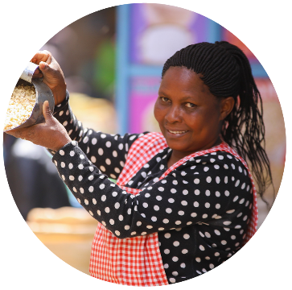
Perceived value of network relationships
Christine: sells cereals and grains
Low value
County government
Medium value
High value
Customers
After paying, you are recognized and they don’t disturb you, you are allowed to operate smoothly and also they ensure clean working environment
They have helped me a lot. The banks give me loans
Banks
Suppliers
It has helped in welfare and the association has ensured that there is security, and they have protected businesses operating within this area
National government
Employees
Associations
Other business people

Slide 23

Perceived value of network relationships
They are the key people in business because they supply me with materials to use, offer trade on credit and the fact that they offer me with quality materials which ensures that my customers are satisfied
John: Wood work / Furniture
Without customers I wouldn’t be calling it a business, I have really grown because of their existence…
Low value
Medium value
High value
Customers
Associations
Suppliers
County government
I feel that the government has failed in terms in ensuring small business people can access loans from the government
National government
Chamas
Employees
I am not satisfied with their services like here there is poor infrastructure which they have never considered working on yet we pay some good cash on a yearly basis. So what ties us together is only that I can’t operate peacefully without complying
Banks
Other business people
I am very close to them [banks] because this where my savings are for present and future plans
Friends and family
They have supported me in terms of giving advice and due to the union we have as business colleagues we have been able to look at ways of growing [our businesses], and also offer protection to our businesses

Slide 24

Perceived value of network relationships
Christine: Hair salon owner
National government
Oh my God the government, just put them on red, they don’t help me at all, they bother me with little things
They are important because anytime I get stuck, I can borrow from them and boost the business
Low value
Medium value
High value
Saccos
Customers
County government
They add some value because when you are down someone will come and talk to you, encourage you that thing will be okay. They give you moral support but not financial
Other business people
Friends and family
That is competition
Employees
Without them there is nothing I can do by myself, when customers come in, I need to have employees to attend to them. They also have to do excellent work so that customers can come again and again
Suppliers
Banks
Chamas
Banks are important because they also give me business loans

Slide 25

Perceived value of network relationships
Rose: Dress maker/ Tailor
They don’t harass us here we do our business without any fear
These are the ones who have made me to be where I am today
Low value
County government
Medium value
Customers
High value
Without them I cannot be in business. Personally I don’t know how to make the sweaters so I depend on them
With chamas lets say I contribute 500 shs per day, when my turn comes I will get all the money at once so I will be able to boost my business
Chamas
Employees
Saccos
If I decide I need a loan I will be able to get it from them. If I decide I need some money from them even today they will give me
The person who supplies me with threads and such things, if I need something right now and I don’t have the money they will give on credit
Friends and family
Suppliers
Other business people
If get an order that needs a lot of money and I don’t have it I will call my family, my brother or a friend and they will assist me. Let’s say I will be away tomorrow, I cannot close the business, I will leave a friend or my sister to take care of the business
Banks
For example if a customer needs a particular color of sweater that I do not have, I will take it from a colleague

Slide 26
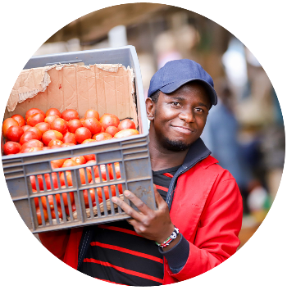
Perceived value of network relationships
Shadrack: Vegetable trader
There are some who stole from me, I gave them credit but they never came back again
They are the reason why I am here. Customers are the ones who have contributed the most because through them I sell my products hence my survival in my business
Employees
Low value
Medium value
County government
They have helped a bit because they have maintained the level of discipline around here, they’ve minimized fights around the market and also, they do respond to our issues once reported to them by our Muthurwa association leaders.
High value
Customers
It has not helped a lot in the business. Equity and KCB have contributed just a little, I use to save with them but they gave me a soft loan but it was a small amount
Banks
Other business people
Suppliers
Friends and family
The loan that they gave us back then has enabled us to do a lot and to grow in this sector of business…through it we expanded our business by adding the stock and also contributed to the shop where my mom is currently working at
I can count on them. Like let’s say I’m running low of stock and I don’t have money, I can call my brother to lend me or even a friend and they will boost me if they have. And my hero is my Mum because she is the one who introduced me here, taught me the way to go and even still supporting me whenever possible
Saccos
National government
It has added a lot of value to my business. First of all, hon. Kibaki gave us the land. Initially my mum was at Gikomba by then I was very young, so they were moved to this place where we were given a small portion of land for business…The government has really contributed
Chamas
I am just in one Chama and let’s say I need money like 20,000 I can get it, but for you to get money again it will take like a year. So is like 20,000 in a year – it’s too little
Associations
They’ve contributed just a little, even their absence can’t affect my business so I haven’t seen their contribution that much

Slide 27

Perceived value of network relationships
Agnes: Metal work
County government
I wish we could just be doing business without paying KRA. They are the only ones who benefit from the money that we pay there
They provide me with advice on how to run the business
Low value
Medium value
Employees
High value
Associations
National government
Money from chamas boost my business in a way. Once I get the money I use it to buy some little things which I do not have at that time
Chamas
Customers
Because they supply me with materials which keeps my work going on. Without them where will I get materials from? If I decide to be getting the materials from outside I will need a lot of money
Suppliers
Saccos
Saccos have given me money in form of loans
Other business people
Banks
Friends and family
They have given me money through loans to buy the materials and that way I keep my work going on
They add some value because at times I borrow money from them but I still have to pay back
They have been assisting me because when I lack money I am able to borrow from them that way they boost my business

