Slide 1
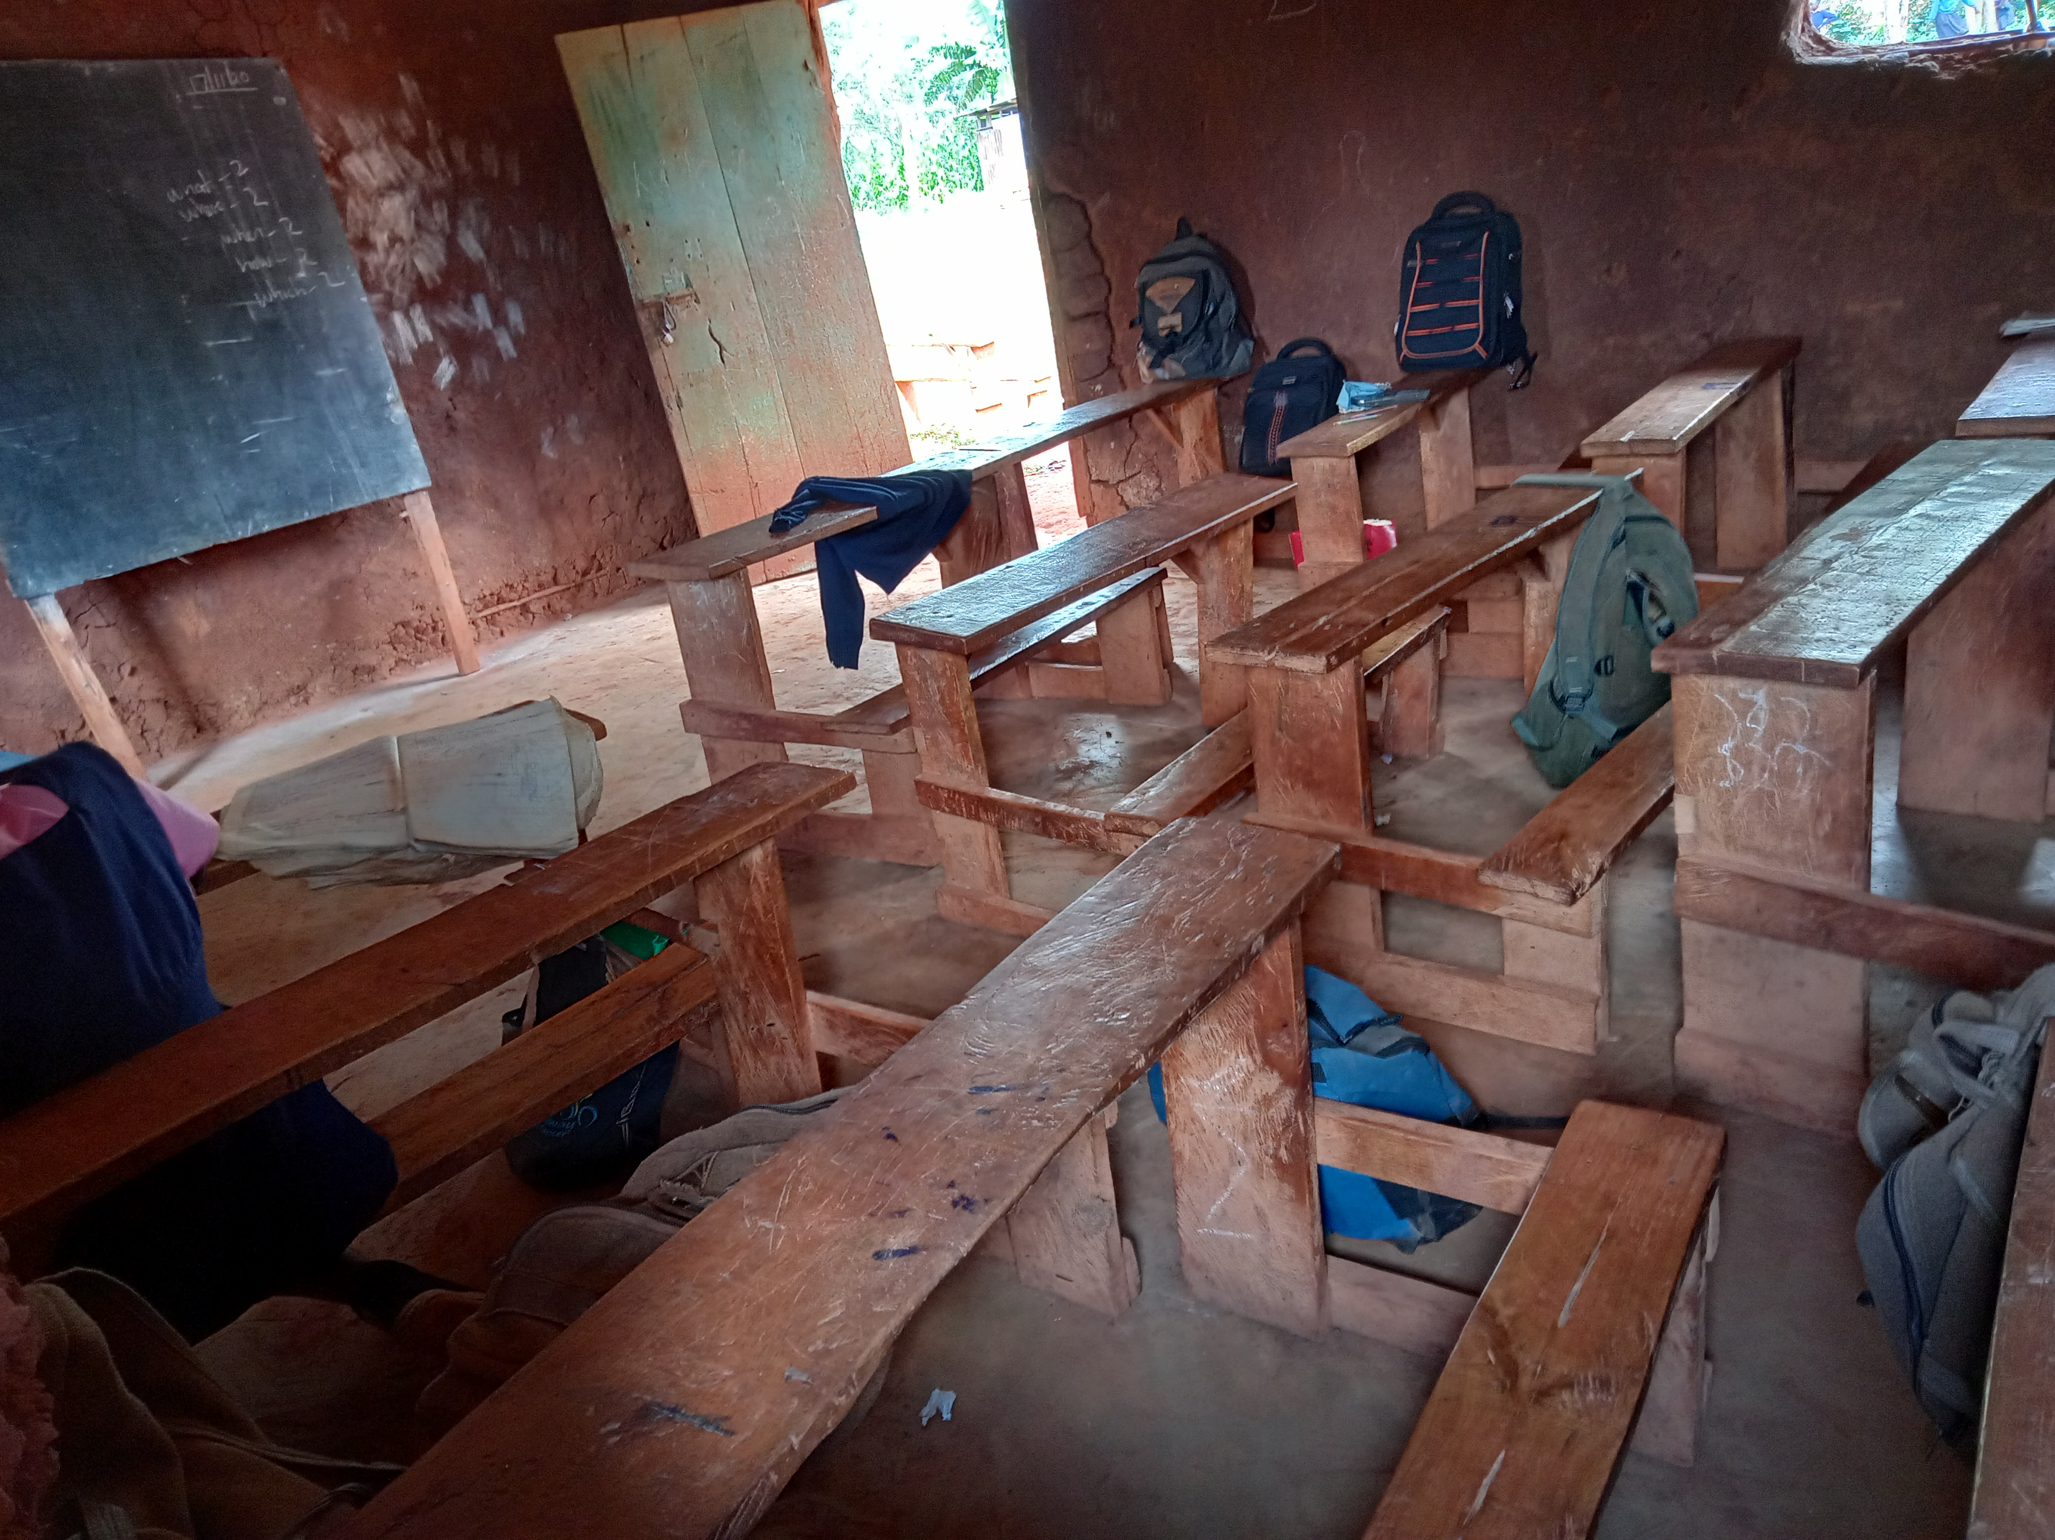
COVID-19 Impact on Low Cost Primary Schools
Notes:
Type your notes

Slide 2
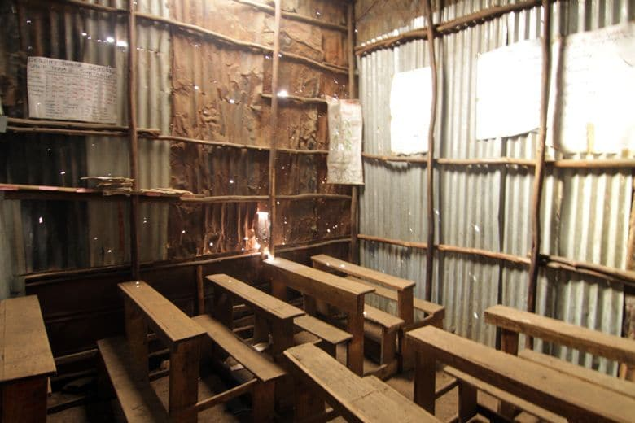

Background
To understand the impact of COVID-19 on low-cost private primary schools in Kenya and to explore financing options for their recovery.
Key questions
What is the extent of COVID-19 impact on low cost private primary schools?
Will low-income households afford school education for their children?
What are the financing options to enable low income households pay for school education?

Slide 3
Low cost private schools dot the education provision in Kenya
Development of low cost private schools is driven by:
  Limited space in public schools due to increasing numbers of children in need of admission- universal primary education.
  Lack of public schools in certain areas especially informal settlements in urban areas.
  Perceived and real quality concerns in the existing public schools due to big class sizes.
  A legal frameworks that make it possible for low cost private schools to emerge.
There is no universal definition of low cost private schools. The study adopted an operational definition:
‘A none-public school that charges a fee of not more than KES 30,000 annually per child (reference Grade 4 in 2019).’

Slide 4




Participants reached
Literature Review (Oct 2020)
Stand alone report
Owners/Head (Nov 2020)
946 telephonic interviews
58% of the interviewees were owners, 38% heads, 2% other managerial roles
15 in-depths
Teachers (Nov 2020)
3 counties, Nairobi, Kisii and Busia
Across 20 schools
302 telephonic interviews
Parents (Nov 2020)
3 counties, Nairobi, Kisii and Busia
Across 15 schools
324 telephonic interviews
15 in-depths
Financial Providers (Dec 2020)
3 FSPs that lend to MSMEs
No. | County (owner interviews) | Sample
1 | Nairobi | 486
2 | Mombasa | 73
3 | Kisii | 34
4 | Migori | 17
5 | Kwale | 14
6 | Busia | 12
7 | Homa bay | 7
8 | Nakuru | 28
9 | Kirinyaga | 24
10 | Narok | 17
11 | Kakamega | 22
12 | Kisumu | 31
13 | Nyeri | 15
14 | Machakos | 19
15 | Uasin Gishu | 63
16 | Siaya | 11
17 | Kajiado | 18
18 | Kiambu | 17
19 | Meru | 10
20 | Turkana | 10
21 | Embu | 12
22 | Kericho | 5
23 | Kilifi | 1

Slide 5
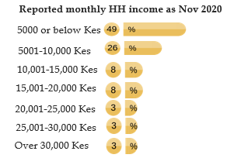
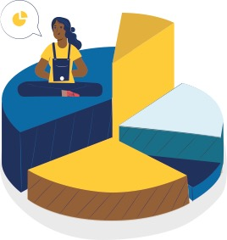
A large number of the households that use these schools have a low incomes
75% of the households that use low cost schools recorded a monthly income of KES10,000 or less in Nov 2020.
On average, there are three children from each households in school and are dependant on only one income earner.
Average number of school going children per household
3
Average number of people who are earning income in the household
1
Parents N=324

Slide 6






The low cost school vary in student population and close to a half operating in rented premises
Student population
School ownership
Student to teacher ratios tend to be lower than those of public
A half of the schools are owned by an individual
Almost a half (45%) of the schools are yet to register with MoE.
“I was told that I had to register the school and that is a process that takes about 60K and you have to go to many administrative bodies.” (school owner)
Less than 200 students | 47%
201-400 students | 40%
400+students | 13%
An individual female | 31%
A group e.g. CBO or church | 24%
An individual male | 21%
Partners mixture of females & males | 11%
Family business | 9%
Premises
Fully rented | 46%
Owned/ family owned | 40%
Part owned/ part rented | 10%
Average number of Teachers
Registration process
Average Pupil Teacher ratio
Micro Schools (Less than 200 Students) | 8
Small Schools (200 - 400 Students) | 13
Medium and large Schools (400+ Students) | 21
Micro Schools (Less than 200 Students) | 16
Small Schools (200 - 400 Students) | 23
Medium and large Schools (400+ Students) | 30
Overall | 20
Owners/heads N=946

Slide 7

Schools finance their operations from fees (94%). Loans are mainly from formal providers and used for infrastructure (70%).
How School operations were financed/paid for in 2019 | n=946
School fees payments | 94%
Sponsors/gifts donors from within the country | 8%
Loan/advance/credit | 8%
Sponsors/ gifts donors from outside the country | 6%
Savings from school operations | 5%
School's income generating activities e.g. hiring hall, farm, etc | 1%
Other specify | 12%
And where was the loan from?
Bank/MFI Sacco | 87%
Chama | 10%
Family / friends | 4%
What was the loan for? | n=71
Building/repair | 70%
Salaries | 42%
Food for students | 17%
Purchase of books | 14%
Rent | 11%
Utilities | 7%
Vehicles | 6%
Loan median size was Kes. 300,000
Owners/heads N=946

Slide 8
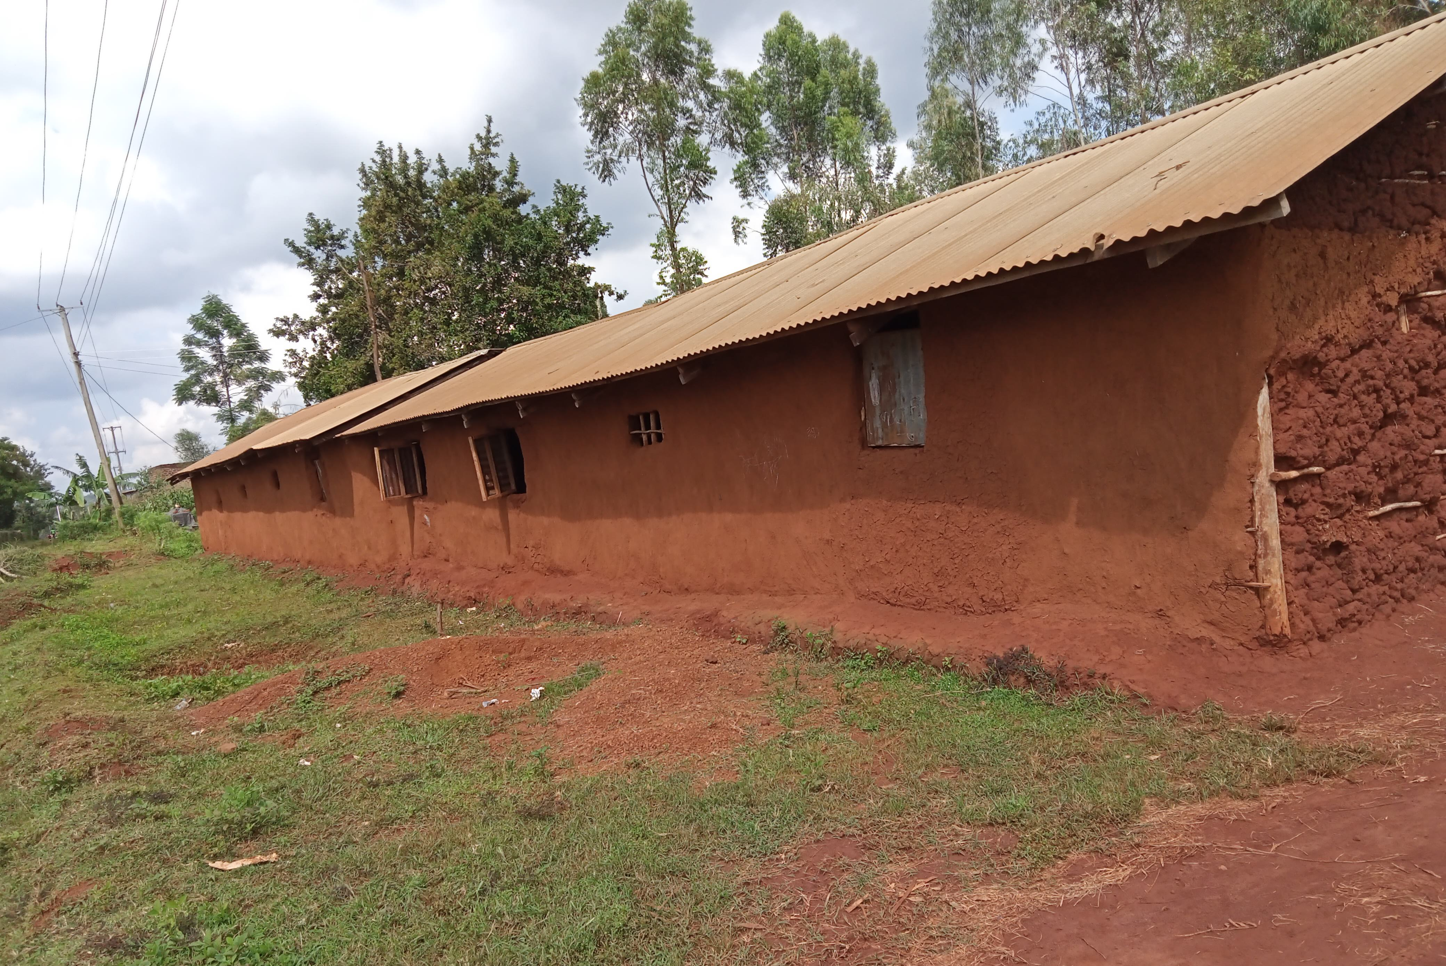
Impact of COVID-19
Notes:
Type your notes

Slide 9


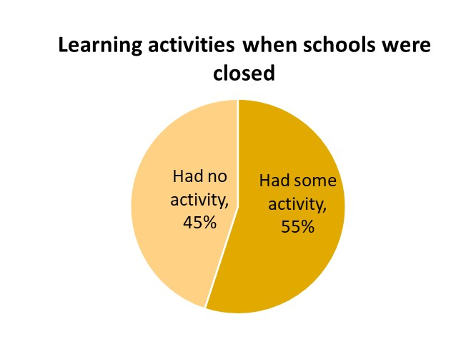



Although 55% ran some learning activities when schools were closed, overall three quarters of teachers received no pay between April – September 2020
3%
Owners estimated that close to 90% of teachers would resume in January 2020.
Replacement of teachers was not a concern for all owners
Learning activities was mainly through WhatsApp for selected classes
Received full salary for April to September 2020
23%
Part salary for April to September 2020
74%
No salary at all for April to September
Owners/heads N=946

Slide 10




8 out of 10 teachers have accumulated more debt during this period. Although a half to on some casual jobs, the majority reported a drop in income
How would you rate your debts level compared to March 2020?
How they coped?
How is your income today compared to March 2020?
52% another income source (construction, farming, tuition, etc)
37% Savings
32% family/friends donations
24% family/friend loan
23% Mobile lenders loan
*top 5 mentions
82%
More debts than I had in March 2020
85%
Reduced
14%
Debt level has not changed from March
11%
Remained
3%
Less debts than I had in March 2020
2%
Reduced
Teachers N=302
Notes:
Add note to this slide

Slide 11
















Households livelihood options have shifted with COVID- 19
Since COVID-19 started the proportion of the households that mainly depended on employment reduced from 32% to 5%.
There has been an increase in households dependent on agriculture and casual employment.
Main source of livelihood | March 2020 | Oct 2020
Casual employment
Employed
Own business
Farming
Remittances
Other
Domestic workers faced major challenges “most of those people they normally say they don’t want people around their homes since Covid came, so its tough , some employers have relocated” (parent)
There were shifts within the business category “(husbands) now sells omena to boost his income since depending on the second-hand clothes business was not possible.” (parent)
1
1
Parents =N 324

Slide 12
Households turned to savings to cope as their indebtedness increased
Parents N=324

Slide 13
Households have struggled to provide 3 meals a day and credit options have dwindled
Chama loans were considered as most ideal for school and other needs but in the current situation, this is not option
“Chama has really been my greatest support financially since it is what I have been using to pay school fees…. now everyone needs a loan from it, who do you give …”(parent)
Parents N=324

Slide 14

Incomes have been affected, rent has become a problem and conflicts have escalated
Collapse of certain livelihood options such as day care, pig rearing etc.
Rent was a challenge in urban areas: Moving to smaller houses has privacy issues
“I have a lot of trauma especially as they witness our sleeping arrangement (moved to a single house) …” (parent).
Wage rates for casual work has dropped with increased supply reduced demand
“….they know we are desperate and will take any amount.”(parent)
Loss of control of assets - cessation of travel meant less interaction with the village with cases where others took advantage of their absence
“When the lockdown was imposed, my in-laws took advantage and sold our land upcountry ...”(parent)
Domestic violence “it has affected me personally since we fight with my husband about money.” (parent)

Slide 15
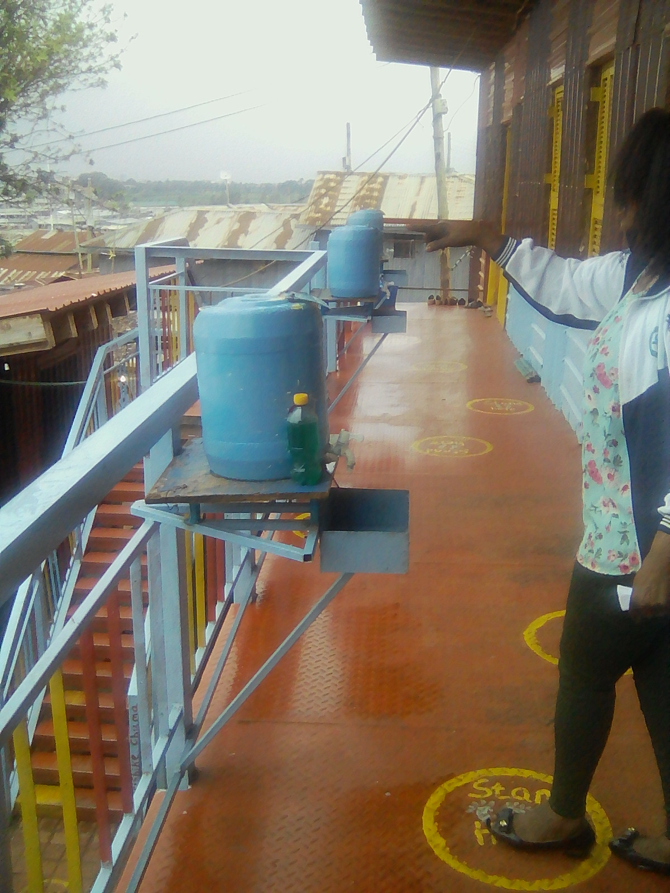
Journey to Recovery
Notes:
Type your notes

Slide 16



Reopening presents significant financial demands for meeting the safety needs and financing normal operations
Schools are struggling to realise social distancing protocols – how to manage space, books, desks, play time, lunch time travel, maintaining physical contact with young learner.
Schools lack working capital to;
  Purchase PPE, adequate water and storage
  Clear rent arrears vs. the expansion of the school infrastructure dilemma
  Providing safety needs such as feeding programs
  Parents are unlikely to accommodate any extra financial demand
Changes in the family interactions/structure – stressed home environment with parents out of work, increase in families living apart, potential increase in child domestic labour, extended hours unsupervised, immorality, etc

Slide 17


Both female and male owned schools will struggle to recover
Double income households, spouse provides financial assistance directly to the school /exclusion from domestic bills.
Extended family are more willing to send remittances to a female.
Female owners have higher degrees of perseverance as they are more likely to be driven by non-financial motivations.
Operate multiple businesses, access to operating capital.
Potential to get higher loan levels as they have collateral.
Less likely to retain expenses based on an emotional appeal. Qualitatively, female owners were more likely provide a small stipend to teachers when schools were closed.

Slide 18
Financial issues
School management’s concerns are mainly financial – Will parents be able to pay school fees given the reduced incomes?
What are some of the adjustments on reopening?
Possible areas of readjustments are as follows;
School payments (77%), Reducing fees not considered viable. Could allow lower value staggered payments or differentiated pricing depending on the parent's status.
Loan/credits (15%)
Sponsors/gifts donors from within the country (9%) and outside the country (5%)
Non-financial issue
Most difficult financial issue when you reopen
49% school fees collection
27% rent / infrastructure.
8% Funds for COVID-19 management
6% Funds for utilities, food
Most difficult Non-financial issue when you reopen
46% COVID-19 management
23% Student's ability to cope/sociopsychology support
23% Uncertainty of numbers that will return
7% retaining teachers
88%
12%
The non- financial needs are described as being addressed by finances
People in this area don’t fear corona, maybe in town but in the reserves they don’t wear masks may be only when one is going to town” (school owner)
Owners/heads N=946

Slide 19
Only 2% of the schools were unlikely to reopen. Of schools that will reopen, 6 in every 10 schools will have less students than they had when they closed
Expect less Students
Households have moved (72%)
Parents unable to pay school fees (40%)
21
Schools (2%)
Indicate they will not reopen mainly due to lack of funds to pay salaries and rent.
Qualitatively these schools already had challenges with school fee payments and high teacher attrition.
Expect more students
Other schools which may close (70%)
Movement of people into the school catchment area (13%)
Owners/heads N=946

Slide 20


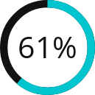
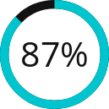
9 out of 10 teachers have already resumed/likely to resume teaching in the same school. A contributing factor is that 6 in 10 of the teachers indicate its unlikely/uncertain to get a job in a different school.
Getting teachers back is not a big challenge for this sector: there are limited options in terms of livelihoods for teachers
61%
Likely
28%
Have already Resumed
Are not likely / unsure to get a teaching position in a different school?
Are likely to continue pursuing a career as a teacher?
11%
Unlikely / Unsure
Teachers N=302

Slide 21

Another factor driving resilience is that the majority (85%) of parents certain they will send their children back to the same schools
Greatest Challenge for parents (n=324)
Paying school fees (48%)
Health safety of the children (32%)
Buying uniform & stationery (8%)
Teacher/quality of teaching (3%)
Other (3%)
None (6%)
How likely is it that all your children in school X go back to the same school when it opens
85% likely/very Have already resumed"
15% unlikely/very unlikely have school fees concerns or unsure of the school status in terms of reopening
Schools are considered a safe haven for learners relative to their home environment “.. this area is risky and its good if a girl stays at school so I had to go and talk to the teacher to let her stay at school if she comes home and I am not there it is risky because I will be exposing her.”(parent)
85%
Parents N=324

Slide 22












More than half of the schools (57%) will require financial assistance. 47% of all schools would like the government to help
As an estimate, how long will it take you after reopening to resume/get to the status you were as at March 2020 (in months)
A quarter of the schools are optimistic that in 3 months upon reopening they will have recovered. They are hoping that parents will be supportive going by the school’s previous academic performance parents.
4 to 6 months
More than 12 months
25%
18%
24%
Less than 3 months
19%
7 to 12 months
14%
Don’t Know
What support (if any) would help you get back to where you were in March 2020 in the shortest time? n=946
Who do you think should provide this support? n=689
Financial support
Government
Support in salary payment
Well wishers/ donors
Assist in rent payment
Non Governmental Organizations (NGOs)
Ensure there is Covid-19 measure facilities
Parents & school committee
Provision of food
Banks/ Microfinance/ Saccos
Owners/heads N=946

Slide 23
42% of households estimate that it will take more than 6 months for them to recover financially once “normalcy” resumes
Parents might not be as concerned about safety in relation to COVID-19 “am not worried, children play with others the whole day here, so what is the difference in the school..” (parent)
Parents are ardent that their children catch up with peers that had remote classes
“yet us here our children were not privileged to attend those lessons (online, on TV, on Radio) so it is upon us to try hard and pay for fees so that our children are not sent home, also the time is limited to cover all topics.” (parent)
Enabling students access to online learning by providing gadgets is an area that some parents are keen on, however others are concerned about connection costs and technology illiteracy in their part
As an estimate, how long will it take you to get back to financial position you were at as at March 2020 [Months]
What support (if any) would help you get back to where you were in March 2020 in the shortest time
Less than 3 months (33%)
4-6 months (24%)
7-9 months (12%)
10-12 months (25%)
More than 1 year (5%)
Capital for business (40%)
Financial support (21%)
Getting a well paying job (16%)
Help with school payment (15%)
/learning materials
Parents N=324

Slide 24
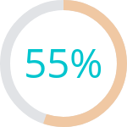
55% of the parents would be willing to borrow to pay fees under the current circumstances but will struggle to pay
In term 1 in 2020, what would have been the fees per term for all your children who were in school then?
In the current situation would you borrow money to pay for school fees?
% Saying "Yes"
How much would you be able to commit to school fees payment given your current circumstances per term?
Average Kes. 16,014
Median Kes. 10,000
Average Kes. 11,628
Median Kes. 4,500
Parents tended to make small irregular payments to ensure that the fees was paid-up by the end of the term.
There were parents who paid as little at KES 500 with no fixed payment schedule.
Some parents whose children had resumed school (grade 4 and class 8) noted an increase in fees.
Notwithstanding, making regular payments is evident in their contributions to chama pre-COVID, with some contributing over KES 500 on a weekly basis.
A savings solution would thus help parents regularly put aside cash for school fees.
Parents N=324

Slide 25
The reality is …
Financial service providers may be willing to finance low cost schools but the risks are high.
Schools rely on fees to service loans … but parents will struggle to pay school fees.
Households are willing to borrow for school fees … but incomes have significantly reduced so parents will struggle to repay loans.
There is an opportunity in providing a savings solution to enable parents to set aside small amounts of money for their children’s school fees.
What are the financing options to enable low income households pay for school education?

Slide 26
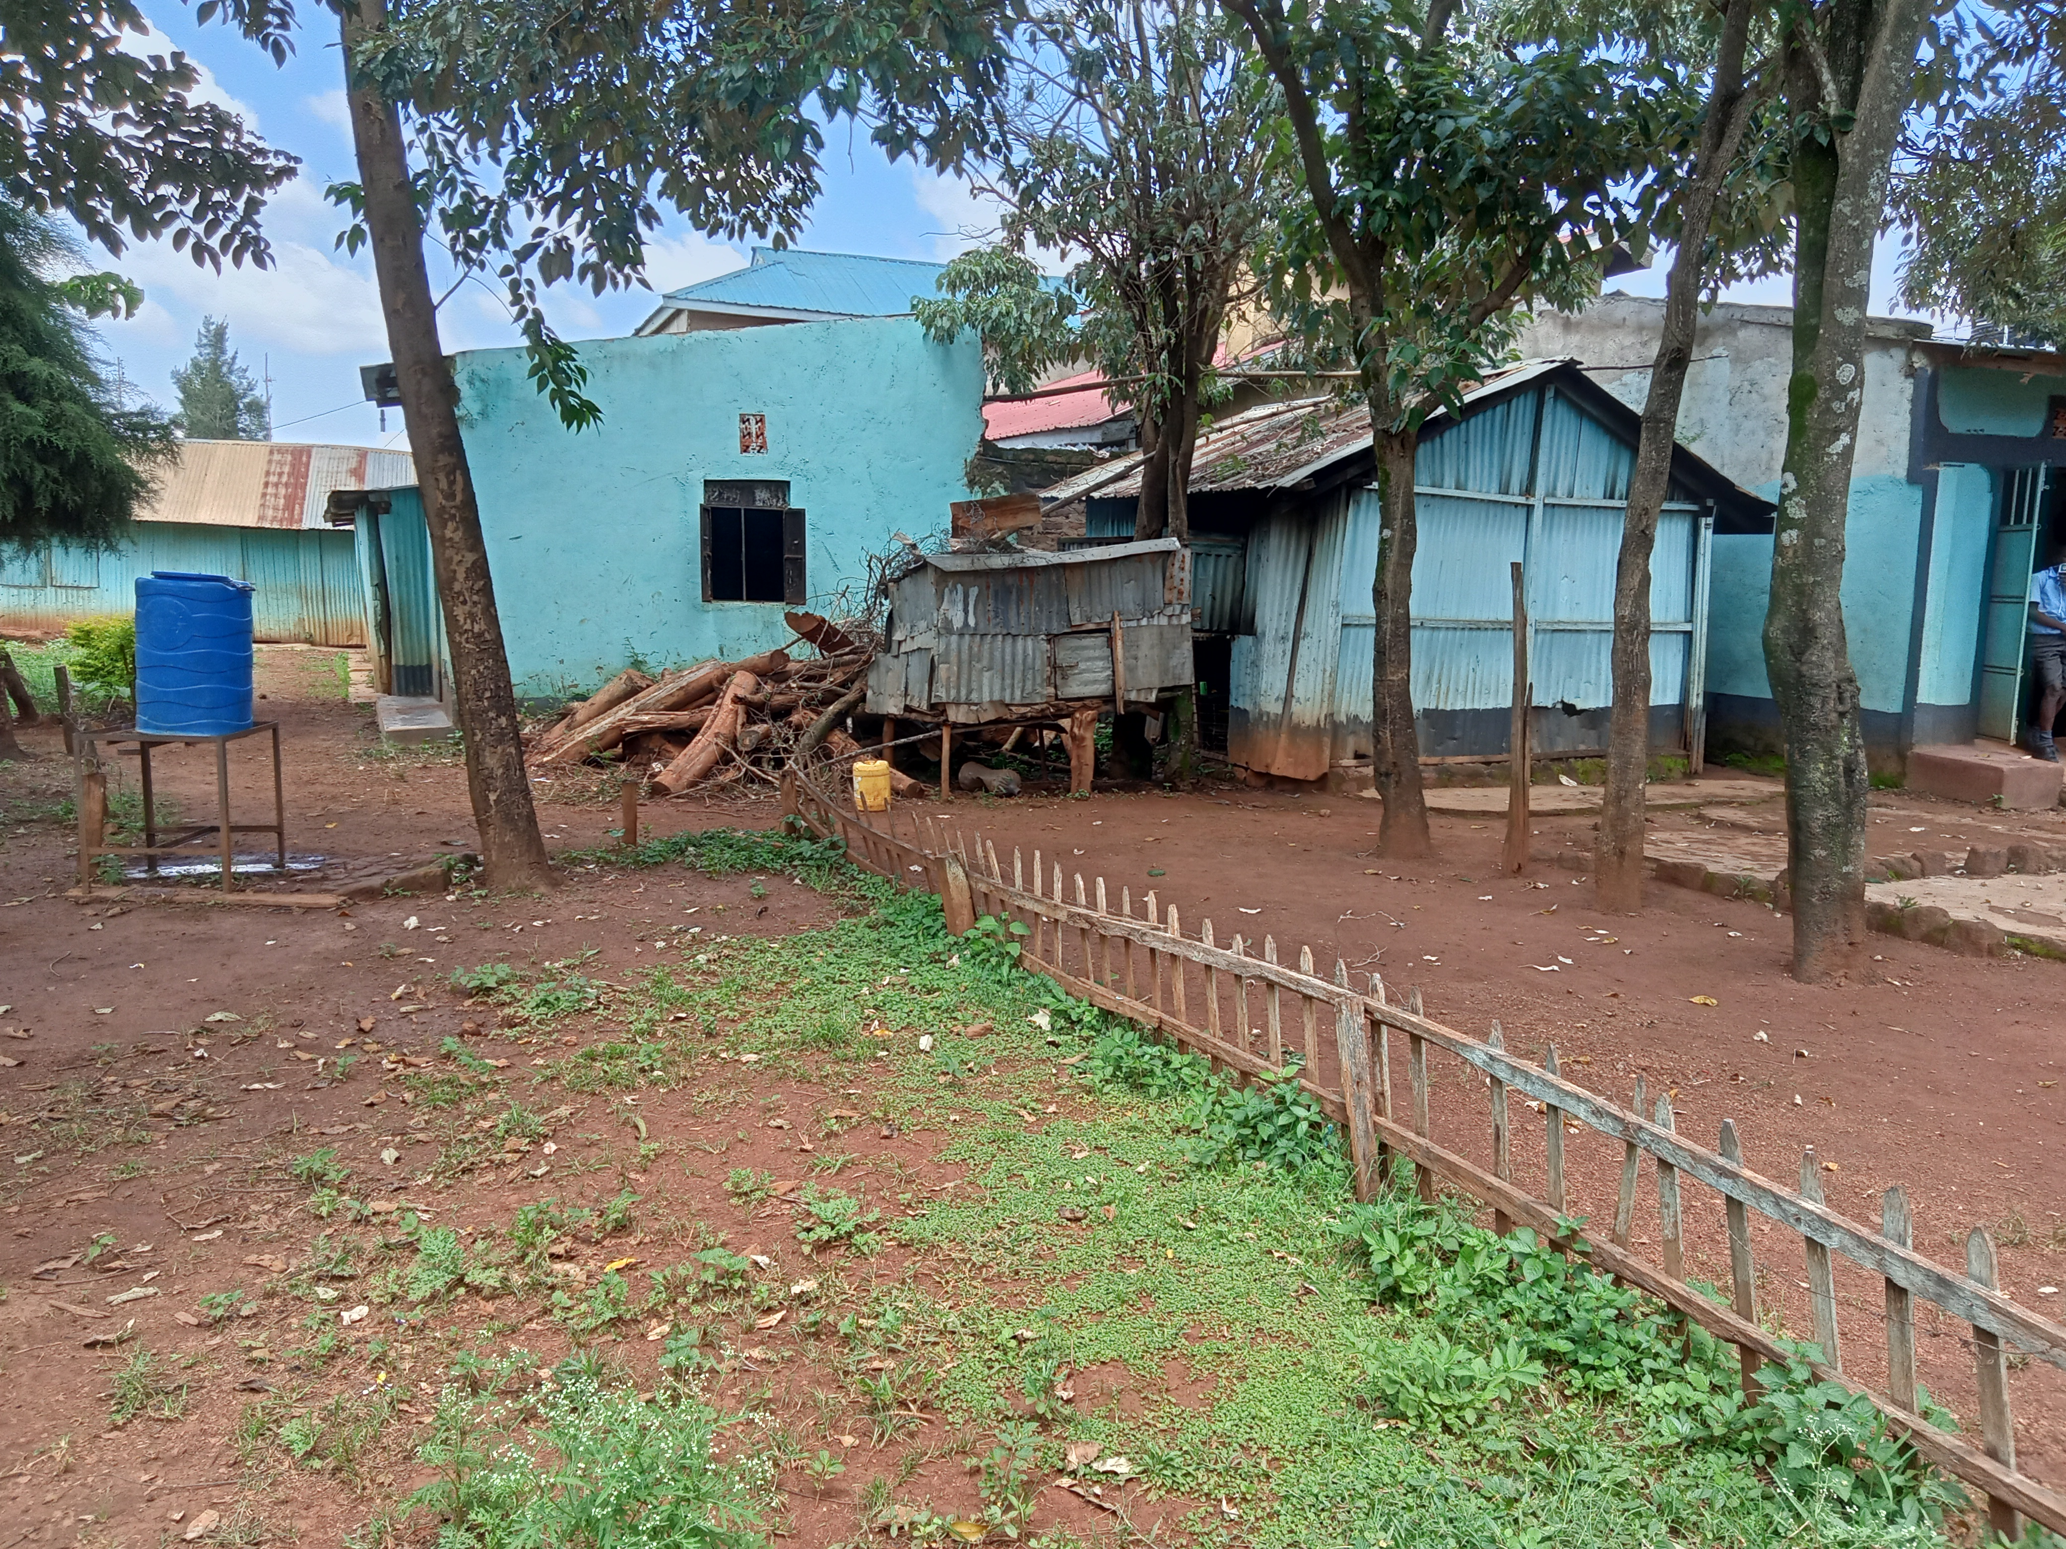
Asante
Notes:
Type your notes

